Slide 2
Md. Saifuddin Khan
Lecturer in English
Hajee Goyes Uddin Mohila (degree)Fajil Madrasah,
Bhangura , Pabna .
Email: skhan84bd@gmail.com
Mobile Number :01710-449379 .
English for Today
Class :Nine & Ten
Time :40 Minutes

Slide 3
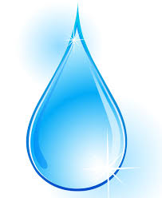
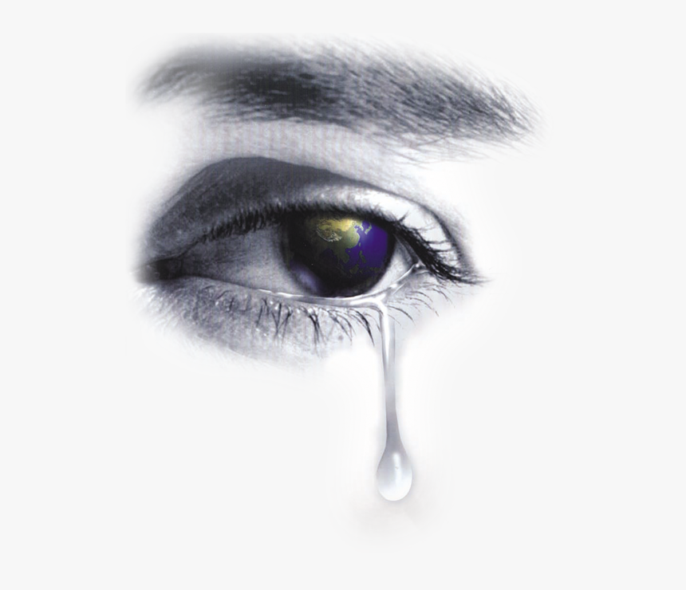
Images of …….
Teardrop
Have you ever heard the name of an island country like Teardrop?

Slide 4
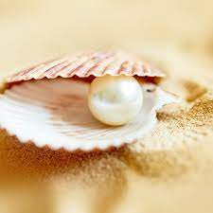
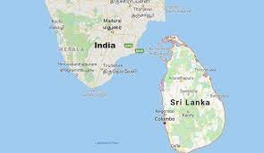
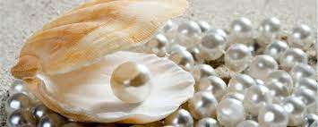
Our Today’s Topic is ….
Unit: Six , Lesson: Two
Sri Lanka:The pearl of the Indian Ocean

Slide 5
Learning Outcomes
After reading the text s s will be able to….
1.Write different names of Sri Lanka.
2.Tell some new word meanings.
3.Write about agriculture in SriLanka .
4.Tell “what things do make Sri Lanka the God given blessings of nature?”

Slide 6
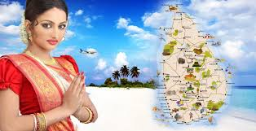
Ayubowan
Traditional greeting of Srilanka
Everyone is welcomed to Sri Lanka

Slide 7
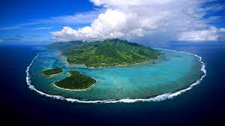
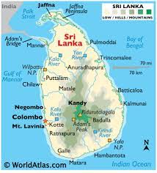
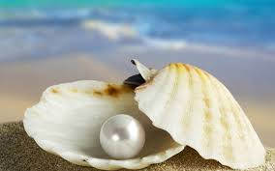
Serendip
Teardrop of Indin
Pearl of Indian Ocean
Sri Lanka is variously known as: Serendip, Ceylon,
Teardrop of India ,Pearl of the Indian Ocean, etc .

Slide 8
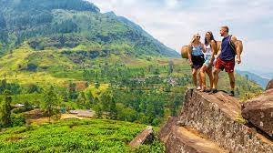
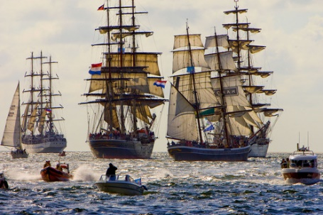
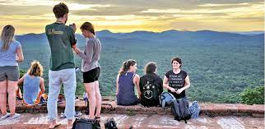
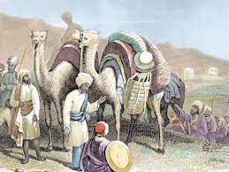
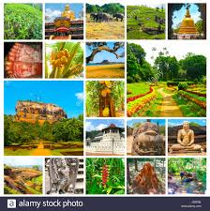
Travellers
Mariners
Tourists
They have been attracted by the beauty of this island.
Natural Beauty
Merchants

Slide 9
Total land area of Sri Lanka is about 65,600 Square kilometers . It also has more than 1340 kilometers of coastline.
North
415 Kilometers
220k.m.
West
East
Indian Ocean
South

Slide 10
Single work
Choose the best answer from the altrenatives :-
1.The traditional greeting in Sri Lanka is ……
(a) Ayubowan (b) nomoskar (c) salam (d) handshake
2. Sri Lanka is often known as pearl of the ……..
(a) Arab Ocean (b) Bay of Bangle (c) Indian Ocean (d) North Ocean .
3.Total land area of Sri Lanka is about ………… kilometers .
(a) 65100(b) 65000(c) 65400 (d) 65600 .

Slide 11
Read the text and tell the meaning of the underlined words.
When someone comes to Sri Lanka, they may often hear the word Ayubowan. This word means ‘May you have the gift of long life’.It is with this traditional greeting that everyone is Welcomed to Sri Lanka has many nicknames: Serendip,Ceylon, Teardrop of India, Pearl of the Indian, Ocean, etc.These names reveal the richness & beauty of this island nation. Many travelers, from ancient mariners & merchants to modern astronauts, have been attracted by the beauty of this island.
Sri Lanka is located in the Indian Ocean, just off the south-eastern coast of Indian.Shaped like a teardrop,the island of Sri Lanka measures about 415 kilometres from north to south ,& 220 kilometres from east to west, with a total land area of about 65,600 square kilometres. It has more than 1340 kilometres of coastline. Despite its modest size, Sri Lanka has a population of about 20 million. Sri Lanka is a multi-religious, multiracial & multi-lingual country.The four major ethnic groups are Sinhalese, Sri Lankan Tamils, Indian Tamils & Muslims.

Slide 12
Key word | Meaning
Welcomed | A salutation
Travelers Teardrop | Tourist
Merchants | A person involved in trade
Teardrop | A drop of that comes from the eye
Traditional | Conventional
Located | Situated
Measures | To find the size Lenth or amount
Shaped | Size
Population | People
Major | Main

Slide 13
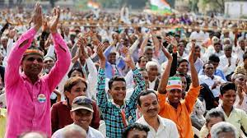
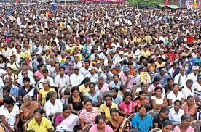
Sri Lanka has about a population of about 20 millions.

Slide 14
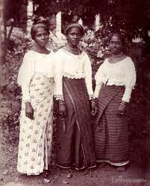
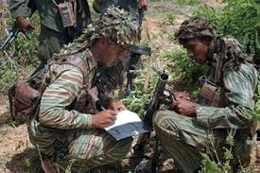
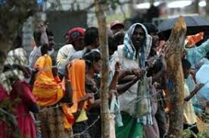
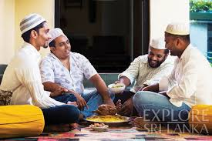
The
four
major
ethnic
groups
in
Sri Lanka
are…
Sinhalese
Sri Lankan Tamils
Indian Tamils
Sri Lankan Moors or Muslims

Slide 15
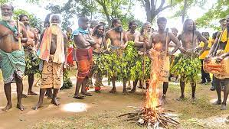
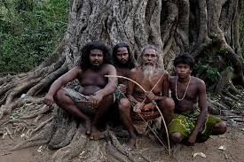
Look at the images and try to guess their ethnic group.
The Veddhas are the original inhabitants of this Island

Slide 16
Pair work
Answer the following short questions
Which country is often known as the pearl of Indian Ocean .
How many ethnic groups do you find in sri Lanka? Write their groups name .

Slide 17
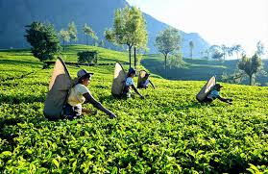
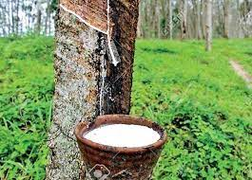
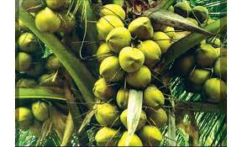
Economy of Sri Lanka
Tea
Rubber
Coconuts
Sri Lanka is the largest tea exporter of the world.

Slide 18
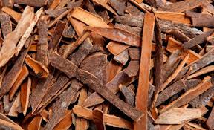
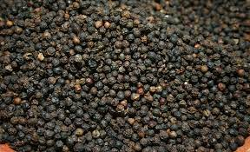
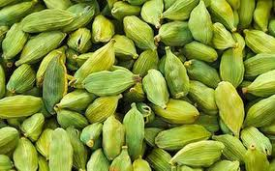
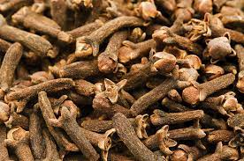
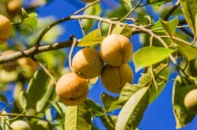
Spices in Sri Lanka
Pepper
Cinnamon
Cardamom
Cloves
Nutmeg

Slide 19
Group work
Fill in each gap with a suitable word based on the information of the text .
Sri Lanka’s economy has traditionally been (a)…….. on agriculture. The emphasis is on (b)…… crops such as tea, rubber, and coconuts. In fact, Sri Lanka is the largest (c) …..
exporter of the world . Cinnamom first (d) ……. in Sri Lanka and was introduced later to the world by Arab (e)…….. .

Slide 20
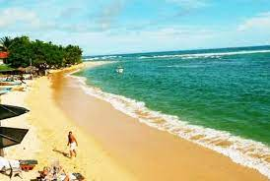
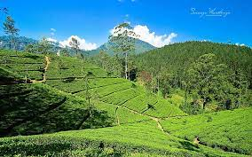
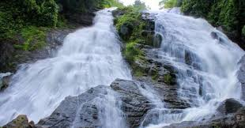
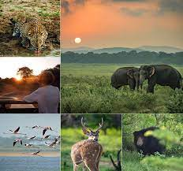
Sandy beaches
Green hills
Cascading water falls
Sri Lanka is blessed with sandy beaches, green hills, cascading waterfalls, aboundant wildlife .
Wildlife

Slide 21
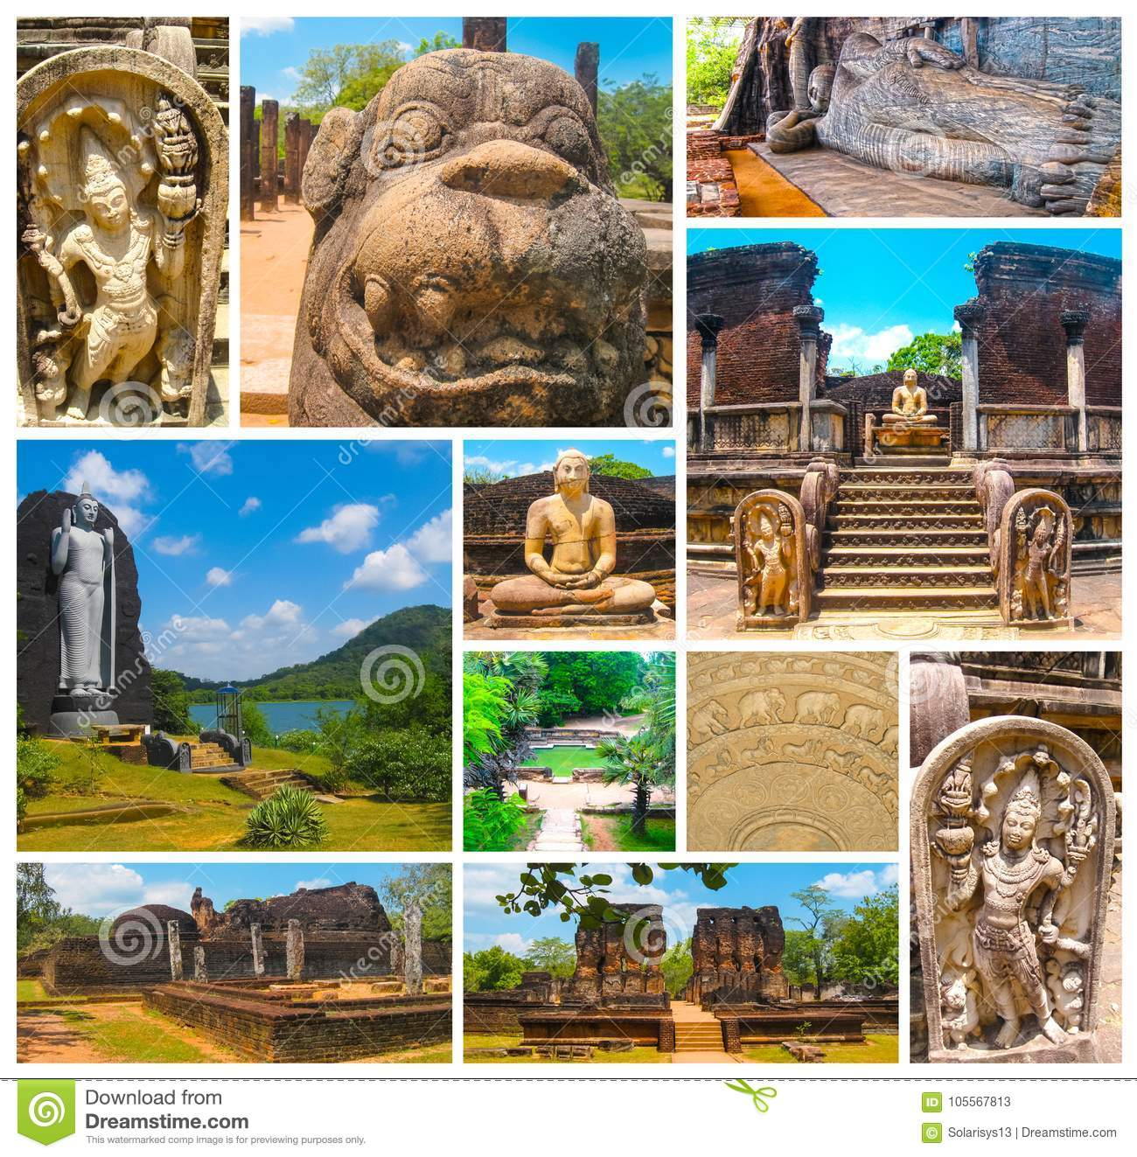
Archaeological Treasures in Sri Lanka.

Slide 22
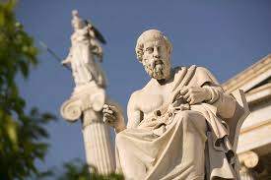
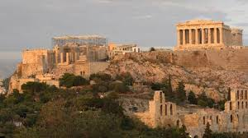
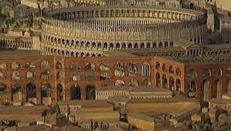
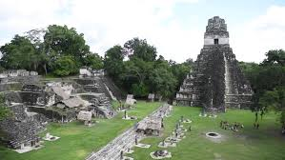
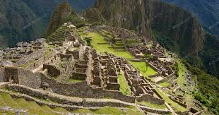
Roman Empire
Grecce civilization
Sri Lanka’s archaeological treasures may
be compared to other civilisations of the past like the Golden Age of Greece, The Roman Emperor and Mayan Citadels .
Mayan citadels

Slide 23
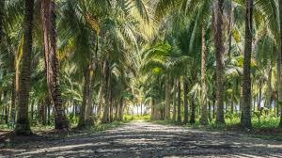
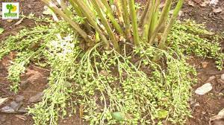
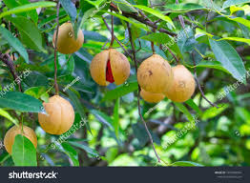
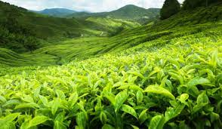
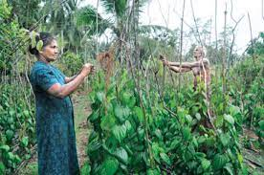
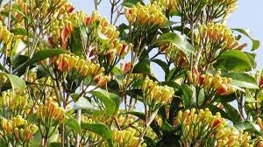
The country abounds with………
Coconut groves
Nutmeng
Cardamom
Tea states
Peeper
Cloves

Slide 24
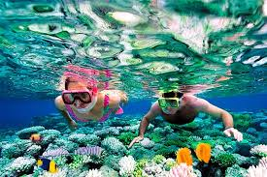
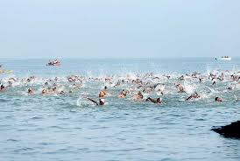
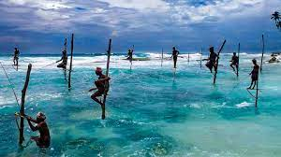
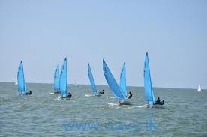
Fishing
Snorkelling
Swimming
For the adventurous, the days can be full of excitement snorkelling, swimming, fishing or sailing.
Sailing

Slide 25
Evaluation
Complete the table with words or numbers based on the text.
People
There are ……………, four main ethnic groups. They are Sinhalese, Sri Lankan Tamils, ……………. and Sri Lankan Moors who are also known as ……………. The earliest residents of Sri Lanka are known as ……………….
Economy
Agriculture is a traditional form of economic activities in Sri Lanka. The country exports many crops and …………… Sri Lanka tops the world in tea export. The spice ……………… was found first in Sri Lanka.
Natural Beauty
Sri Lanka is blessed with awesome natural beauty. There are blue seas, sandy beaches, green hills, and flowing …………… . The country has a very rich wild life. A wide variety of fruits and …………… are also available. Traveller can enjoy the …………… view sitting at the palm shaded lagoons.

Slide 26
Home task
Write a short note on “the god-given blessing of nature in Sri Lanka .

Slide 27
Thanks to all .

