Slide 2
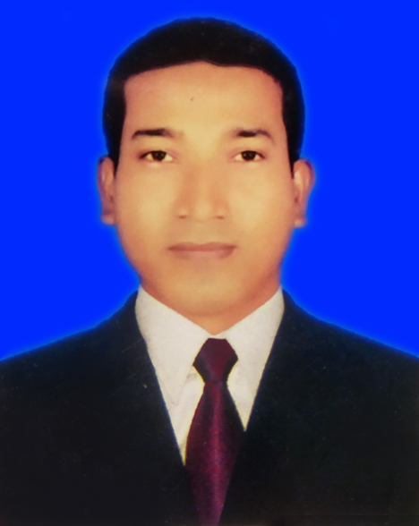
About Teacher
MD. Shaifur Rahman Chowdhury
Assistant teacher
Debiganj Model G.P.S
Mobile: 01757983700
E-mail:
saifur1980ict@gmail.com

Slide 3
Class: 3
Today’s lesson
My friend
Subject: English
Unit: 35 Lesson: 1-3

Slide 4
Learning outcomes : Students will be able to
Listining :
4.3.1 enjoy and understand simple stories.
Reading :
5.1.1 read simple paragraphs

Slide 5
Look at the picture

Slide 6
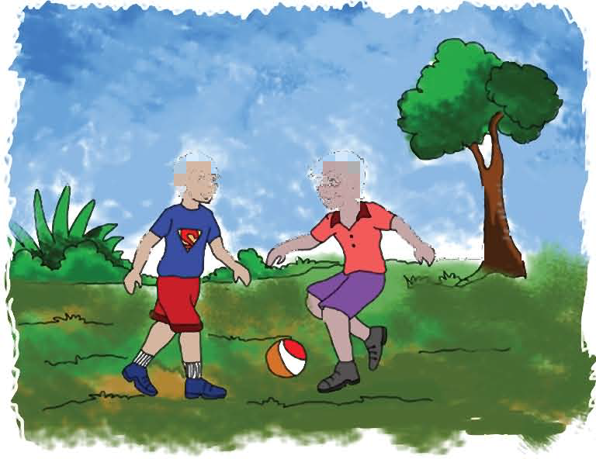
What can you see in the picture?

Slide 7
I’m Radif. I’m eight years old. Anik is my friend. He’s eight years old, too. We go to Rajbari Primary School. We are in the same class. Anik sits next to me. In the afternoon, we play football.

Slide 8
B. Pairwork. Ask and answer
1 How old is Radif?
2 What is his friend’s name?
3 How old is Radif’s friend?
4 What school do they go to?
5 Where does Radif sit in the class?
6 What do they do in the afternoon?
Ans: Radif is 8 years old.
Ans: His friend’s name is Anik.
Ans: Radif’s friend’s is 8 Years old.
Ans: They go to Rajbari primary school.
Ans: Radif sits next Anik.
Ans: They play football in the afternoon.

Slide 9
Thanks

