Slide 2
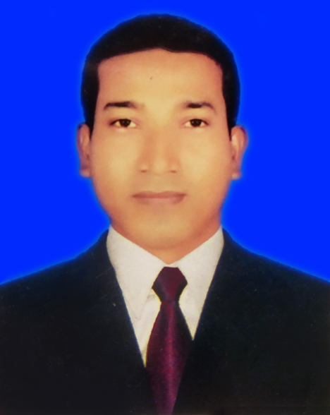
About Teacher
MD. Shaifur Rahman Chowdhury
Assistant teacher
Debiganj Model G.P.S
Mobile: 01757983700
E-mail:
saifur1980ict@gmail.com

Slide 3
Class: 3
Today’s lesson
Food we need
Subject: English
Unit: 36 Lesson: 1-3

Slide 4
Learning outcomes : Students will be albe to
Speaking:
1.1.1 repeat words, phrases and sentences after the teacher with proper sounds and stress.
1.1.2 say words , phrases and sentences with proper sound and strees.

Slide 5
Look
at the picture

Slide 6
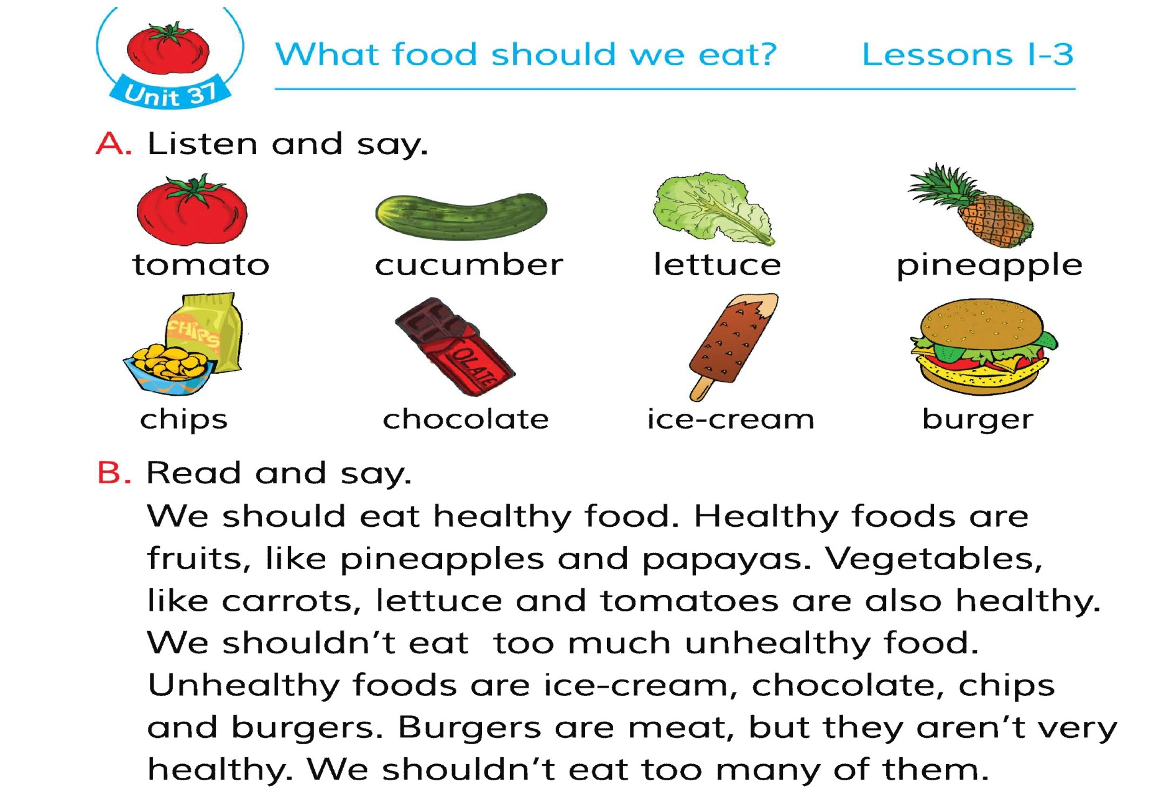
What can you see in the picture?

Slide 7
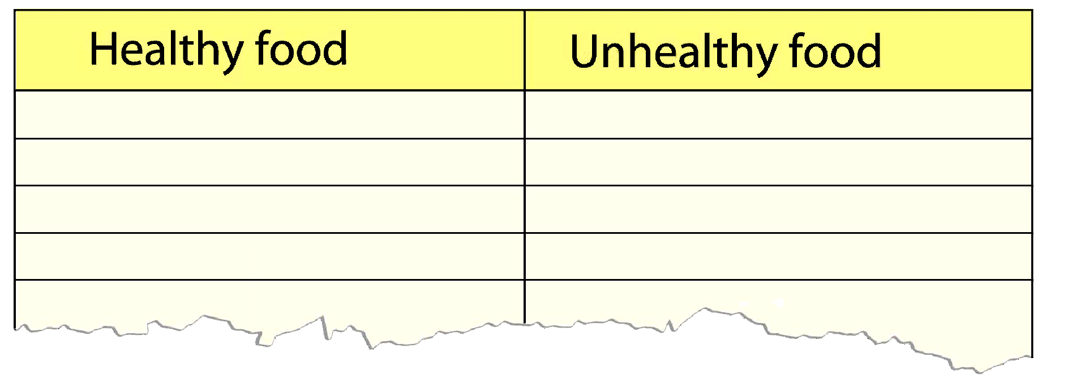
Pineappple
Ice-cream
Papaya
Chocolate
Carrot
Chips
Lettuce
Burger
Tomato

Slide 8
Thanks

