Slide 1
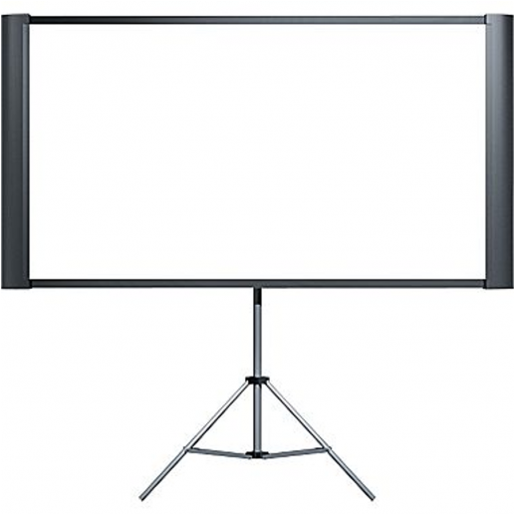
WELCOME TO
MY CLASS

Slide 2
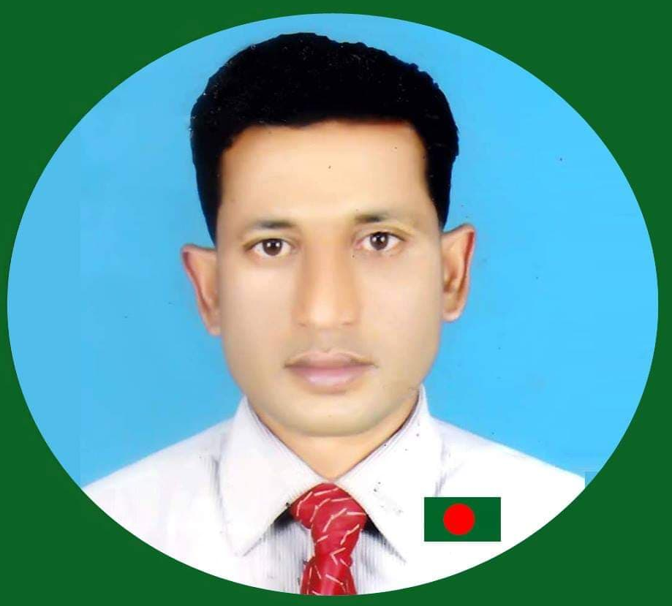
Md Abul Kalam
Assistant Teacher
Shahapur Govt Primary School
Baniyachong, Habiganj.
01718509171
Subject- English
Class- Four
Time- 40minites

Slide 3
GREETING
Good morning, students.
Teacher
Good morning, teacher.
students
How are you?
Fine, and you?
Fine, thank you.

Slide 4
Click link and
Watch video
Let us go to watch video.
Teacher discus about thevideo.

Slide 5
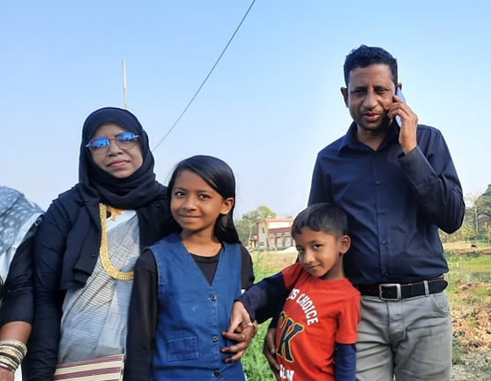
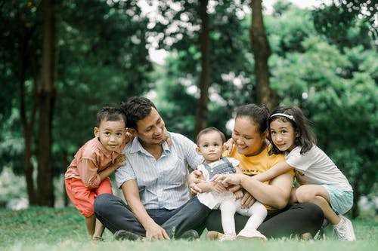
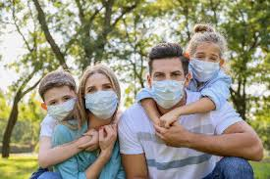
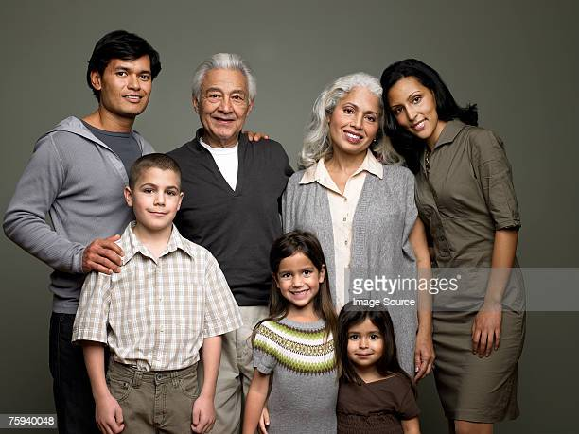
Look at the picture and think alone.
Students, Right here are some family picture.
Who can tell about the picture? Rise your hand.

Slide 6
Dear students, Think what will be todays topic.
Family
Yes, Todays topic is …
SAGAR AND HIS FAMILY
Unit-15, Lesson-1-3

Slide 7
Learning outcomes
After the lesson the learner’s will be able to…
Listening: to enjoy and understand about the text.
Speaking: to talk about the text.
Reading: to read about the text.
Writing: to write answer of some question.

Slide 8
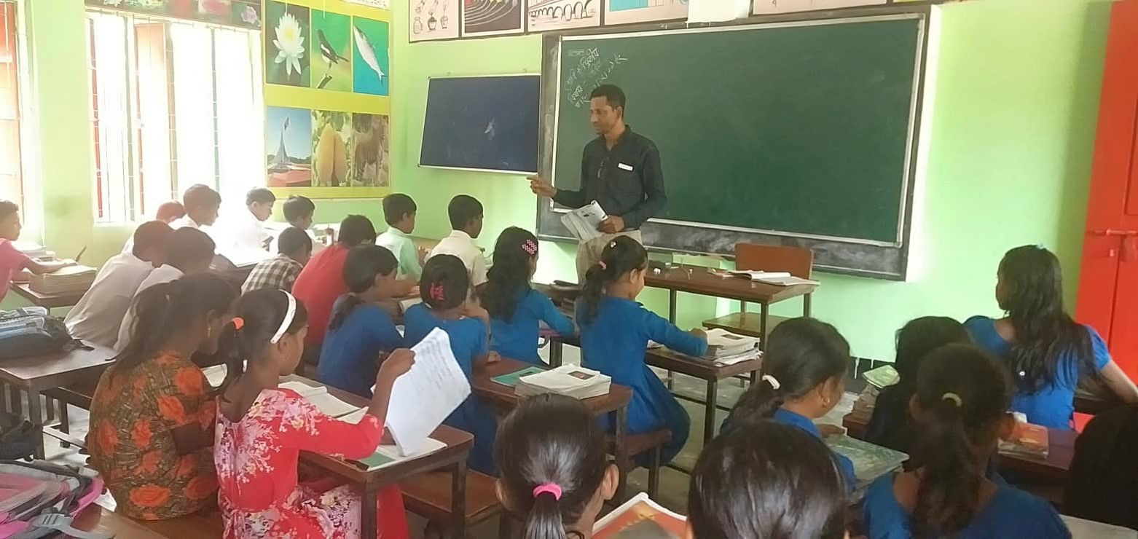
TEACHER’S READING

Slide 9
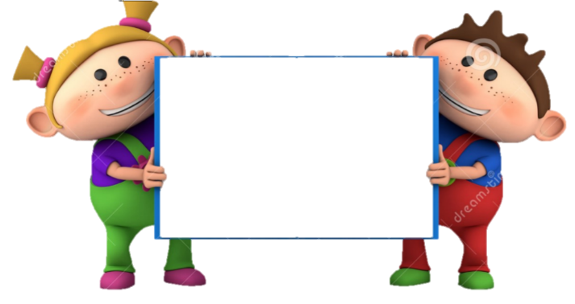
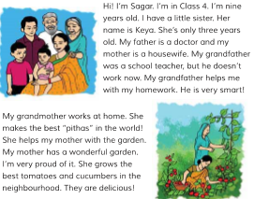
INDIVIDUAL WORK
Open your book at page 30 and read the text loudly.

Slide 10
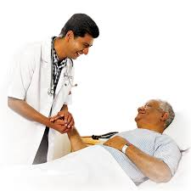
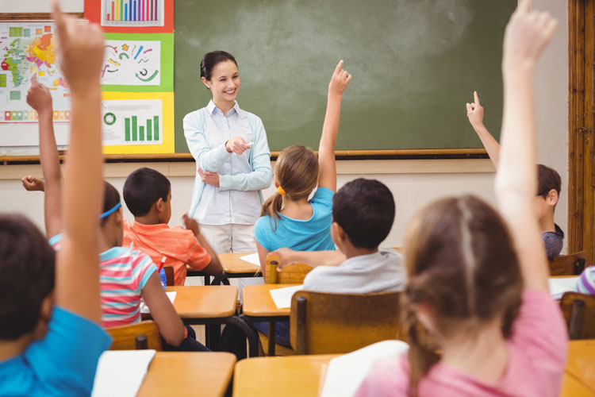
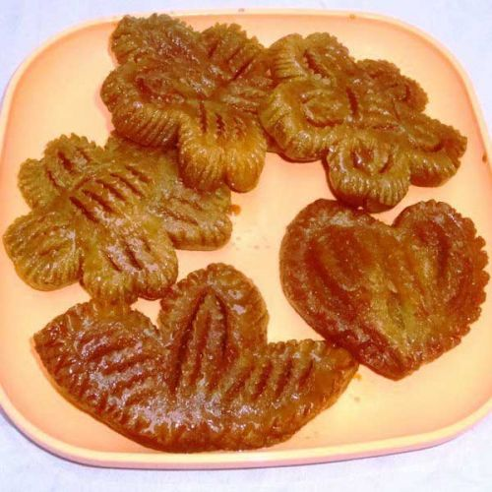
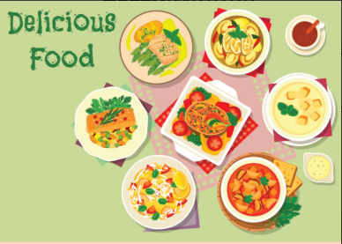
New words
A Doctor is a parson who treats the patient.
Doctor
A teacher is a parson whose work is teaching.
Teacher
Pitha is a one kind of food that’s usually makes at home.
Pitha
Delicious food is very pleasant to eat.
Delicious

Slide 11
Look at the picture and read the statements.
Sagar is in class 4.
He is nine years old.

Slide 12
She is a little sister of Sagar.
Her name is Keya.
She’s only three years old.

Slide 13
Sagar father is a doctor.

Slide 14
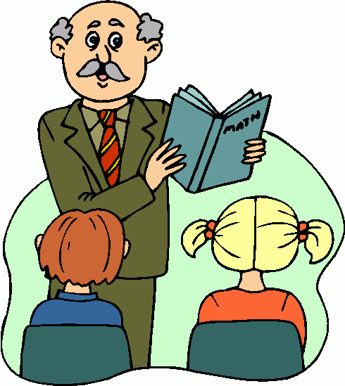
Sagar’s grandfather was a teacher.
But he doesn’t work now.
His grandfather helps him with his homework.

Slide 15
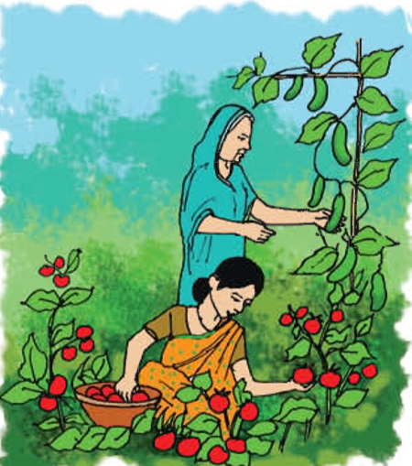
Sagar’s mother is a housewife. She has a wonderful garden. She grows the best tomatoes and cucumbers.

Slide 16
Sagar’s grandmother works at home. She makes the best pitha in the world. She helps his mother in the garden.

Slide 17
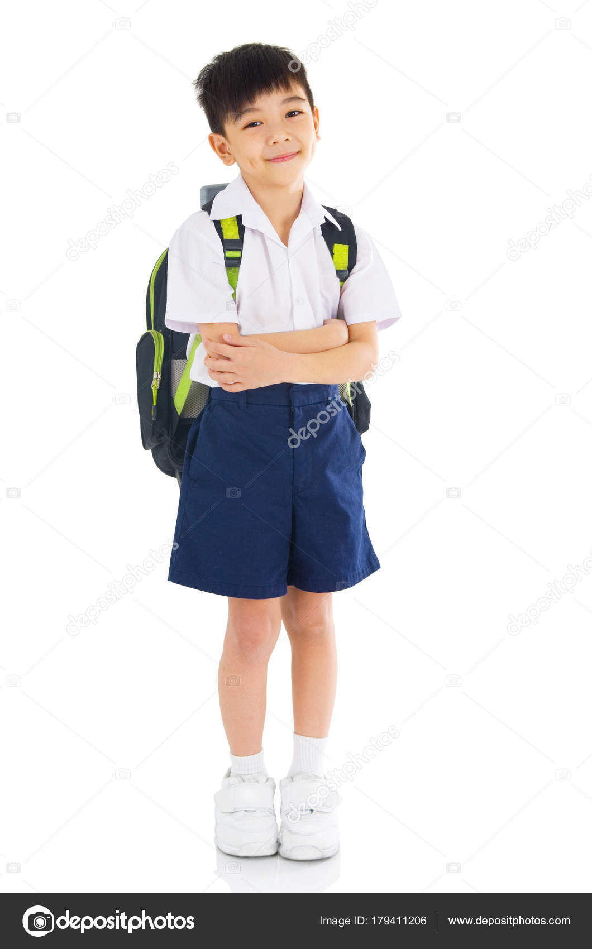
PAIR WORK
Conversation to each other about your mother.

Slide 18
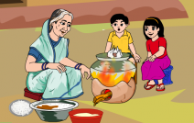
Look at the picture and tell me
What are they doing?
Sagar grandmother makes the best pitha’s in the world.

Slide 19
Look at the picture and tell me
What are they doing?
Sagar mother works in the garden and his grandmother help him.

Slide 20
EVALUATION
Answer to the question:
1) How old is Sagar?
2) What class does he read in?
3) Who is Keya?
4) Who helps Sagar to do his homework?

Slide 21
HOME WORK
Dear student’s you will be write five sentences in your khata about your family.

Slide 22
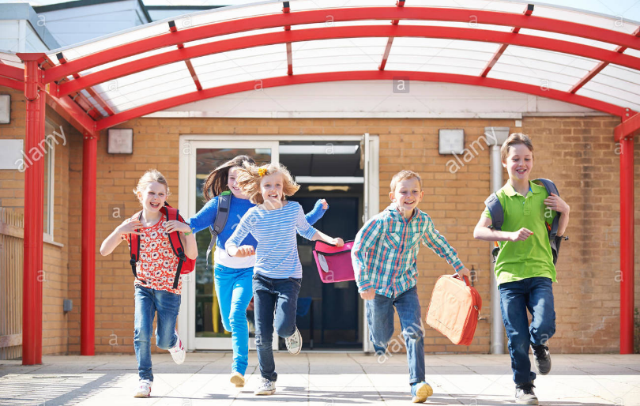
NO MORE TODAY
BYE

