Slide 1
Welcome

Slide 2
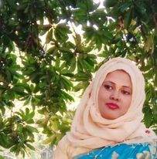
Teacher’s Introduction
Mst.Sharmin Akter
Assistant teacher
Matain Govt. Primary School
Hajiganj, Chandpur
E-mail:
mstsharminakter1985@gmail.com

Slide 3
Lesson Identity
Class : Five
Subject : English
Lesson :1-2
Unit:8
Activity : A
Time : 40 min
A
e
r
G

Slide 4
Learning Outcomes
Student’s will be able to-
Listening:1.3.1-recognize which words in a sentence are stressed.
Speaking:1.1.1-say words and phrases and sentences with proper sounds and stress.
Reading:1.5.1-read words , phrases and sentences with proper pronunciation , stress and intonation.

Slide 5
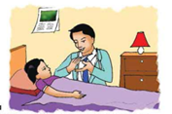
Look at the pictures and think about the picture.

Slide 6
Lesson declaration
Our todays lesson is Write to me soon !

Slide 7
cough
medicine
New word
sore
flu
throat

Slide 8
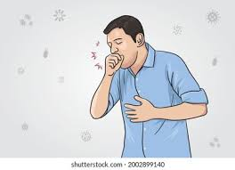
Cough
An act or sound of coughing.
He is coughing a lot.

Slide 9
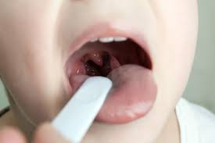
sore
painful
She has a cough and a sore throat.

Slide 10
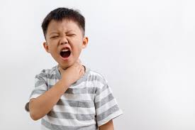
throat
neck
She has a cough and a sore throat.

Slide 11
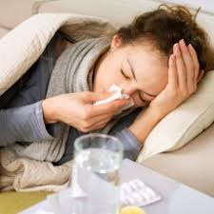
flu
Viral disease.
He has the flu.

Slide 12
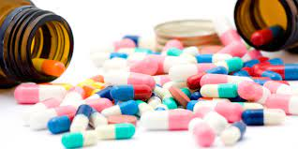
medicine
drug
I need some medicine.

Slide 13
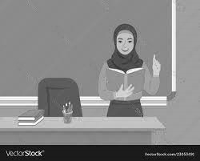
Teacher’s Reading

Slide 14
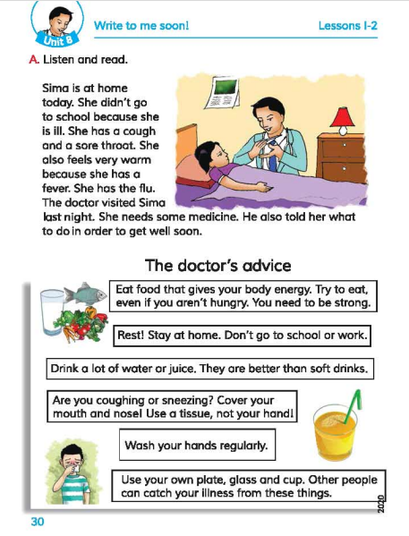
Open your book at page 30.

Slide 15
Sima is at home today.
She didn’t go to school because she is ill.
She has a cough and a sore throat.

Slide 16
She also feels very warm because she has a fever . She has a flu.
The doctor visited Sima last night.

Slide 17
She needs some medicine . He also told her what to do in order to get well soon .

Slide 18
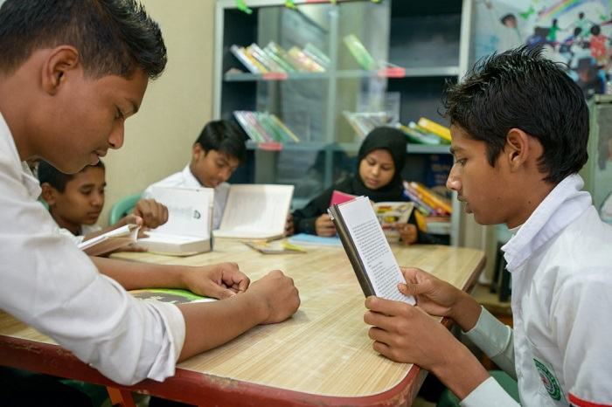
Group reading

Slide 19
Read in pair

Slide 20
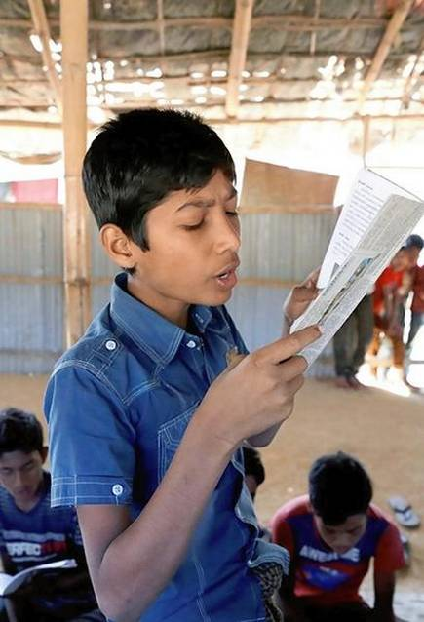
IW
Student’s reading

Slide 21
Questions:
Why Sima didn’t go to school ?
2. Why she is feeling warm ?
3.Who visited Sima ?
4. Who needs medicine ?

Slide 22
Answers:
1.Sima didn’t go to school because she is ill.
2.She is feeling warm because she has the flu .
3. Doctor visited Sima .
4. Sima needs medicine.

Slide 23
One day one word
Cough- কাশি

Slide 24
Goodbye

