Slide 1
To my multimedia class

Slide 2
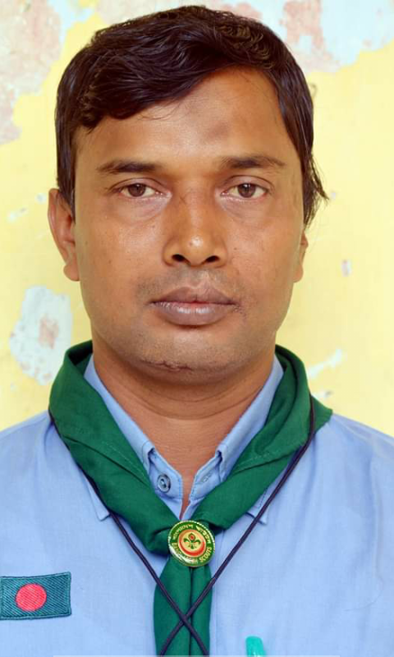
Introduction
Md. Faruq Hossain
Assistant teacher
Anandabash Govt. primary school.
Mujibnagar, Meherpur.
Mobile no- 01717406029
E-mail- faruqbd01@gmail.com

Slide 3
Let`s watch a video clip.
What did you watch?
https://www.youtube.com/watch?v=zKPJ8KxTpPs&ab_channel=RiafatHasan
Great day!

Slide 4
Today`s lesson
It was a great day!
The next day----a great day.(Lessons 3-4)

Slide 5
Learning Outcomes
Students will be able to-
1.3.1.recognize which words in a sentence are stressed.
4.2.1.understand & enjoy simple stories.
Listening
1.1.1.say words, phrases & sentences with proper sounds & stress.
6.2.1 talk about people,objects,events etc
Speaking
1.5.1 read words,phrases and sentences with proper sounds,strees and intonation.
1.7.1 read paragraphs,dialogues,stories,letters and other texts.
Reading

Slide 6
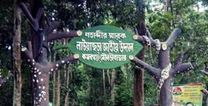
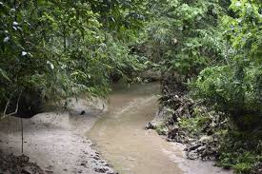
Think about the picture
What are these?
Lowachara National Park
Stream
The next day, after the camporee, they went to Lowachara National Park. They took a walk beside a small stream in the forest.

Slide 7
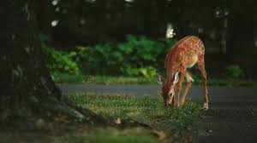
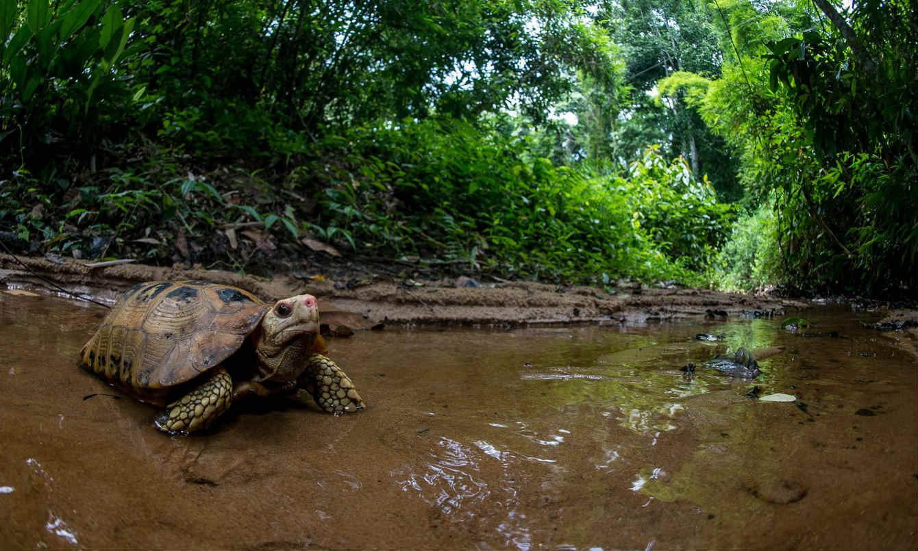
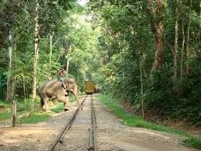
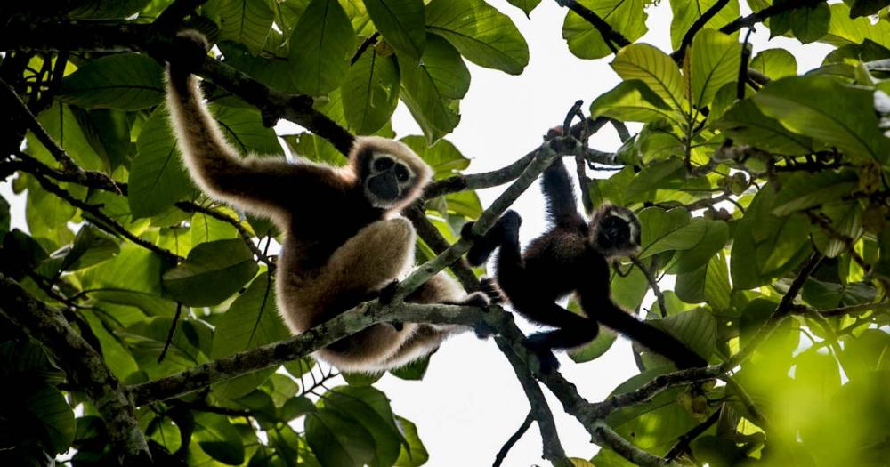
Think about the picture
What are these?
Deer
Tortoise
Elephant
Gibbon
All these animals are in the Lowachara National Park.

Slide 8
Group work
Answer the following questions.
Group-A: When did they go to Lowachara National Park?
Group-B: Where did they take a walk?
Ans: The next day, after the camporee, they went to Lowachara National Park.
Ans: They took a walk beside a small stream in the forest.

Slide 9
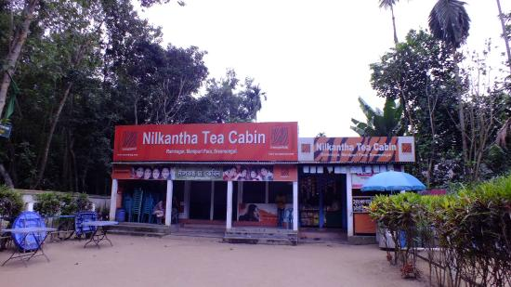
Think about the picture
What is it?
What is the name of this tea cabin?
Tea cabin
Nilkantha Tea cabin
After visit to Lowachara National Park, they went to the Nilkantha Tea Cabin.

Slide 10
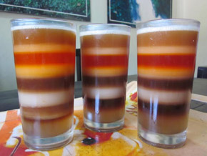
Think about the picture
What is it?
Tea in seven colours
The Nilkhanta Tea cabin sells a glass of tea of different colours and flavours.

Slide 11
Let`s watch a video clip.
What is the video about?
https://www.youtube.com/watch?v=QGsw4bF6iNg&ab_channel=KMPILOT
Lowachara National Park and The Nilkantha Tea Cabin

Slide 12
Pair work
Answer the following question.
1. Where did they go after visiting the park?
Ans: After visiting the park, they went to the Nilkantha tea cabin .

Slide 13
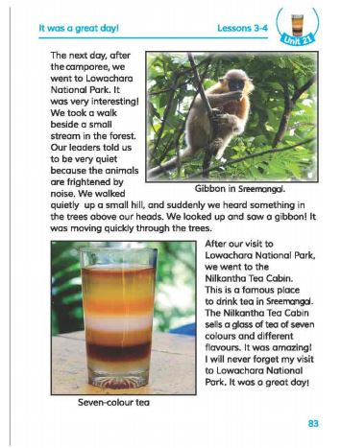
Open your english book at the page no- 83.

Slide 14
Some word meanings
Next
National
Park
Interesting
Beside
Stream
Quiet
Frightened
Noise
Hill
Famous
Colour
Flavour
Amazing
Forget
হৈ চৈ/ কোলাহল
পরবর্তী
জাতীয়
পাহাড়
উদ্যান/বাগান
বিখ্যাত
আনন্দদায়ক
রং
পাশে/পার্শ্বে
স্বাদ
জলস্রোত/জলপ্রবাহ
মনোমুদ্ধকর
শান্ত
ভুলে যাওয়া
ভীত

Slide 15
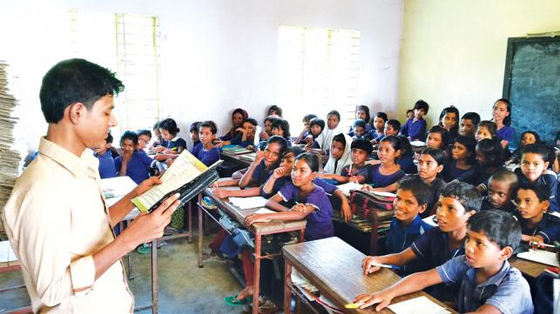
Loud reading

Slide 16
EVALUATION
A. Write “T” for true statement or “F” for false statement.
1. The animals are frightened by noise.
2 The Nilkantha Tea Cabin sells one colour tea .
3. Lowachara National park is in Shylet.
B. Answer the following questions.
1. Which place is called famous in Sreemangal ?
2.How was the day?
T
F
F
Ans: The Nilkantha Tea Cabin is a famous place in Sreemangal.
Ans: It was a great day.

Slide 17
Home work
Write a short composition on “Visit to the Lowachara National Park” in at least five sentences.

Slide 18
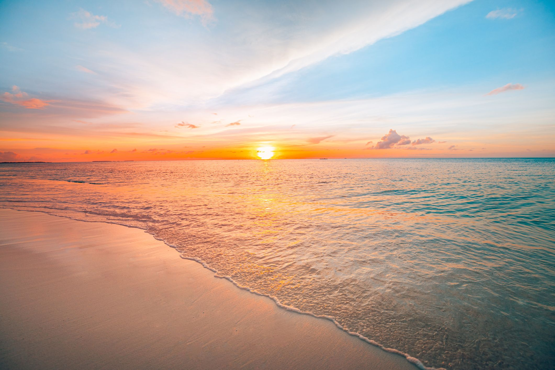
GOOD BYE!

