Slide 1
WELCOME
Kachari Bazar High School,Borogram,Thakurgaon

Slide 2
INTRODUCING
Krishno Chandra Barman
Assistant Teacher In English
Kachari Bazar High School
Borogram,Thakurgaon
Phone:0172413948
krishnobarman3@gmail.com
Date:29/09/2020
Class: Nine/Ten
Subject: English First Paper
Students: Fifty
Kachari Bazar High School,Borogram,Thakurgaon

Slide 3
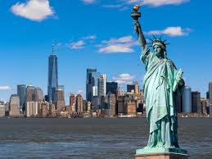
Look at the picture and talk about in pairs .
a)Do you know what it is ?
b)Do you think it is man or woman?
c) Discuss what stands out in the
Kachari Bazar High School,Borogram,Thakurgaon

Slide 4
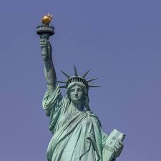
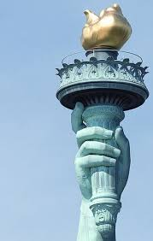
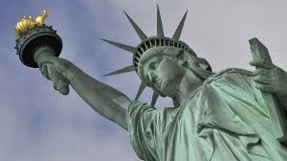
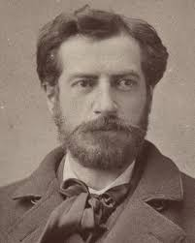
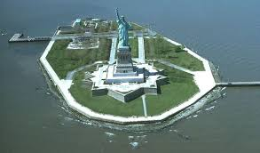
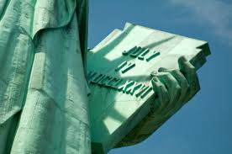
Crown
Torch
The Statue of Liberty(Woman)
pedestal
Fredric Auguste Bartholdi
Liberty Island
Scribed Book
Kachari Bazar High School,Borogram,Thakurgaon

Slide 5
Topic :The statue of Liberty
Unit : Eight
Lesson: Three
Kachari Bazar High School,Borogram,Thakurgaon

Slide 6
Learning Outcomes
After we have studied this unit , we will be able to…..
a)Listen for specific information
b)Read and understand texts through silent reading.
c)Ask and answer question.
Kachari Bazar High School,Borogram,Thakurgaon

Slide 7
. Read the question first
Questions:
a)Where is the statue of liberty situated ?
b) Which country gave the statue as a gift ?
c)The gift was meant for which country ?
d)What does the statue represent ?
Now Listen the Audio about the statue of Liberty and answer the following questions .
AUDIO
Kachari Bazar High School,Borogram,Thakurgaon

Slide 8
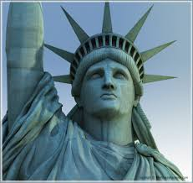
Questions and Answers
Questions:
a)Where is the statue of liberty situated ?
Answer:The statue of Liberty is situated on Liberty Island in the Harbour of New York.
b)Which country gave the statue as a gift?
Answer:France gave the statue as a gift.
c)The gift was meant for which country?
Answer: The gift was meant for the USA.
D)What does the statue represent?
Answer:The statue represents her free forword movement,enlightening the world with her torch and free from oppression and slavery .
Kachari Bazar High School,Borogram,Thakurgaon

Slide 9
C) Listen to the text again and complete the chart.
The Statue of Liberty | Information
situated
artist
gift from
reason for the gift
Presented on
The statue of Liberty symbolizes
Framework made of
weight
Year it was declared a UNESCO
in the Harbour of New York
Frederic Auguste Bartholdi
France
to commemorate the centennial of the US independence
Liberty of the USA
Freedom from oppression and slavery
Copper sheets ,iron ,24k gold
254 tons
In 1984

Slide 10
Read the text silently and answer the following questions.
a)What do you understand by the expression 'Enlightening the world’?
b)How was she transported?
Answer : a) The expression means that the woman like statue is enlightening the world with the torch in her right hand being out of any oppression and slavery.
b)Answer: She was transported on board the France war ship ’Isere’.
Kachari Bazar High School,Borogram,Thakurgaon

Slide 11
Meaning Word and Pronounce the difficult words:
Oppression –torture
Sculptor-artist
Enlightening-instructive
Centennial- hundred years anniversary
Wrap-cover
Kachari Bazar High School,Borogram,Thakurgaon

Slide 12
Evaluation :
Fill in the gap without clues.
The statue of Liberty is situated at (a) . She stands for universal (b) . The statue of liberty is made by (c)
.The France government (d) the statue of liberty to the USA it’s (e) ceremony of independence.
New York
friendship
Fredic Bartholdi
gave
centennial
Kachari Bazar High School,Borogram,Thakurgaon

Slide 13
Hometask
Write a paragraph ‘‘The Statue of Liberty”
Kachari Bazar High School,Borogram,Thakurgaon

Slide 14
Stay home save and sound .Watch the online class.
Kachari Bazar High School,Borogram,Thakurgaon

