Slide 2
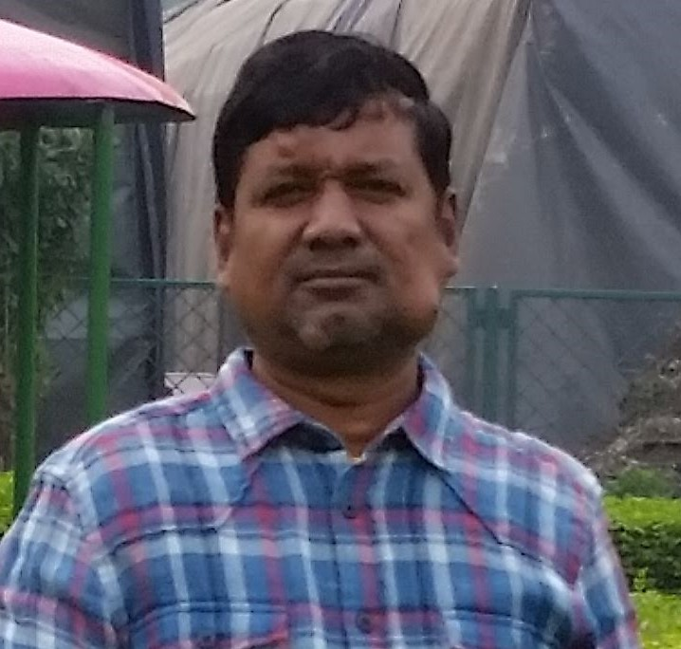
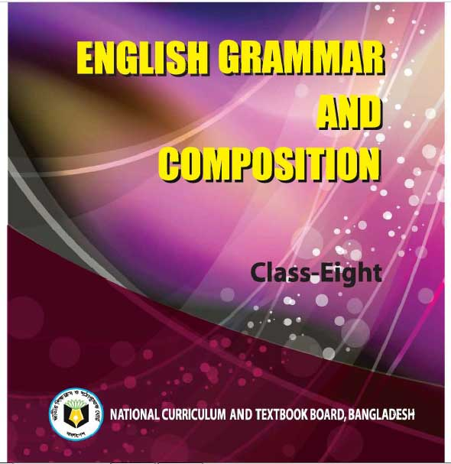
Shah Mohammad Lutful Haider
Assistant Teacher
LUTFUNNESA BALIKA BIDDANIKETON
PAGLA, GAFARGAON
Class- 8
Story writing.
Time: 50 minutes

Slide 3
Objectives
Students will be able to……….
Guess the Story
Give the Title
Write the Story

Slide 4
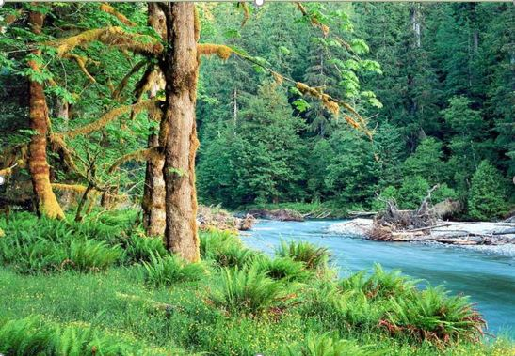
A Jungle

Slide 5
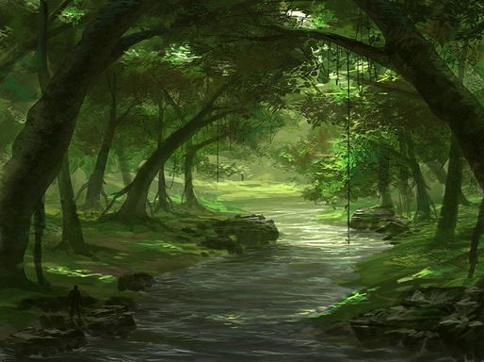
A river is running through the jungle

Slide 6
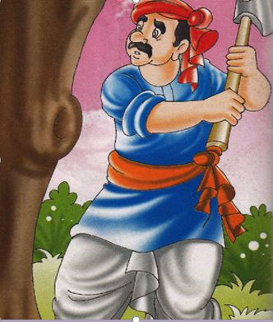
A Wood Cutter

Slide 7
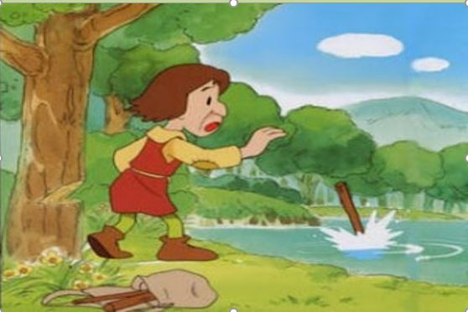
What happened?
The Wood Cutter lost his axe

Slide 8
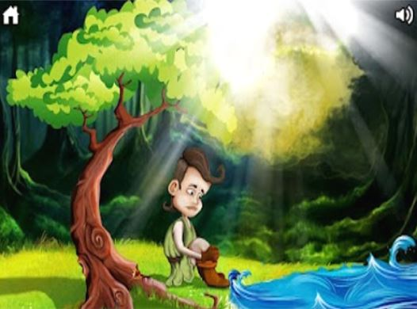
He was………..

Slide 9
What can be the title of the story?
An Honest Woodcutter

Slide 10
Fill in the gaps with clues from the box.
There was a poor wood cutter.
1. One day he was
wood in the jungle beside a river.
2. Suddenly his axe
of his hand.
3. It fell
deep water.
4. It was a great
for him.
5. He began to
$$.$$
cutting
slipped out
into
loss
weep

Slide 11
Make sentences from the table
A | Told about his great loss
The water goddess | Asked the wood cutter, “Why are you crying?”
The wood cutter | Rose up from the river
He | Said , “No”
She | Took pity on him and diving into the water she brought golden axe and asked him, “Is it your?”
 | Told about his great loss

Slide 12
Write a story on
“An honest wood-cutter”
Once there lived a poor wood-cutter. But he was very honest. Everyday he went out to cut wood in the jungle. He earned his livelihood by selling wood in the market. One day while……………………….

Slide 13
Home work
Think, you and some of your friends went to visit Shalban Bihar. Your friend Tamanna was capturing picture with her digital camera. Suddenly she lost her camera. She started weeping. A fairy come down from a tree and……………………………

