Slide 1
Welcome
How are you all?

Slide 2
Presented By:
Mst Rokeya Khatun
Assistant Teacher (ICT)
Kaharol Pilot Girls High School
Kaharol,Dinajpur.
Mobile No: 01706878351
E-mail: rokeyakhatun2005@gmail.com
Class : Six
Subject : English 2nd Paper
Topic : Present Continuous
Duration : 45 minutes
Date : 06-10-2021

Slide 3
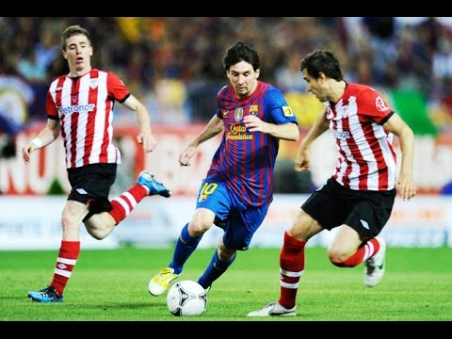
What are you looking in the pictures:
Picture-A
Picture- B
They are playing football.
He is watching TV.

Slide 4
What will be our today’s topic

Slide 5
Learning Outcomes
At the end of this lesson, We will be able to:
know the structure of Present Continuous Tense
ask and answer using the mentioned
identify the mentioned Tense
describe pictures

Slide 6
Present Continuous Tense
Present continuous tense is used when an action is continued or going to be continued in near future.
বর্তমানে কোন কাজ চলছে বা নিকট ভবিষ্যতে চলবে এরূপ বোঝালে Present Continuous Tense হয়।
বাংলায় চিনার উপায়: বাংলায় ক্রিয়া বা verb এর শেষে চ্ছ, চ্ছি, চ্ছে, চ্ছেন, ছি, ছেন, ইত্যাদি থাকে।
Structure: Subject + am/ is/ are+ verb + ing + object.
Example:
আমি ভাত খাচ্ছি । – I am eating rice.

Slide 7
More Examples:
আমি স্কুলে যাচ্ছি। – I am going to school.
সে স্কুলে যাচ্ছে। – He is going to school.
তুমি/ তোমরা বই পড়ছ। – You are reading book.
আমি আজ রাতে ঢাকা যাব। – I am going to Dhaka tonight. (Near Future)
[ Note - I এর পর am বসে। He, She, it এবং অন্যসব Third Person Singular Number এর পর is বসে। We, you, they এবং Plural Subject এর শেষে are বসে।]

Slide 8
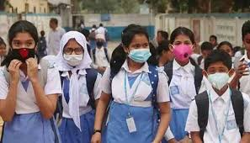
Individual Work:
What are they doing?
Answer : They are going to School.
What is the man doing?
The man is reading newspaper.

Slide 9
Affirmative, Negative, Affirmative. Interrogative and Neg. Int
Affirmative | I am going to School.
2. Negative | I am not going to School.
3. Affirmative Interrogative | Am I going to School?
4. Negative Interrogative | Am I not going to School?
5. Active | She is writing a letter.
6. Passive | A letter is written by her.

Slide 11
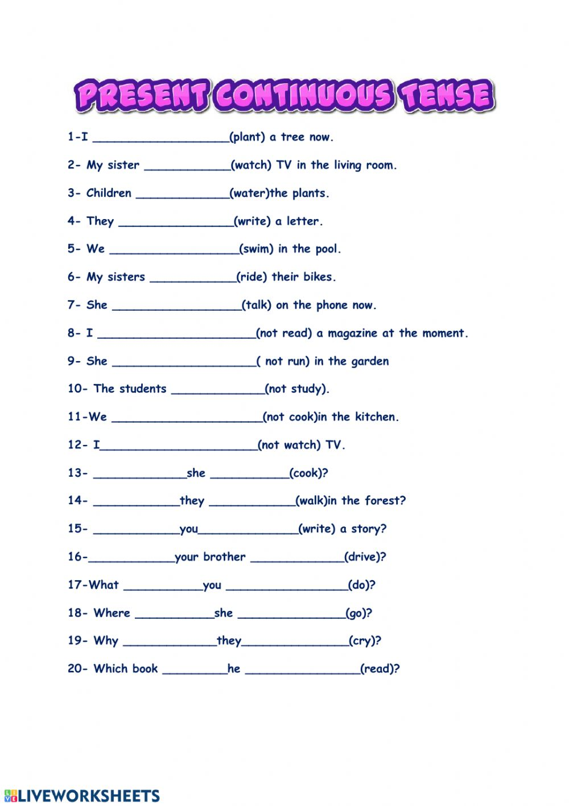
Home Work

Slide 12
No More Today
See you again
Thank You all.

