Slide 2
Welcome
to English class

Slide 3
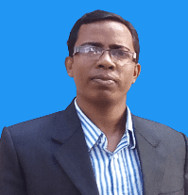
Md.Abdur Razzak
Assistant Teacher (English)
Shatgram Akota High School
Baniachang,Habigang
District Ambasadder,Habigang
Class:Eight
Subject: English For Today
Unit:Three
Lesson:Eight
Email:marazzak55555@gmail.com
Mobile Number:01731181479

Slide 4
Watch the video attentively and answer the following questions.
1. About what is the teacher talking in the classroom?
1. What can we do to keep our classroom net and clean?
3. What should we do to maintain discipline in our class?

Slide 5
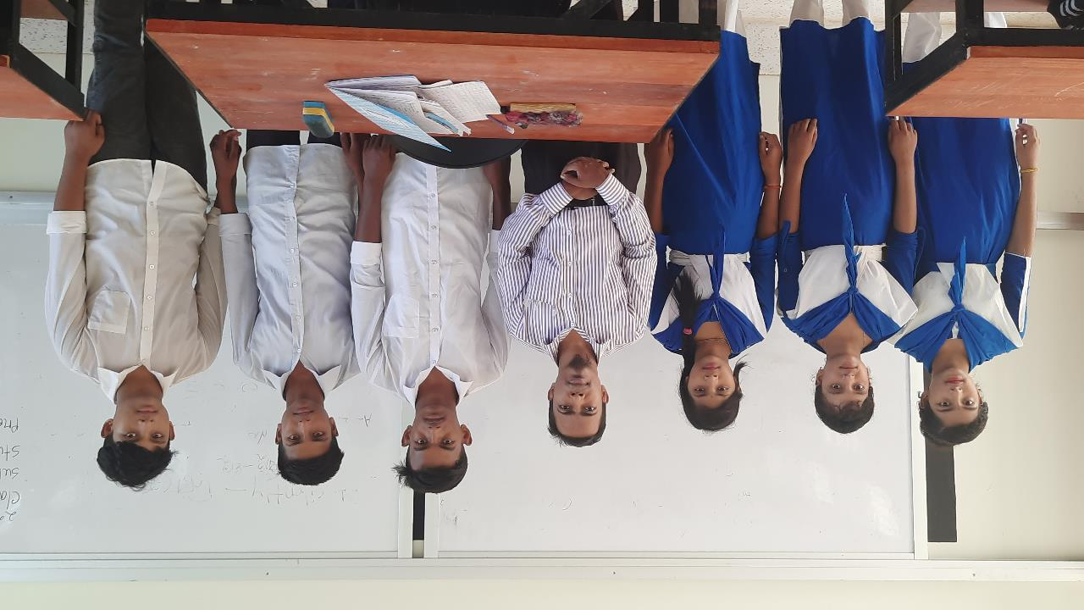
Making a class committee.

Slide 6
Learning outcome
By the end of the lesson the students will be able to-

Slide 7
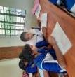
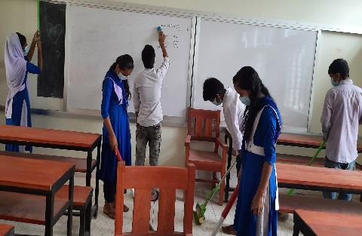
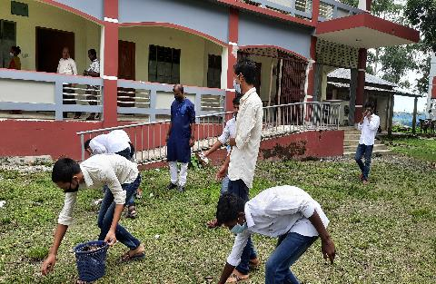
Look at the pictures first and then answer the following questions in pairs.
Pair Work
5
00
2
3
4
1
1. What do you see in the picture?
2.What are the students doing in picture 1 and 2?
Time:five minutes
3. Do you do these things at home? If you don't who does?

Slide 8
There are some students who are busy with cleaning their classroom.
Do you do these things at home? If you don’t?Who does?
There are some students who are busy with cleaning the front side of their school.
What do you see in the first picture?
What do you see in the second picture?
Yes, I sometimes do these things at home. When I don’t my mother does this at home.

Slide 9
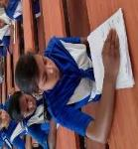
Listen to the audio and tell whether the information is true or false.
False
1.The students do not need to rearrange the furnitures.
Individual work
False
2.All the students will start cleaning the classroom at a time.
5
00
2
3
4
1
False
3.The teacher will clean the blackboard at the beginning of the lesson because the students likes it.
Time:five minutes
True
4.At the end of the class,the students will organize the class systematically.

Slide 10
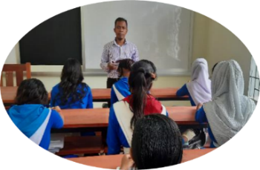
Ms Subana Saha, the class teacher, has just entered the classroom. She is now
talking to the students.
"Why is the classroom so dirty?" asks Ms Saha. "I know the school cleaner is
absent today. So what? Can't we ourselves keep our classroom clean?"says Ms
Saha. "Sorry teacher," Shafiq, the class captain, says politely. "This is our
classroom. If you clean it, you will do physical work and feel good. Also it
is our responsibility to keep it clean and tidy", says Ms Saha.
"Okay, teacher," says Shafiq. "We'll do it from now on."

Slide 11
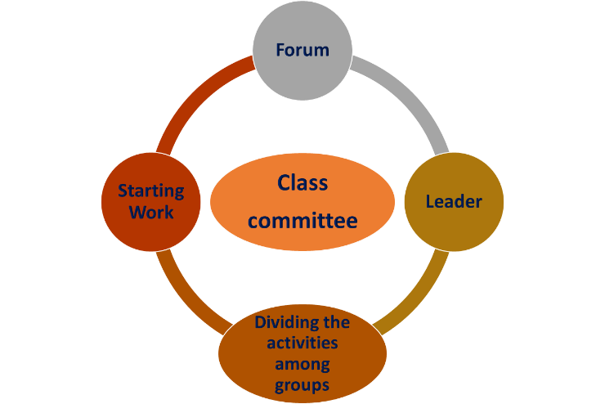
"First, you can make a forum, and select a leader," the class teacher suggests.
"Then divide the cleaning activities among different groups."
It's really a great idea, teacher" says Shafiq. "We'll make the committee
now and start working immediately."

Slide 12
After this, a committee is formed by class 8 students under the leadership of their class captain. The students are divided into several groups and a work plan is made for cleaning. The students decided to make some ground rules.

Slide 13
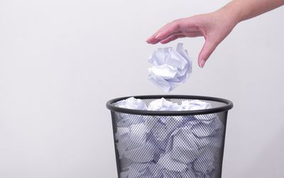
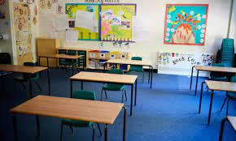
Here is a list of some of the rules:
Do not spit in the classroom.
Do not drop litter in the classroom.
Use the bin for trash.
Keep the desks and chairs in place.
All the students of class 8 are very excited to be involved in this activity at
School.

Slide 14
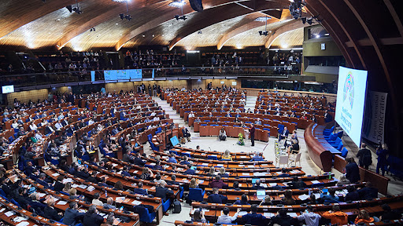
Forum
a place, meeting, or medium where ideas and views on a particular issue can be exchanged.
They made a forum

Slide 15
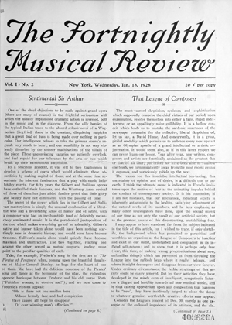
Fortnightly
happening or produced in every two weeks.
Evening classes will run fortnightly.

Slide 16
Responsibility
A duty or task that one is required or expected to do.
It is our responsibility to save the world.

Slide 17
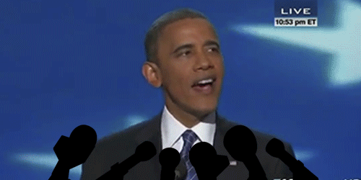
Immediately
Without any intervening time or space.
He immediately protested after Obam’s Speech.

Slide 18
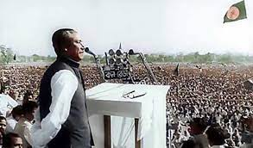
Leadership
The action of leading a group of people or an organization.
We got our independence under the leadership of Bangabandhu.

Slide 19
Involve
engage as participant.
Their mission is to serve the country.

Slide 20
Tidy
Odds and ends, discarded and scattered refuses.
5
00
2
spit
3
4
rubbish
1
litter
Net and clean
Time:five minutes
trash
Send liquid(saliva) out from the mouth

Slide 21
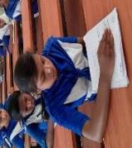
C. Read the text in B silently and then choose the best answer.
1. Ms Subarna Saha is.....................
a. a physical education teacher
b. an English teacher
c. a class teacher
d. a science teacher
2. The class teacher suggested the students to make a forum...
a. to keep their classroom clean
b. to participate in social activities.
c. to keep the school environment clean
d. to help each other
3. The students were happy to be able to
a. become the members of the committee
b. take part in the cleaning programme at school.
c. make their class captain leader of the committee
d. make themselves good students
Individual work
4. The students were divided into................groups.
5
00
2
3
a. four
b. many
4
1
d. several
c. some
Time:five minutes

Slide 22
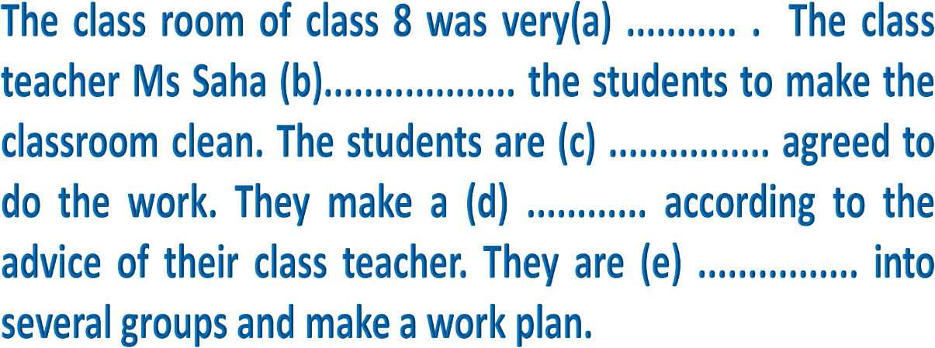
5
00
2
3
4
1
Time:five minutes
dirty
suggested
eagerly
forum
divided

Slide 23
Pair work
5
00
2
3
6
4
8
1
7
Time:Eight minutes
1.Why did the students make some ground rules?
2.Why did they make several group?

Slide 24
Match your answers with my answers and write down on your exercise book.
1.The students made some ground rules so that all could follow them properly.
2.They made several groups to divide the activities among themselves.

Slide 25
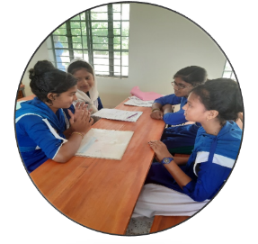
5
00
2
3
6
4
8
1
7
Time:Eight minutes
Write a paragraph about how we can keep our classroom clean in 60 words.

Slide 27
See you again.

