Slide 1
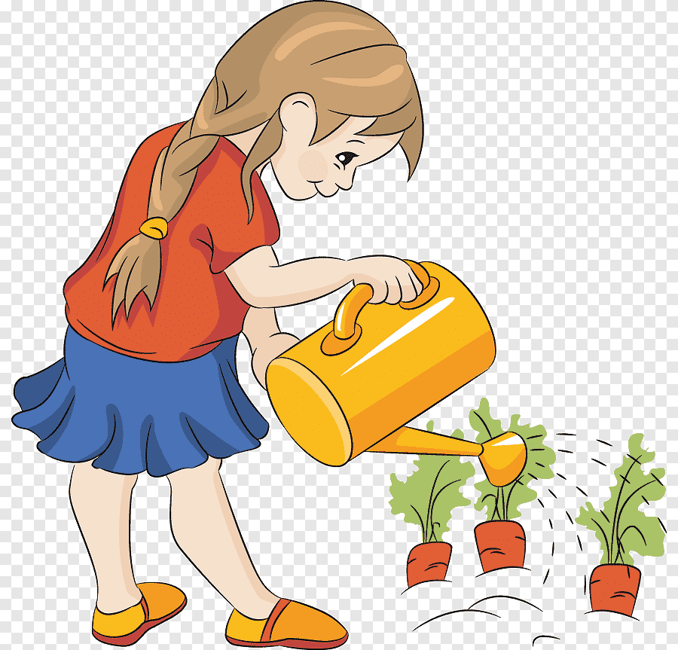

Slide 2
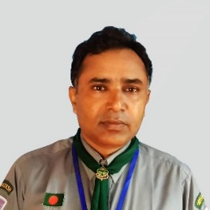
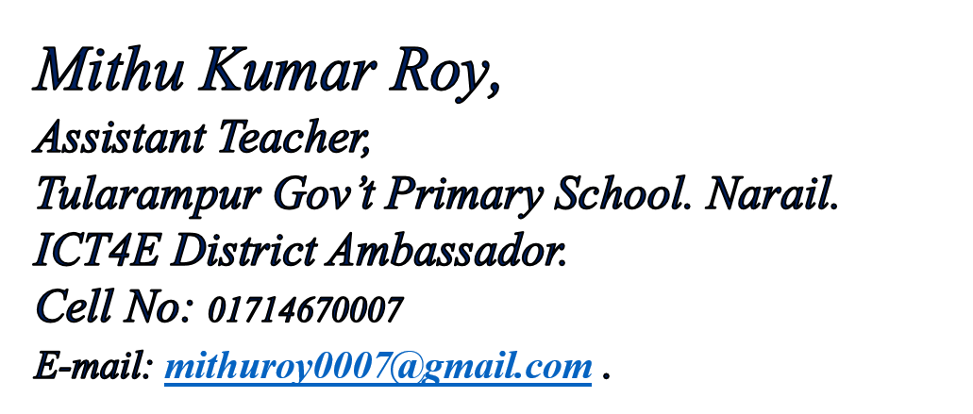
Class Two
Sub: English For Today
Unit:15, Lesson: 2. Activity: A

Slide 3
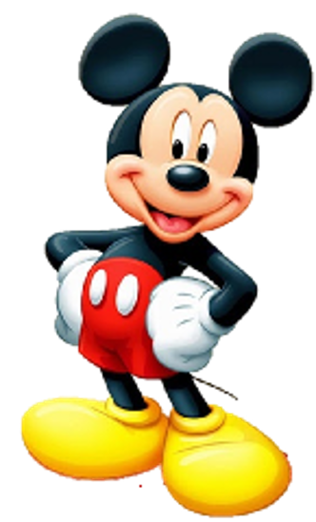
Let us sing a Song.
I can see left
I can see right
Hello to you!
Hello to you!!
I look at ground
I look at the sky
Fly away little Bird
Goodbye Goodbye..!

Slide 4
Review the previous Lesson
Sunday
Monday
Tuesday
What day is it today?
Wednesday
Thursday
Friday
Saturday

Slide 5
Review the previous Lesson
On Sunday
Dear students,
On Monday
What does Rima do on Sunday?
On Tuesday
On Wednesday
When does She water the seed?
On Thursday
When does She put the seed in a tub?
On Friday
On Saturday

Slide 6
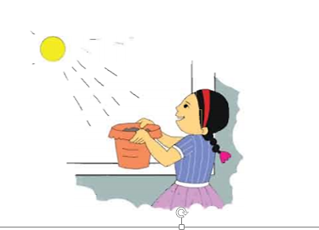
Our Today’s Lesson is…
Story: Rima and the seed (2nd Part)

Slide 7
Learning Outcomes
Listening: 1.1.1 become familiar with English sounds by listening to common English words.
2.1.1 following simple commands and instructions.
3.1.2 understand simple questions and statements about familiar objects.
4.2.1 enjoy simple stories
Speaking: 1.1.1 repeat after the teacher simple words and phrases with proper sounds and stress.
1.1.2 say simple words and phrases with proper sounds and stress.
5.1.1 say the names of the days of the week.
7.1.1 give simple commands and instructions.
Reading: 1.3.1 recognize and read the names of objects having the same initial and final sounds.
1.4.1 read words and phrases with the help of visual clues and simple sentences.
5.1.1 recognize and read the days of the week.

Slide 8
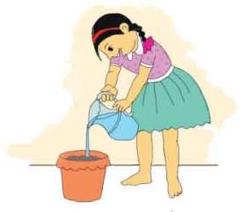
Now, we read the rest of the story
On Monday, Rima waters the seed.
What does Rima do on Monday?

Slide 9
On Tuesday, Rima puts the tub in the sun.
When does Rima put her tub in the sun?

Slide 10
Open your Book at page 30 and
Listen to the Audio

Slide 11
Pair Work
Listen and Read
On Monday, Rima waters the seed.
On Tuesday, Rima puts the tub in the sun.

Slide 12
Ask and Answer
What does Rima do on Sunday?
When does she water the seed?
What does she do on Monday?
What do you do on Friday?

Slide 13
Fill in the gap on your exercise book
waters
On Monday, Rima _____ the seed.
sun
On Tuesday, Rima puts the tub in the _____.

Slide 14
Checking Learning
Say the words properly.
seed
tub
plant
put
wait
give
water

Slide 15
Checking Learning
Read and say.
On Saturday, Rima’s father gives her a seed.
On Sunday, Rima puts the seed in a tub.
On Monday, Rima waters the seed.
On Tuesday, Rima puts the tub in the sun.

Slide 16
Home work
Page 30 will be well read and written

Slide 17
