Slide 1
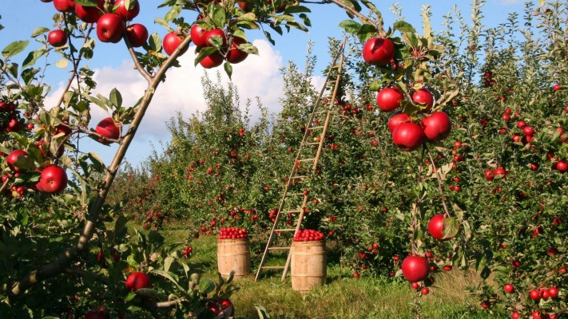

Slide 3
Identity
Md. Noor –E- Alam Siddiki
Asstt. Teacher
Nageswari Keramatia M.L High School.
Mobile- 01716962418
Email- nooralam.na35@gmail.com
Unit -2, Lesson 2

Slide 4
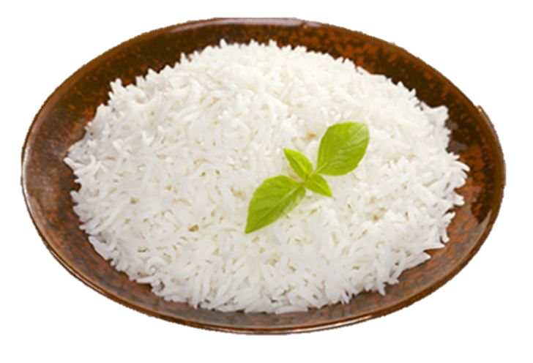
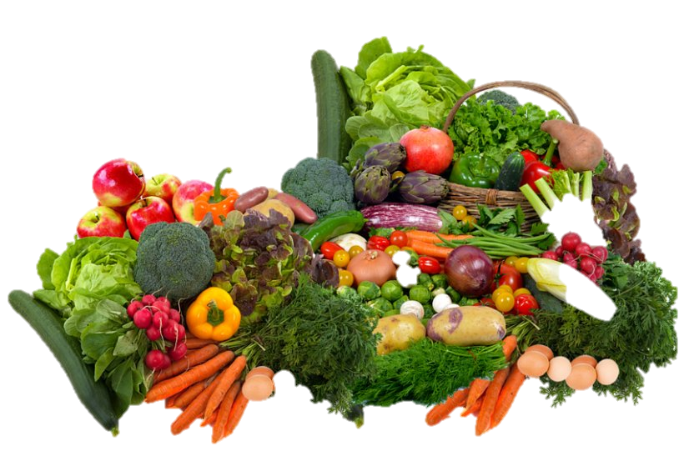
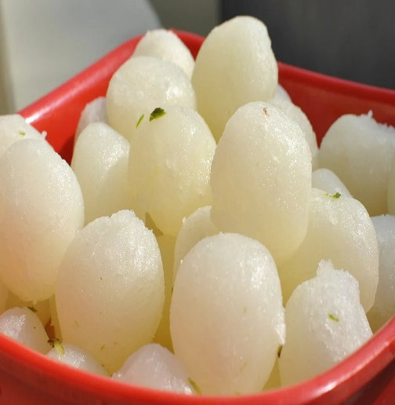
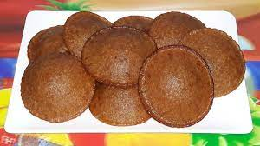
What can you see in the pictures below?
rice
vegetables
sweetmeat
pitha
What are these?
These are various kinds of food.

Slide 5
Today’s title is…
Unit 2, Lesson 2

Slide 6
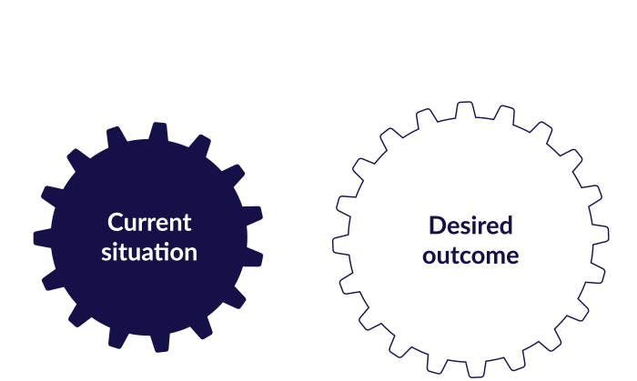
After studied the lesson , students will be able to …
practise listening skill.
Say how many substances contain in food.
answer questions.
choose the best answers.

Slide 7
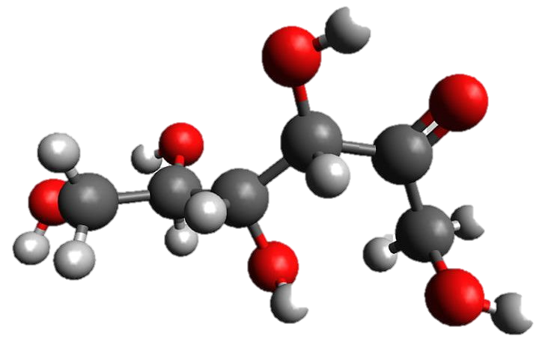
Let’s know some new words
Carbohydrate
Carbohydrates (also called carbs) are a type of macronutrient found in certain foods and drinks. Sugars, starches and fiber are carbohydrates.
Sugar contains a lot of carbohydrates.

Slide 8
Vitamins
Vitamins are substances that our bodies need to develop and function normally. They include vitamins A, C, D, E, and K, choline, and the B vitamins (thiamin, riboflavin, niacin, pantothenic acid, biotin, vitamin B6, vitamin B12, and folate/folic acid).
We get vitamins from leafy vegetables, milk, egg , fish etc.

Slide 9
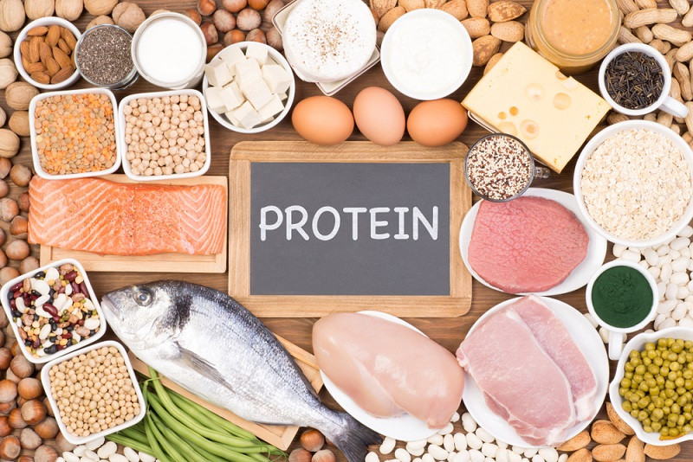
Protein
Protein is an important part of a healthy diet. Proteins are made up of chemical 'building blocks' called amino acids.
We get protein from meat.

Slide 10
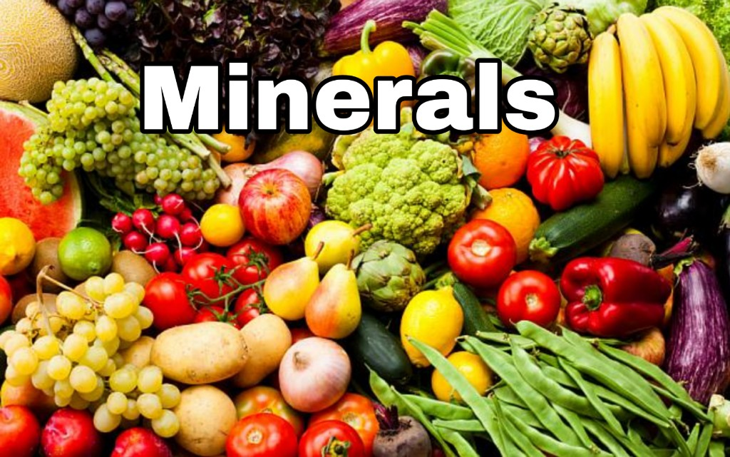
Minerals
a solid, naturally occurring inorganic substance.
"it identifies the mineral or compound present"
Leafy vegetables contain minerals.

Slide 11
Listen to the audio and answer the following questions.
Audio

Slide 12
Pair work
A answer the questions.
1. How many kinds of food do we need?
2. What are they?

Slide 13
Match your answer
1. We need six kinds of food.
2. They are carbohydrate, protein, vitamins, minerals, fat and water.

Slide 14
Individual work
Choose the best answers.

Slide 15
Match your answer
1. Foods are divided into classes according to their
a) Colours and tastes
c) Substances they contain
b) Shapes and sizes
d) Water they contain
2. Potatoes contain a lot of
a) Carbohydrate
c) vitamins
b) Protein
d) minerals

Slide 16
3. Butter and ghee are a good source of
a) protein
c) vitamins
b) Fat
d) Carbohydrate
4. Minerals are present in
a) nuts
c) Milk
b) Peas
d) Water
5. Which food has the most carbohydrate
a) Sugar
c) Fruits
b) Rice
d) Vegetables

Slide 17
Evaluation
What is water’s role in our body?

Slide 18
