Slide 1
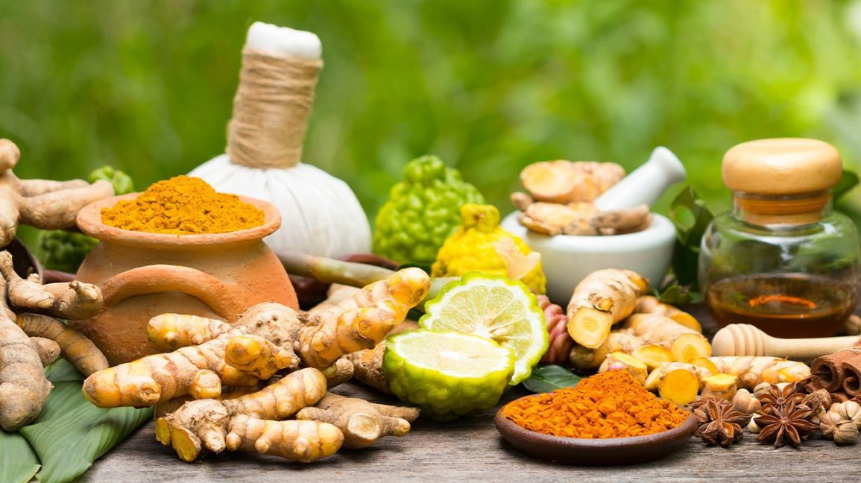

Slide 2
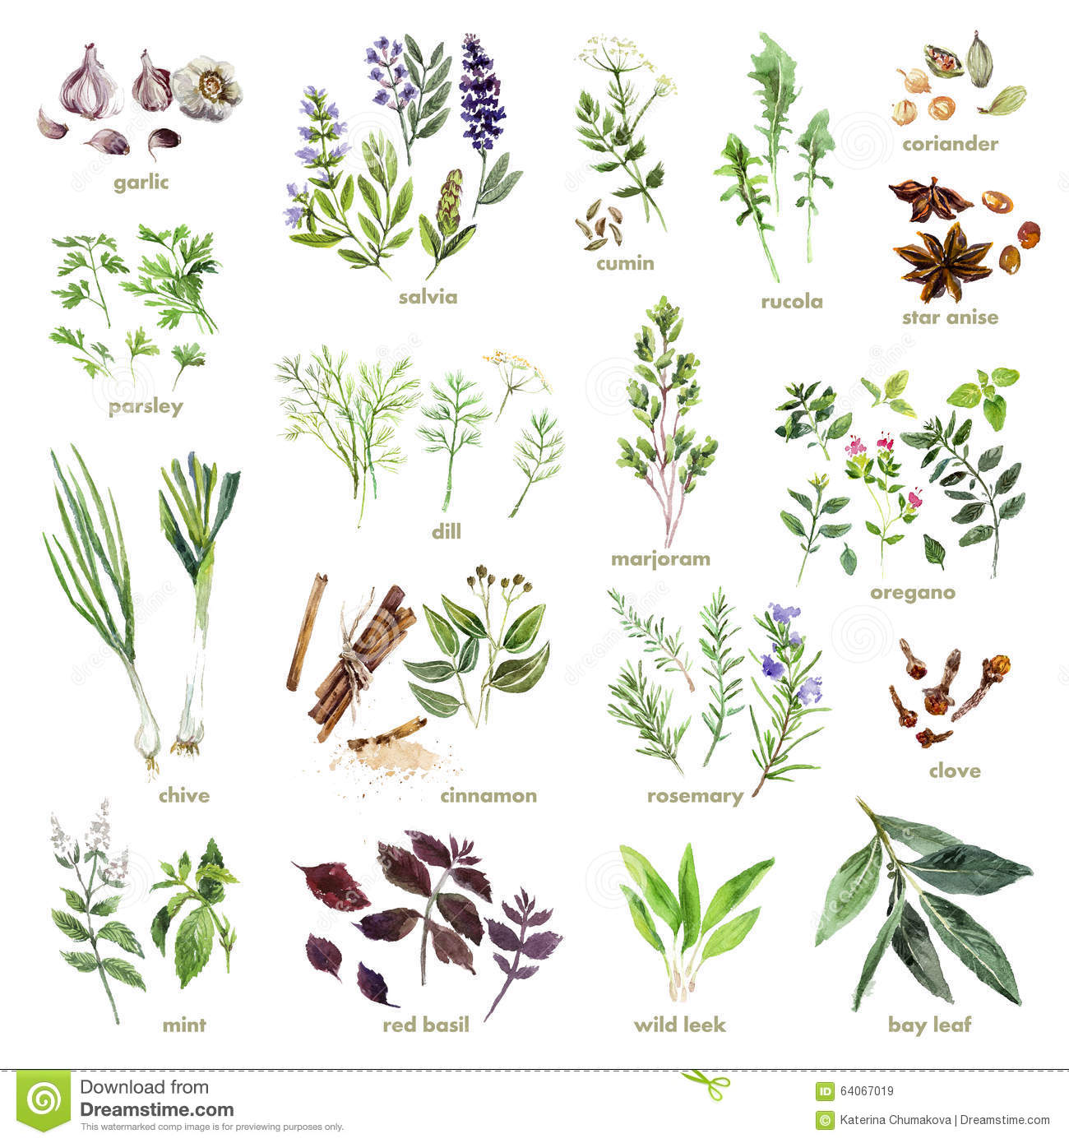
You are welcome

Slide 3
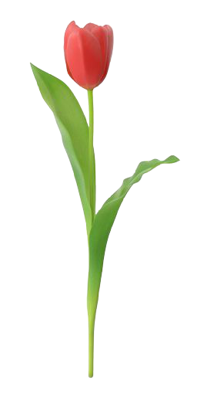
INTRODUCTION
Swandip Banerjee
Asst. Teacher (English)
Pallimangal Secondary School
Sonadanga, Khulna.
Mobile: 01718503573
E-mail: swandipb1@gmail.com

Slide 4
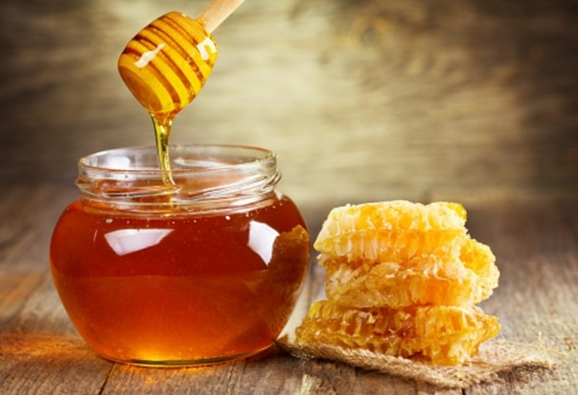
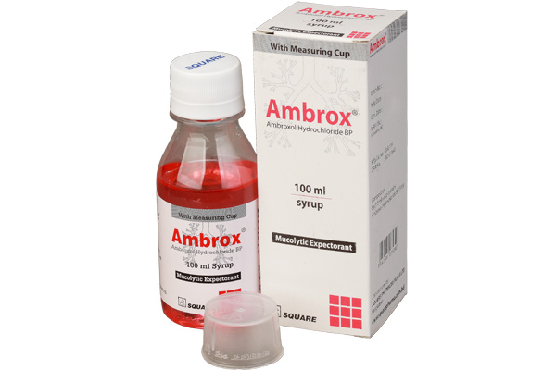
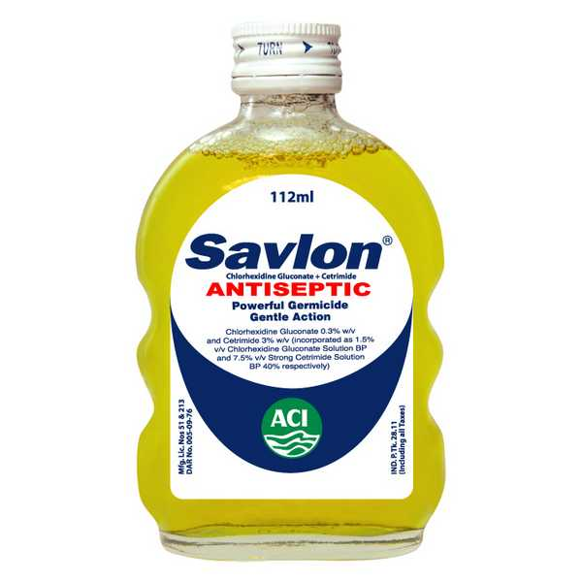
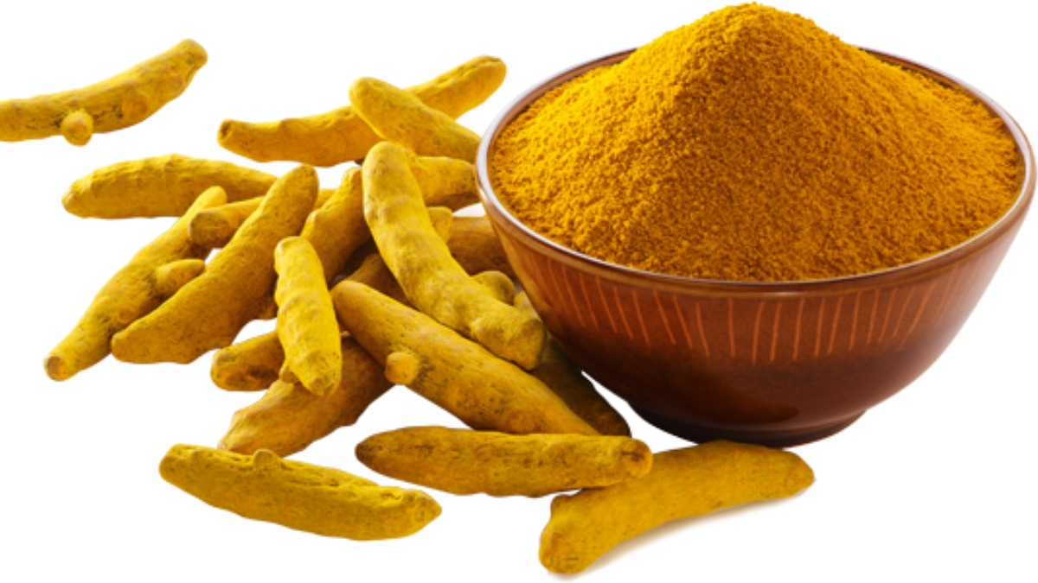
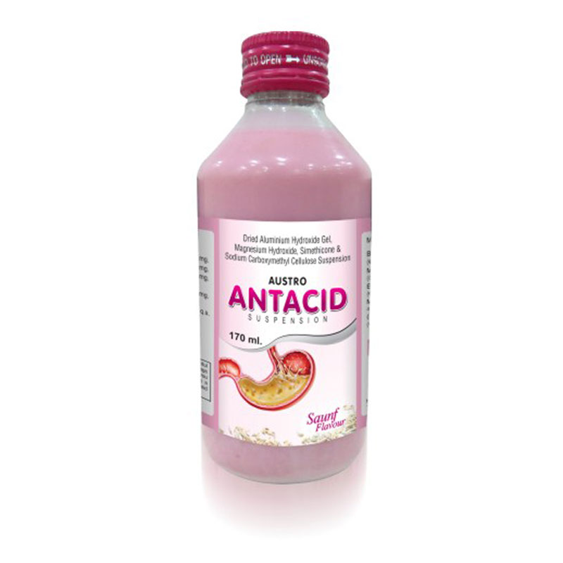
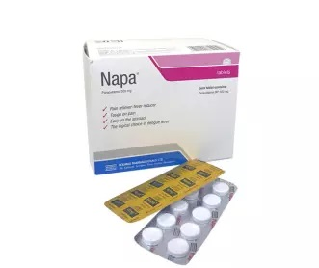
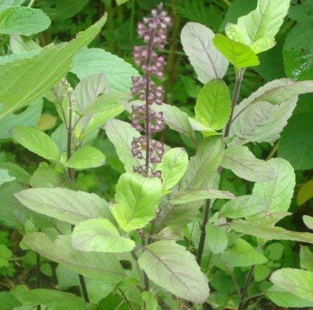
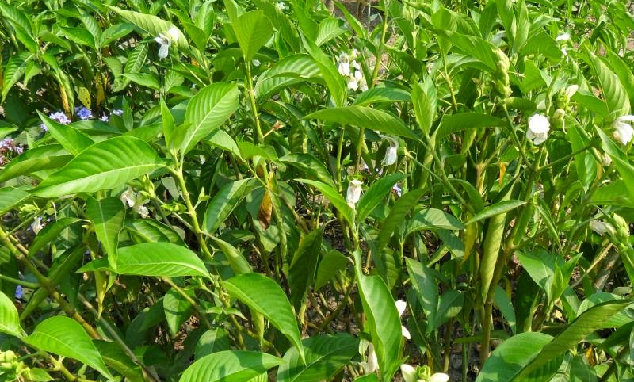
Look at the following pictures.
Traditional
Modern

Slide 5
Our today’s lesson is……
Remedies: modern and traditional
Lesson: 10

Slide 6
Learning outcomes.
By the end of the lesson, students will be able to ……
read and understand written instructions
read and understand texts
ask and answer questions
participate in short dialogues and conversations on familiar topics
write short paragraphs

Slide 7
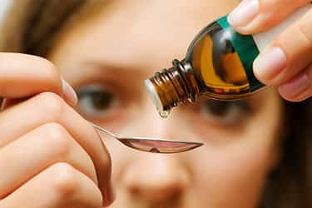
New word
Remedy
A medicine or treatment for a disease or injury.

Slide 8
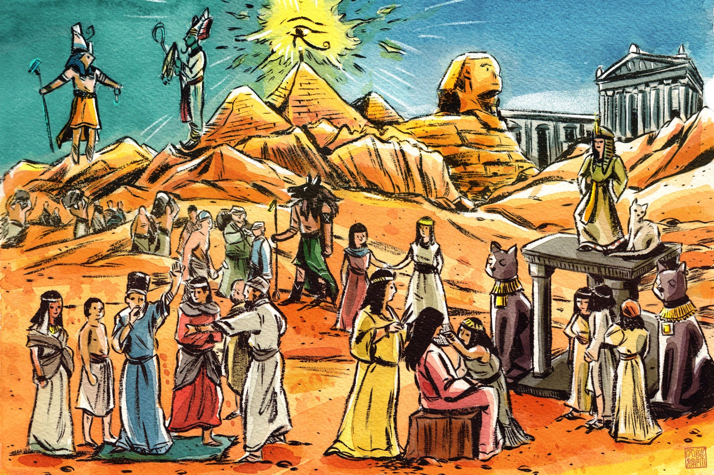
New word
Ancient
Belonging to the very distant past and longer in existence.

Slide 9
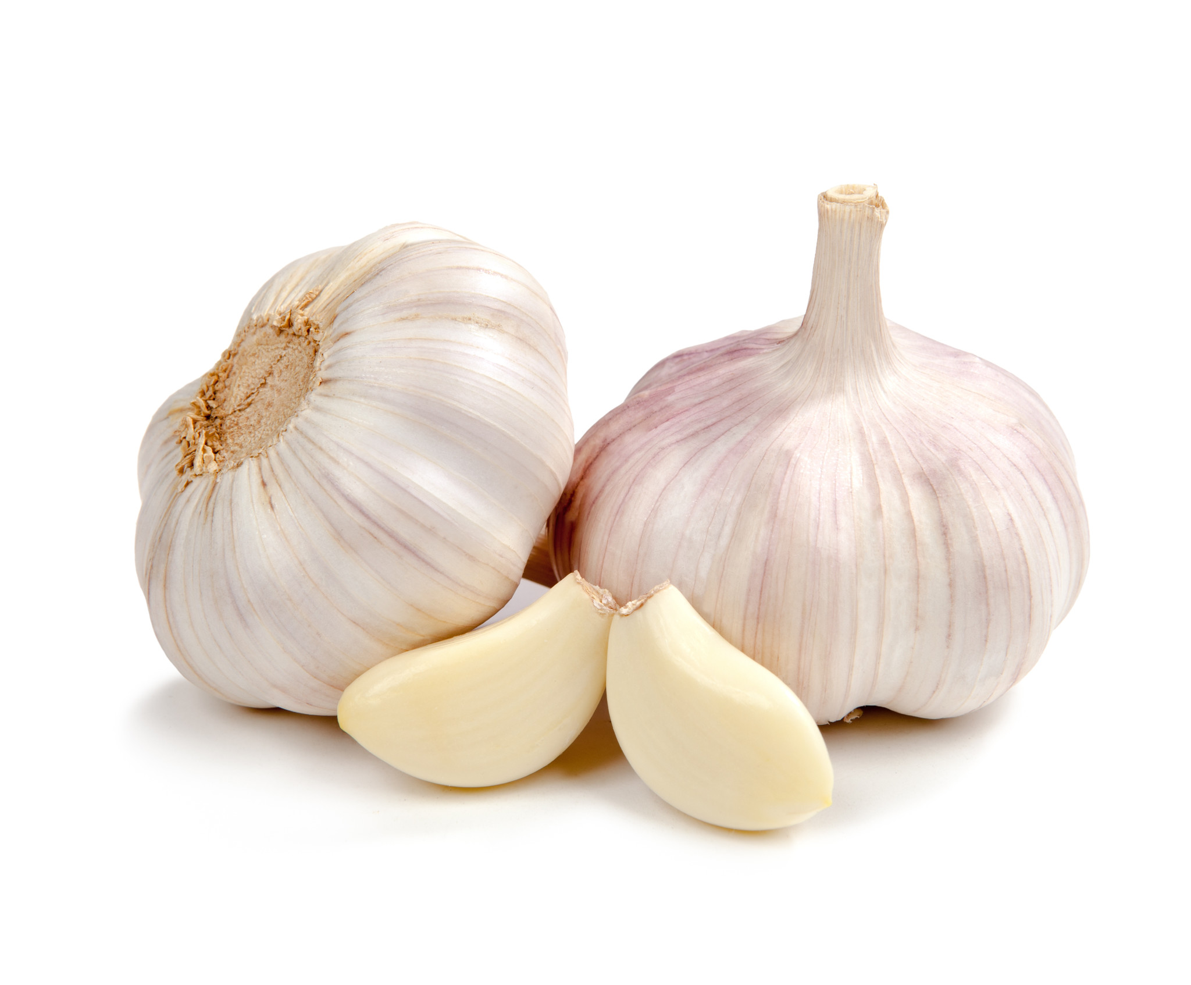
New word
Garlic
A strong smelling and pungent-tasting bulb used as a flavoring in cooking and in herbal medicine.

Slide 10
New word
Turmeric
the state of having, owning or controlling something.

Slide 11
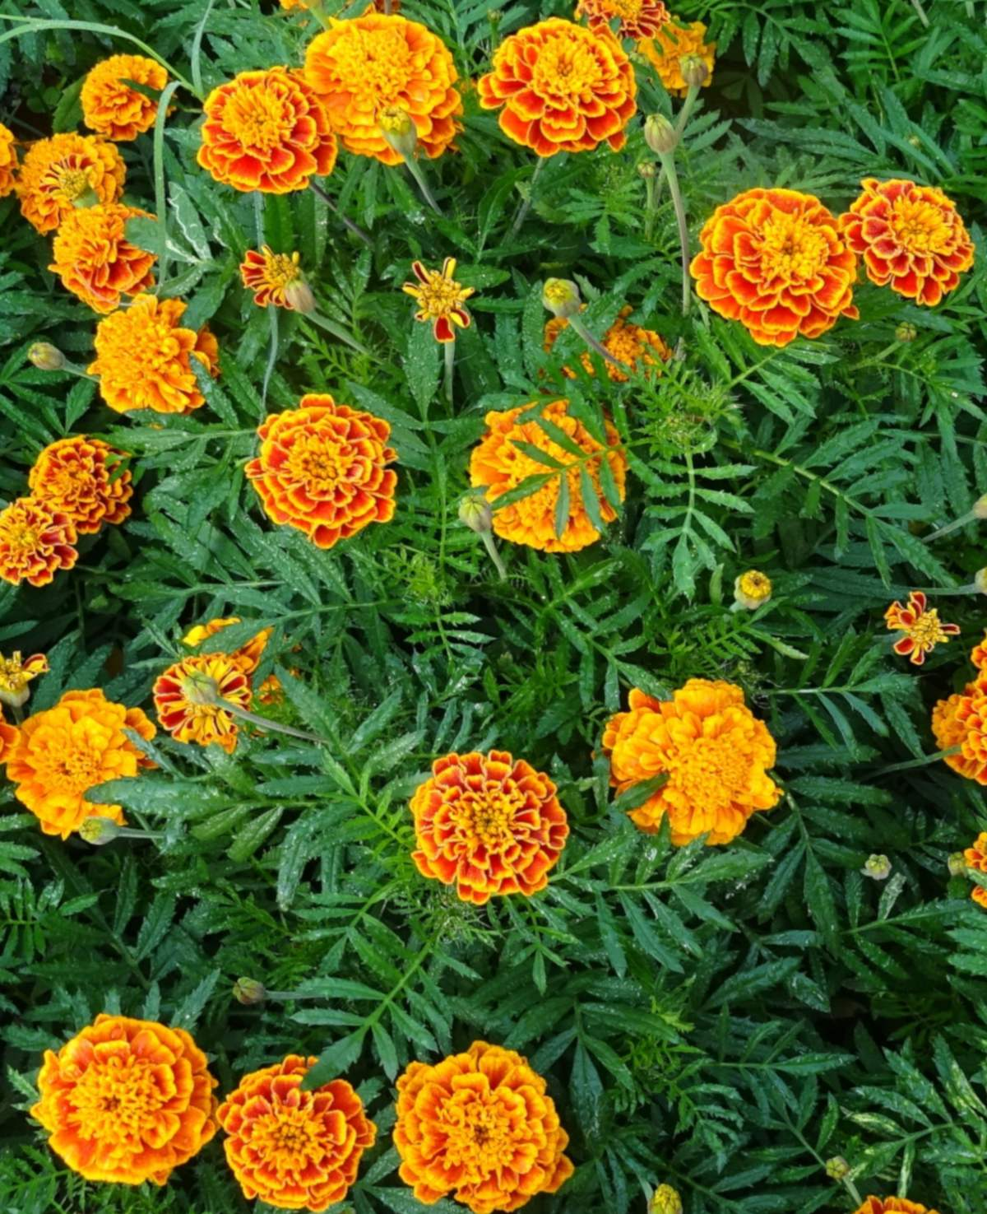
New word
Marigold
Widely cultivated yellow, orange or copper-brown flowers.

Slide 12
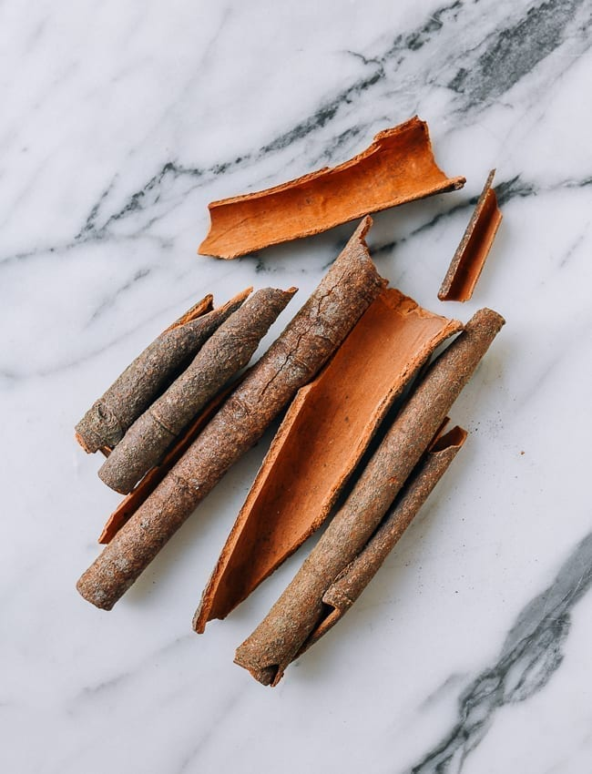
New word
Cinnamon
An aromatic spice made from the peeled, dried and rolled bark of a tree.

Slide 13
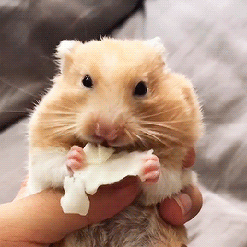
New word
Munch
Eat something with a continuous and often audible action of the jaws.

Slide 14
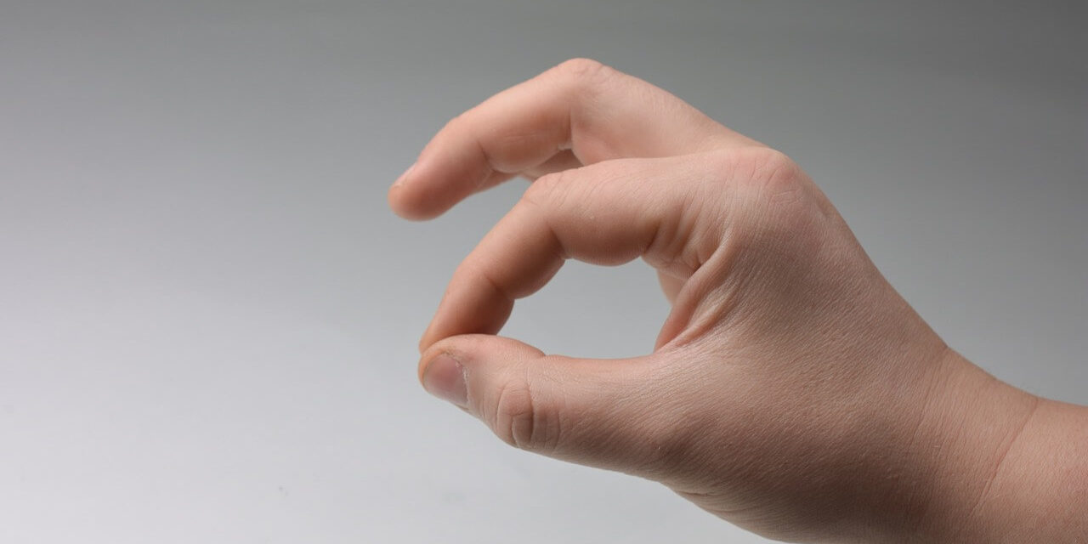
New word
Pinch
Grip something tightly between finger and thumb.

Slide 15
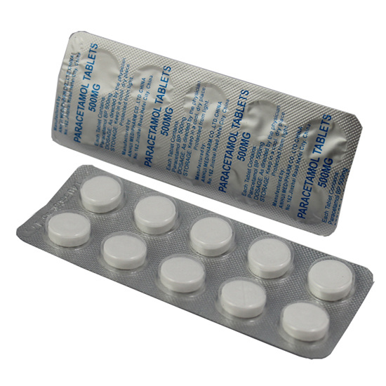
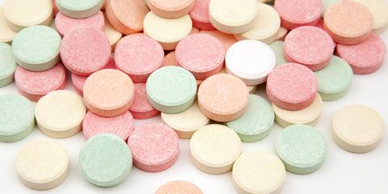
A. Look at the following pictures. Discuss with your partner what they are. Match them with their names given in the box.
Paracetamol
Holy basil/Tulsi
Antacid
Honey
Neem
Savlon
Turmeric
Aloe Vera

Slide 16
B. Read the following text.
People around the world are slowly changing their attitude towards medicine. More and more they are turning to natural cures. Natural cures are made of natural things, most often herbs and plants. History says that natural or herbal remedies are nothing new. People used them all along in different ages. Herbal medicines were used in ancient civilizations like India, China, Greece, Egypt and Rome. Some ancient treatment systems are still in practice today. They have come down through generations.

Slide 17
For a minor burn injury the doctor may prescribe you a tube of ointment. But for the same, a rural grandma may put some aloe vera or use cold water. If children have cold in our country, grandmas give them honey and tulsi leaves to eat. And it works too. If you have a minor cut or wound, grown-ups may put some turmeric, marigold or aloe vera on it. Rural people usually use garlic, neem or turmeric to cure skin problems. With experience they have seen that these remedies work. Moreover, they are easy to get, are cheap and most often are without any side effects.

Slide 18
Group work
B1. Find out the items for natural cures and chemicals. Write the names of natural cures in column A. In the column B, write the items that are chemicals.
A (Natural cures) | B (Chemicals)
Honey
Aloe vera
Savlon
Neem
Paracetamol
Tulsi
Antacid
Turmeric

Slide 19
Group work
B2. Answer the questions.
1. What are natural cures made of?
2. Are herbal cures modern inventions? Explain your reasons.
3. Which civilizations are known for herbal treatment?
4. What natural remedies are used for cold? Can you add any more natural treatment for cold?
5. What herbal cures are used for skin problems?

Slide 20
Let us see the probable answers of group work.
1. What are natural cures made of?
Answer: Natural cures are made of natural things, most often herbs and plants.
2. Are herbal cures modern inventions? Explain your reasons.
Answer: Herbal cures are not modern inventions. They are ancient. Some of the treatment systems are still in practice today. Since then we know them.
3. Which civilizations are known for herbal treatment?
Answer: Some ancient civilizations like India, China, Greece, Egypt and Rome are known for Herbal treatments.
4. What natural remedies are used for cold? Can you add any more natural treatment for cold?
Answer: The natural remedy used for cold is eating tulsi leaves with honey. I am familiar with another natural remedies used for cold and it is- taking lemon juice and honey mixed in lukewarm water.
5. What herbal cures are used for skin problems?
Answer: For skin problems, garlic, neem or turmeric are used.

Slide 21
C. Work in pairs. Complete the following expressions with words from the box.
bottle | box | can | package | tube
1. a __________ of ointment
2. a __________ of aspirin
3. a __________ of bandage
4. a __________ of foot spray
5. a __________ of tissue
tube
box
package
bottle/can
package
Now write down some sentences using these phrases.

Slide 22
D. Read the dialogue and practise it in pairs.
Pharmacist : Good morning. Can I help you?
Mr. Arman : Do you have anything for dry skin?
Pharmacist : Well, you may try this new body lotion. It’s good. Or, you can try this brand of olive oil. Olive oil is also good for dry skin.
Mr. Arman : Well, I think I’ll take the lotion. How much is it?

Slide 23
D. Work in pairs. Read the following situations and then make short conversations for each situation. Use can, could, may, should, etc. where necessary.
1. You want your teeth to be strong. Ask for a good toothpaste. Your partner will suggest or offer one.
2. Decide first what you want to buy and ask for it. Your partner does not have what you want but he/she has something similar.
3. You have slightly cut your finger. You ask for something to put on it. Your partner suggests ‘Bandaid’.
4. Your mother has a headache. You ask for medicine. Your partner gives you ‘Vicks’.

Slide 24
E. People with a cold, a fever, or the flu often go to the doctor for help. But many people in our country also use home remedies for common illnesses. Read about some simple home remedies and answer the following questions.
Cough
For children’s cough, grandmas give two tea-spoons of basil leaf/tulsi juice with one spoon of honey. It works excellent.
Some people take grape juice and honey too. It is also good for dry cough. Hot milk with honey is also useful in cough problems.
You can take ginger tea which is also a useful home remedy for cough.
Cold
Lemon juice is good for any cold because it contains vitamin C. Vitamin C increases body resistance. Lemon juice, hot water and honey together work well in healing common cold.

Slide 25
Toothache
In normal toothache, keep a clove in your mouth. Place it in between the aching teeth and suck on it. You can even apply clove oil on the affected tooth.
Garlic also cures toothache. Place a clove of garlic on the aching tooth and munch mildly. Its juice will work as a relief.
A pinch of pepper powder mixed with common salt works well on the aching tooth. It’s especially effective against the increased sensitiveness of the teeth.
Headache
Eating apples gives good result in headaches. While eating, add a little salt to it.
When headache is caused by cold winds, cinnamon works the best. Make a paste of cinnamon by mixing in water and apply it on your forehead.

Slide 26
E1. Learn these words:
ginger
আদা
cinnamon
দারুচিনি
resistance
প্রতিরোধশক্তি
sensitive
সংবেদনশীল
clove
লবঙ্গ
munch
কড়মড় করে চিবানো
garlic
রসুন
pinch
চিমটি
pepper
গোলমরিচ

Slide 27
Home work
E2. Do you know of any other home remedies that people use in our country? Ask your parents/relatives and make a list of such remedies other than the items given in your text.

Slide 28
