Slide 1
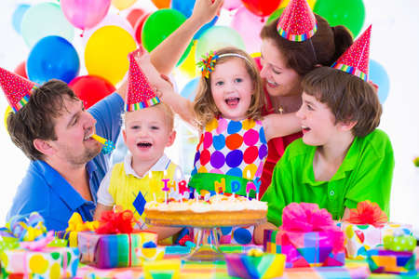
Welcome you all, dear students.

Slide 2
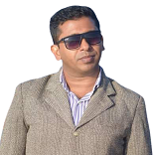
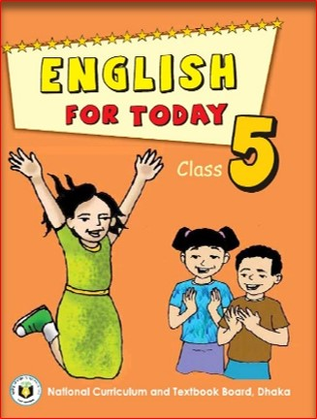
Identity
Md. Abdul Gafur,
Assistant teacher
Gaiar Bhanga G.P.S
Lalmai, Cumilla.
Unit: 15
Lesson: 1
Time: 40 minutes
Date: 9/14/2021

Slide 3
Look at the picture
Who are there in the picture?
What is written on the top of the picture?
What is happening in the picture?
What can you see in the picture?

Slide 4
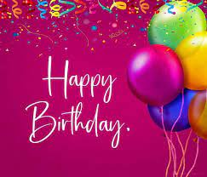
Our Today’s lesson is-
Happy Birthday

Slide 5
Learning outcomes
Students will be able to:
Listening: 3.3.1 understand question about objects around them.
Speaking: 6.2.1 talk about people, objects, events etc.
Reading: 1.7.1 read paragraphs, dialogues, stories, letters and others texts.

Slide 6
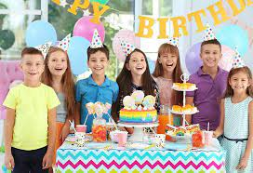
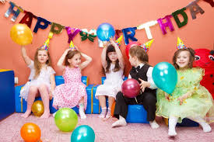
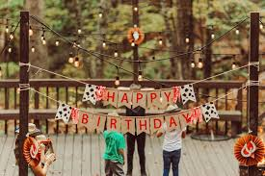
What do you see in the picture?
People around the world celebrate birthdays in different ways.

Slide 7
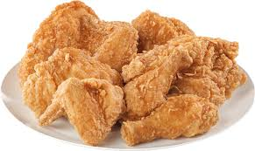
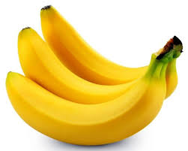
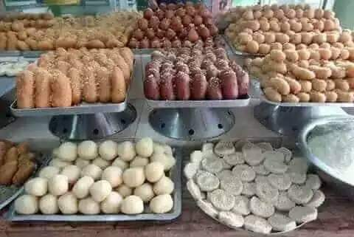
What do you see in the picture?
A birthday party arrange special foods, like sweets.

Slide 8
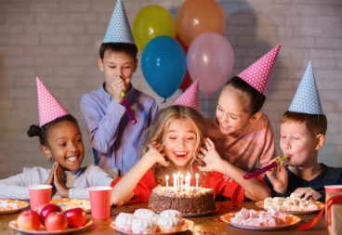
Individual Work
a) Do people around the world celebrate birthday in the same way?

Slide 9
Key words/new words
Try to tell the meaning of the word then follow the picture and match the meaning. Make a sentence with the main word.

Slide 10
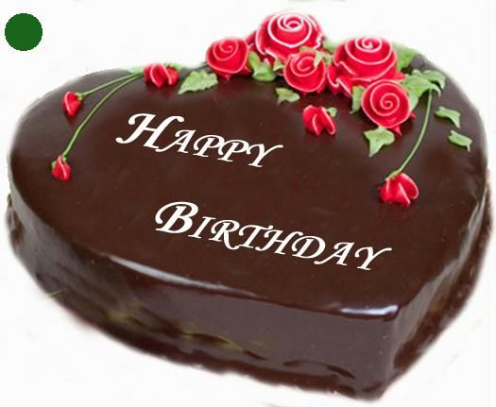
Cake
Meaning
An item of sweet food.
In many countries, people birthday celebrate with a cake.

Slide 11
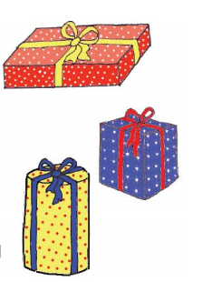
Gift
Meaning
A thing given to someone without payment.
The gift may be a toy, a book or some clothes.

Slide 12
Celebrate
Meaning
Acknowledge with a social gathering.
People around the world celebrate birthdays in different ways.

Slide 13
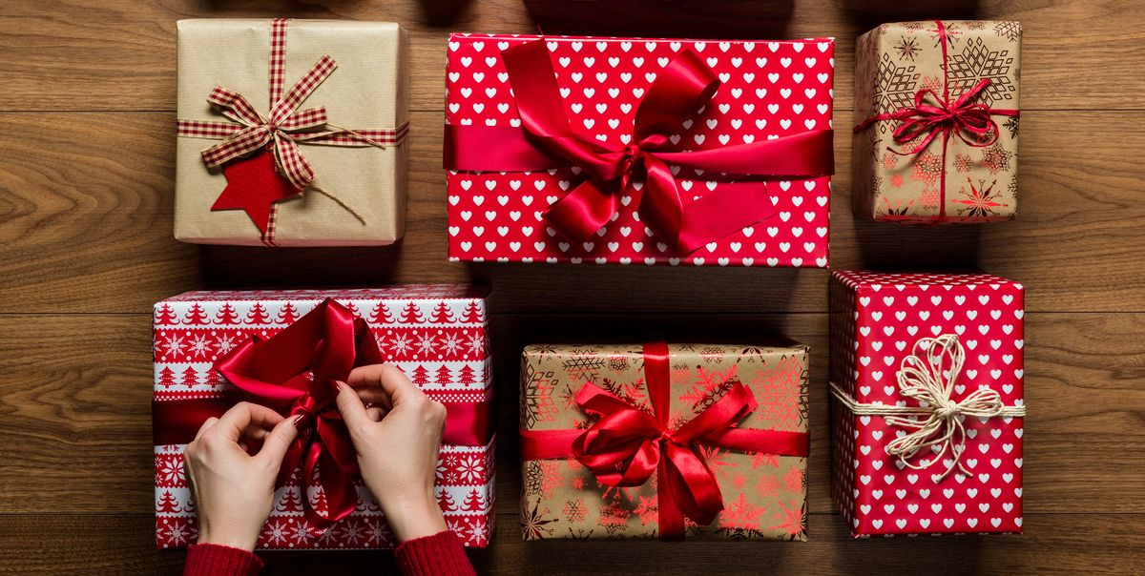
Wrap
Meaning
Cover in paper.
The gift are wrapped in colourful paper.

Slide 14
Pair Work
1. How many candles are put on the cake?

Slide 15
Teacher’s Reading
Please, open your book at page 58. Listen to me carefully and put your finger under the line.From, “A person’s birthday ………..friends and family.”

Slide 16
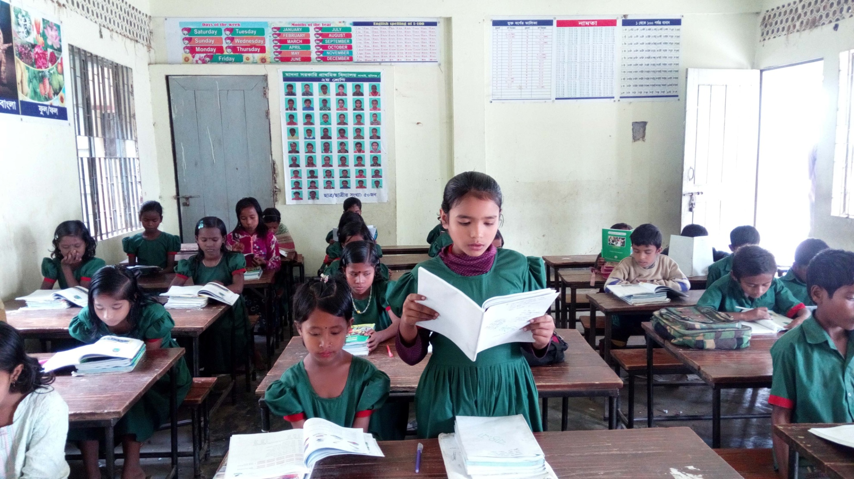
Student’s Reading

Slide 17
Students are divided into three grops.
Every group have to do the same work.
Group Work
Write True or False.
a) A birthday is the date when the person was born.
b) People celebrate their birthday only with candle.
c)The birthday gifts are usually wrapped in colourful paper.
d) The guests blows out the candles on birthday.
e) We sing the birthday song for the person on his birthday.
f) Gifts are the most important things for celebrating a birthday.
True
False
True
False
True
False

Slide 18
Fill in the blanks with the given words:
Evaluation
special, cake, candles, friends, food, celebrate, different, people.
a)There are candles on the ……. .
b)There is special …….., like sweets.
c) A person’s birthday is a ……… day.
d) The persons blows out the ……….. .
e) The child’s …………. come to the home.
cake
food
special
candles
friends

Slide 19
Home work
What did you learn from the lesson? Write in 5 sentences.

Slide 20
Goodbye

