Slide 1
Welcome
to this
class

Slide 2
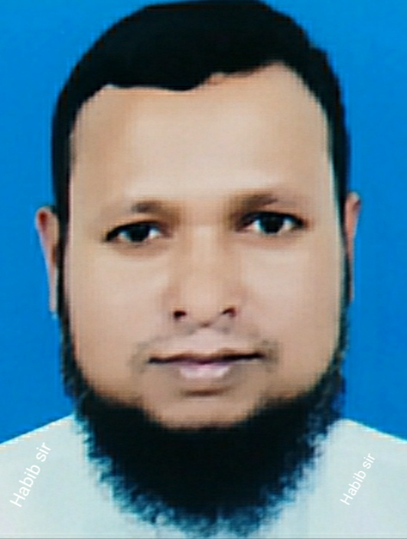
INTRODUCTION
Class: Eight
Sub:English
First-paper
Unit-3..Lesson-8
MD. Habibur Rahman
Assistant teacher
Tilsindur Dakhil Madrasah
Barhatta-Netrakona
habib523277@gmail.com

Slide 3
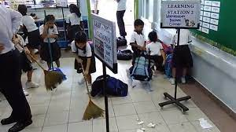
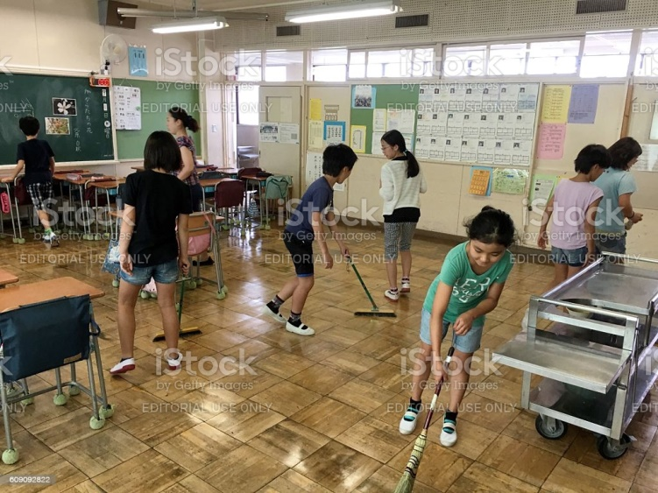
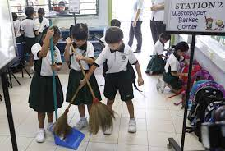
LOOK AT THE PICTURES
You said the pictures matched any text in your textbook

Slide 4
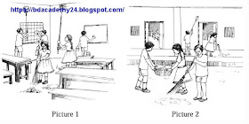
What are the students doing in the picture 1
What are the students doing in the picture 2

Slide 5
Today’s topic is…..
Making
a class
commitee
Unit—3
Lesson--8

Slide 6
Learning Outcomes
After this lesson the students will be able to-
read and understand text through silent reading
Be able to get acquainted with some new words.
choose the best answers from the alternatives.
ask and answer questions.

Slide 7
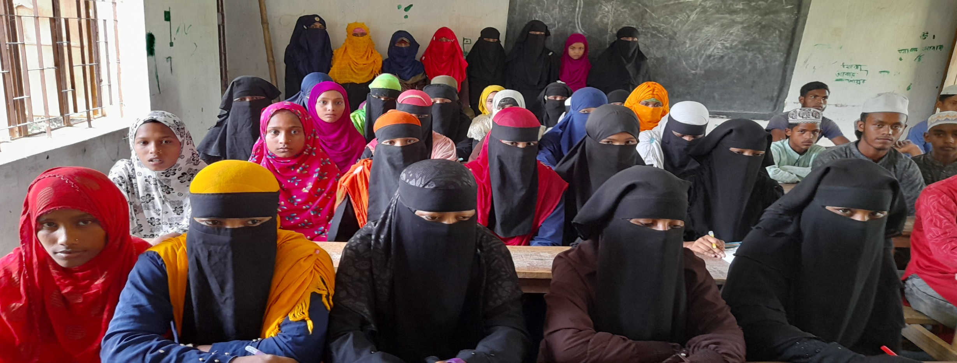
Silent reading…..
Dear learners open your text book and read the text carefully
in 5 minutes to your text book.

Slide 8
Key words….
Dirty
nasty
gently
politely
neat and clean
Tidy

Slide 9
Sugesst
advise
A few
Several
rubbish
Trash

Slide 10
Group work
Dear students,
ask the semantics to each other
in groups of 4 and clarify
the pronunciation of the lesson.

Slide 11
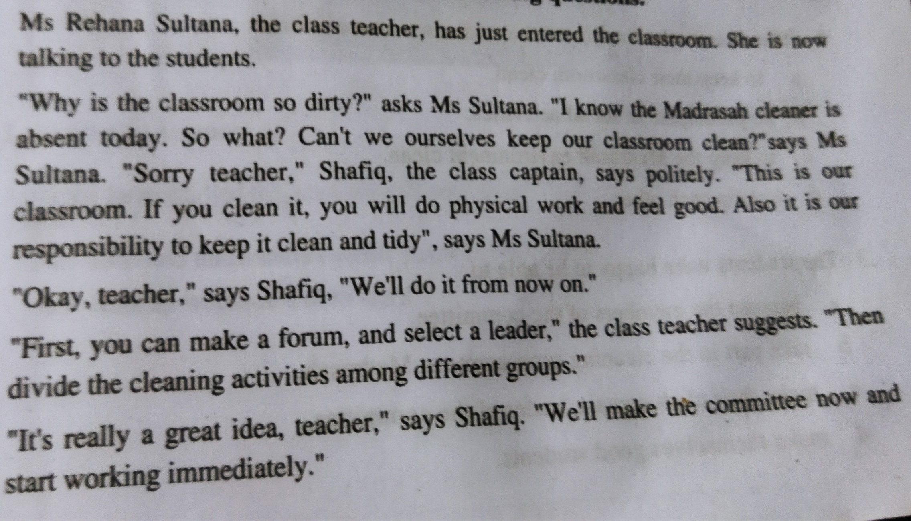
Look at the text....

Slide 12
Individual work
1.Ms Rehana Sultana is------
a) a Math teacher b) a class teacher
c) ) an English teacher d) a science teacher
2.The class teacher suggested the students to make a forum--
a) to keep their classroom clean b) to keep road clean
c) to practice in social activitiies d) to help each other
3.The students can keep the classroom---
a) clean b) untidy
c) dirty d) unhygienic
√
√
√

Slide 13
4. The students were happy to be able to----
a) become the members of the committe
b) take part in the cleaning programme at Madrasah
c) make their class captain leader of the commitee
d) make themselves useful
5. Shafiq bahaves with his teachers -------
a) rudely b) roughly
c) harshly d) politely
6. Politely means ------
a) rudely b) gently
c) harshly d) happily
7. The words ‘select’ refers to—
a) chose b) identity c) consider d) confirm
√
√
√
√

Slide 14
The teacher is talking with students about responsibiliy of students.

Slide 15
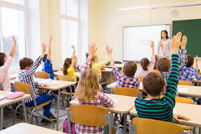
The teacher is suggests to students about forum .

Slide 16
Evaluation…
Who is the class teacher?
2. How was the classroom?
3. Who was the class captain?
Ms Rehana Sultana is the class teacher.
The classroom was dirty..
Shafiq is the class captain..

Slide 17
4. What is the responsibility of the students?
5. What does Ms Rehana Sultana suggest?
It is the responsibility of the students to keep the classroom clean and tidy..
Ms. Rehana Sultana suggests that they can make a forum select a leader first.

Slide 18
Home Work
Make a few rules to keep the classroom clean

Slide 19
Thanks all

