Slide 1
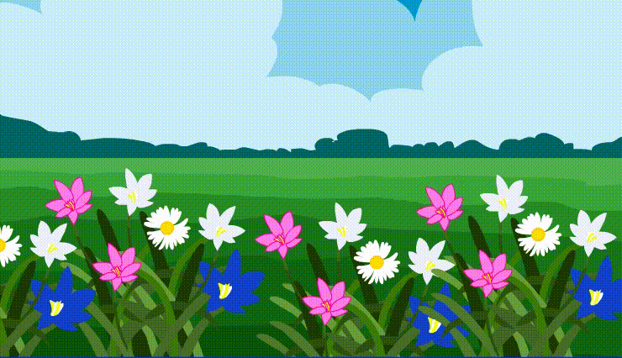
Welcome

Slide 2
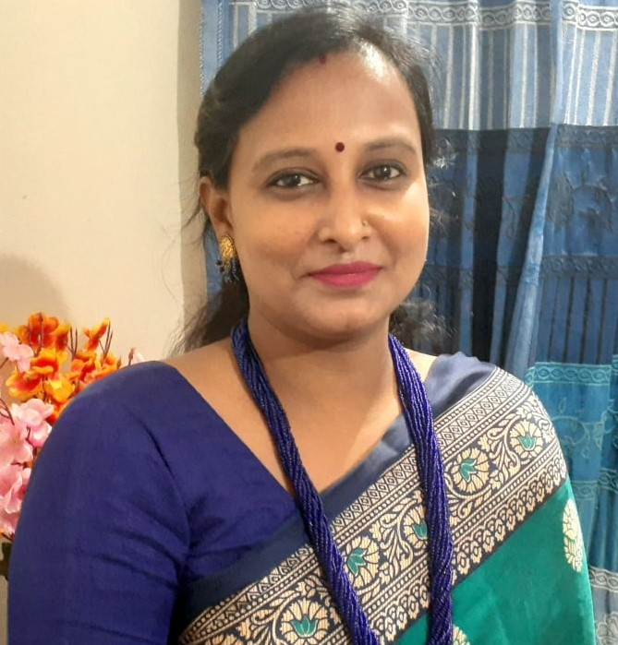
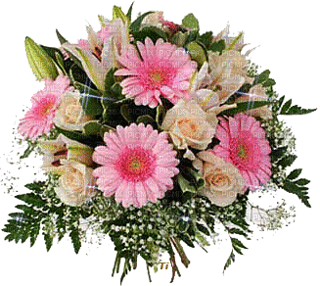
Presented By
Moly Rani Dey
Assistant Teacher
Mirkumully Govt. Primary School,
Delduar ,Tangail.

Slide 3
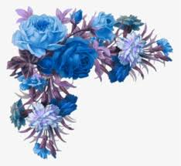
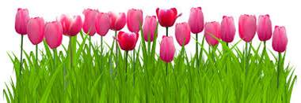
Lesson
Class: Three
Subject :English
Unit:28
Lessons:1-2

Slide 4
Lets see the video
https://www.youtube.com/watch?v=XwFuyCaStxg

Slide 5
Let’s learn about another such tale
We watched that one should be happy with what one has

Slide 6
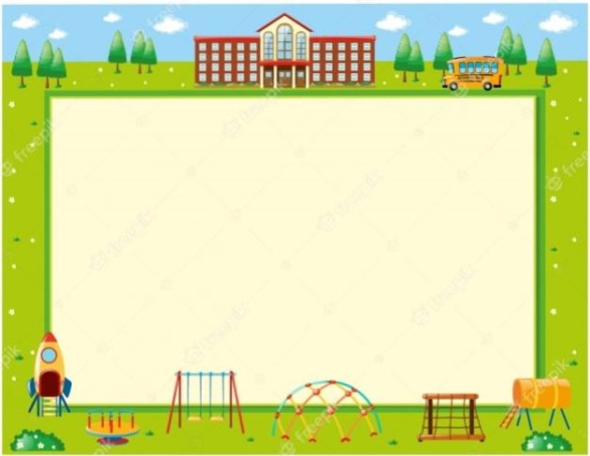
Today we will learn
The cow and the frog

Slide 7
Learning Outcomes
Students will be able to
Listening
4.3.1 enjoy and understand simple stories.
Reading
5.1.2 read simple stories.

Slide 8
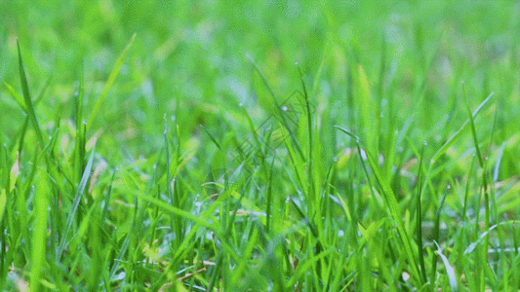
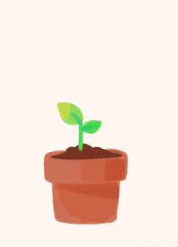
Word meaning
grass
a common wild plant
sit
to rest your weight on your bottom
grow
to become bigger

Slide 9
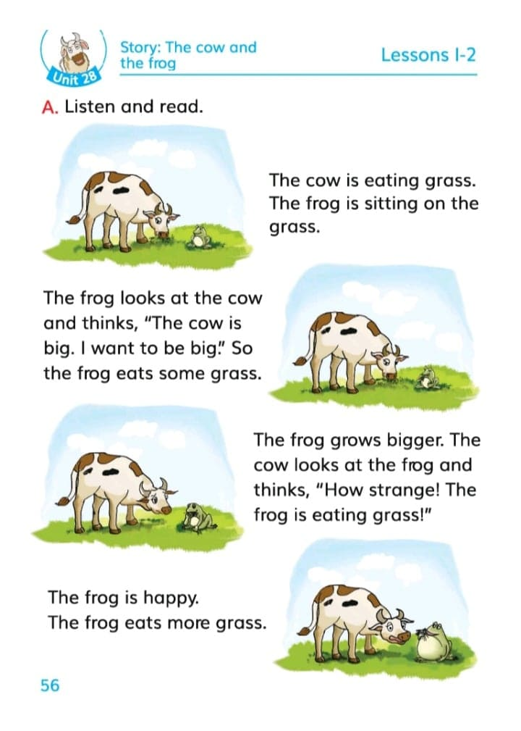
56 page

Slide 10
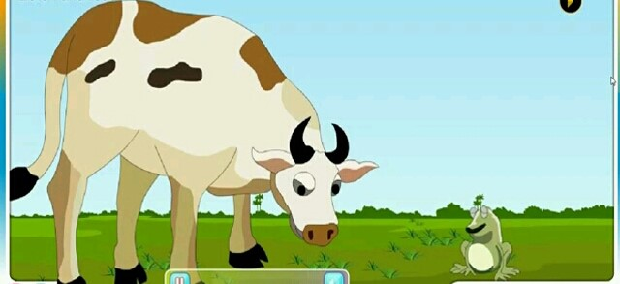
What does a cow eat?
Grass
What can you understand from this image?

Slide 11
Listen attentively

Slide 12
The frog looks at the cow and thinks, “The cow is big. I want to be big”. So the frog eats some grass.
The frog is happy.
The frog eats more grass.
The frog grows bigger. The cow looks at the frog and thinks, “how strange! The frog is eating grass!
The cow is eating grass.
The frog is sitting on the grass.

Slide 13
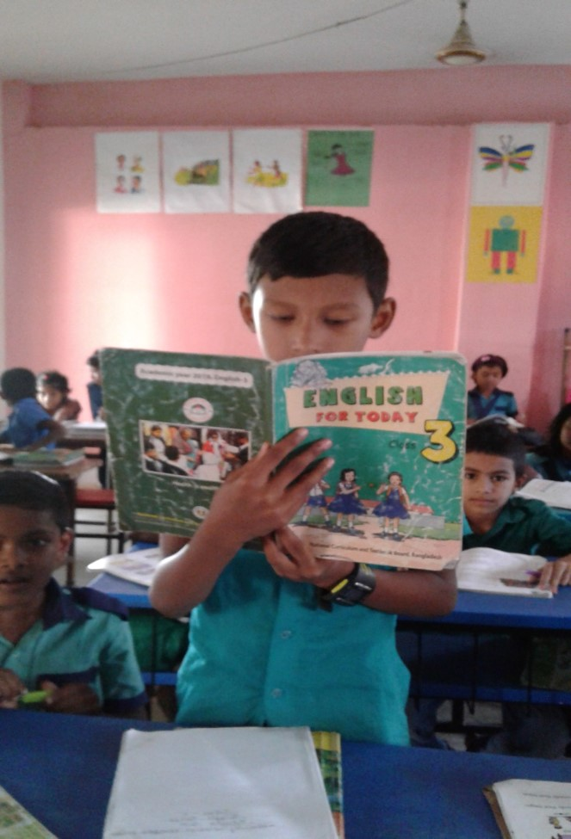
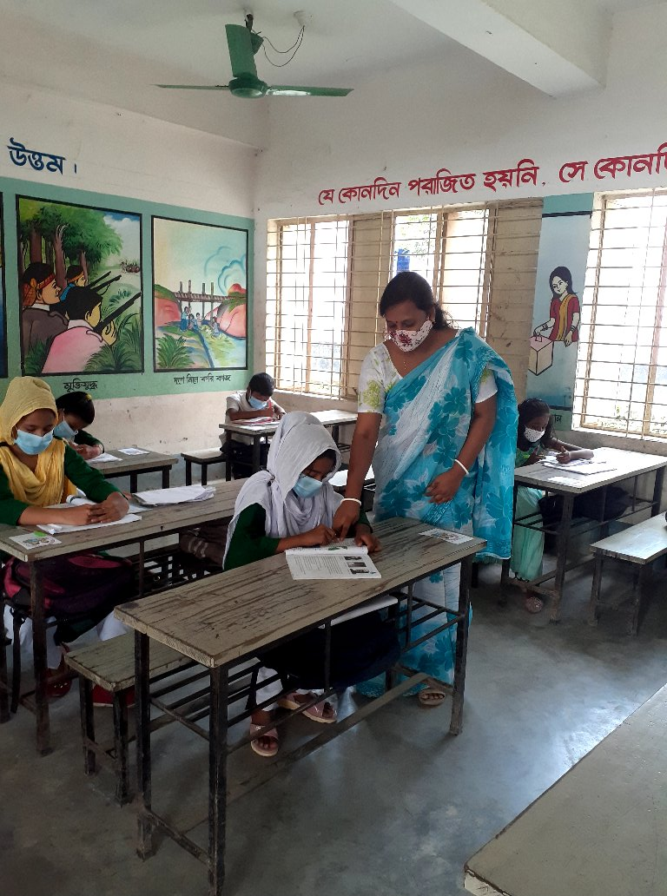
Students, Read loudly

Slide 14
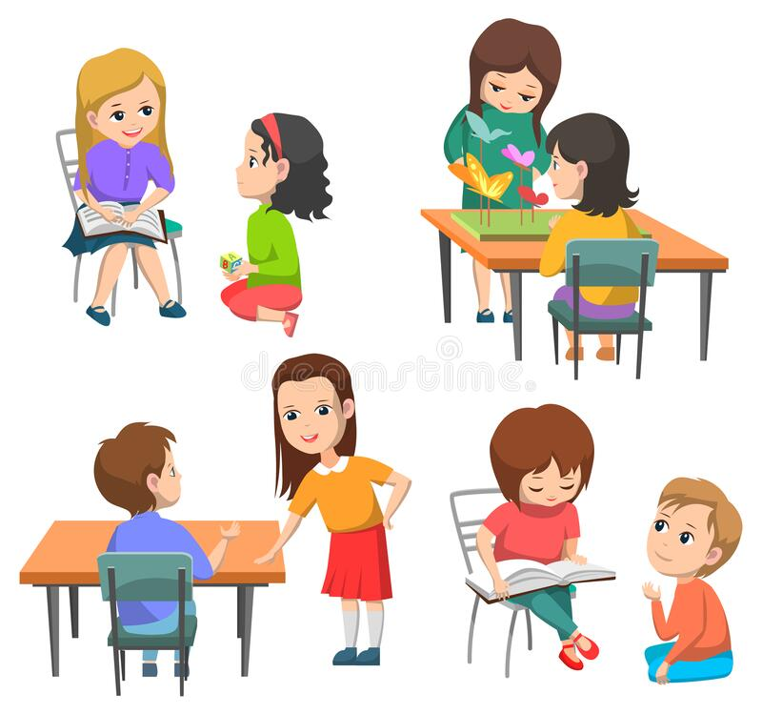
Pair work

Slide 15
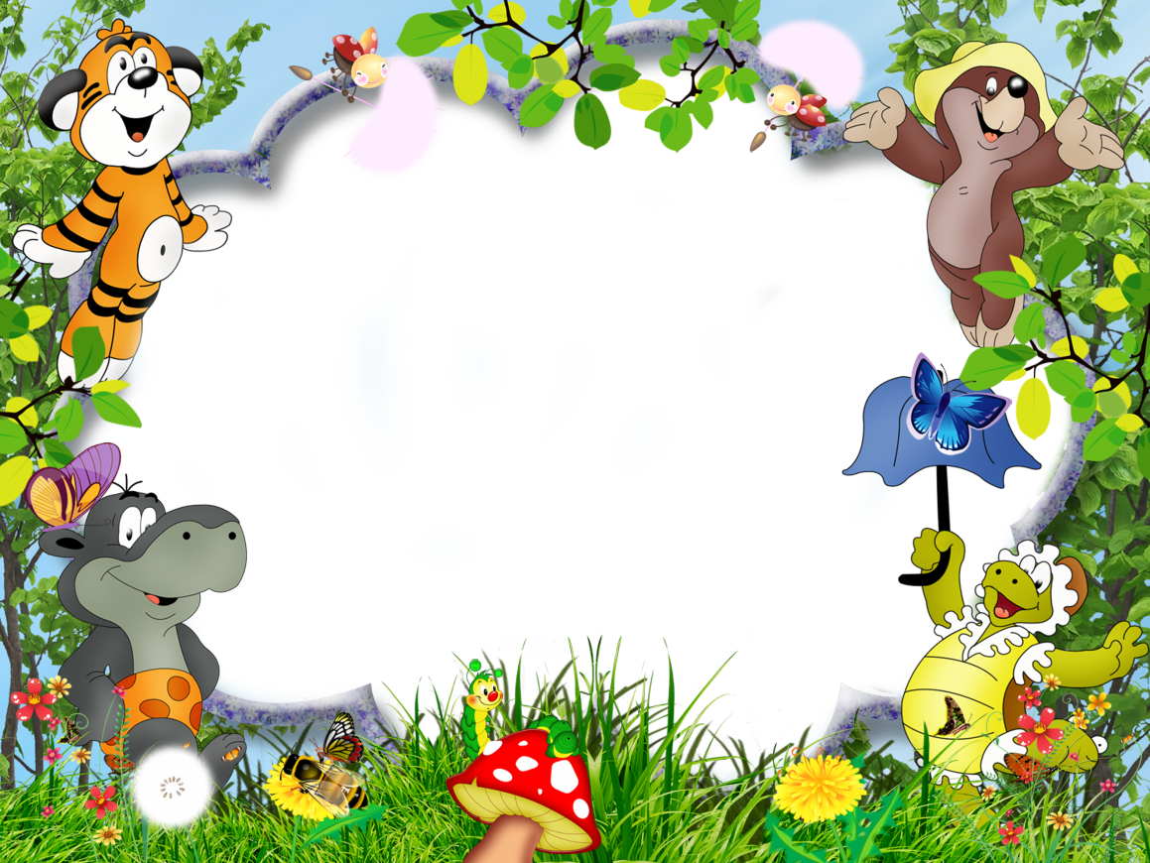
Reading in
Chains

Slide 16
Choose the right answers.
The cow is eating ______.
bread b. tomato
c. potato d. grass
2. What does the frog want to be?
a. small b. big
c. very small d. very big
3. The frog is ______.
a. satisfied b. pleased
c. happy d. cheerful
Group work

Slide 17
Find out true/false
1
The cow is eating meat.
False
2
The frog is sitting on the grass.
True
3
The cow is small.
False
4
The frog is happy.
True

Slide 18
Answer the following questions
1
Where is the frog sitting?
2
What does the cow think?
3
What does the frog eat?

Slide 19
Fill in the blanks:
away
sitting
away
eating
is
sitting
grows
is
grows
eating
The frog is ______ on the grass.
The frog _____ bigger.
The cow is _____ grass.
The frog ____ happy.
The frog is flying _____ .

Slide 20
Match the words in of the column ‘A’ with their meaning in column ‘B’.
Evaluation
Column ‘A’ | Column ‘B’
a. grass | i. feeling pleasure
b. grow | ii. a small animal with smooth skin
c happy | iii. to rest your weight on your bottom
d. frog | iv. a common wild plant
e. sit | v. to increase in size, number strength or quality
 | vi. not quick to do something.

Slide 21
Home work
Make sentences of your own with the following words:
Big
Small
Eat
Sit

Slide 22
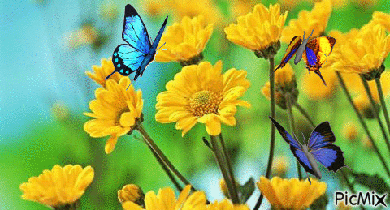
Bye Bye
Thank you

