Slide 1
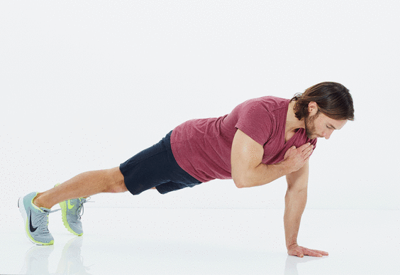
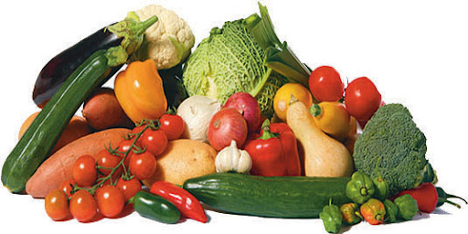
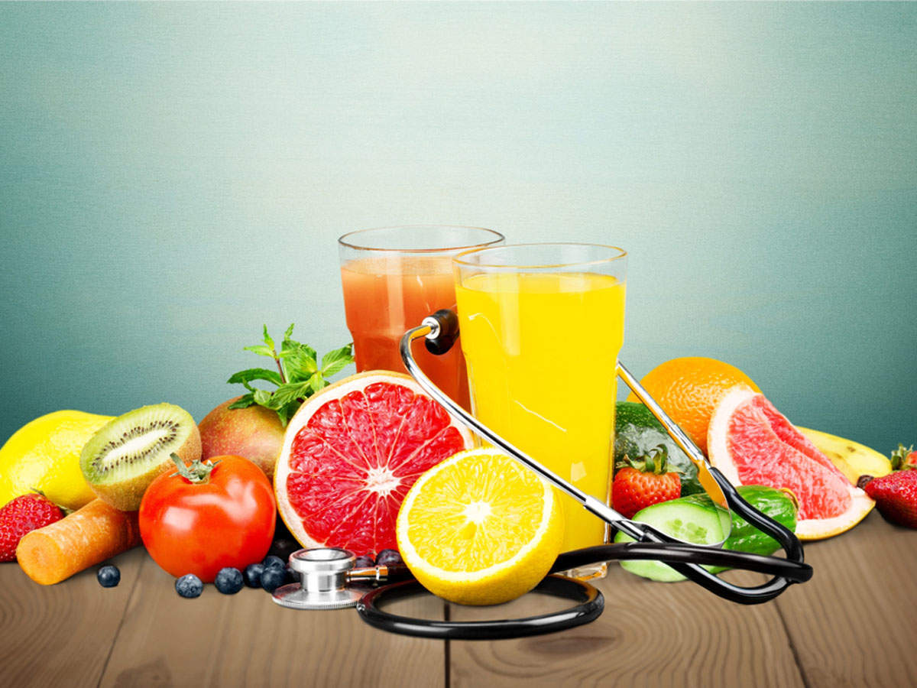
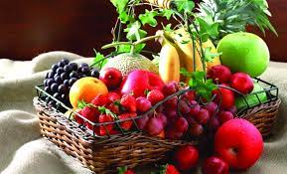

Slide 2
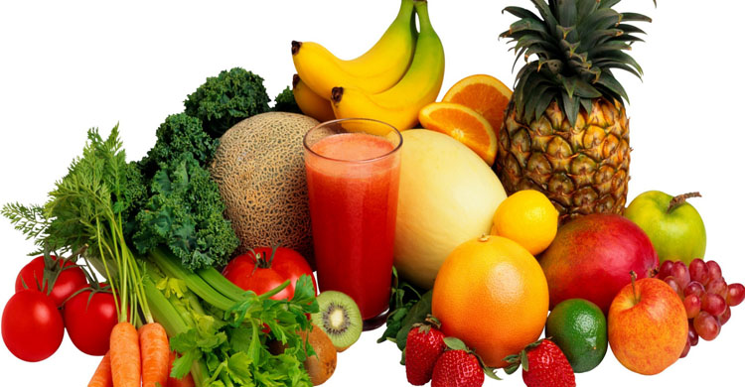
Welcome

Slide 3
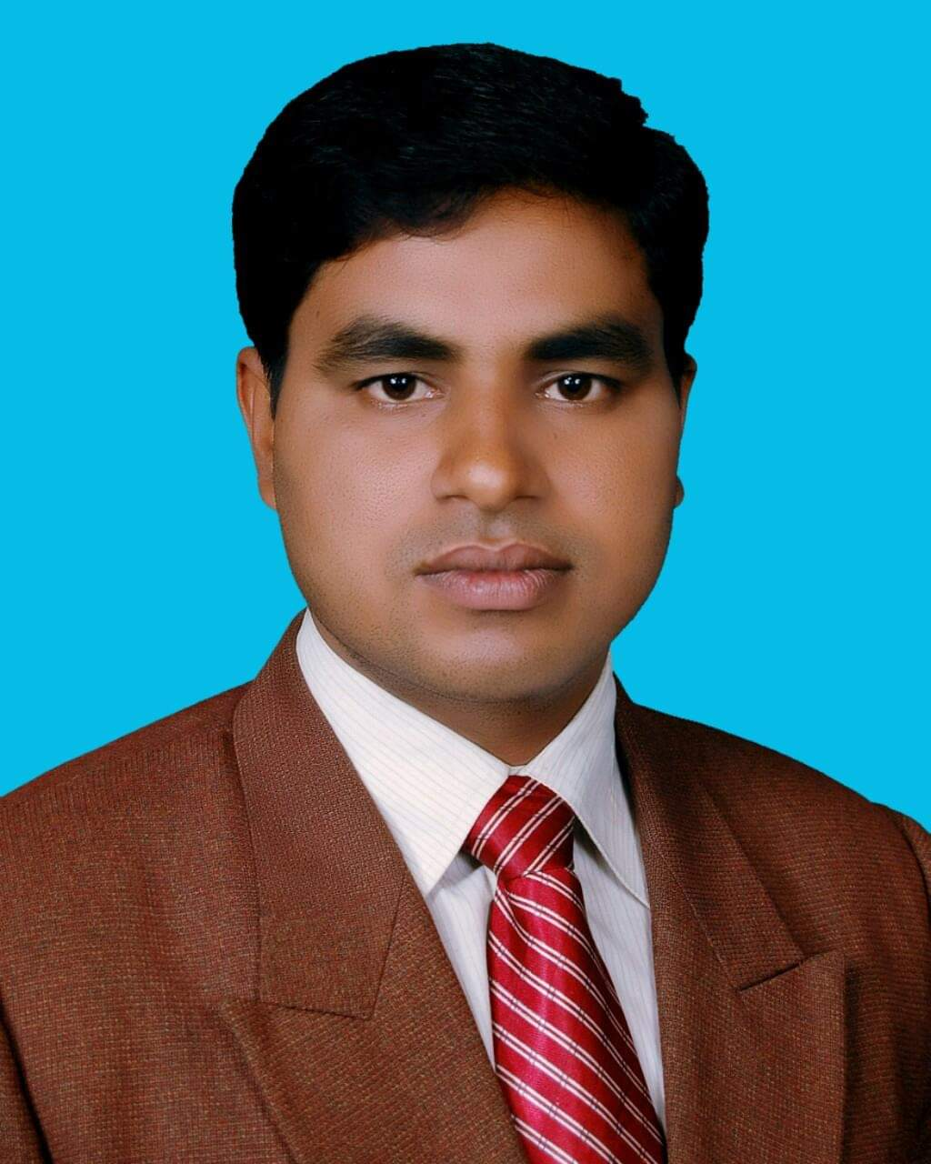
Identity
Md. Noor –E- Alam Siddiki
Asstt. Teacher
Nageswari Keramatia M.L High School.
Mobile- 01716962418
Email- nooralam.na35@gmail.com
Unit -2, Lesson 2

Slide 4
Let’s see a video.
What is the video about?
About our daily diet.

Slide 5
Today’s class title is
Our daily diet
Unit 2, Lesson 3

Slide 6
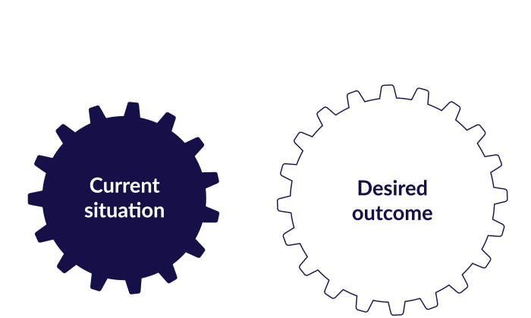
After studied the lesson , students will be able to …
Tell about our daily diet.
make questions .
answer questions.
choose the best answers.

Slide 7
Let’s know some new words
Essential
absolutely necessary; extremely important.
a thing that is absolutely necessary.
Water is essential for our body.

Slide 8
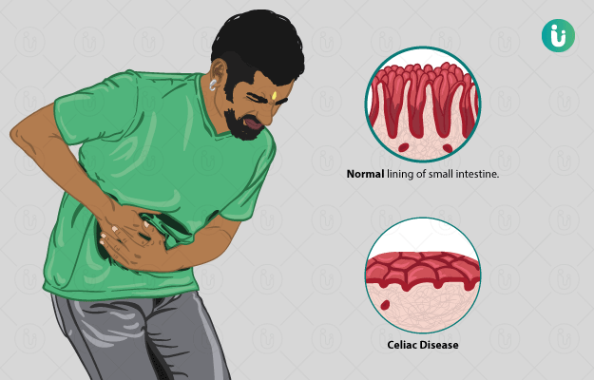
Disease
a disorder of structure or function in a human, animal, or plant, especially one that produces specific symptoms or that affects a specific location and is not simply a direct result of physical injury.
Vitamins and Minerals keep our body free from disease.

Slide 9
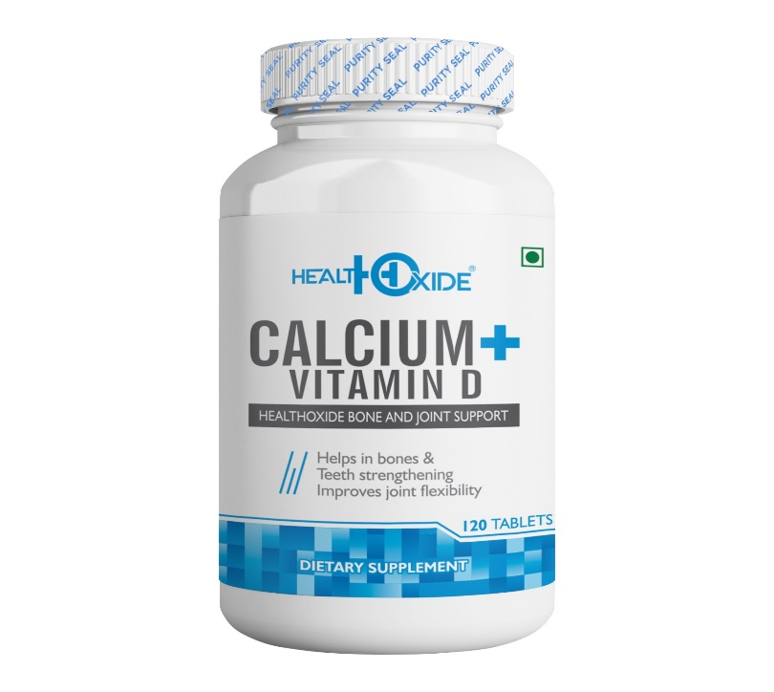
Calcium
Calcium is a mineral that is necessary for life. About 99% of the calcium in our bodies is in our bones and teeth.
Calcium enables our blood to clot, our muscles to contract, and our heart to beat.

Slide 10
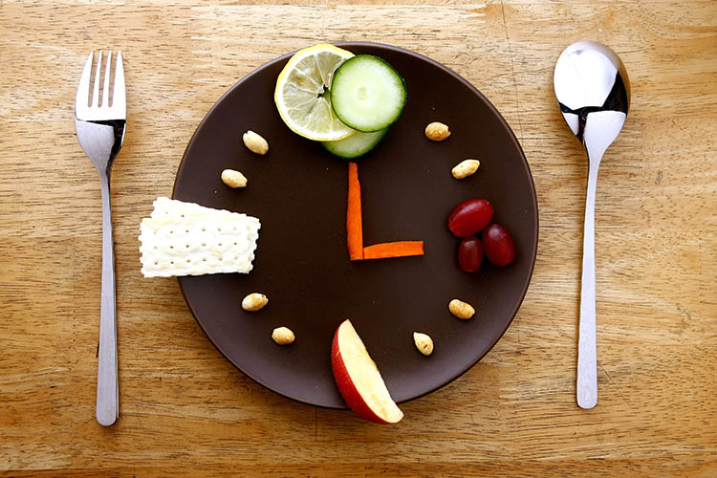
Interval
a period of time between events or states.
a space between things Signs were posted at regular intervals.
the difference in pitch between two tones.
We must take food at regular intervals.

Slide 11
A read the dialogue silently

Slide 12
Group work
Make five questions from the following tables.
Why
essential for our body.
do
good for our skin.
What
are
is
we need to eat good food.
What foods
vegetables contain ?
mineral do to us.

Slide 13
Match your answer
1. Why do we need to eat food food?
2. What foods are essential for our body?
3.What do minerals do to us?
4. What do vegetables contain?
5. What foods are good for our skin?

Slide 14
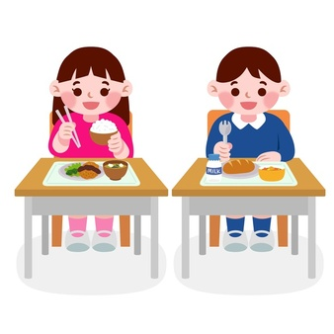
Pair work
C Now write the answers to the questions that you have made in section B.

Slide 15
Match your answer
1. We need to eat good food because good foods help us to keep healthy.
2. Water is essential for our body.
3. Minerals keep our body free from diseases.
4. Vegetables contain vitamins and Minerals.
5. Vegetables and fruits are good for our skin.

Slide 16
Individual work
Read the text in section A again and tick the best answer.
1. Milk is highly rich in fat/calcium/sugar.
2. Fruits and vegetables are good for eyes/ general health/ teeth.
3. Water/ energy drink / milk is most important for our life.

Slide 17
Match your answer
1. Milk is highly rich in fat/calcium/sugar.
2. Fruits and vegetables are good for eyes/ general health/ teeth.
3. Water/ energy drink / milk is most important for our life.

Slide 18
Evaluation
How often do we have to drink water?

Slide 19
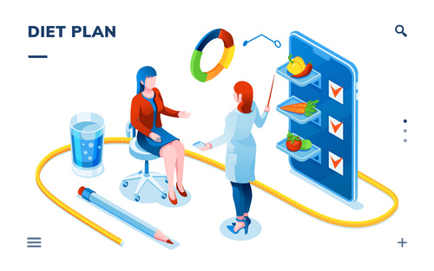
Good bye

