Slide 3
Introduction

Slide 4
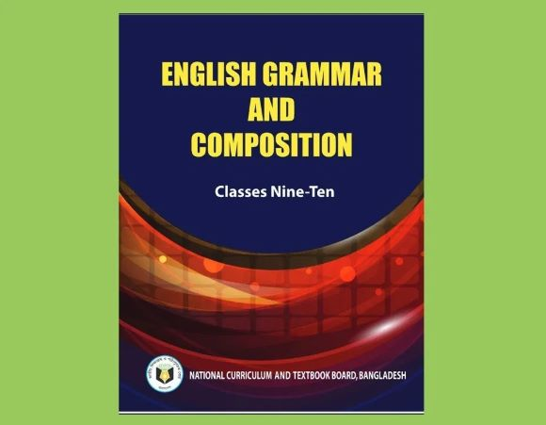
Lesson’s Identity
Class IX-X
English 2nd Paper
Tense

Slide 5
What do we see?
She writes an E-mail.
She wrote an E-mail.
She will write an E-mail.
a) Which time indicates 3 sentences ?
b) What is called the total action of time ?

Slide 6
Learning outcomes
After studied this lesson, we will be able to---
define tense
know the three main tenses & their uses.
Asked & answered the questions.
to identify 12 structure of tenses & apply it.
Notes:
Target to achieve from this lesson.

Slide 7
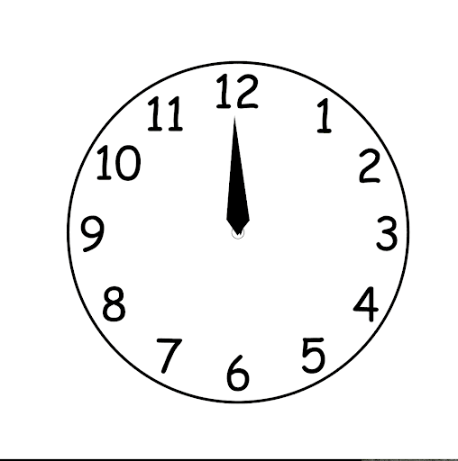
What does “Tense” do ?
Tense shows time.
Past Present Future

Slide 8
Main classification of tense
PRESENT
He reads a book.
I go to school.
PAST
Jalal was a farmer.
He worked very hard.
FUTURE
I shall go tomorrow.
She will go to school.
TENSE

Slide 9
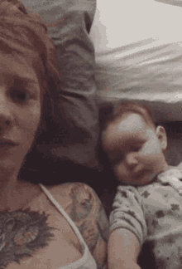
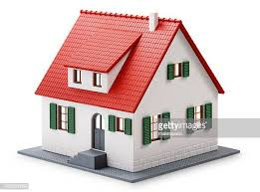
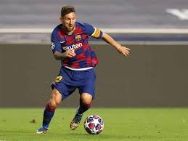
Example of tense
☞ Mother loves her child.
(Present Tense: Describe an action of present time.)
Structure: S + V+ s/es + O
☞ I made a home.
(Past Tense: Describe an action of past time.)
Structure: S + V2 + O
☞ He will play football.
(Future Tense: Describe an action of future time.)
Structure: S + V + Shall/Will + O

Slide 10
Structure of Tenses

Slide 12
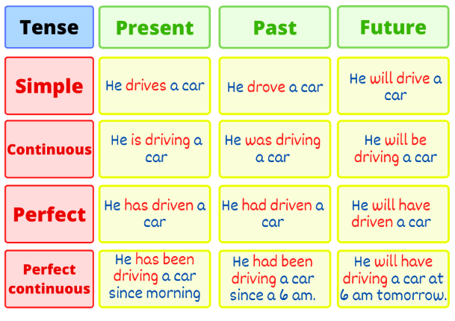
More Example

Slide 13
Read the passage than answer the questions
Pair work
 Rassel is in class nine. Last year he was in class eight. Next year he will be in class ten. He wants to prosper in life.
a) How many sentences in the passage belong to present tense ?
b) Which sentence is past tense ?
c) Which sentence is future tense ?
Answer: a) Two sentences.
b) Last year he was in class eight.
c) Next year he will be in class ten.
Notes:
D

Slide 14
Team work
Fill in the gaps using right form of verbs in the box.
grow | to be | work | get | hope
use | know | believe | think | to use
Imran a)...... a farmer. He b).…very hard. He c)…... fertile land on which he d)…. different crops. He e) …....how to f)….fertilizer. Last year he g)...the award of the best farmer in the village. The villagers h)…..that he will get the same award this year too. But Imran i)…..to become the best farmer in the district. He j)…..that diligence is the mother of good luck.
a)is b)works c)uses d) grows e) knew f) use g) got h) hope i) thought j) believes

Slide 15
INDIVIDUAL WORK
Follow & answer the questions
Ans: a) takes

Slide 16
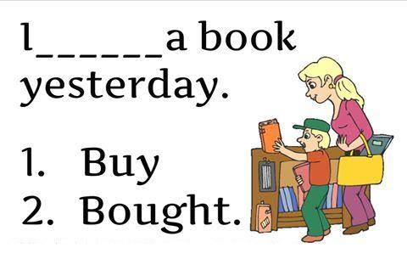
Which option is correct & which tense ?

Slide 17
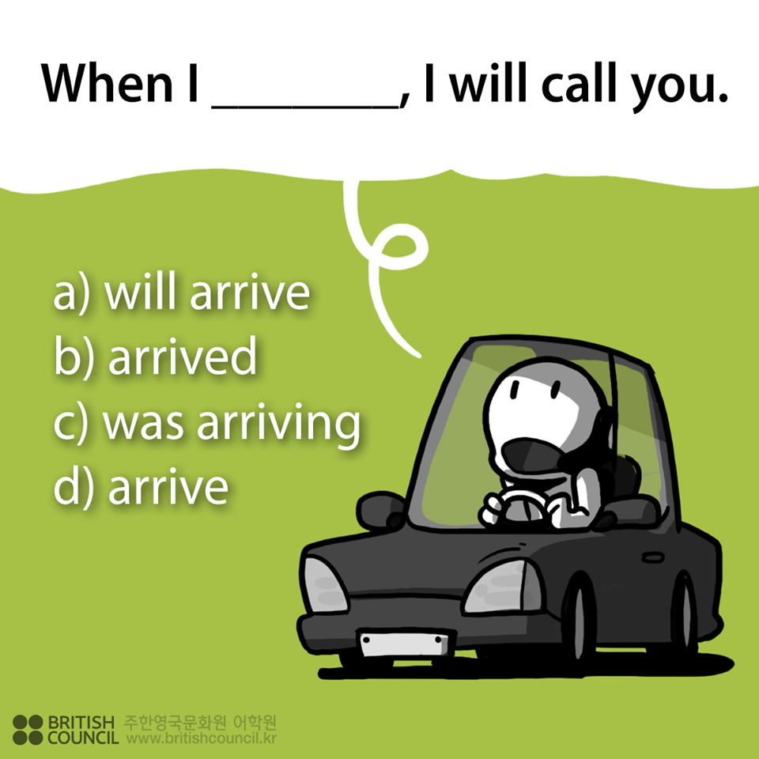
Ans: a) will arrive

Slide 18
Evaluation: (Find out which tense ?)
a) Nowrin sang a song.
b) She visited our house.
c) Aristatle is a scientist.
d) The boy went to school.
e) He will arrive home.
Past tense
Past tense
Present tense
Past tense
Future tense
Notes:
re

Slide 19
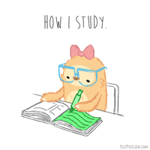
Homework
Make meaningful 12 sentences using present, past & future tense.

