Slide 1
Welcome

Slide 2
Teacher’s Introduction

Slide 3
Lesson Identity
Class : Five
Subject : English
Lesson :2-3
Unit:6
Activity : D,E
Time : 40 min
A
e
r
G

Slide 4
Learning Outcomes
Student’s will be able to-
Listening:3.4.1-understand statement made by teacher and students.
Speaking:1.1.1-say words and phrases and sentences with proper sounds and stress.
Reading:1.7.1-read words and phrases and sentences with proper pronunciation, stress and intonation.

Slide 5
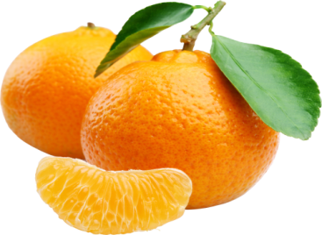
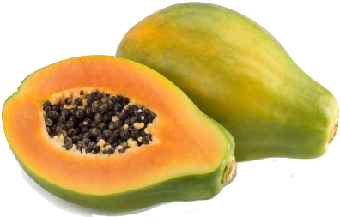
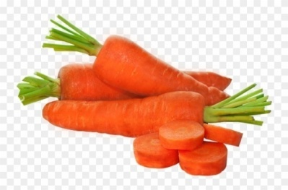
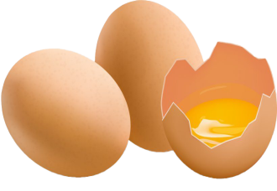
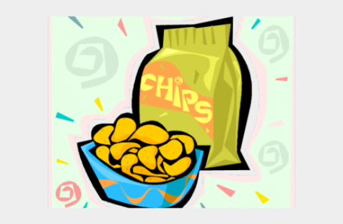
What food you like most?
I like to eat chips and ice-cream most.

Slide 6
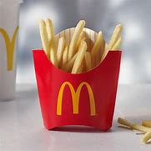
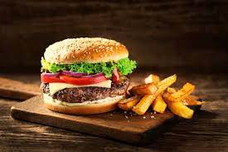
Tell the name of some unhealthy food.

Slide 7
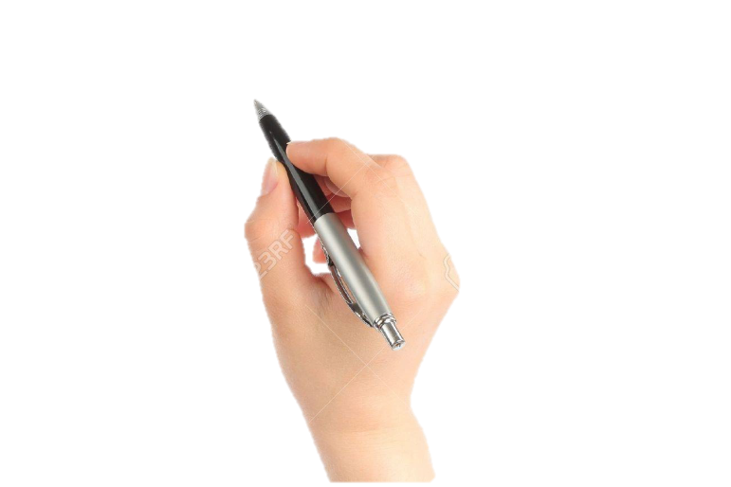
Lesson declaration
Our todays lesson is Eat healthy

Slide 8
fat
grain
New word
dairy
bean
lentil

Slide 9
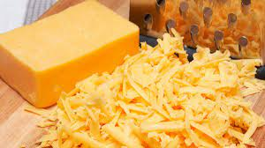
fat
lard
Fat and oil make food delicious.

Slide 10
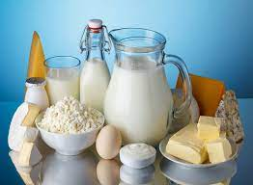
dairy
Made from milk.
Dairy products help our teeth and bones.

Slide 11
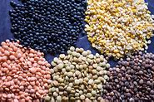
A high protein pulse that is dried then soaked and cooked before eating.
lentil
He likes to eat lentils.

Slide 12
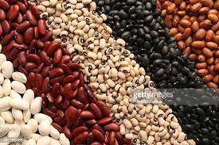
An edible seed growing in a long podson lsguminous plant.
bean
He likes to eat beans.

Slide 13
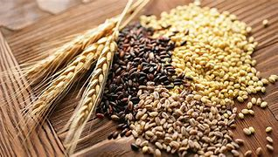
grain
crop
He likes to eat fries.

Slide 14
Teacher’s Reading

Slide 15
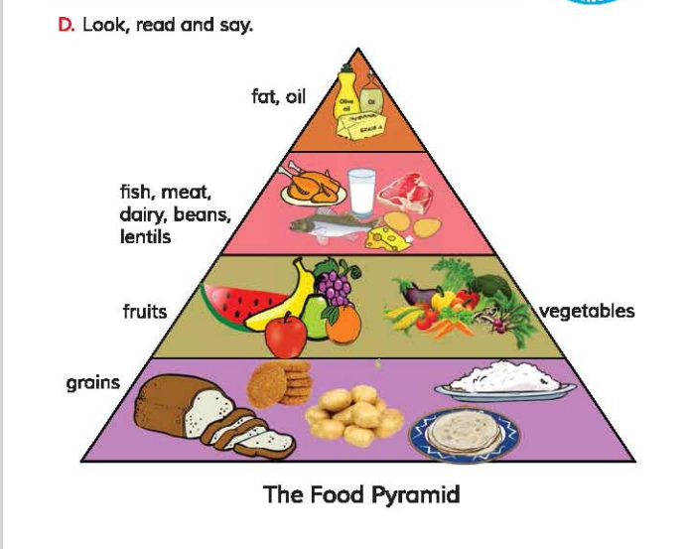
Open your book at page 23.

Slide 16
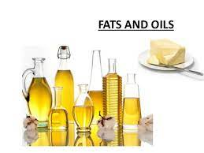
What food are at the top of the pyramid ?

Slide 17
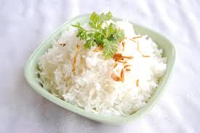
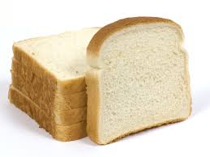
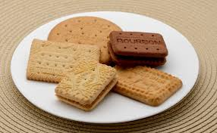
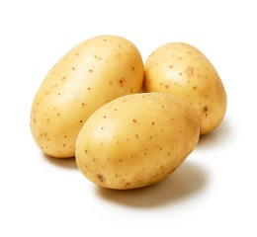
What food are at the bottom of the pyramid ?
grains

Slide 18
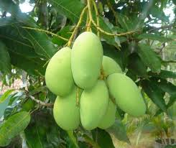
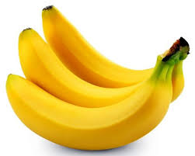
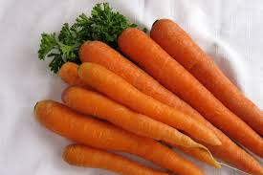
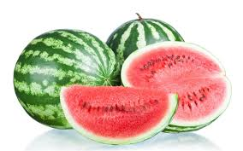
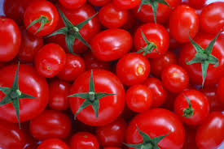
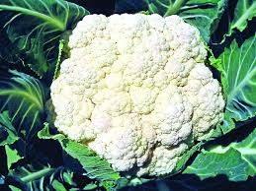
What food are at the second step of the pyramid ?
Fruits and vegetables

Slide 19
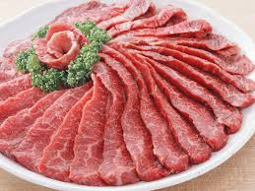
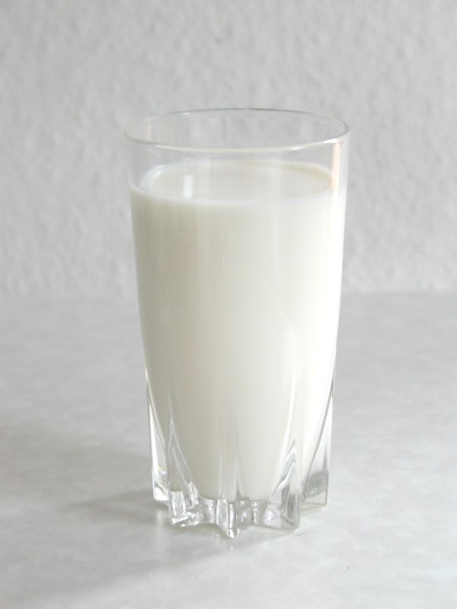
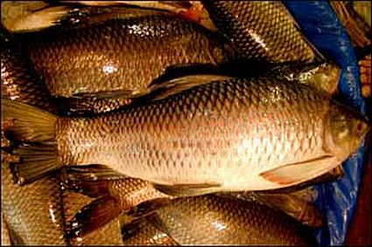
What food are at the third step of the pyramid ?
Fish, meat, dairy , beans, lentils

Slide 20
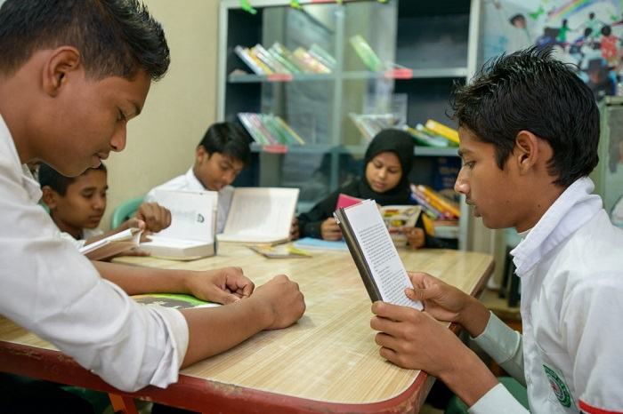
Group reading

Slide 21
Read in pair

Slide 22
evaluation
1. From which level of the food pyramid we eat more food ?
Answer: From the bottom of the food pyramid we eat more food.
2. Which food are at the bottom of the pyramid?
Answer : Rice , ruti and bread are at the bottom of the pyramid .
These foods are maid from grains.
1. From which level of the food pyramid we eat less food ?
Answer: From the top of the food pyramid we eat less food.

Slide 23
One day one word
lentils-ডাল

Slide 24
Task
Write five sentences about your food habits.

Slide 25
Goodbye

