Slide 1
Welcome

Slide 2
Introducing
Mujibur Rahman
Assistant Teacher
Eklimiah GPS
Biswanath, Sylhet
Class: Three
Subject: English
Lessons: 1-3
Unit: 5

Slide 3
Good morning, students.
Good morning, teacher.
How are you today?
Fine. and you?
Fine, thank you.

Slide 4
Let’s enjoy a video.

Slide 5
Today's lesson
Commands and instrutions

Slide 6
Students will be able to
Listening: 2.1.1- carry on commands and instructions.
Learning outcomes
Speaking: 1.1.1- repeat words, phrases and sentences
after the teacher with proper sounds and stress.
1.1.2- say words, phrases and sentences with proper
sounds and stress.
Reading: 1.5.1- read simple sentences with proper
pronunciation and stress.

Slide 7
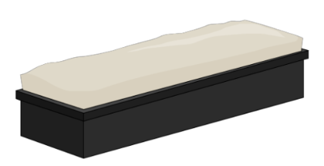
What do you see in the picture?
board
duster

Slide 8
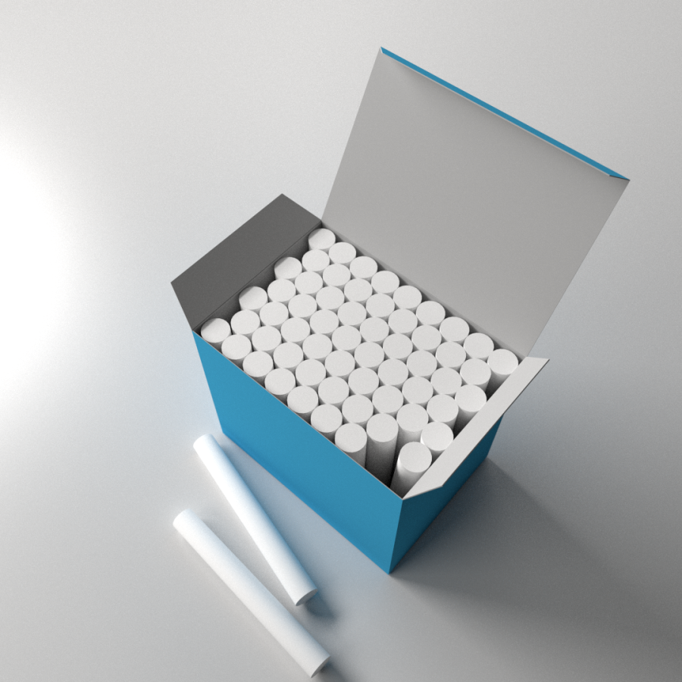
What do you see in the picture?
chalk.
flag

Slide 9
Everybody listen and do after me.
Take the chalk.
Go to the board.
Clean the board with the duster.
Draw our flag.

Slide 10
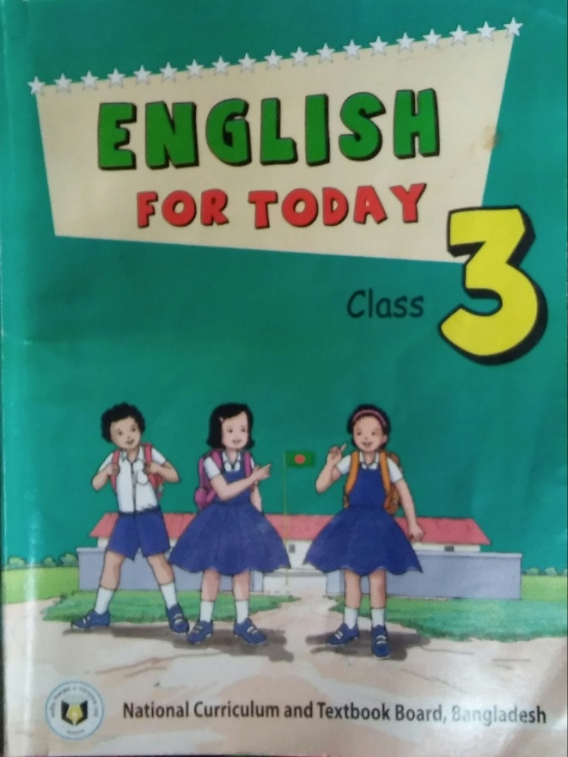
Open your book at page 10.

Slide 11
Student’s doing the instructions
Stand up.
Exercise.
Take the chalk.
Go to the board.
Clean the board with the duster.
Draw our flag.
Go to your seat.

Slide 12
Evaluation
Look at the pictures and say the commands and instructions about these.

Slide 13
Thank You

