Slide 2
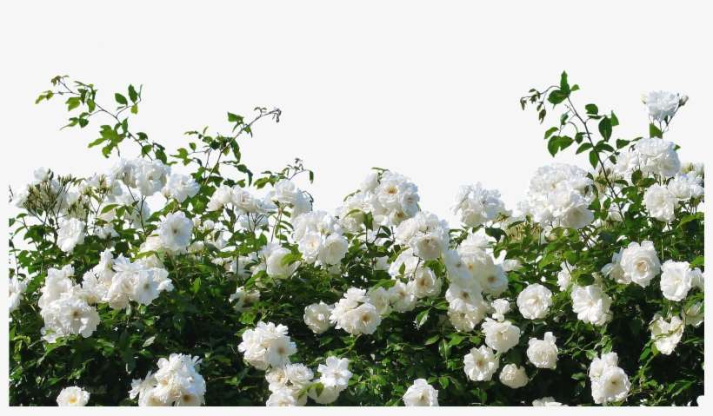
Welcome

Slide 3
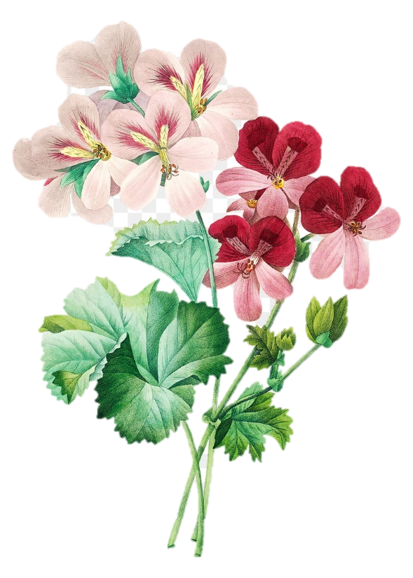
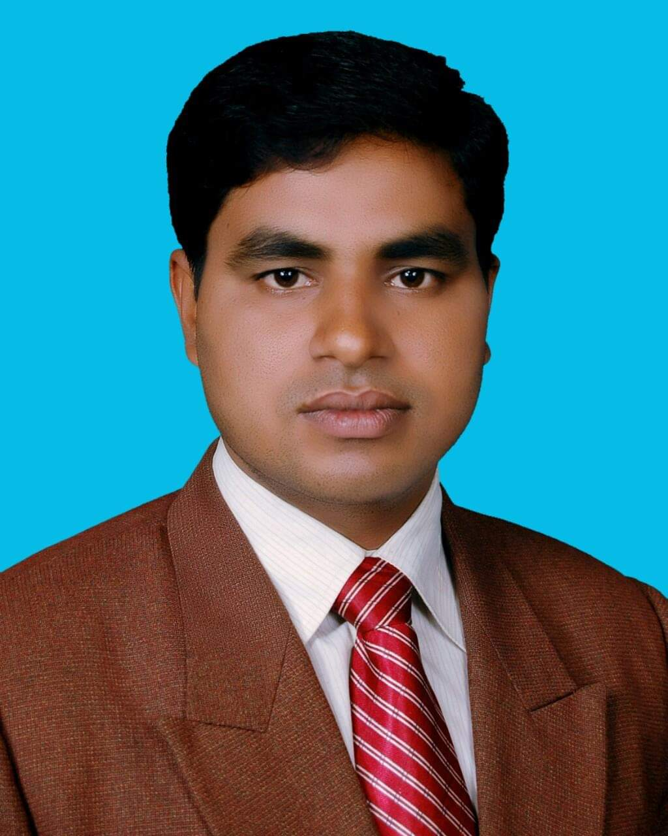
Identity
Md. Noor –E- Alam Siddiki
Asstt. Teacher
Nageswari Keramatia M.L High School.
Mobile- 01716962418
Email- nooralam.na35@gmail.com
Unit -2, Lesson 2

Slide 4
Let’s see a video...
What is the video about ?
It is about poem Ode on solitude.

Slide 5
Today’s class title is
Ode on solitude
Unit 2, Lesson 3

Slide 6
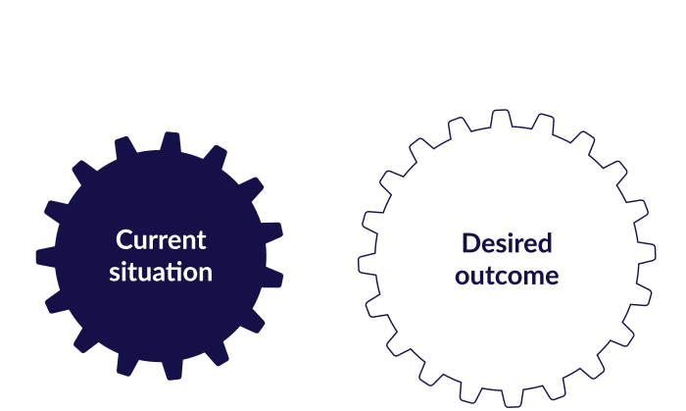
After studied the lesson , students will be able to …
Tell about ode on solitude poem.
recite the poem .
answer questions.

Slide 7
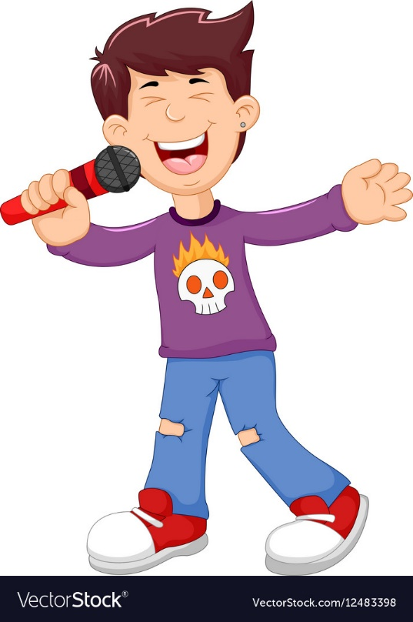
Let’s know some new words.
Ode
a lyric poem in the form of an address to a particular subject, often elevated in style or manner and written in varied or irregular meter

Slide 8
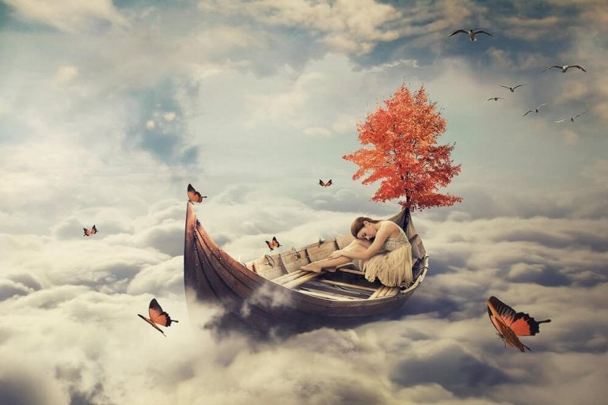
Solitude
the state or situation of being alone.
a lonely or uninhabited place.
The battle to preserve beloved solitudes flared up all over the country.

Slide 9
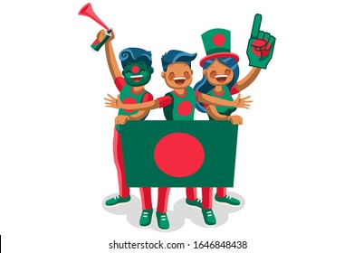
Native
a person born in a specified place or associated with a place by birth, whether subsequently resident there or not.
associated with the place or circumstances of a person's birth.
He is a native Bangladeshi.

Slide 10
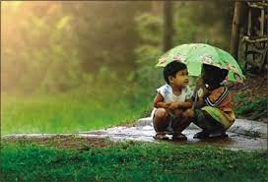
Innocence
the state of being not guilty of a crime or other wrong act · lack of experience with the world and with the

Slide 11
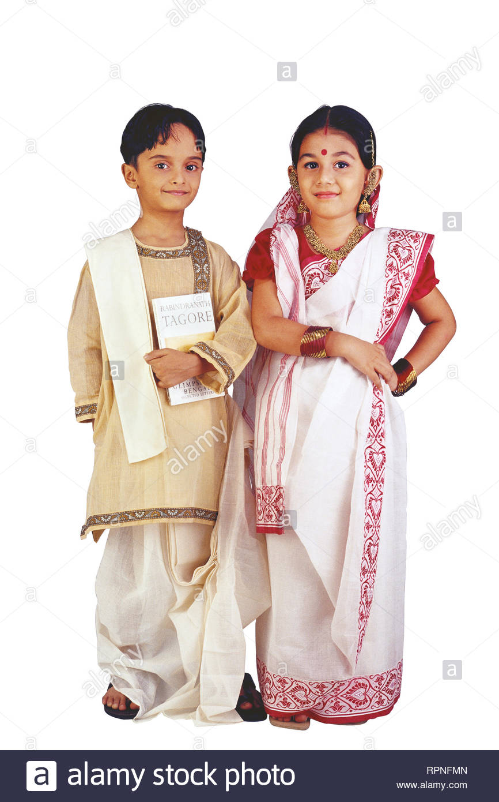
Attaire
clothes, especially fine or formal ones.
be dressed in clothes of a specified kind.
She was attired in an elaborate evening gown.

Slide 12
Recite the poem

Slide 13
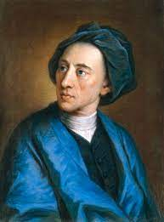
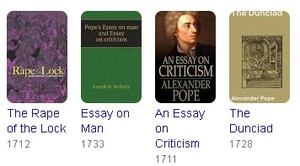
Born: 21 May 1688; London‎, England‎
Famous works
Death: May 30, 1744, Radnor House Independent School,Twickenham, United Kingdom
Alexander Pope

Slide 14
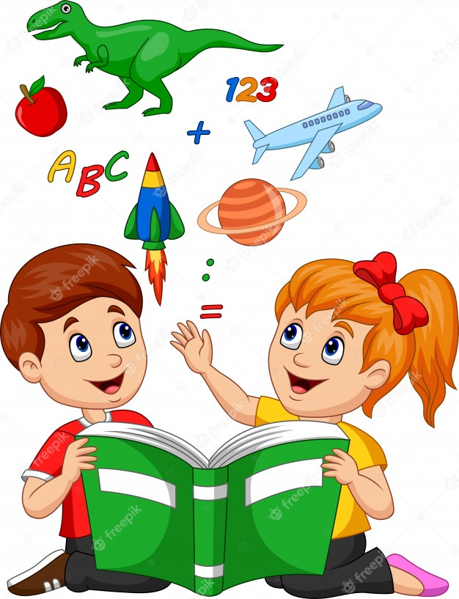
Pair work
B Answer the questions
1. What things does a happy man have ?
2. How does he pass time ?
3. How does he wish to die?
4. How do you think you can be happy in life?

Slide 15
Match your answer
1. A happy man has a few paternal land, native air, cows , crops filled land etc.
2. He passes his time soft away with sound body and mind.
3. He wish to die a peaceful death which will occur in his land.
4. I am happy as I have parents and they keep me happy all time.

Slide 16
Evaluation
what is happiness?

Slide 17
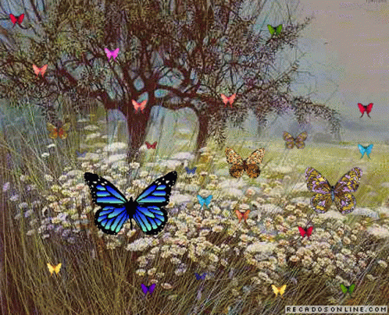
Thank you.

