Slide 1
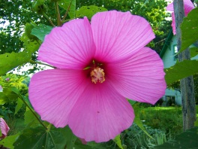
W
E
L
C
O
M
E
INTRODUCTION
CLASS: SIX/SEVEN
SUBJECT: ENGLISH SECOND PAPER
TOPIC: RIGHT FORMS OF VERBS (SUBJECT VERB AGREEMENT)
Rajkumar Sarker.
(Assistant teacher)
Chhatiani High school.
Sherpur.Bogura.

Slide 2
Today our topic is
Subject Verb Agreement (Part 2)
(Right forms of verbs)

Slide 3
Learning Outcomes-
After the lesson the students will be able to –
* use the right forms of the verbs in sentences.

Slide 4
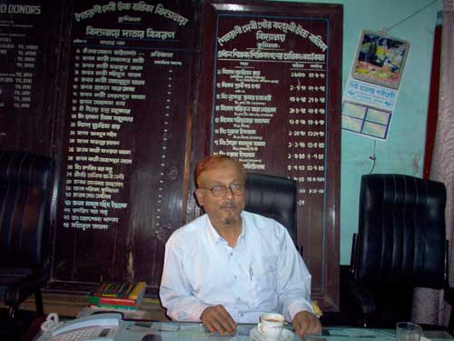
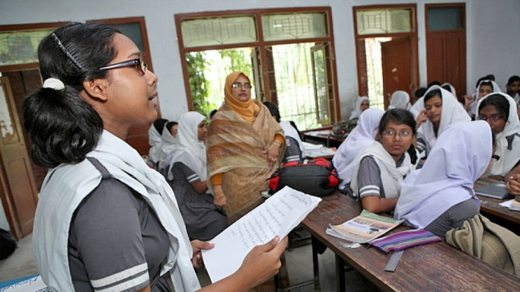
Can you choose the correct verb?
1. The Headmaster and secretary was/were present.
The girl and student is/are answering the question.
If the nouns suggest the same person, only the first noun will take article “the” and verb will be singular.

Slide 5
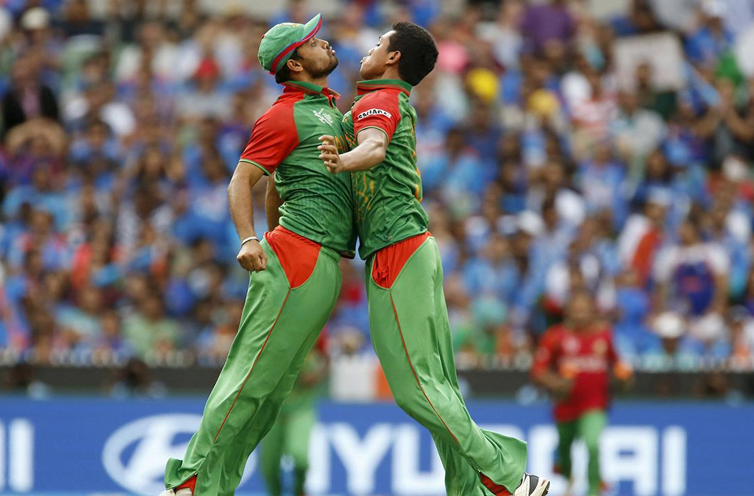
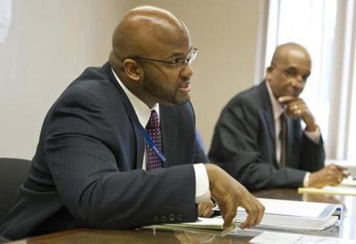
Can you choose the correct verb?
1. The Captain and the player was/were celebrating of taking wicket.
2. The Headmaster and the Secretary was/were present.
If the nouns suggest the different persons, both nouns will take article “the” and verb will be plural.

Slide 6
Choose the correct verbs.
1. The magistrate and judge was/were present.
2. The magistrate and the judge was/were present.
Notes:
This slide is the evaluation of the previous two rules of the subject-verb-agreement.

Slide 7
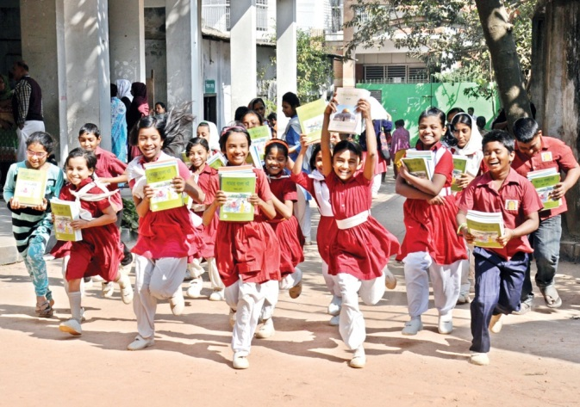
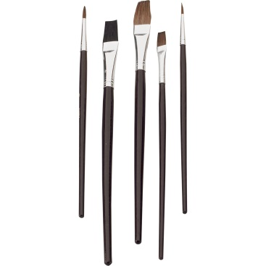
Can you choose the correct verb?
1. Each boy and each girl has/have books.
2. Every pencil and every brush is/are new.
When two or more nouns qualified by each / every /no, even though they are joined by and, will take singular verb.

Slide 8
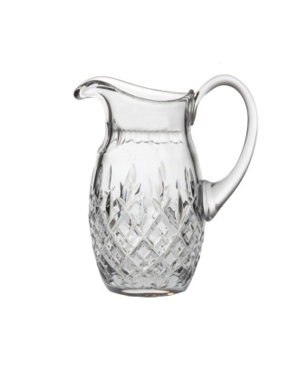
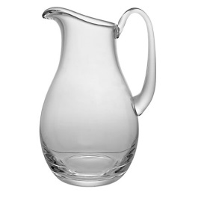
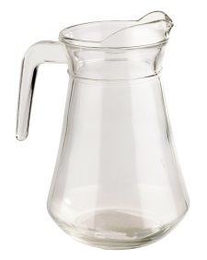
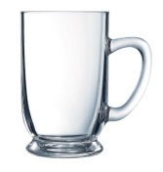
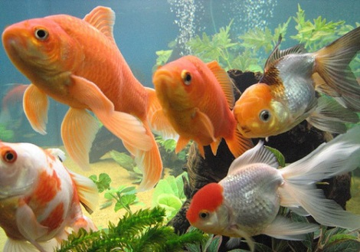
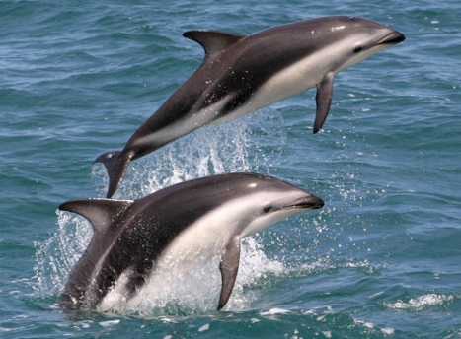
Give the answers using right forms of verbs.
1. Every jug and every mug ____ (be) made of glass.
is
2. Each jellyfish and each dolphin ____ (be) looking beautiful.
is
Notes:
This slide is the evaluation of the previous rule of the subject-verb-agreement in slide no. 8.

Slide 9
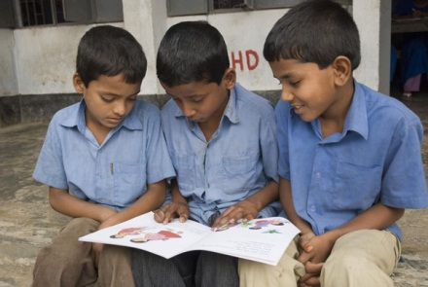
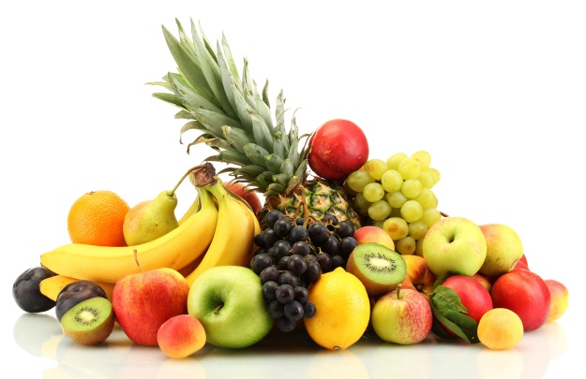
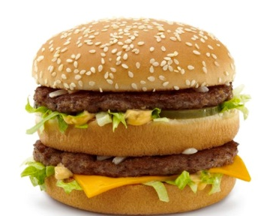
Can you choose the correct verb?
1. The boy and not his friends has/have held the book.
2. The fruits and not junk food is/are good for health.
If there is not + noun after and, the verb will follow the noun before and.

Slide 10
Choose the correct verb from the box and give the answers using right forms of verbs.
1. My cousins not my friend _____(be) with me yesterday.
were
2. Her uncle not her cousins usually ______ (sing) well.
sings
Notes:
This slide is the evaluation of the previous rule of the subject-verb-agreement in slide no. 10.

Slide 11
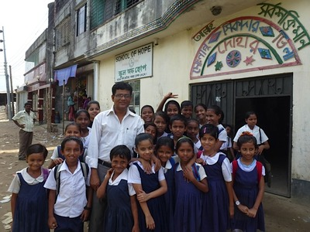
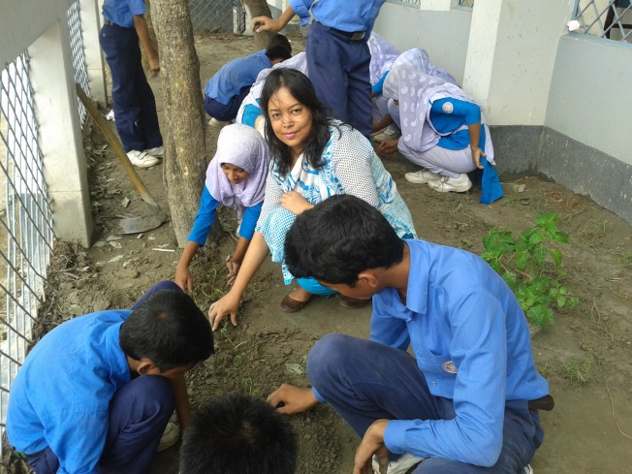
Can you choose the correct verb?
1. The Headmaster along with his students is/are present in the picture.
2. The students with their teacher is/are making garden.
If in the subject there is a noun or a pronoun followed by with, along with, together with, as well as, accompanied by + noun or pronoun, the verb will be according to the first noun or pronoun.

Slide 12
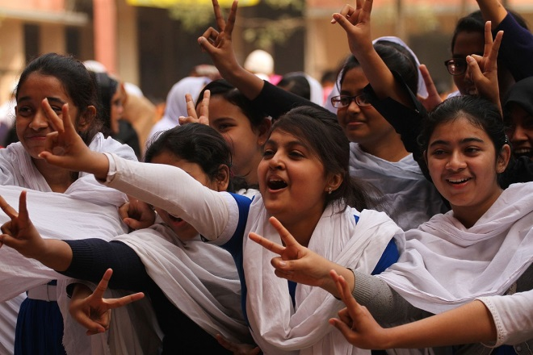
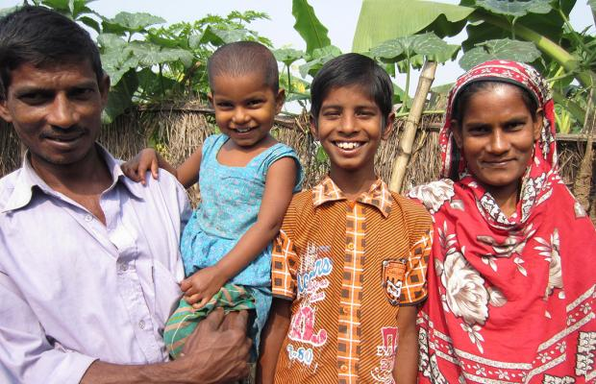
Choose the correct verb from the box and give the answers using right forms of verbs.
be, have
1. Nitu as well as her friends _____ done well in the examination.
has
2. The children with their parents _____ happy.
are
Notes:
This slide is the evaluation of the previous rule of the subject-verb-agreement in slide no. 12.

Slide 13
Choose the correct verbs and fill the gaps with right forms of verbs.(Pair/Group work)
have, be, draw
has
1. The singer and musician ______ sung the song.
have
2. The poet and the writer ______ written these articles.
was
3. No bus and no train ______ seen in the roads last night.
draws
4. Ranu not her sisters ________ pictures regularly.
Notes:
This slide is the evaluation of the previous all rules of the subject-verb-agreement in this lesson.

Slide 14
Choose the correct verbs and fill the gaps with right forms of verbs.(Pair/Group work)
have, be, draw
has
5. Limon accompanied by his brothers ______done the work.
is/was
6. Each bottle and each box _______ of plastic.
has
7. Ranu together with her parents ______ just left the station.
are
8. Ranu’s parents not her brother ______ going to her uncle’s house.
Notes:
This slide is the evaluation of the previous all rules of the subject-verb-agreement in this lesson.

Slide 15
Thank You All

