Slide 1
Welcome
in
Z.Sir’s M.M Class

Slide 2
Teacher’s identity
Md.Zakir Hossain Molla
(M.B.S,B.Ed)
Assistant Teacher(Social Science)
Baneswardi High School,
Nagarkanda,Faridpur.
Mobile No:01621-401412

Slide 3
Lesson introduction
Class: Nine& Ten
Subject:English-1
Unit: 01
Lesson:02
Date:06-08-2021

Slide 4
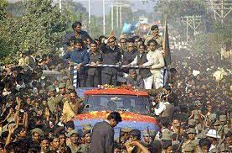
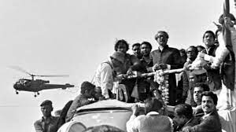
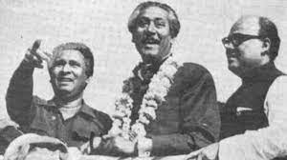
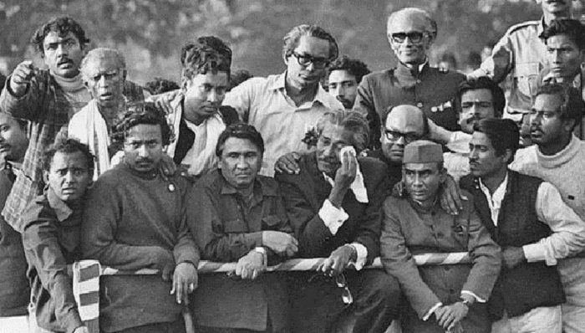
Collected

Slide 5
Lesson Declaration
So, Today’s Lesson is “ Bangabandhu’s homecoming.”

Slide 6
Learning outcomes
After completing the lesson, students will be able to:
Ask and answer the questions
*Tell the meaning of words
*read the passage carefully
* make table with information from the passage
* write a short paragraph

Slide 7
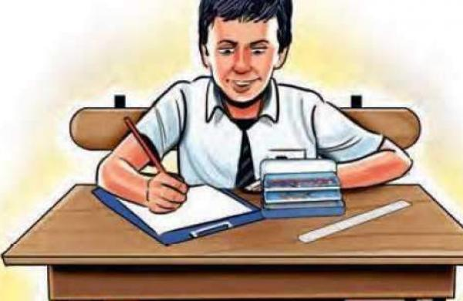
dd
dd

Slide 8
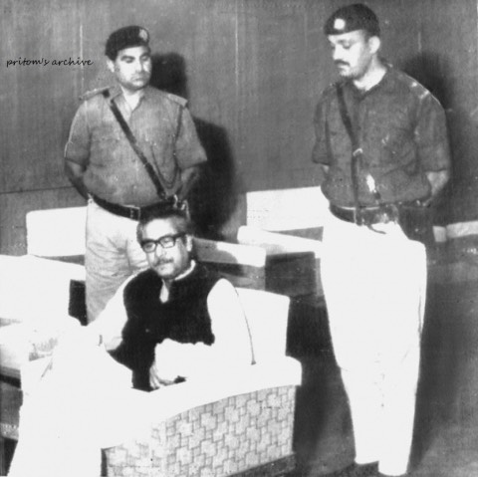

Slide 10
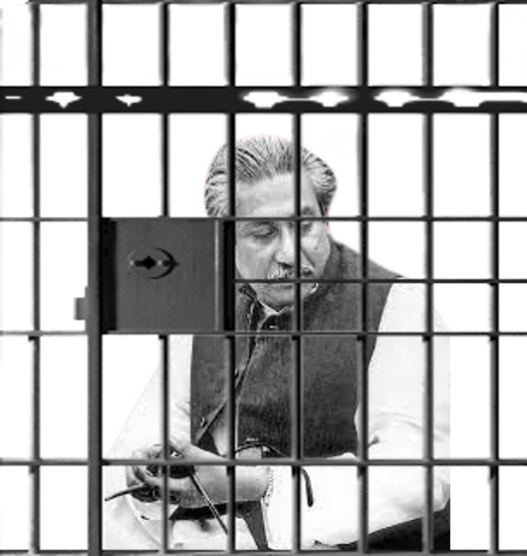

Slide 11
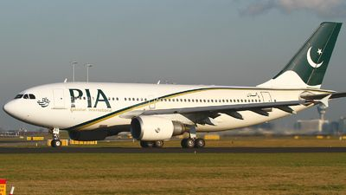

Slide 12
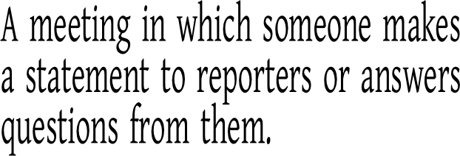
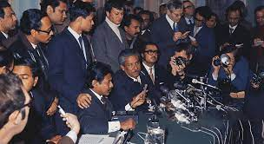

Slide 14
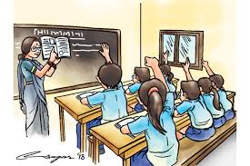
Read the text carefully.

Slide 15
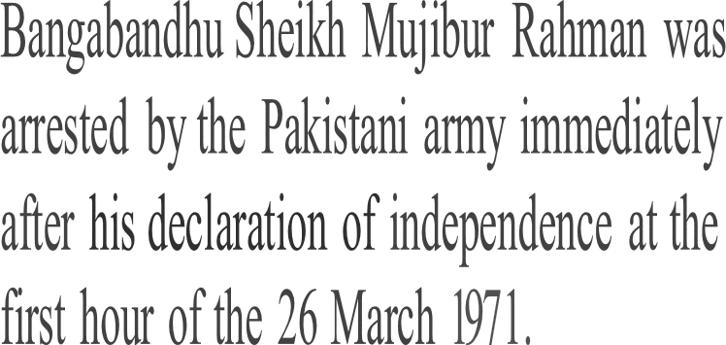
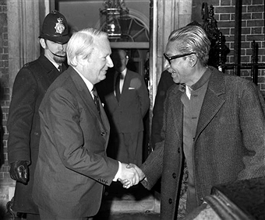
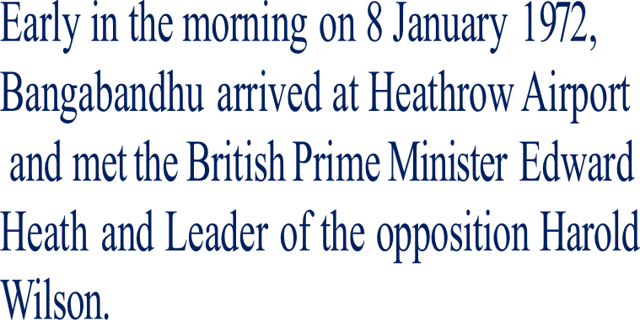

Slide 16
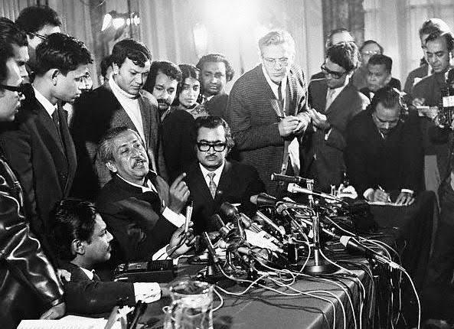
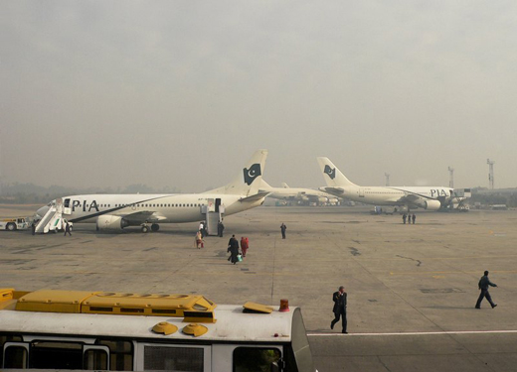
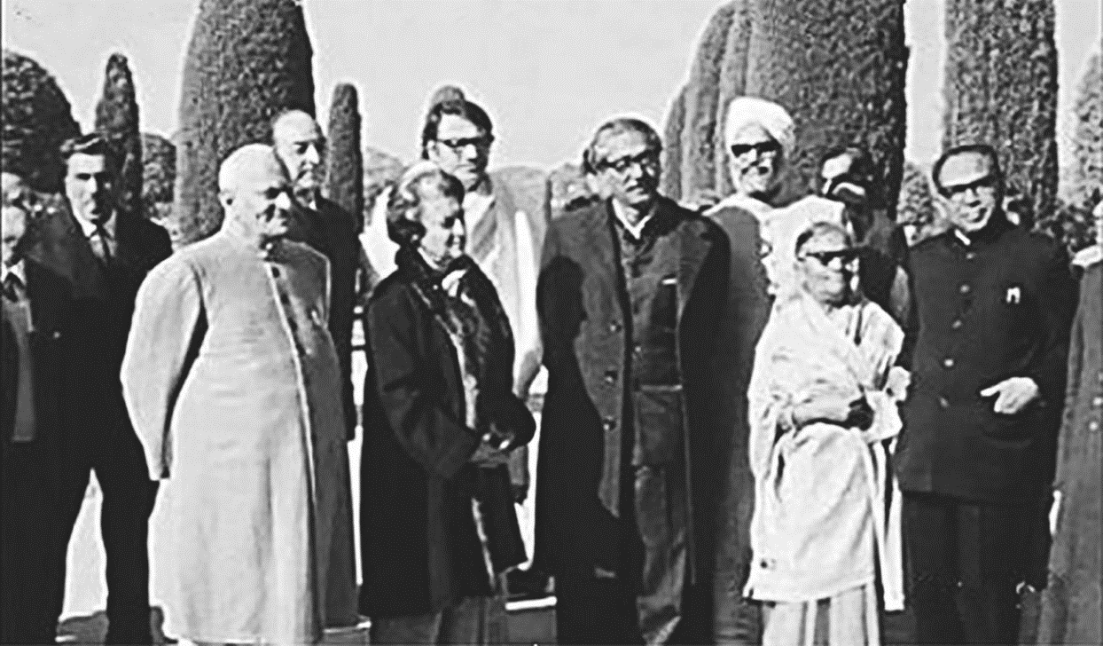
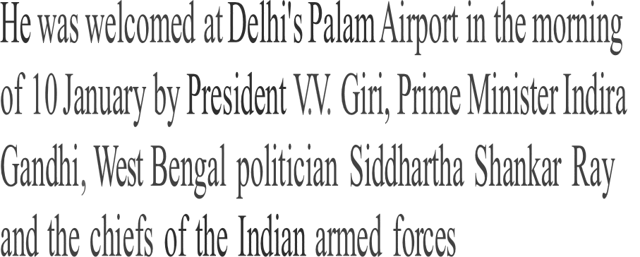
Early in the morning on 8 January 1972,
Bangabandhu arrived at Heathrow Airport
and met the British Prime Minister Edward
Heath and Leader of the opposition Harold Wilson.
Bangabandhu met a news conference
at Hotel Claridge in London in
theevening 0n 8 January 1972.

Slide 17
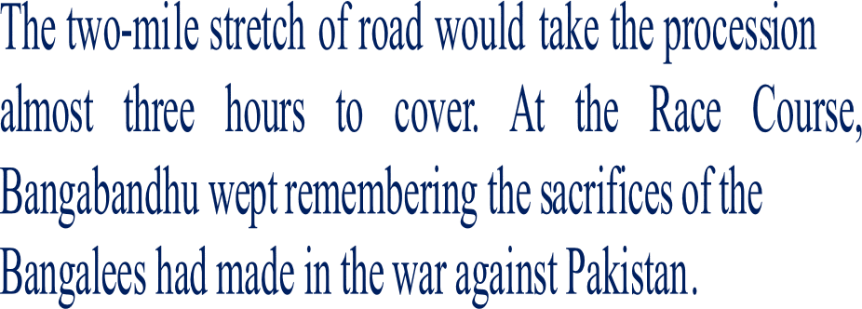
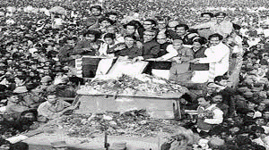
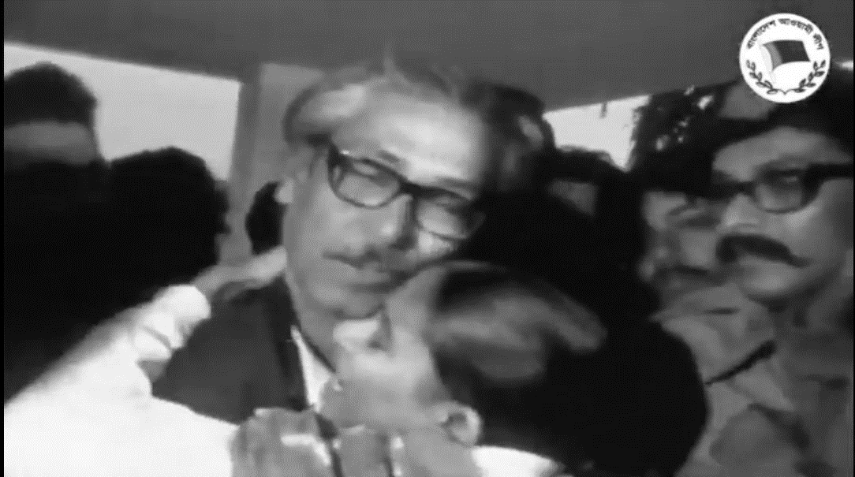
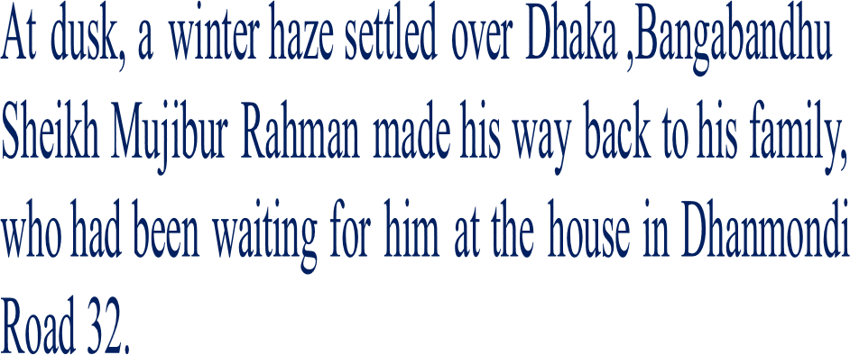

Slide 18
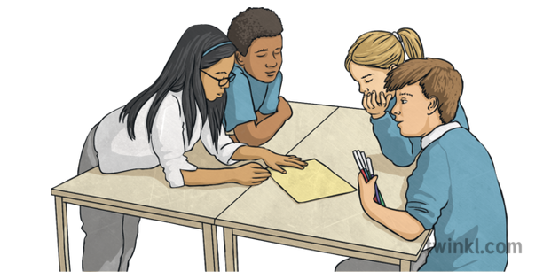

Slide 19
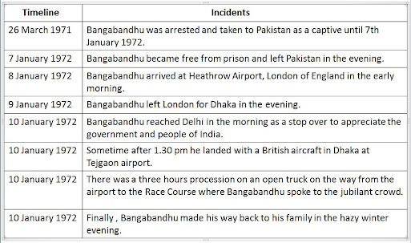
Evaluation
Make a timeline of the incidents mentioned in the texts
on Bangabandhu's homecoming.

Slide 20
“Bangabandhu’s homecoming”

Slide 21
Thanks all.

