Slide 1
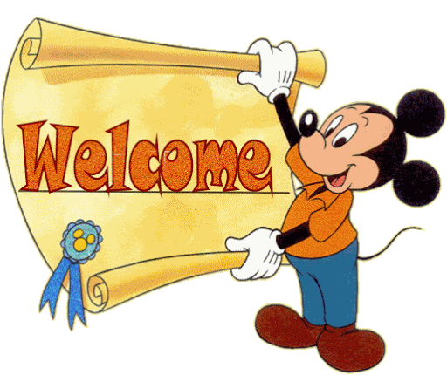

Slide 2
TEACHER’S IDENTITY
CHARADHARY GOVT PRIMARY SCHOOL
ASSISTANT TEACHER
BRAHMANPARA, CUMILLA.
EMAIL- tanzina121996@gmail.com.
TANZINA AKTER

Slide 3
Lesson name: Why does the frog croak
Class : Five
Subject : English

Slide 4
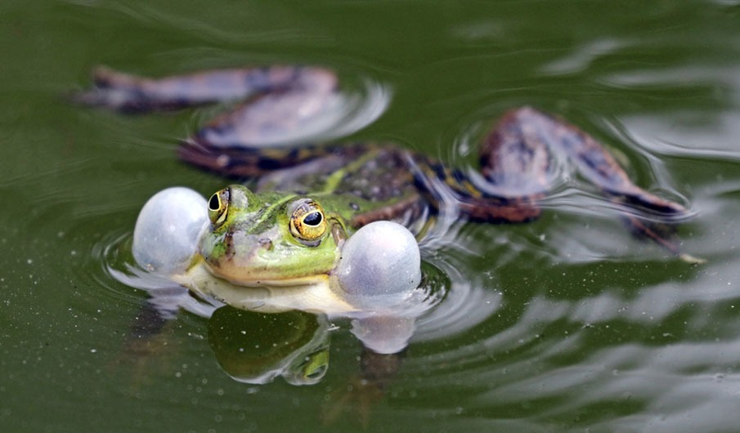
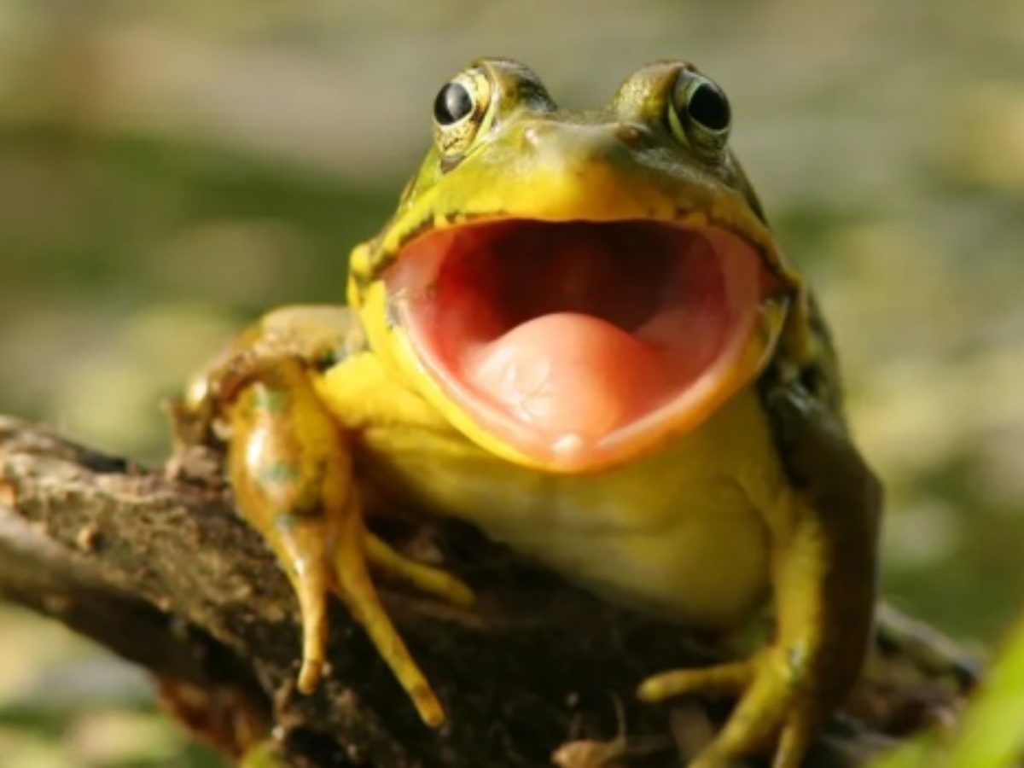
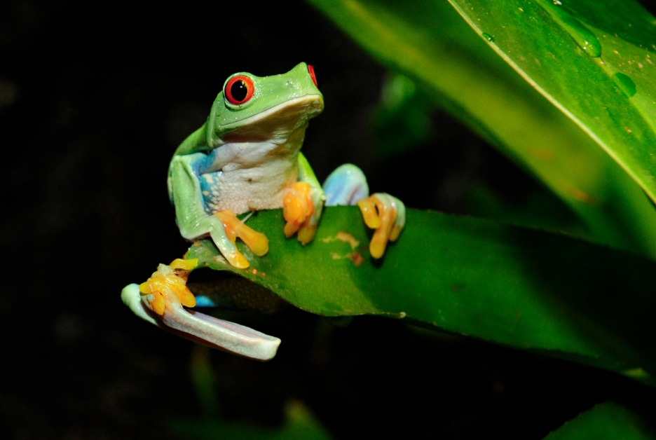
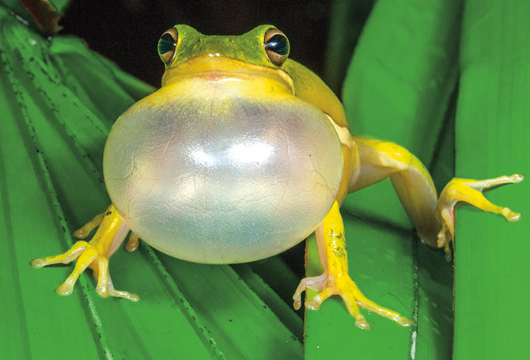
FROG

Slide 5
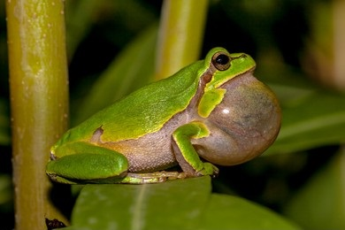
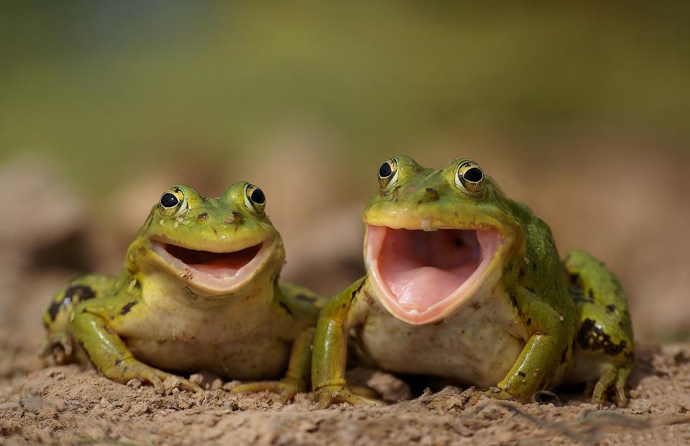
Why does the frog croak? Do we know?

Slide 6
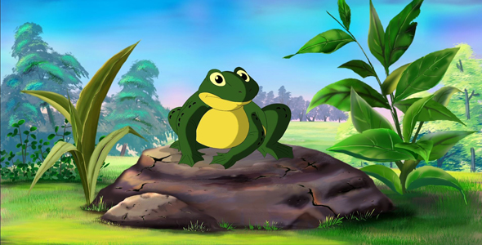
Our today’s lesson name: Why does the frog croak?

Slide 7
LEARNING OUTCOME’S
By read this passage student’s will be able to……….
a. Read the story throughly.
b. Learn some new word meaning.
c. Learn about the moral of the story.
d. Describe about why does the frog croak…..croak.

Slide 8
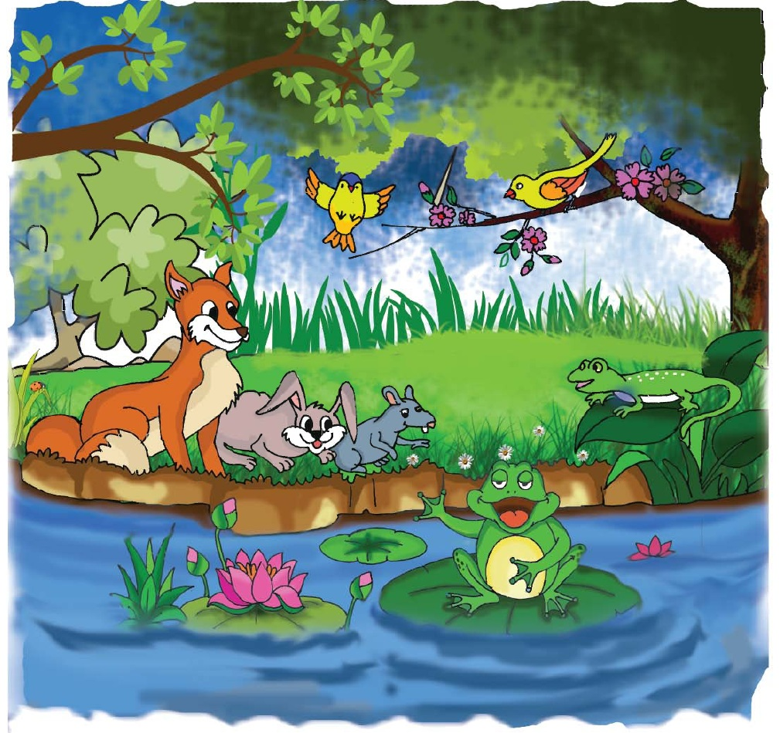
Look at the picture

Slide 9
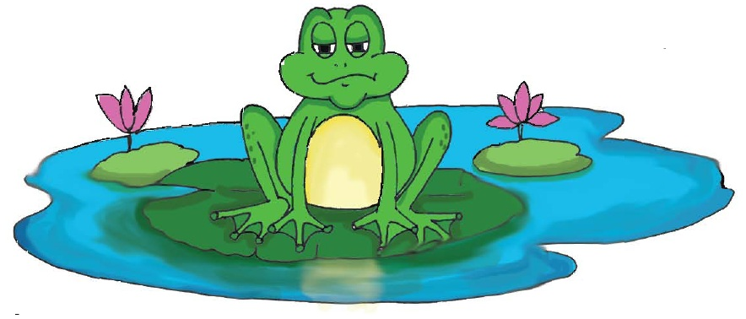
What sound does a frog make? Croak, croak! It isn’t a beautiful sound. But, a long time ago, frogs had beautiful voices. They could sing more beautiful than the birds. This all changed because of one frog named Bluster.

Slide 10
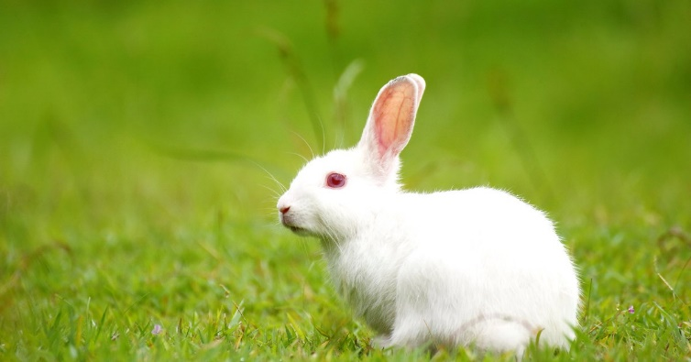
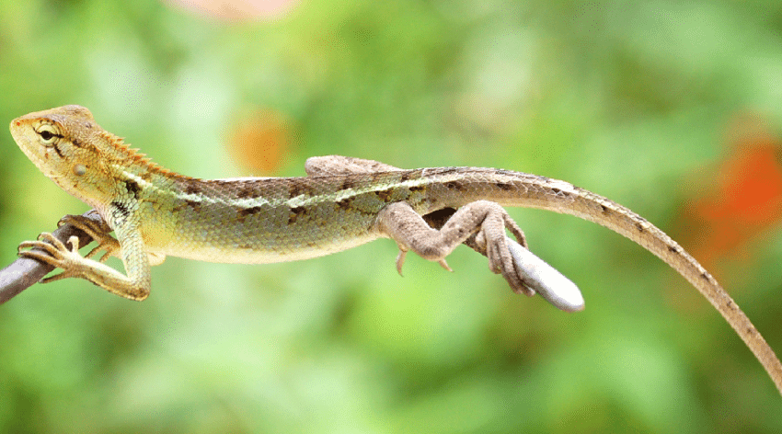
Moxie the rabbit
Pluck the lizard

Slide 11
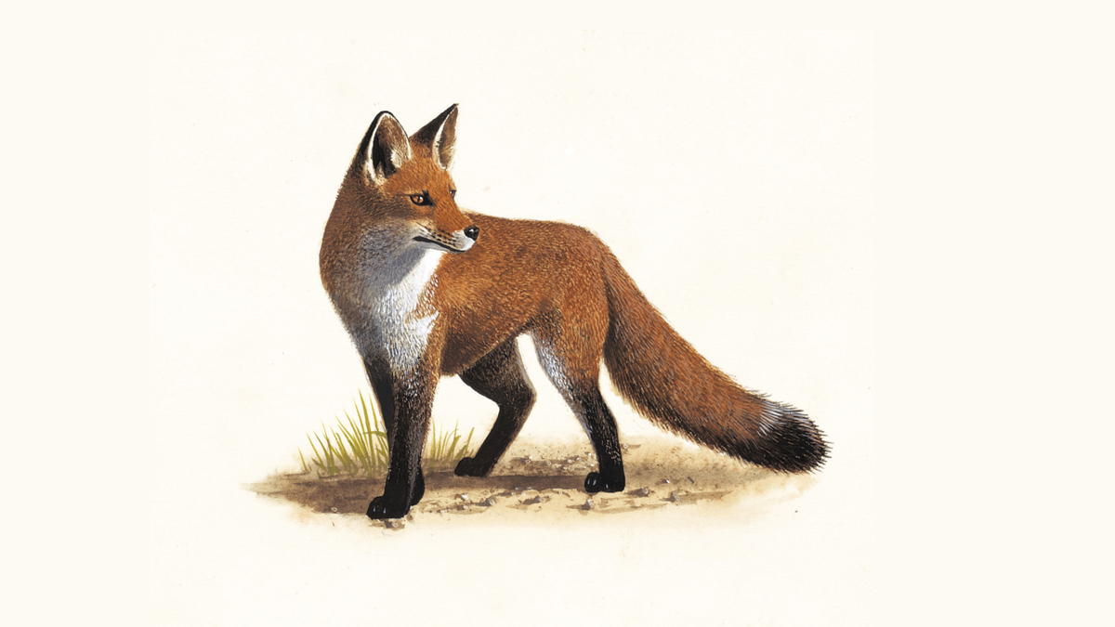
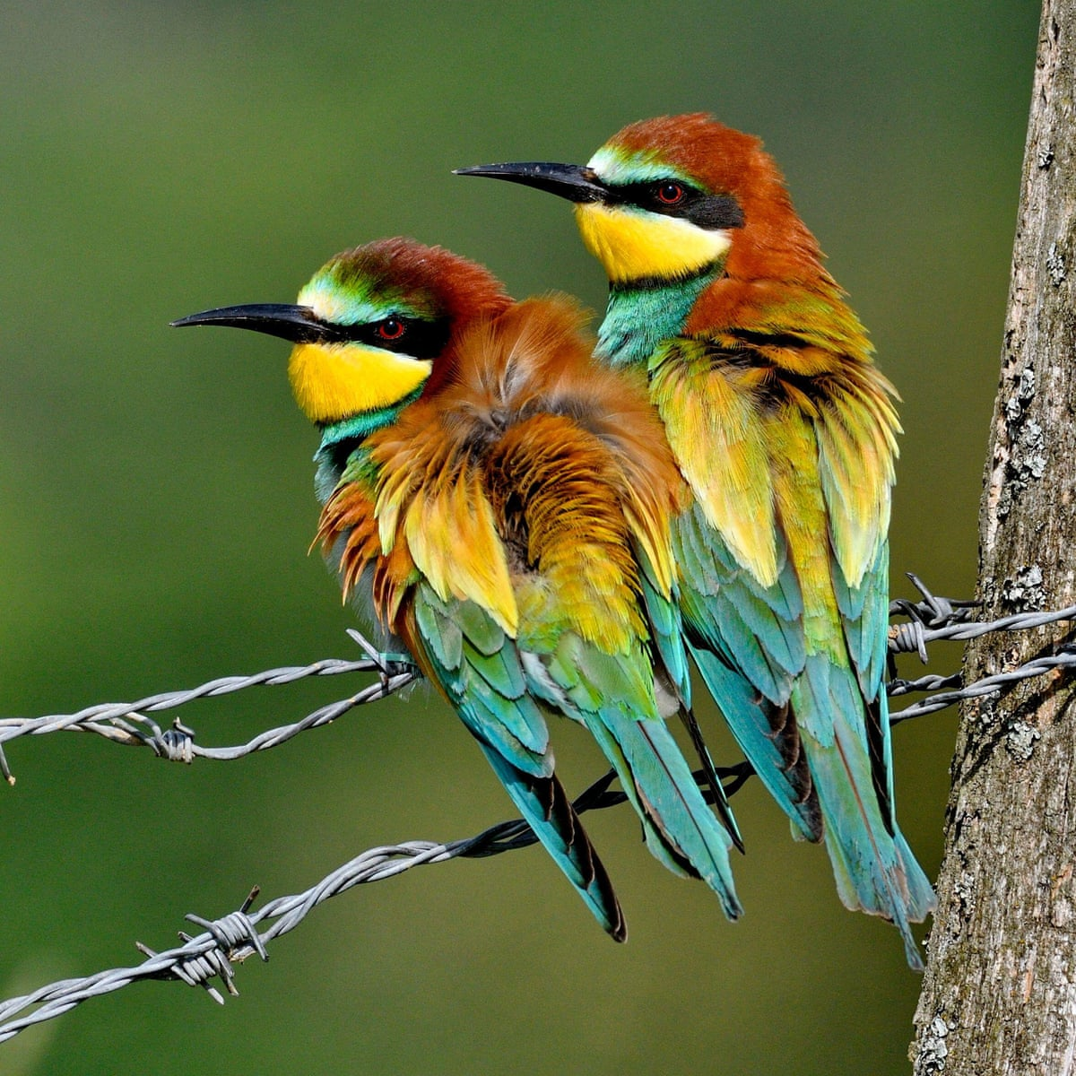
Fox
Bird

Slide 12
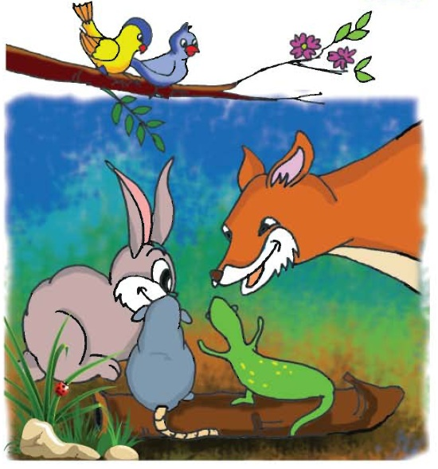
The animals talked and talked late into the afternoon. They made a plan to take Bluster’s voice. They decided not to tell the birds. But they didn’t have to tell them! The birds were sitting in the tree and they heard the animals plan.

Slide 13
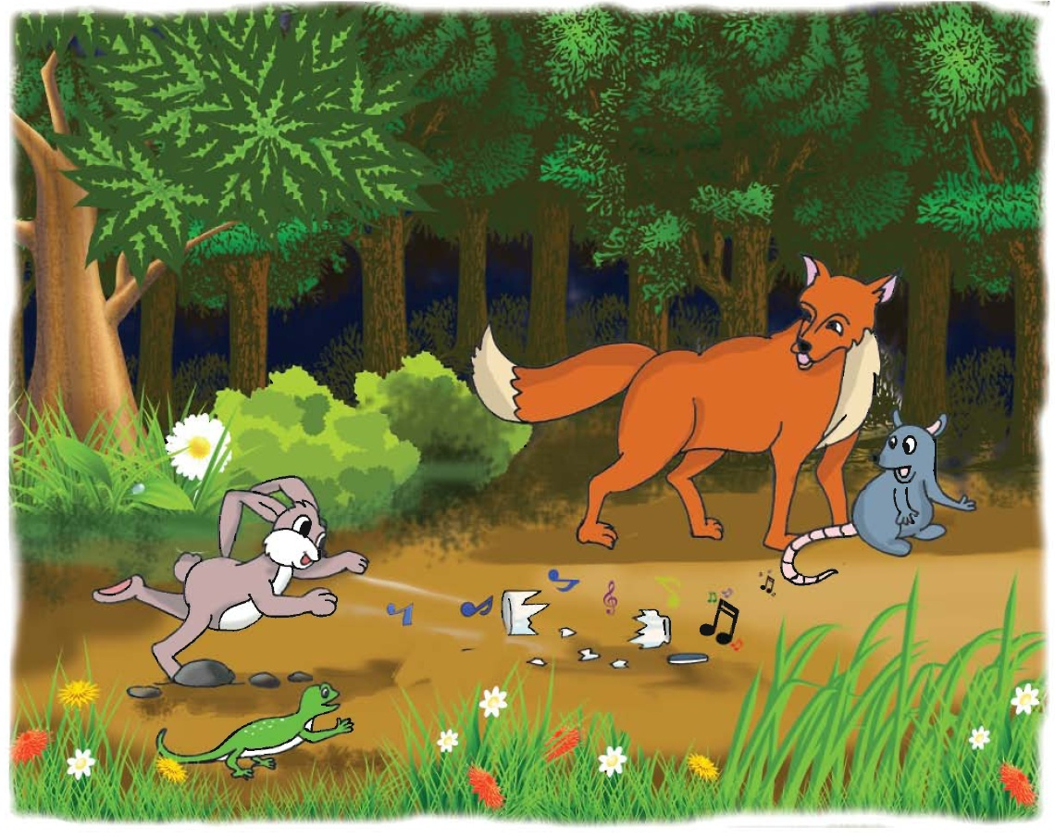
The jar fell to the ground and it broke.

Slide 14
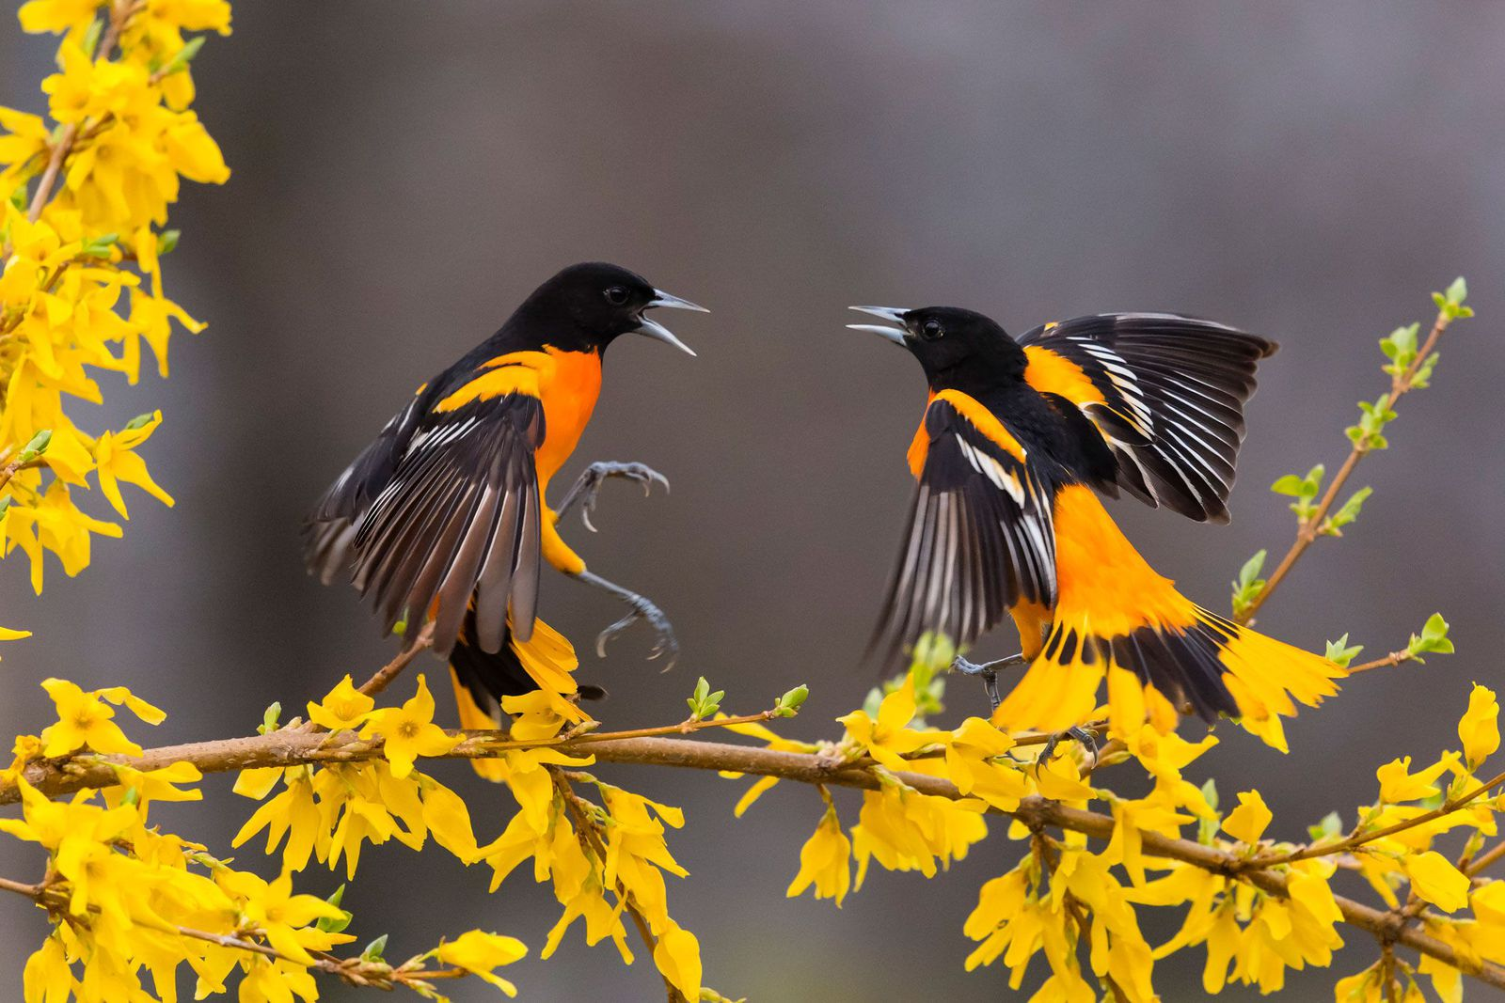
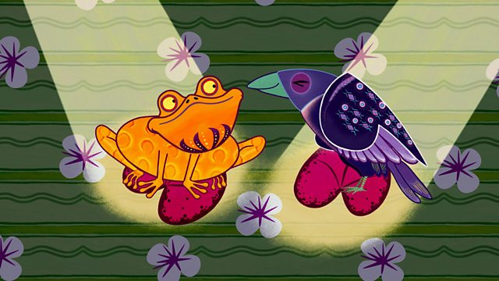
The birds picked up Blusters beautiful voice. And to this day, the birds sing with Blusters beautiful voice and Bluster and all the other frogs can only say croak……….croak.

Slide 15
GROUP WORK
Make sentences with this word
Frog
Bird
Voice
Sing
Sound
Night

Slide 16
EVALUATION
Fill in the gaps with suitable word:
a. The animal wanted the frog to share--------------.
b. The animals met to make a plan to------------------.
c. The jar broke because--------------------.
d. --------------got Blusters voice at the end of the story.
e. Bluster has ------------ voice.

Slide 17
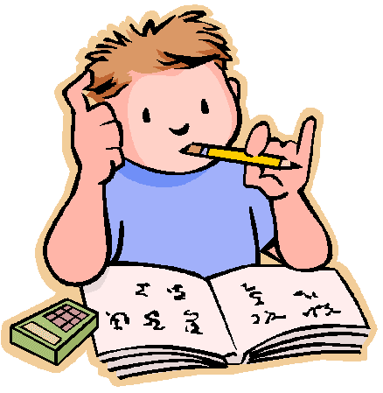
HOME WORK
Do you think this is a true story? Why or why not?

