Slide 1
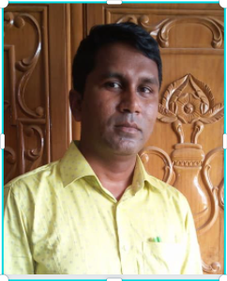
MD.OMAR FARUQUE
ASSISTANT TEACHER
SATIANTOLI GOVERNMENT PRIMARY SCHOOL

Slide 4
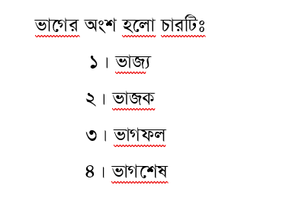

Slide 10
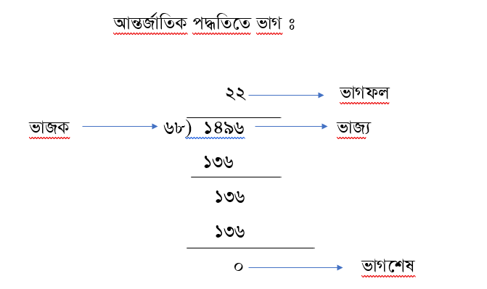

Slide 12
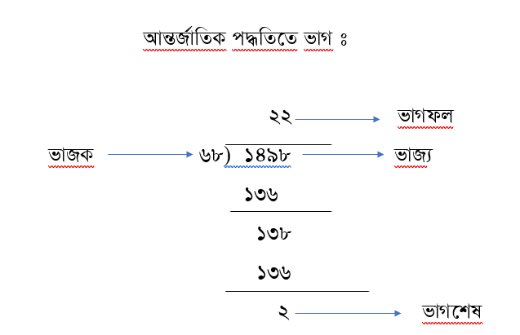

Slide 14
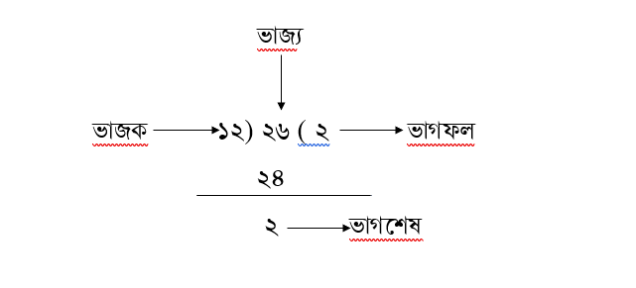

Slide 16
THANK YOU EVERYBODY

