Slide 1
Welcome

Slide 2
Introducing
Mujibur Rahman
Assistant Teacher
Eklimiah GPS
Biswanath, Sylhet
Class: Three
Subject: English
Lessons: 1-3
Unit: 6

Slide 3
Let’s enjoy a video

Slide 4
Today's lesson
Numbers

Slide 5
Students will be able to
Learning out come
Listening: 1.1.1- repeat words, phrases and sentences after the teacher with proper sounds and stress.
1.1.2-say words, phrases and sentences after the teacher with proper sounds and stress.
Reading: 2.1.1- Recognize and read cardinal numbers
6 to 10.
Writing:2.1.1write cardinal numbers 6 to 10 in a figures
4.1.2- write cardinal numbers 6 to 10 both in figures and in words.

Slide 6
Good morning, students.
Good morning, teacher.
How are you today?
Fine. and you?
Fine, thank you.

Slide 7
Look and say
How many pencils?
6
Six

Slide 8
Look and say
How many caps?
7
Seven

Slide 9
Look and say
How many bags?
8
Eight

Slide 10
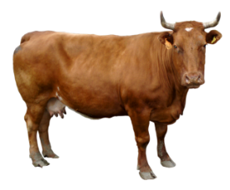
Look and say
How many cows?
9
Nine

Slide 11
Look and say
How many footballs?
10
Ten

Slide 12
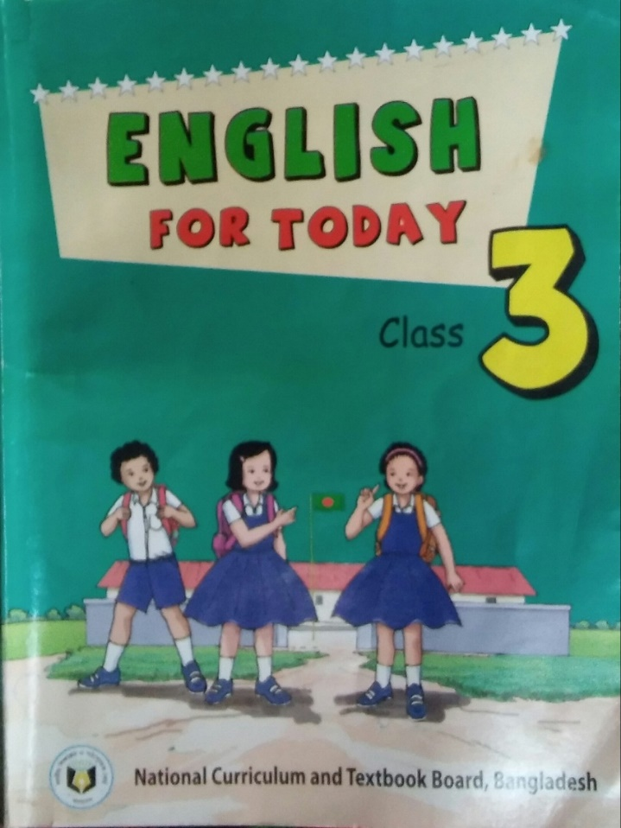
Now you open your text book at page no - 12

Slide 13
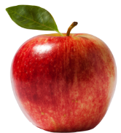
Everybody listen and say after me.
What is this?
Apple
How many apples?
6
Six

Slide 14
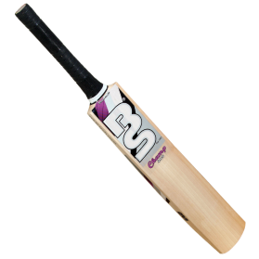
What is this?
Bat
How many bats are there in the picture?
7
Seven

Slide 15
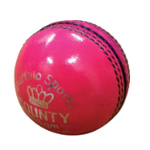
What is this?
How many balls are there in the picture?
Ball
8
Eight

Slide 16
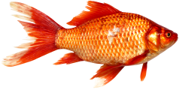
What is this?
How many fishes are there in the picture?
Fish
9
Nine

Slide 17
What is this?
Pencil
How many pencils are there in the picture?
10
Ten

Slide 18
Group Work
Write the missing number or word.
6
8
10
Seven
Eight

Slide 19
Pair work
Write the number and word 6 to 10.

Slide 20
6
Lets play bingo game.
Individual Work
7
10
8
9

Slide 21
Evaluation
How many eggs are there in the picture?
1.
2. What’s the next number of 7?
3. What’s the next number of six?
4. What’s the previous number of ten?
5. What’s the next number of nine?

Slide 22
Thank You

