Slide 1
Welcome to Multimedia class

Slide 2
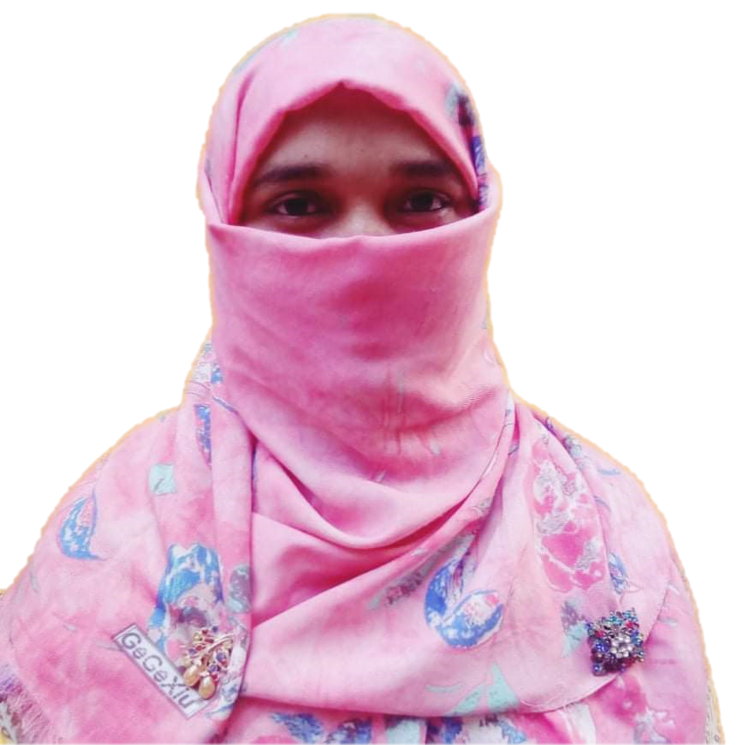
Introduction
Mosammat Nelufa Afrose Bithi
Lecturer in English
Khilbaisa Rahmania Fazil Madrasah
Sadar, Lakshmipur
E-mail:nelufa.afrose@gmail.com

Slide 3
Lesson
English First Paper
Class-XI-XII/Alim

Slide 4
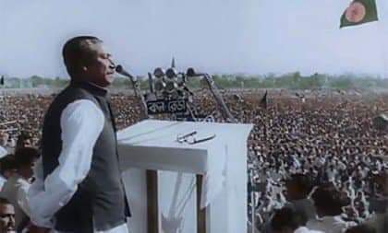
Let’s watch a picture-
Answer the questions-
4.Which features of the speech do you appreciate most? Why?
1.Who is the speaker here?
2.Where is he giving the speech?
3.Have you ever heard the speech? Where?

Slide 5
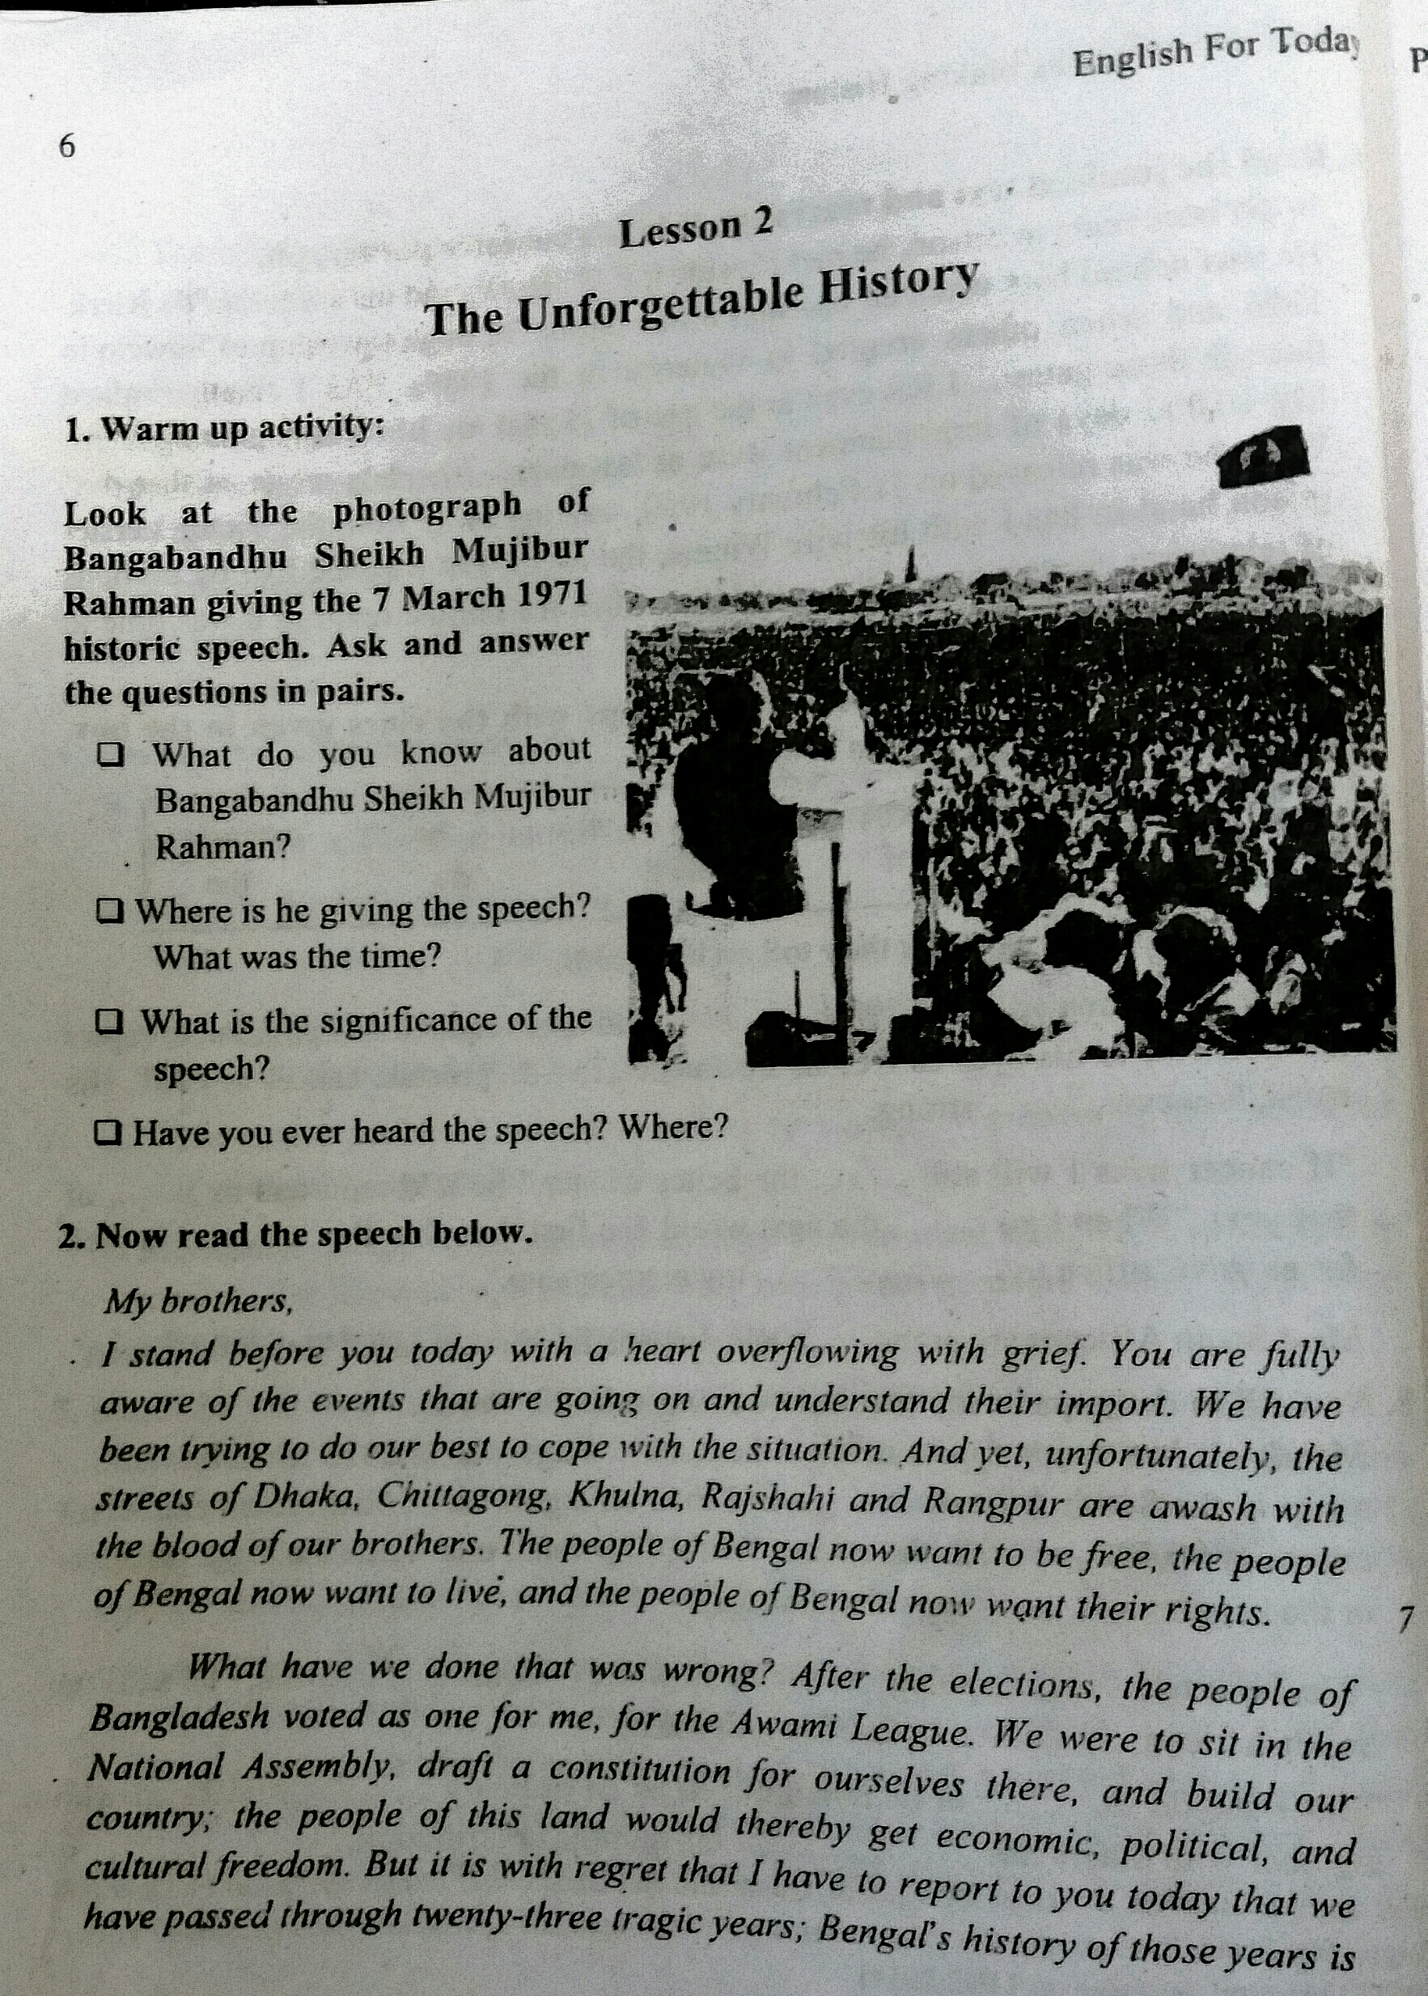
The topic of our today class is-
‘The Unforgettable History’
Unit-1:People or Institutions Making History.
Lesson: One.

Slide 6
Learning Outcomes
At the end of the lesson , we’ll able to-
1. Learn New Vocabulary from the text.
2. Get much information about the unforgettable history of 7 March,1971.
3. Know the oppression of Pakistan rulers and history of freedom war.
4.Know about the father of nation of Bangladesh.

Slide 7
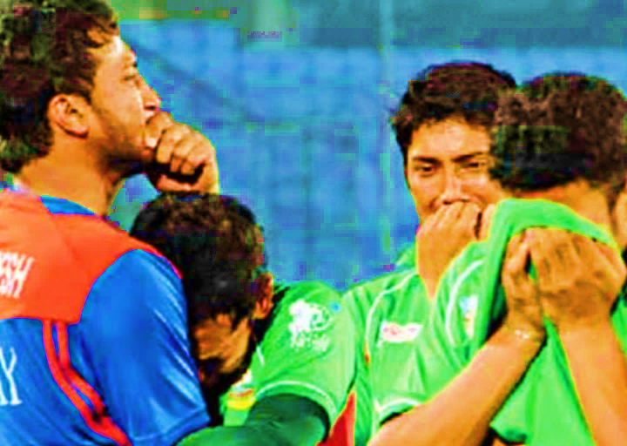
Let’s know some new words from the text-
Agony:
(verb):
Intensive physical or mental suffering.
New words

Slide 8
Crimson:
(adjective):
A rich deep red colour inclining to purple.
New words

Slide 9
Negotiation:
(Noun):
The process of trying to make or change an agreement by discussion.
New words

Slide 10
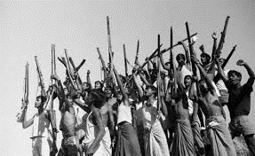
Spontaneously:
(Adverb):
Coming or resulting from a natural impulse without being asked.
New words

Slide 11
At a glance 7 March speech
The 7th March historical speech is delivered by Bangabandhu Sheik Mujibur Rahman.
Year: 1971
Date: 7 march
Day: Sunday
Time: 3:20
Place : Ramna Race Course maidan.
( Now, Suhrawardy Udyyan)
Lasting :Approximately 19 minutes
Words: 1108
UNESCO recognizes as a part of world documentary heritage: 30 October, 2017
7 march speech

Slide 12
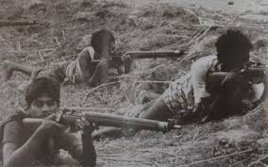
The landmark fiery speech is important for us because-
It motives the whole nation to fight to the last drop of blood for independence.
It clears the reasons for demanding separation from the then Pakistan.
The ultimate consequence is 16th December victory of our mother land
7 march speech

Slide 13
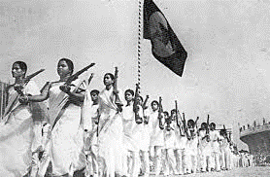
The main two parts of the speech-
The discussion about the oppression and injustice of the West Pakistan Rulers.
The way forward for the emancipation of Bengali people.
7 march speech

Slide 14
Some important quotations from the speech :
“We have been trying to do our best to cope with the situation. And yet, unfortunately, the street of Dhaka, Khulna, Rajshahi, and Rangpur are awash with the blood of our brothers.”
“Twenty three years of a history of men and women in agony.”
I request all of you: converted every house into a fort; confront enemy with whatever you have.
“Be prepared to act with whatever you in your possession.”
“Remember: since we have already had to shed blood, we’ll have to shed a lot more of it: by the grace of God, however, we’ll be able to liberate the people of this land.”
“The struggle this time is a struggle for freedom- the struggle this time is a struggle for emancipation.”
7 march speech

Slide 15
Open at page-1 and read the text.
My brothers,
I stand before you today with a heart overflowing with grief. You are fully aware of the events that are going on and understand their 'import. We have been trying to do our best to cope with the situation. And yet, unfortunately, the streets of Dhaka, Chittagong, Khulna, Rajshahi and Rangpur are awash with the blood of our brothers. The people of Bengal now want to be free, the people of Bengal now want to live, and the people of Bengal now want their rights……………
Silent Reading

Slide 16
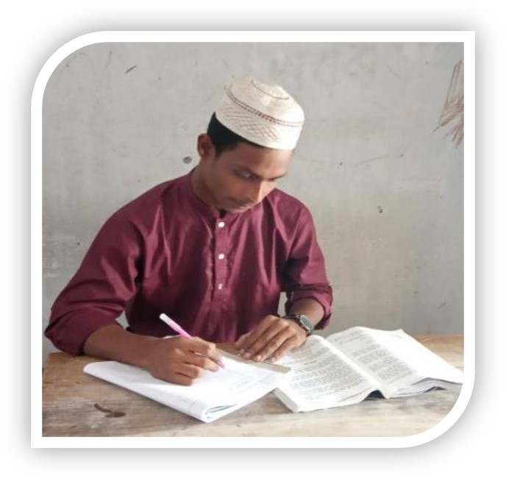
Individual work
Present your ideas on how The March 7 speech has become a part of our history.

Slide 17
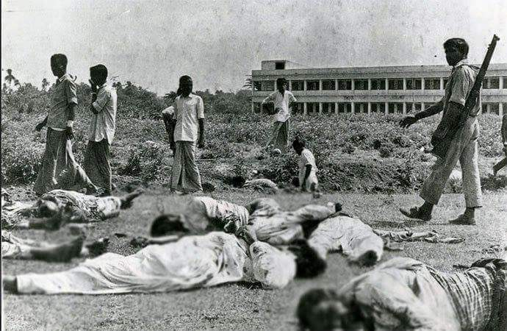
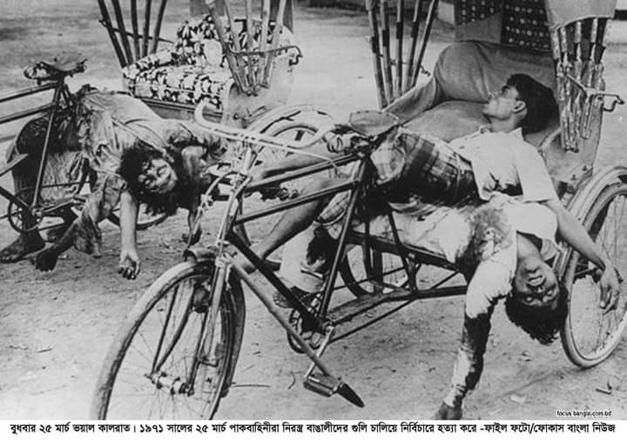
The oppression of Pakistan and history of freedom war.
The 23 years of our history with Pakistan is a history of oppression and bloodshed. Twenty-three years of a history of men and women in agony.
Those who brought arms with our money to defend us from external enemies are now using those arms on the poor.
Oppression

Slide 18
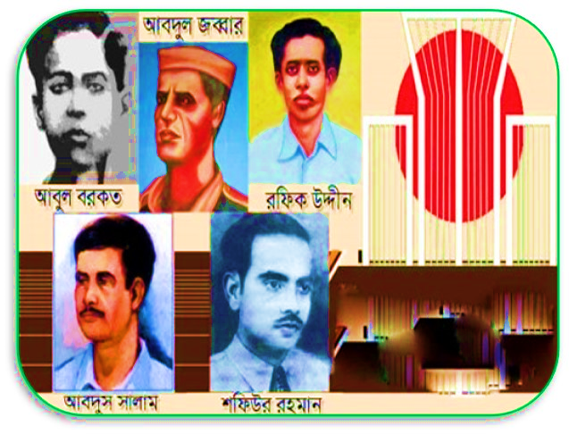
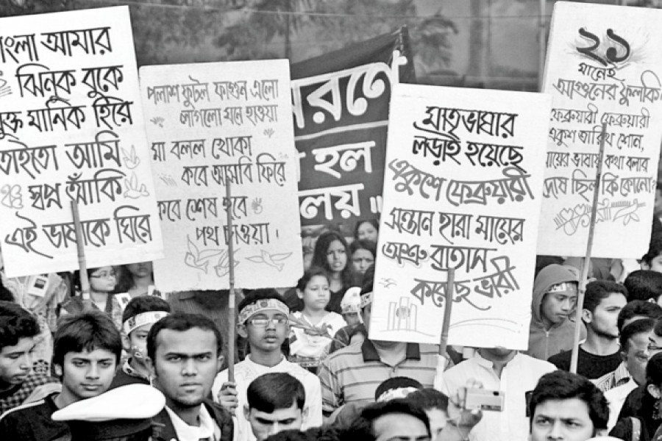
Language movement
The history of Bengal is the history of a people who have repeatedly made their highways crimson with their blood.
We shed Blood in 1952.
Oppression

Slide 19
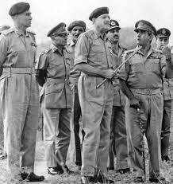
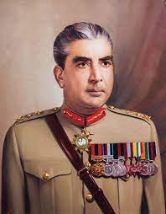
Whenever we Bengalis have tried to assume power they have used force on us.
He has put all the blame on Bangabhau. He has even blamed the Bengali people!
He declared that he would give us a constitution and restore democracy. But, in 1971 he has suddenly dissolved the Assembly without carrying out any discussions with Sheik Mujibur Rahman, the leader of Bengali .
In 1958 Ayub Khan declared Martial Law to enslave us for the next ten years.
After the six-point movement of 1969 Ayub Khan fell from power and Yahya Khan assumed the reins of government.
Ayub Khan
Yahya khan
Oppression

Slide 20
Evaluation
a)Who is the speaker here? When did he make this speech?
b)What was unfortunate as Bangabandhu mentioned in his speech?
c) Why does Bangabandhu say that “23 years of our history with Pakistan is a history of repression and bloodshed?
d) How do you differentiate between the ‘struggle for freedom’ and the ‘struggle for emancipation’?
e) Why did Ayub Khan declare Martial Law? Explain in brief.

Slide 21
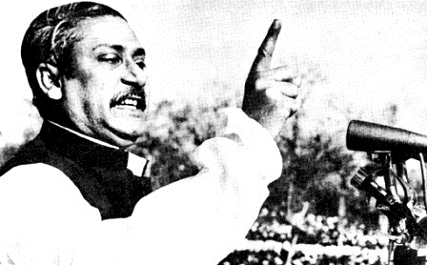
About Father of Nation
Bangabandhu Sheikh Mujibur Rahman is the father of Nation of Bangladesh. He is the architect of independent Bangladesh. The historical speech of Bangabandhu on 7th March in 1971 has great significance in the history of Bangladesh.
It is the first formal declaration of liberation presented in front of millions people in the Race Course Maidan.
It was the time when the whole nation was fierce to attain independence from Pakistan.
Father of Nation

Slide 22
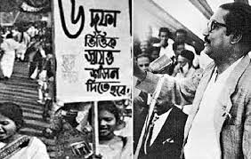
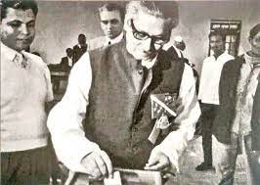
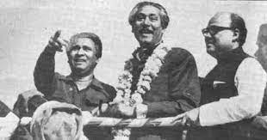
In 1966 Bangabandhu launched the six-point-movement. It is regarded as the manifestation of Bengalis’ emancipation.
In 1970 the people of Bangladesh voted as one as him, for Awami League.
Father of Nation

Slide 23
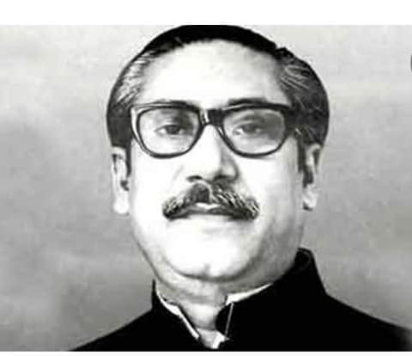
A fact file on Bangabandhu’s life.
Born on 17 march, 1920 in Tungipara.
Became the first President of Independent Bangladesh in 1971
Showed sign of future leader by distributing rice among poor .
Launched the historical Six Point Movement in1966.
Played a leading role in the student movement in 1952.
Entered a second coalition government as a minister in1956.
Joined the Awami Muslim League and was elected GS in 1953.
Became the undisputed leader of AL in 1957.
Father of Nation

Slide 24
Pair Work
Read the speech again.
The speech has reference to some years and dates in our history. Find out their historical importance and complete the flow chart, ending with 25 March’1971
1958
1966
23 February 1969
7 December
1970
25 March 1971

Slide 25
HOME WORK
Write a paragraph on “War of Independence.”

Slide 26
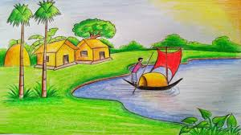
Thank you

