Slide 1


Welcome

Slide 2
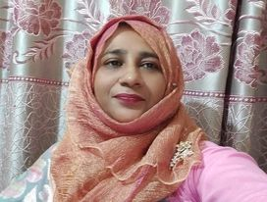
Presented by
Maksuda khatun
Assistant Teacher
S.M Govt. Primary School.
Meherpur sadar, Meherpur.

Slide 3
3
Lesson’s Identity
Unit-17
Section A & B
Page- 35
Lessons-4-6

Slide 4
By the end of the lesson students will be able to -
Students will be able to-
Listening: 1.1.1 become familiar with English sounds by listening to command English words.
Speaking: 1.1.2 say simple words and phrases with proper sounds and stress.
Reading:1.4.1 read words and phrases with the help of visual clues(about 30 new words) and simple sentences.
2.1.1 say simple words and phrases with proper sounds and stress.
Writing : 2.1.1 write cardinal number up to 30 in figures.

Slide 5
Let’s watch a video
https://youtu.be/tRNy2i75tCc
Everybody listen the rhyme carefully

Slide 6


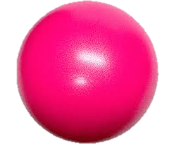
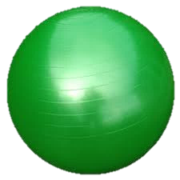
19
How many balls are there?
Find out the green ball.
4
balls

Slide 7

7
Today’s lesson is-
COLOURS AND NUMBERS
Lesson declaration

Slide 8
Let’s know the 7 colours.
red
orange
yellow
green
blue
violet
indigo

Slide 9


Count and write the number.
4
_______roses

Slide 10

Count and write.
_______bats
7

Slide 11

Count and write the number.
6
_______butterflies

Slide 12


Count and write the number.
3
_______kites

Slide 13
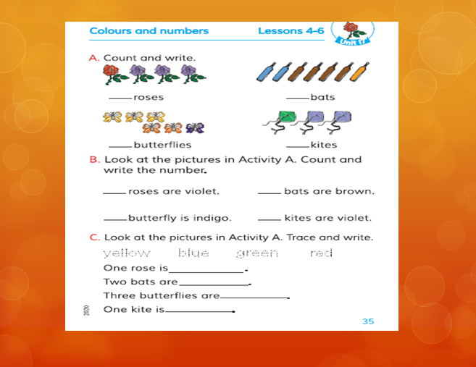


Open your English book at page 35

Slide 14
B. Look at the pictures in Activity A. Count and write the number.
3
4
___roses are violet
___bats are brown
1
2
___butterfly is indigo
___kites ase violet

Slide 15




19
Evaluation
Write the colour’s name below the pictures.
blue
________________
violet
________________
green
________________
orange
________________

Slide 16

How many roses are there?
8
roses

Slide 17
How many colours are there in Rainbow?
7 Colours

Slide 18
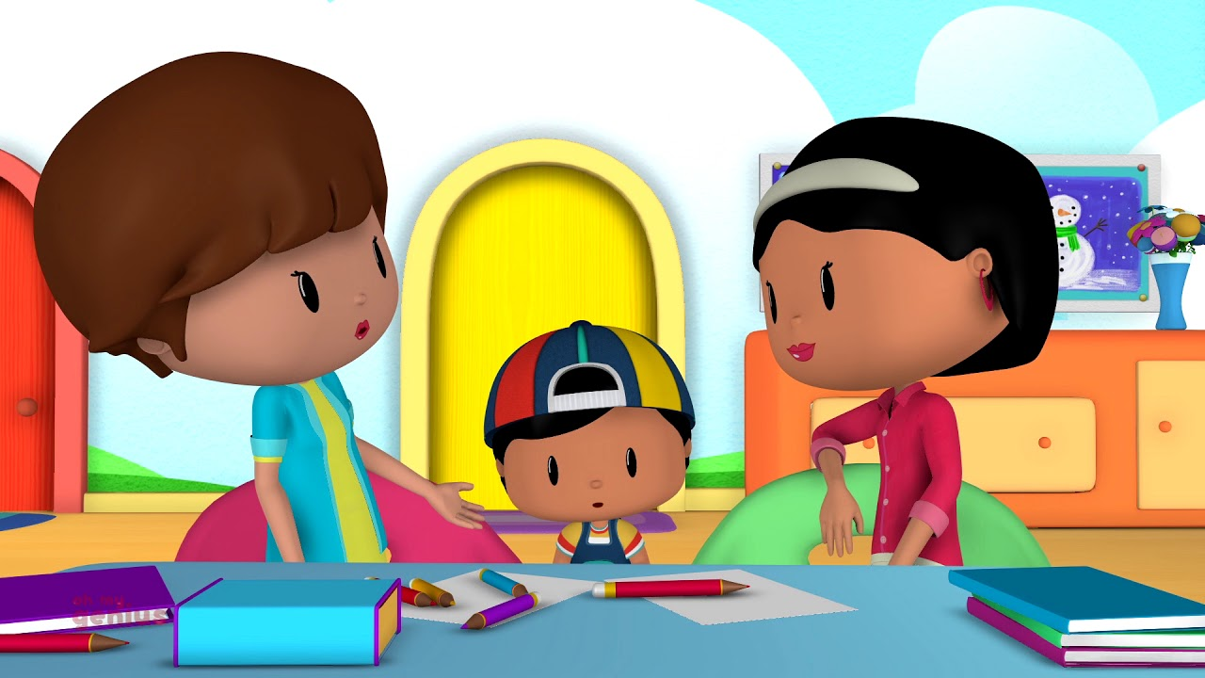
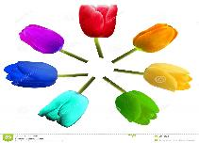
20
Home work
Write 7 colours at home and number from 1-30.

Slide 19




21
Good
STAY HOME
STAY SAFE
Thanks to all

