Slide 1
jh
Welcome to my class

Slide 2
English For Today
Class: Three
Unit: 34
Lesson: I’m Tisha…….Old.
Nahidal Arjin
Assistant Teacher
Boddipur Govt. Primary School
Satkhira Sadar, Satkhira

Slide 3
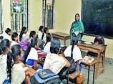
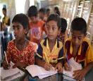
Good morning, students.
Good morning, Teacher.
How are you students?
Fine, thank you teacher.

Slide 4
Let’s See a Video
Click the video below:
What do you see in the video?

Slide 5
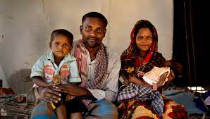
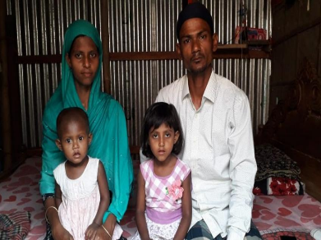
Look at the picture and say about it.
Family

Slide 6
Lesson declearation
My family

Slide 7
Learning Outcomes
Listening-4.3.1 enjoy and understand simple stories.
1
2
Reading- 5.1.1 read simple paragraphs.

Slide 8
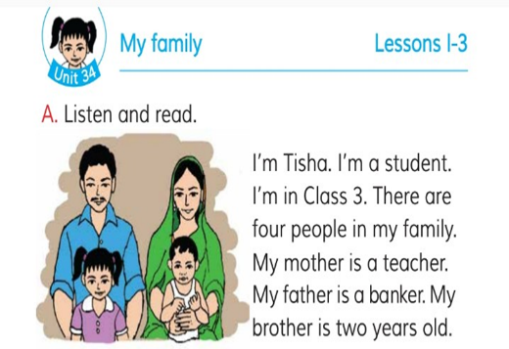
Teacher’s reading
Open page at 68

Slide 9
Listen to the audio carefully.
Listen to the audio again.

Slide 10
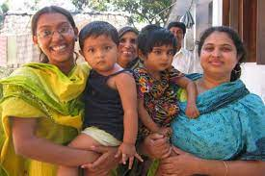
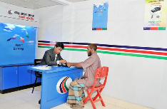
NEW WORD
people
জনসাধারণ
ব্যাংকে চাকুরি করেন
Banker

Slide 11
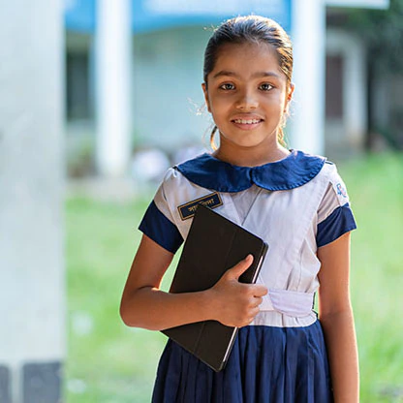
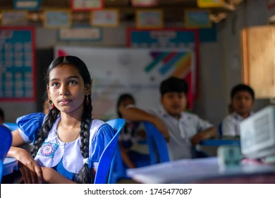
Look at the picture and read the text
I’m Tisha. I’m a student. I’m in class 3.

Slide 12
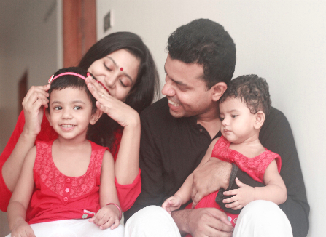
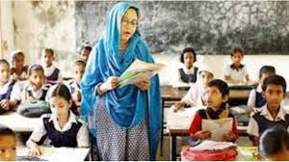
Look at the picture and read the text
There are four people in my family.
My mother is a teacher.

Slide 13
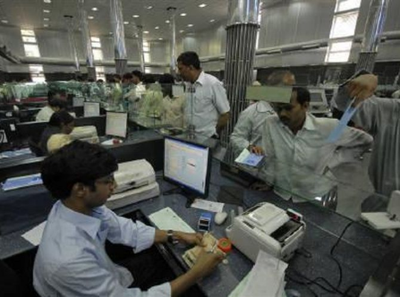
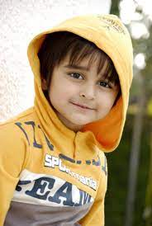
Look at the picture and read the text
My father is a banker.
My brother is two years old.

Slide 14
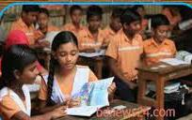
Pair Work
Read the Text
Open your book page at 68

Slide 15
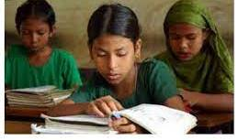
Silent reading

Slide 16
Pair work
Fill in the blank with correct word
two
three
four
Tisha is in class …………….
There are ……………people in her family.
Her brother is …………… Years old.

Slide 17
Evaluation
Answer the following question.
1. What is Tisha?
2. How many people are there in Tisha’s family?
3. What class is Tisha read in?

Slide 18
Home Work
Write 5 sentences about your own family.

Slide 19
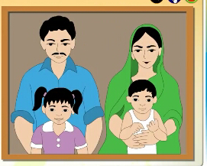
One day one word
Family
পরিবার
I love my Family.

