Slide 1
Welcome to you all

Slide 2
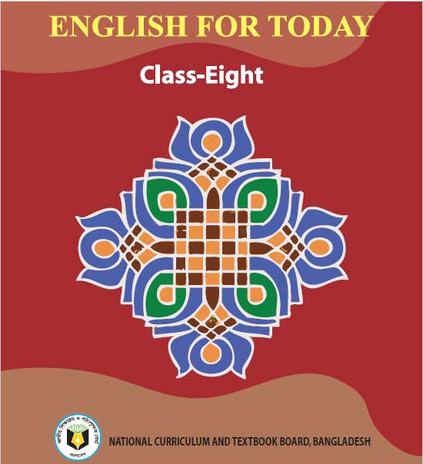
Identity
Unit -5,
Lesson 1
Md. Shamsul Alam
BA(Hons.)MA in English.
Assistant Teacher( English)
Nabodoy Girl’s High School
Shailkupa Jenaidah.
Phone:01917-452052,01722-922691
Email:shamsul101085@gmail.com
Bangabandhu and the Language Movement

Slide 3
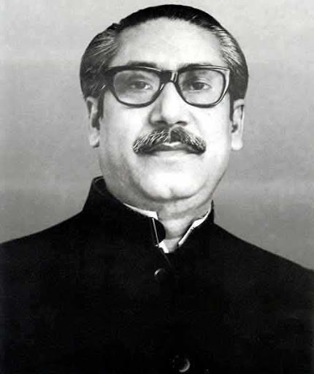
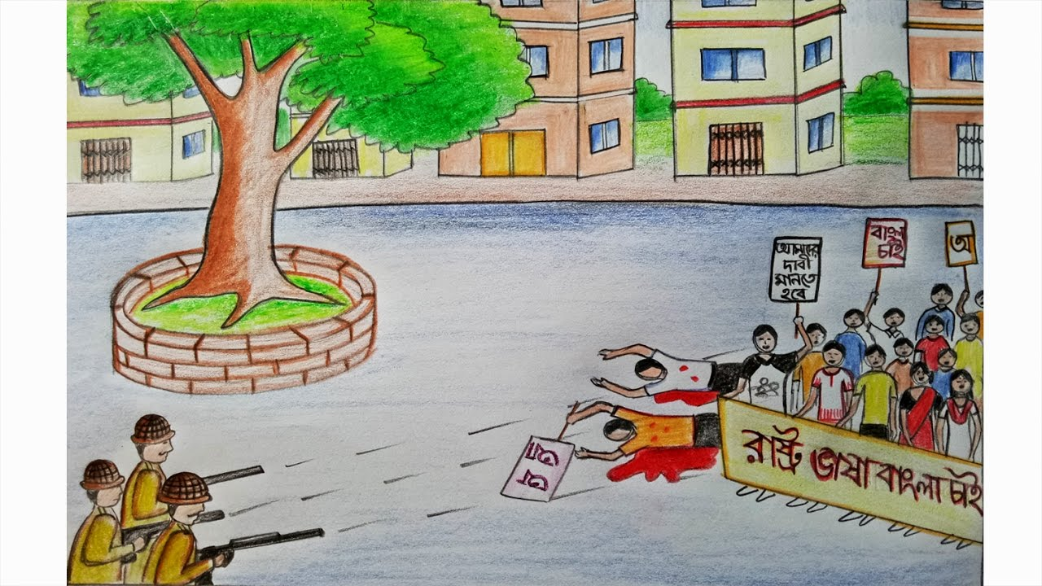
Whom can you see in the picture below…
What can you see in the picture below…
Bangabandhu Sheikh Mujibur Rahman
Language movement

Slide 4
Todays lesson is…….
Bangabandhu and the Language Movement
Unit- 5, lesson-1

Slide 5
After studied the lesson, students will be able to……
Read and understand texts through silent reading.
Infer meaning from context.
Write answer to questions.

Slide 6
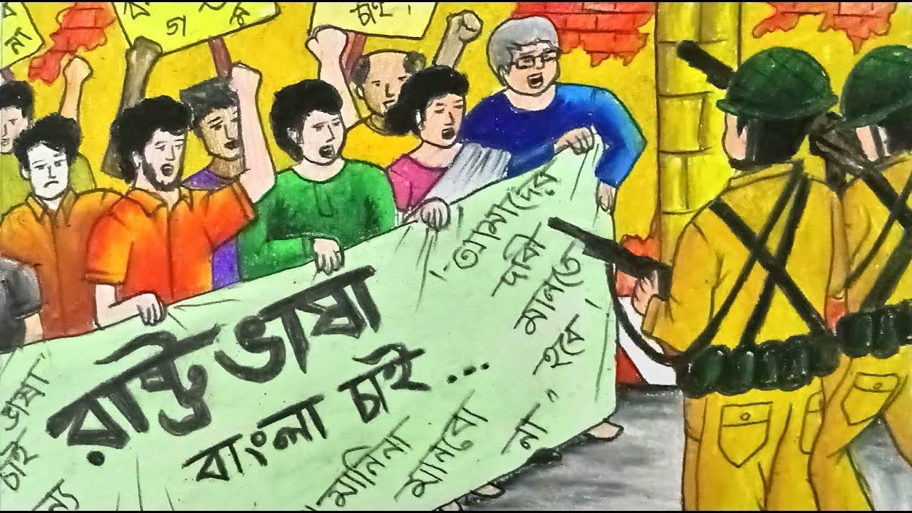
Movement
the act or process of changing a situation or event,
or
of changing the way something happens or is done

Slide 7
Discriminatory
making or showing an unfair or prejudicial distinction between different categories of people or things, especially on the grounds of race, age, or sex.

Slide 8
Identity
the fact of being who or what a person or thing is.
Name, specification, identification, recognition

Slide 9
emergence
the process of becoming visible after being concealed.
the process of coming into existence or prominence.

Slide 10
Sheikh Mujibur Rahman was one of the few student leaders who played a significant role in turning the language movement into a mass movement. As a student leader, he was the central figure in organizing mass gatherings, rallies and strikes for raising awareness against the discriminatory language policy of Pakistan.

Slide 11
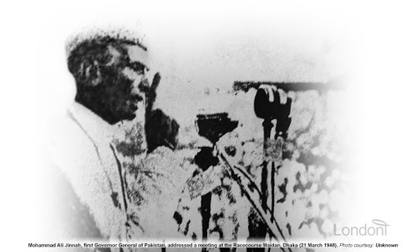
The language movement started when the Governer General of Pakistan , Muhammad Ali Jinnah, declared “ Urdu and only urdu shall be the state language of Pakistan” on 19 March 1948 at the Racecourse Maidan while addressing a public gathering.

Slide 12
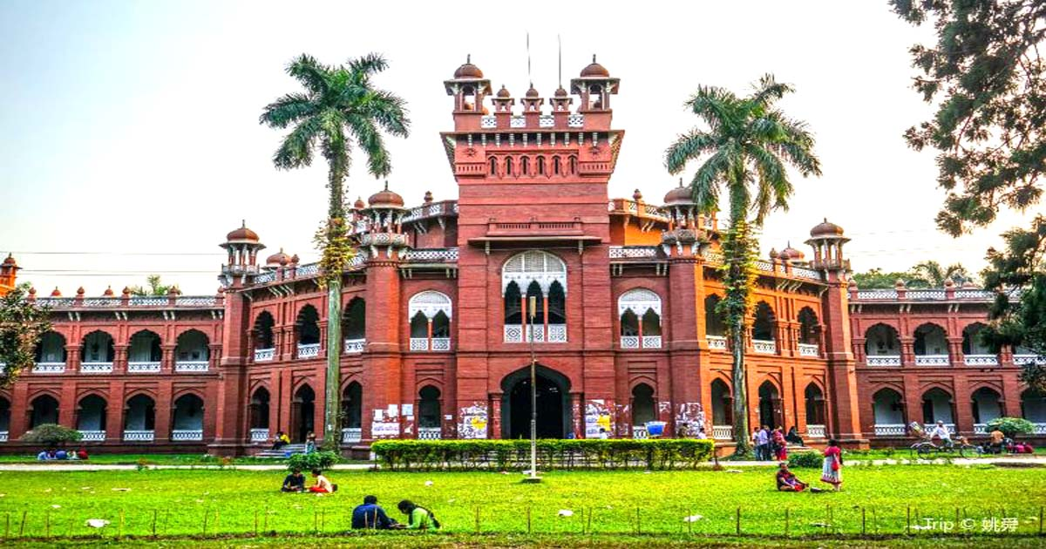
He again uttered the same on 24 March 1948 at the University of Dhaka during his convocation speech. The students instantly protested against this announcement vehemently.

Slide 13
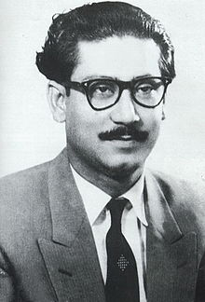
It was the time when young Mujib started organizing the student front of Muslim League in East Pakistan. He was proud of his Bengali Identity and very active to initiate strikes and protests against the language policy of Pakistan government.

Slide 14
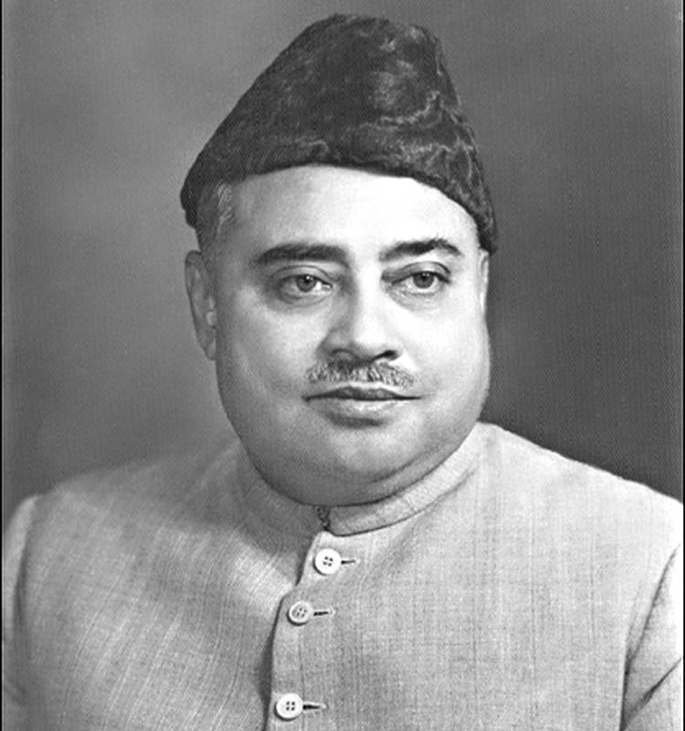
Later, the then Prime Minister of Pakistan Khwaja Nazimuddin echoed the statement of Mr. Jinnah on 26 January, 1952.

Slide 15
Mujib was in prison during this time due to his political activism and was admitted to the Dhaka Medical College under police custody. However, he stayed in constant touch with other leaders directly engaged in the movement to a success. On 14 February, he started a hunger strike there.

Slide 16
During general strike on 21 February, 1952 the protesting students tried to defy section 144 imposed by the government. The police opened fire and killed a number of student s including Abdus Salam. Rafiq Uddin Ahmed, Abun Barkat, Abdul Jabbar and others .

Slide 17
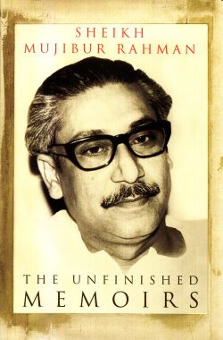
In his autobiography, Sheikh Mujibur Rahman says, “…… We decided in the meeting in my room to observe 21 February as state Language Day and to form a committee that day to conduct the movement to establish Bengali as the state language.”

Slide 18
Read the text B silently.

Slide 19
5 minutes
C. Choose the correct answer and put a tick mark beside it.

Slide 20
Match your answer
Sheikh Mujibur Rahman played a significant role in our Language Movement.
What does the underlined word mean here?
a) Famous
b) Important
c) infamous
d) Active
2. The protesting students tried to defy section 144 imposed by the government.
What does the underlined words mean in this sentence ?
a) to refuse
b) to agree
c) to accept
d) to obey
3. What is the meaning of the word “autobiography” in the passage ?
a) The story of a person’s life written by somebody else.
b) The story of a person’s life written by his friends.
c) The story of a person’s life written by that person himself.
d) The story of a person’s life written by a journalist.

Slide 21
4. Which of the following words is the meaning of “central” in the passage?
a) Most important
b) Less important
c) unimportant
d) popular
5. “ We decided in the meeting in my room to observe 21 February as State Language day.” What does the underlined word mean ?
a) To celebrate
b) To maintain
c) To understand
d) To arrange

Slide 22
10 minutes
D Read the text again and answer the following questions.
1. Where was Sheikh Mujibur Rahman during the Language Movement in 1952?
2. Why do you think Mujib struggled for establishing Bengali as the state language ?
3. What happened on 21 February in 1952?

Slide 23
Match your answer
1. Answer: During the Language Movement in 1952 Sheikh Mujibur Rahman was in prison and was admitted to the Dhaka Medical College under police custody .
2. Answer: Sheikh Mujibur Rahman stayed in constant touch with other leaders directly engaged in the movement to make Bangla the state language. His directions from prison led the movement to a success. So I think Mujib struggled for establishing Bengali as the state language.
3. Answer: During a general strike on 21 February, 1952 the protesting students tried to defy Section 144 imposed by the government . The police opened fire and killed an number of strudents including Abdus Salam, Rafiq Uddin Ahmen, Abul Barkat, Abdul Jabbar and others.

Slide 24
5 minutes
E Match the phrases with their contextual meaning.

Slide 25
Match your answer.
Discriminatory
unfair
Vehemently
Strongly
Open fire
Began to shoot
Stay in touch
Be in communication
Engaged in
Involved
Raise awareness
Involved in

Slide 26
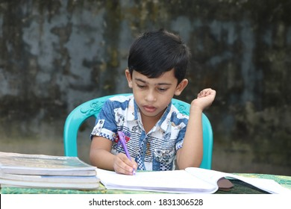
Home work
F Identify the main points in the text in Section B and rewrite the text again in 100 words.

