Slide 1
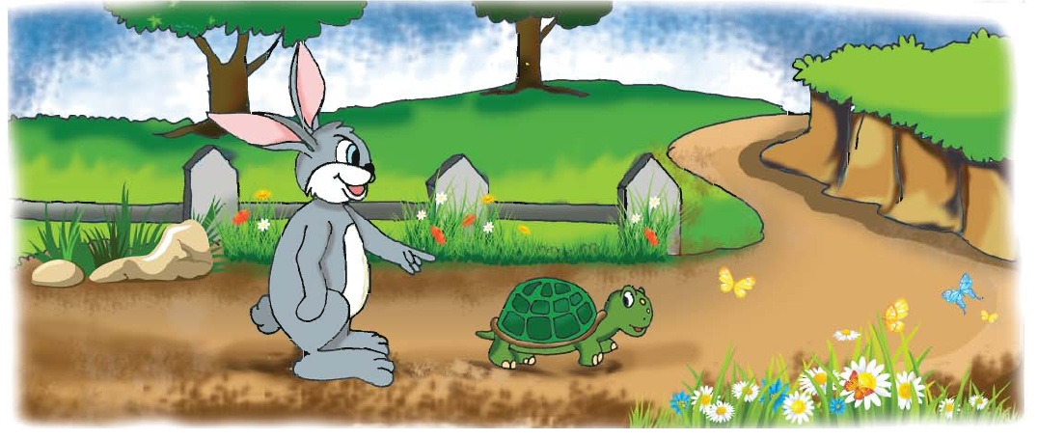
Welcome To Everybody

Slide 2
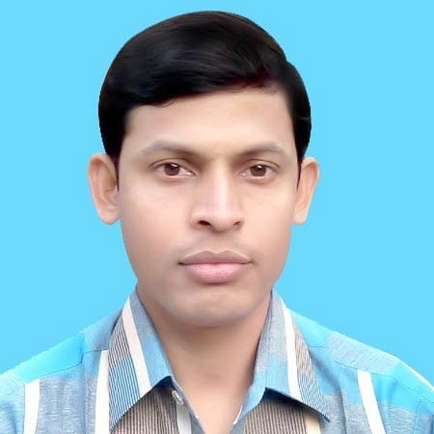
Teacher’s Identification
Md. Kamrul Islam
Assistant Teacher
15 No. Bag-Basantapur Govt. Primary School
Kaliganj, Satkhira
Mobile No : 01716-342134; 01911-575706
email : kamrulsirbgps@gmail.com

Slide 3
Lesson Identification
Class-Five; Subject-English
Lesson Unit-14
(Story: The Hare and the tortoise)
Today’s Lesson-A (One day a hare was ------ race begin)

Slide 4
Learning Outcomes
Student will be able to-----
understand and enjoy simple stories
read words, phrase and sentences in the text. with proper pronunciation, stress and intonation.

Slide 5
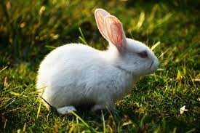
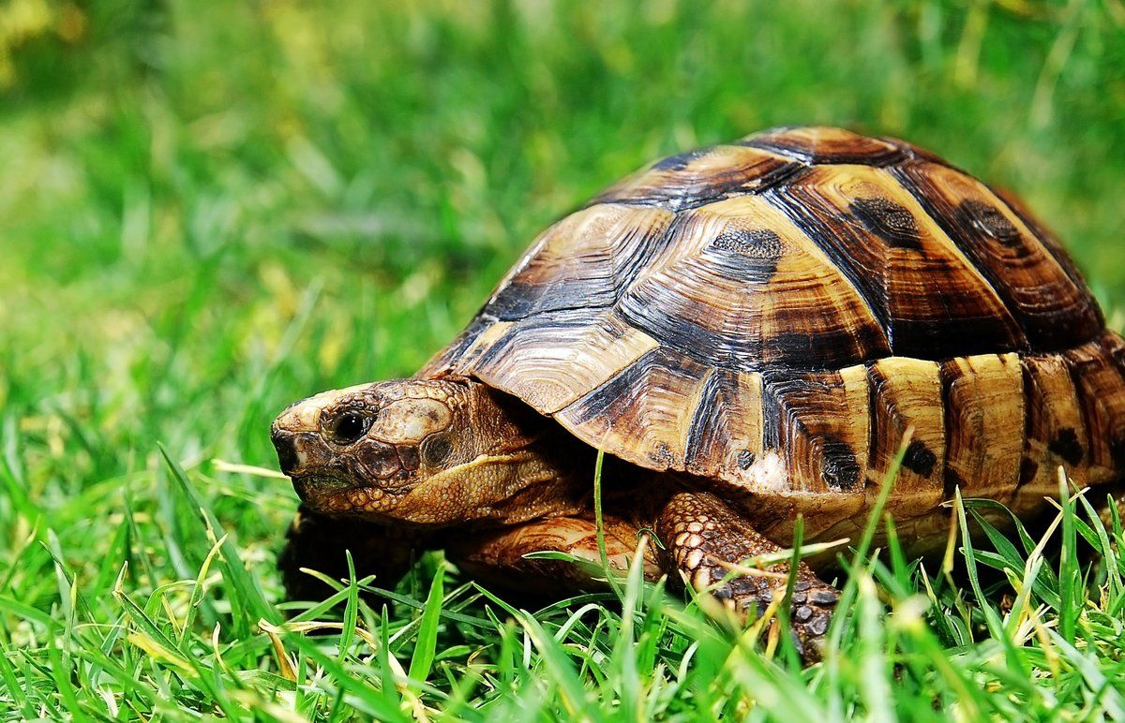
What Can You See in the Picture?
A hare
A Tortoise

Slide 6
Let’s watch a video
What do you see in this video

Slide 7
Today’s our lesson is ...

Slide 8
Let’s find new words, meaning them and make sentences
NEW WORDS
Start
Angry
Laugh
Fast
Slow
Finish

Slide 9
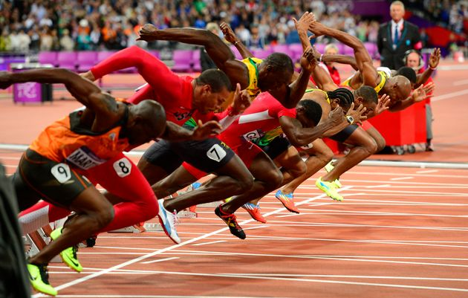
New Words
Start
Begin
Let’s start the game.

Slide 10
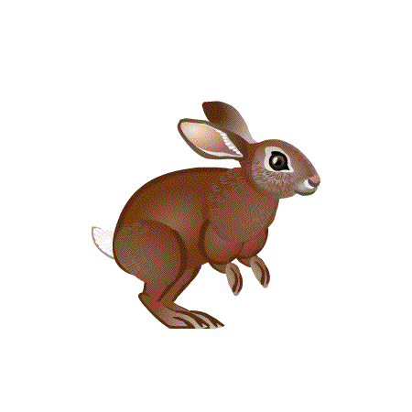
New Words
Fast
Quick
The hare is the fastest animal.

Slide 11
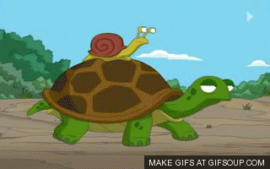
New Words
Slow
Late
The tortoise is the slowest animal.

Slide 12
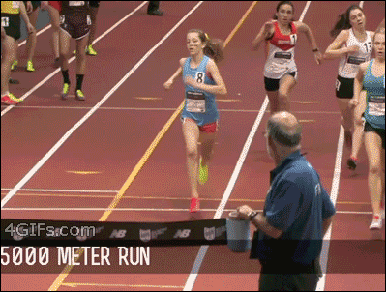
New Words
Finish
End
They crossed the finish line.

Slide 13
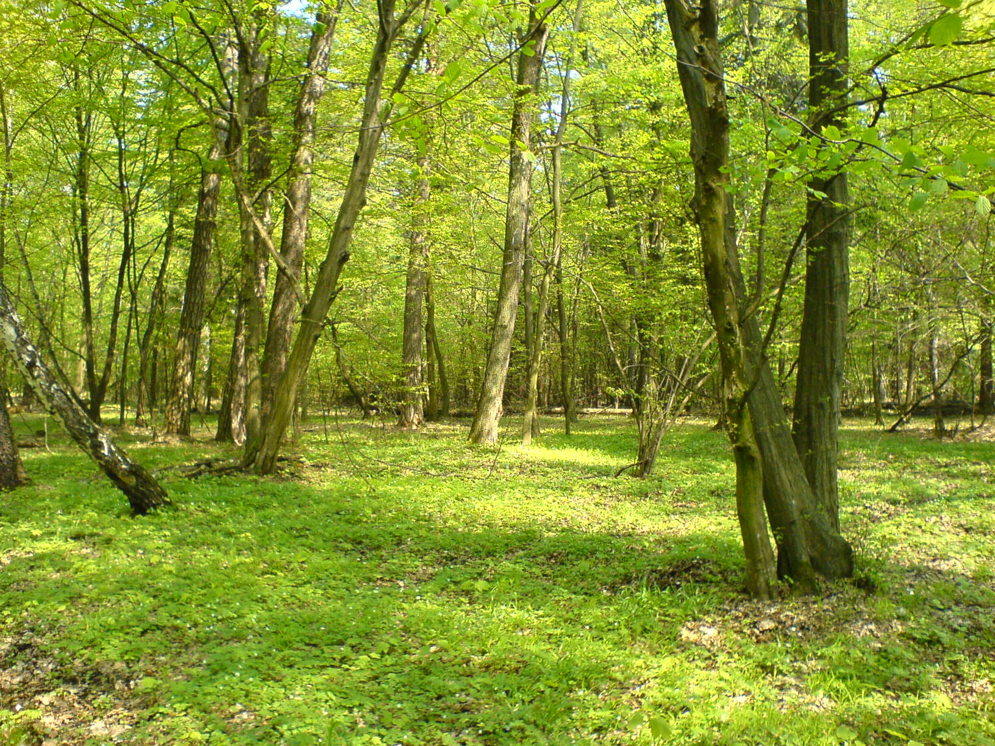
Look and listen
One day a hare was waking in the forest, when he saw a tortoise.

Slide 14
Look and listen
The hare was the fastest animal in the forest.
The tortoise was the slowest animal in the forest.

Slide 15
Look and listen
The hare called out to the tortoise, “Hurry up! You are so slow! Can’t you walk faster? Can’t you run?”

Slide 16
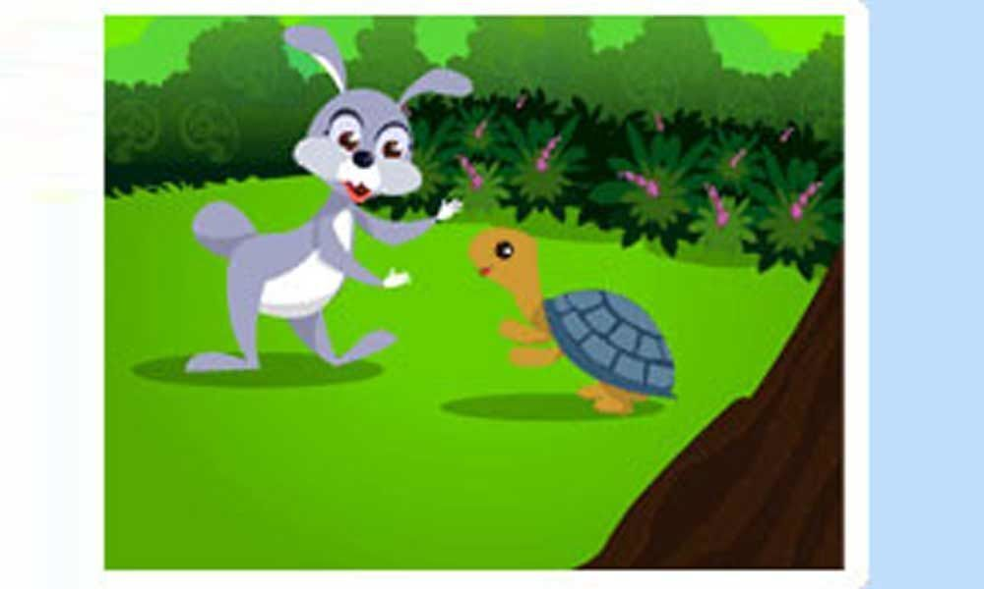
Look and listen
The hare laughed and laughed. “Sure! I will win!” The hare said

Slide 17
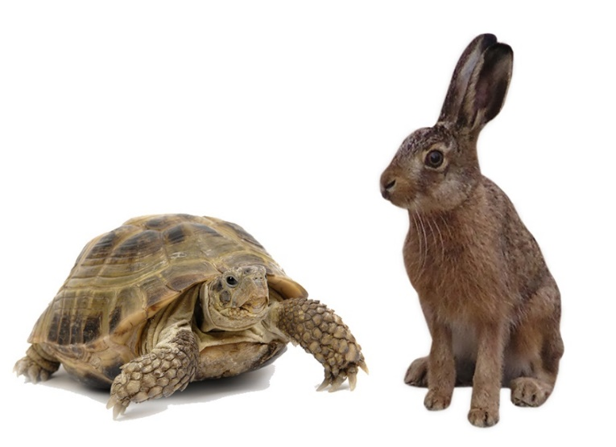
Look and listen
The tortoise felt angry and said to the hare, “Why don’t we have a race? Maybe I can win!”

Slide 18
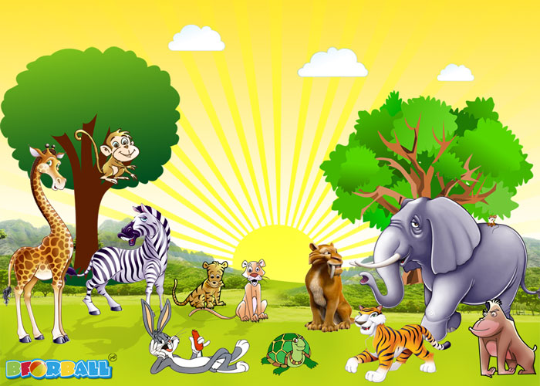
Look and listen
Then they called their friends to watch.

Slide 19
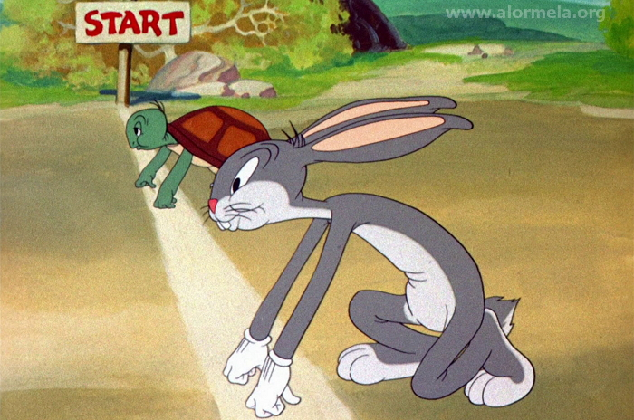
Look and listen
The hare stood beside the tortoise and the race began.

Slide 20
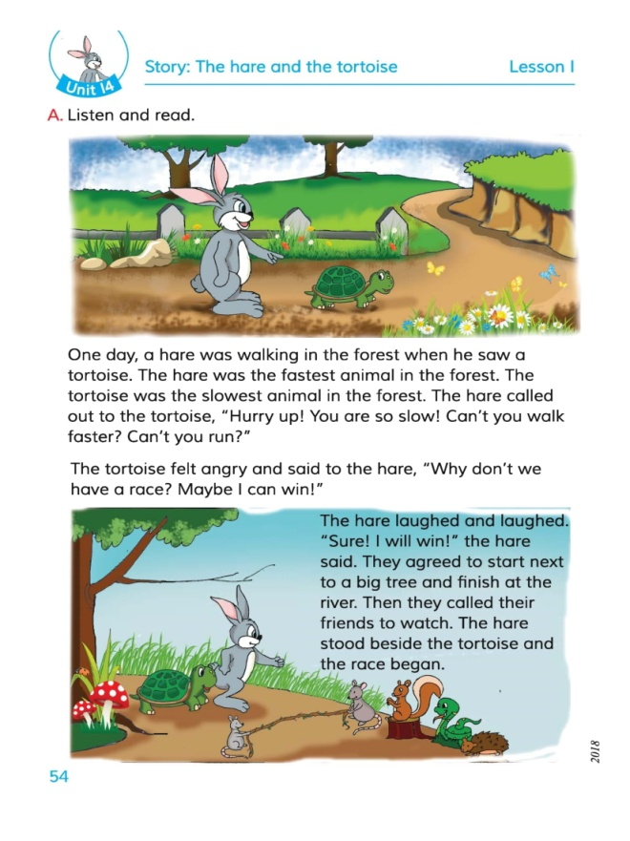
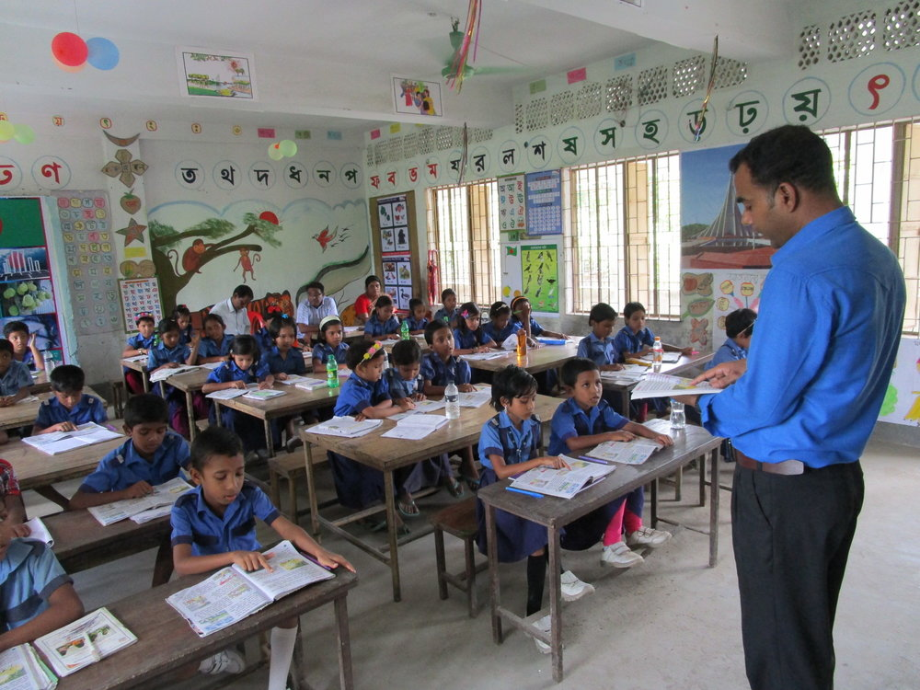
Open at page no-54
Teacher’s loud reading

Slide 21
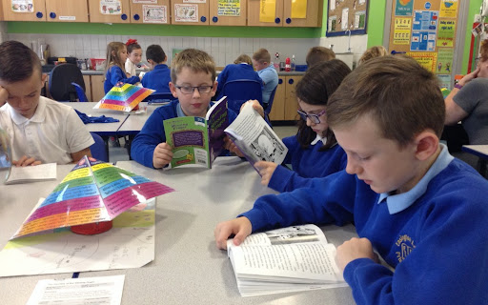
Students silent reading

Slide 22
Individual Work
Answer the questions
Who was the slowest animal in the forest?
Who felt angry?

Slide 23
Pair Work
Math the column A with their meaning in column B
Column A | Column B
Start | End
(b) Fast | (ii) Smile
(c) Slow | (iii) Late
(d) Laugh | (iv) Quick
(e) Finish | (v) Begin
Ans. (a+v); (b+iv); (c+iii); (d+ii); (e+i)

Slide 24
Group Work
Write True or False
The tortoise was the fastest animal in the forest.
The hare felt angry.
The hare lived in a jungle.
The race started from the bank of a river.
Ans.
(1) False (2) False (3) True (4) False.

Slide 25
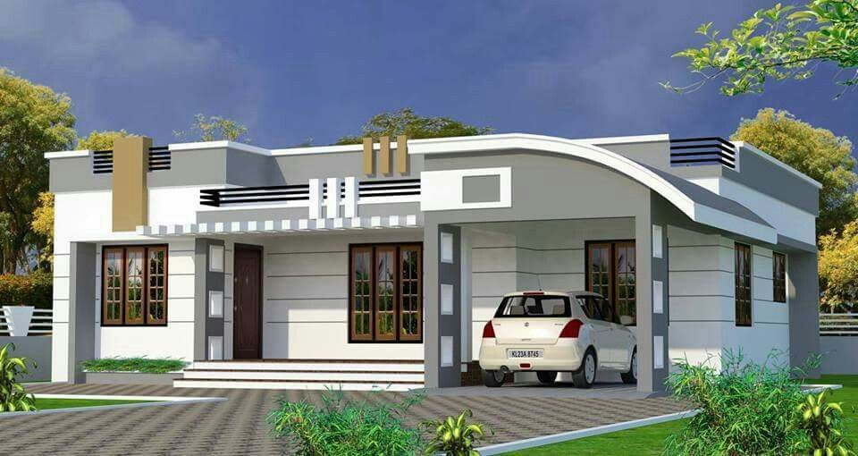
Home Work
Write 5 sentences about “The race between the hare and the tortoise.”

Slide 26
See & talk you the next class

