Slide 1
Welcome you all, dear students.

Slide 2
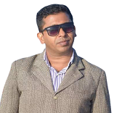
Identity
Md. Abdul Gafur,
Assistant teacher
Gaiar Bhanga G.P.S
Lalmai, Cumilla.
Unit: 03
Lesson: 1-2
Time: 40 minutes
Date: 9/6/2021

Slide 3
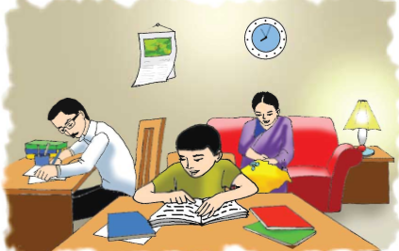
Look at the picture
What do you see in the picture?

Slide 4
Our Today’s lesson is-
Saikat’s family

Slide 5
Learning outcomes
Students will be able to-
Listening: 3.2.1 understand questions about family and friends of students.
Speaking: 6.2.1 talk about people, objects,events etc.
Reading: 1.7.1 read paragraphs,dialogues, stories, letters and other texts.

Slide 6
New words
Flat
Apartment
Live
To reside
Parents
Father and mother
Neighbour
Not far from
Housewife
Household

Slide 7
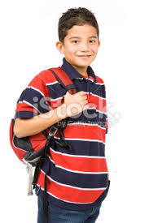
Who is he?
He lives in Bogura.
He is Saikat.

Slide 8
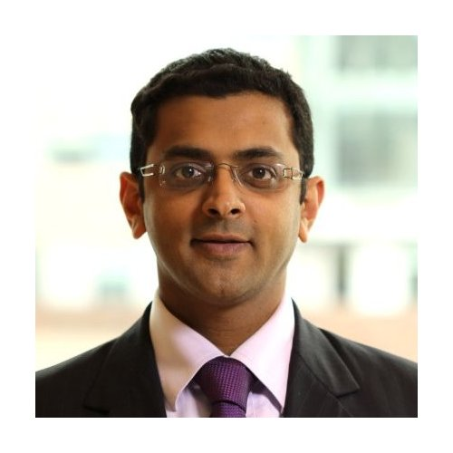
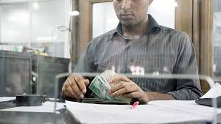
Who is he?
He is Saikat’s father.
His name is Mr.Rashidul Islam.
He is a banker.

Slide 9
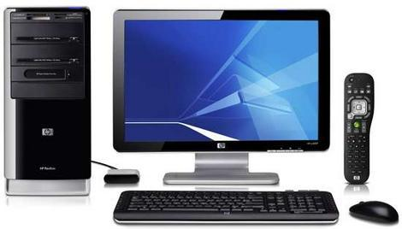
Saikat’s father.
In his free time, he writes stories and listens to music.

Slide 10
Individual Work
1.What is Saikat’s father’s name?

Slide 11
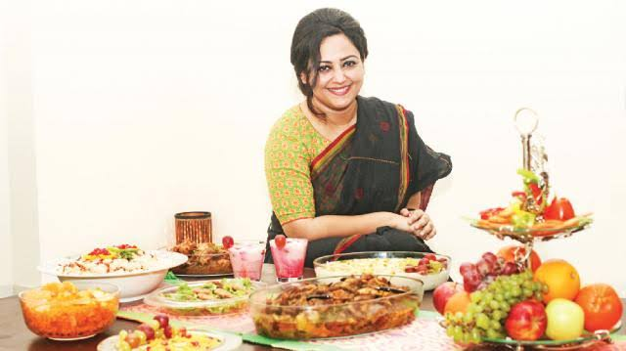
Who is she?
She is Saikat’s mother.
Her name is Monwara Islam.

Slide 12
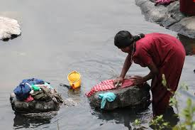
Saikat’s mother is a housewife.

Slide 13
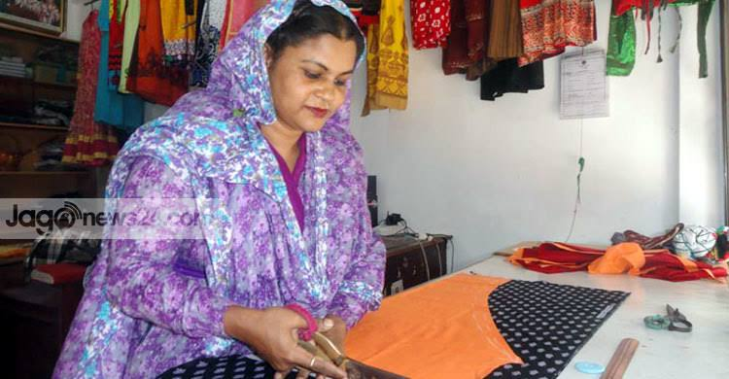
In her free time, she enjoys sewing.
Saikat’s mother.
She makes dresses.

Slide 14
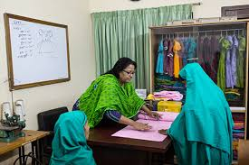
She often gets orders from her friends and neighbours.

Slide 15
Pair Work
1.What does Saikat’s mother do?

Slide 16
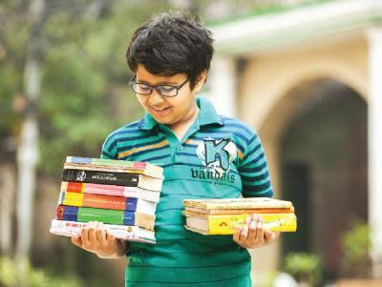
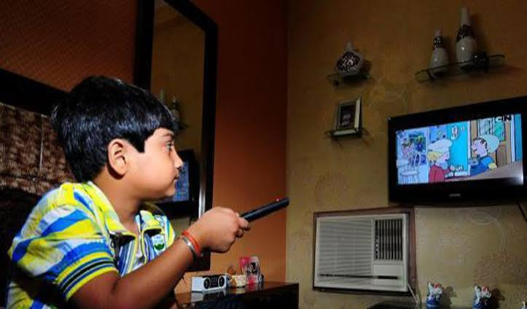
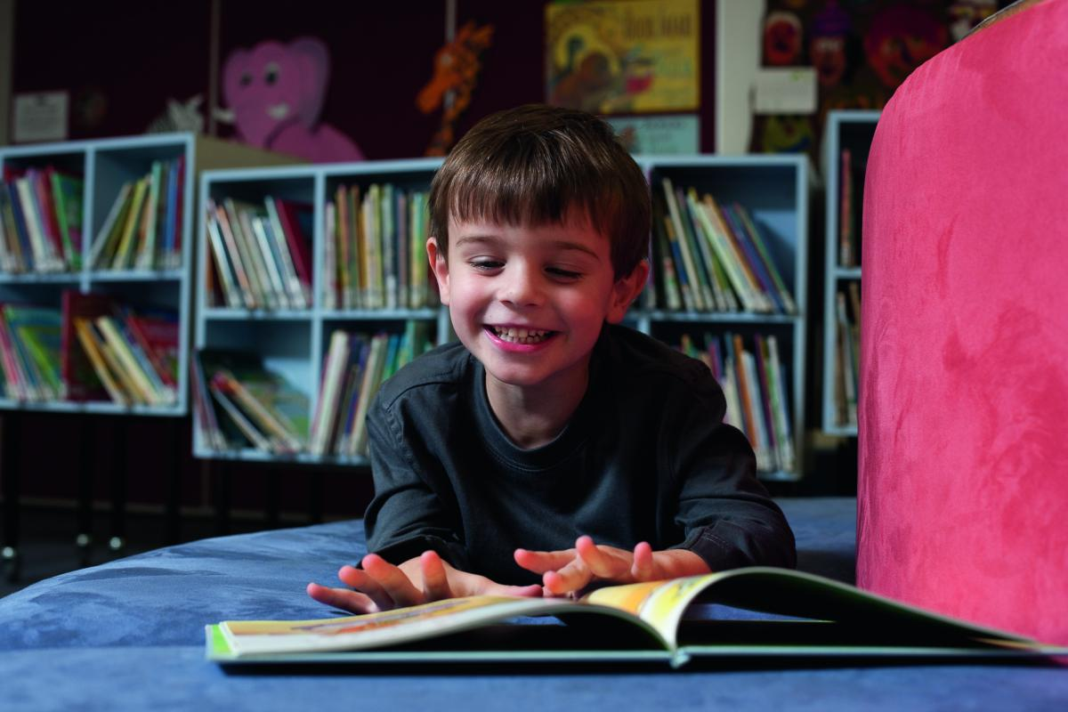
Saikat is a good student.
He wants to improve his English. So he watches cartoons on TV everyday.
He also reads English books.

Slide 17
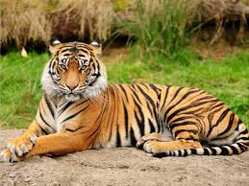
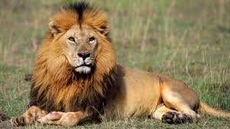
Saikat likes books about animals, especially tigers and lions.

Slide 18
What is this?
Saikat’s family tree.

Slide 19
Saikat’s Family
Saikat
Saikat’s father
Saikat’s mother

Slide 20
Write True or False.
a) Saikat reads in class 5.
b)Mr. Rashidul Islam lives in Baogura.
c) Mrs. Monwara Islam watches cartoons on TV everyday.
d)There are three members in Saikat’s family.
e) Mr. Rashidul Islam reads stories in his free time.
f) Saikat likes books about fruits.
True
True
False
True
False
False

Slide 21
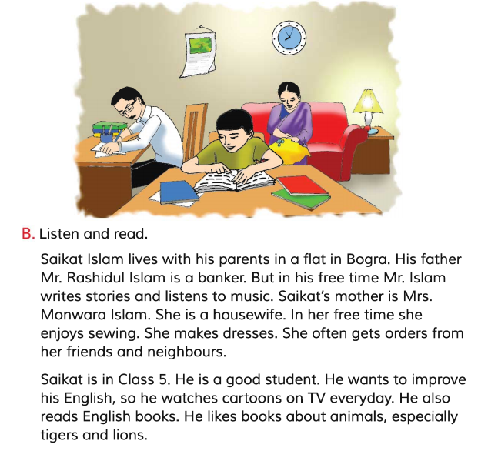
Now open your English book at page number 10. Listen to me attentively and put your finger under the line.
Read the text silently.

Slide 22
Fill in the gaps with the correct word.
Banker, parents. Reads. Student, father, teacher, makes, flat
student
a) Saikat is a good ………………. .
b) Saikat lives in a …………….. .
c) Mr. Rashidul Islam and Mrs. Monwara Islam are Saikat’s… …………. .
d) Mr. Rashidul Islam is a ……………… .
e) Saikat’s mother ………………... dresses.
flat
parents
banker
makes

Slide 23
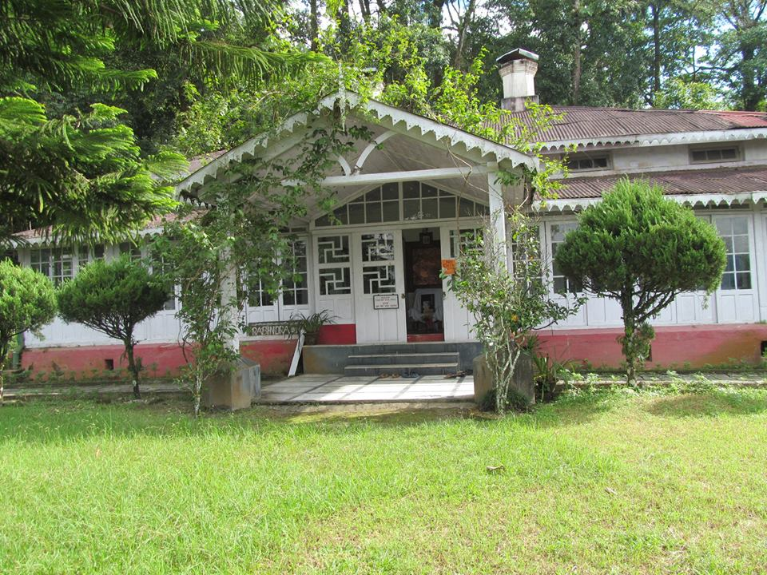
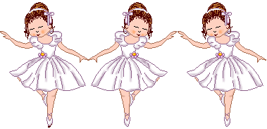
Home work
Write five sentences about “Your family”.

Slide 24
Thanks to all. Goodbye.

