Slide 1
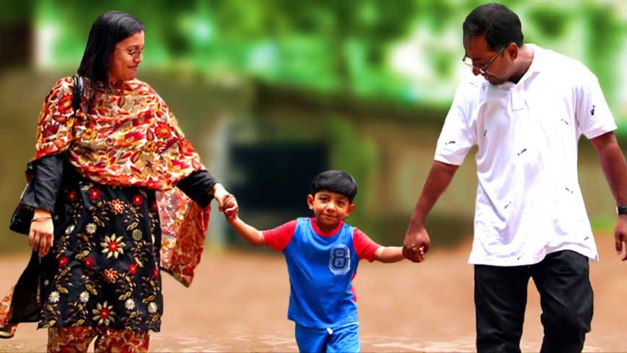
Welcome

Slide 2
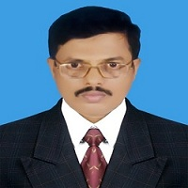
IDENTITY
Md. Saiful Islam Chowdhury
Senior Teacher
C. J. M High School,
Mohara,Chandgaon,Chittagong.
ENGLISH FOR TODAY
Class: - Eight
Unit-5; Lesson: –One ;
Time: 40 Minutes.

Slide 3
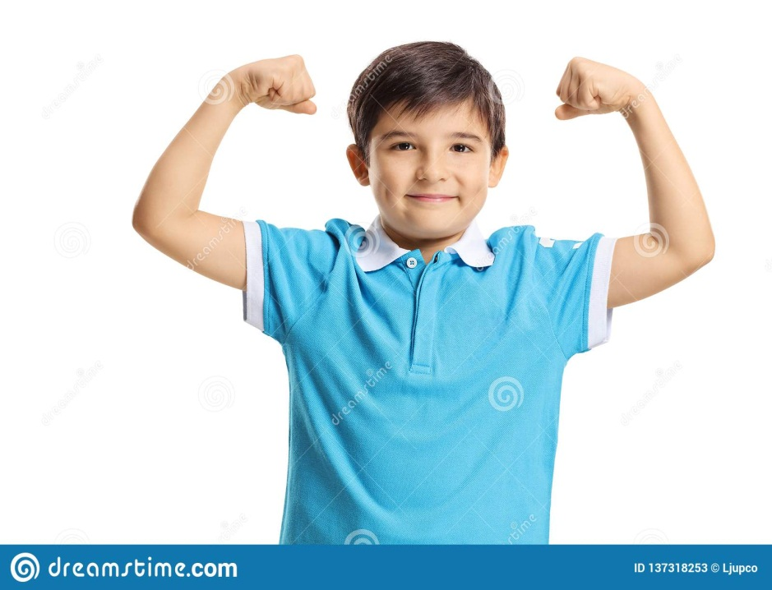
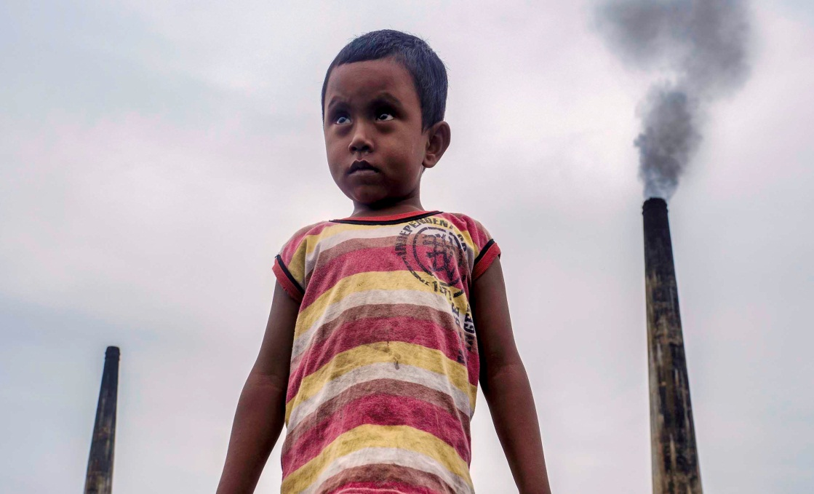
Look at the picture
Healthy boy
Unhealthy boy

Slide 4
Today our Lesson is about
Health
Unit-5; Lesson: –One ;

Slide 5
Learning outcomes
After completing the Lesson students will be able to
Read and understand texts through silent reading;
Ask and answer questions;
Write the answers to questions;
Write a short paragraph.

Slide 6
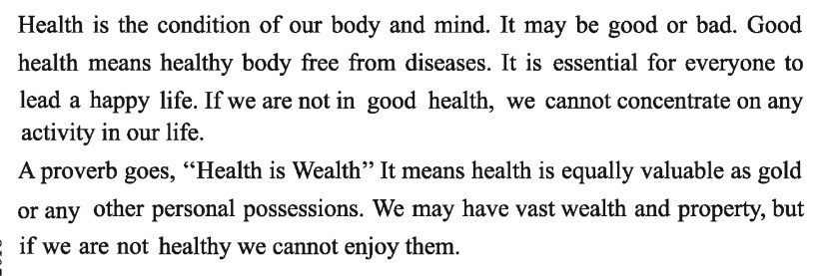
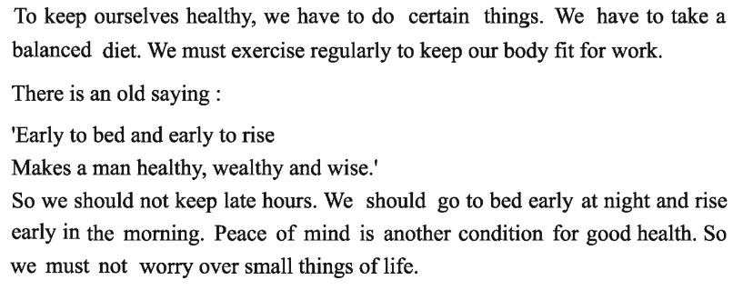
Read the following passage about Health

Slide 7
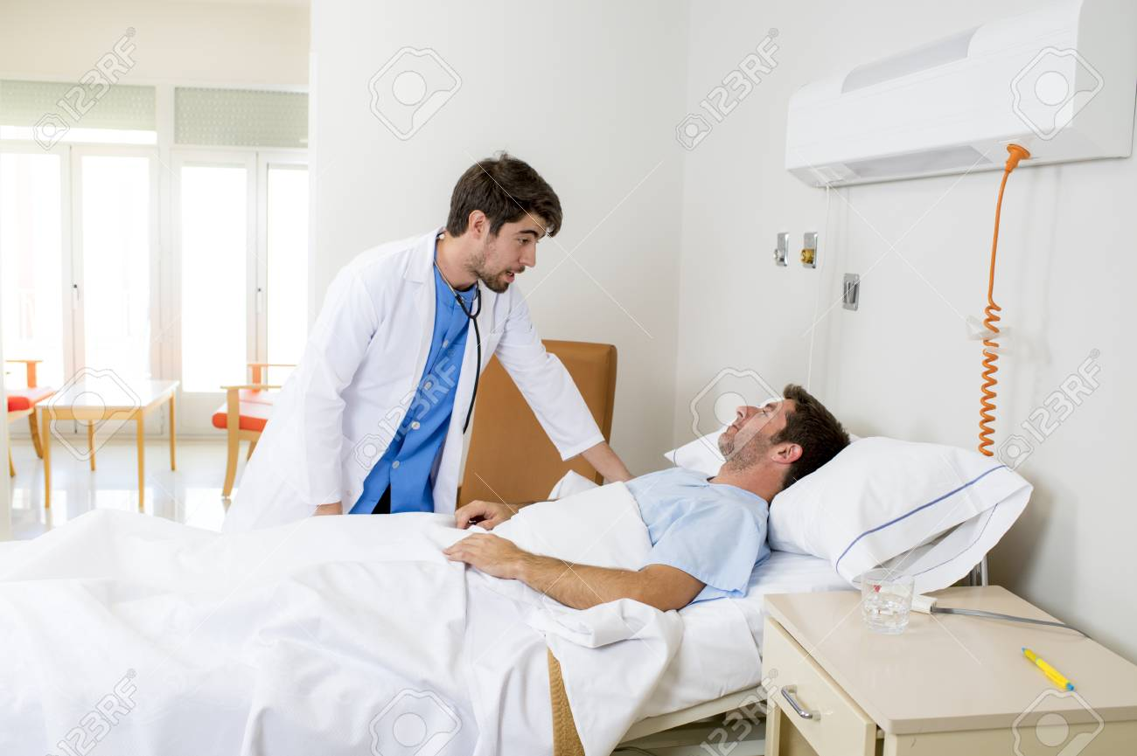
Key Word
Disease
Meaning
Illness
A disease known is half cured.

Slide 8
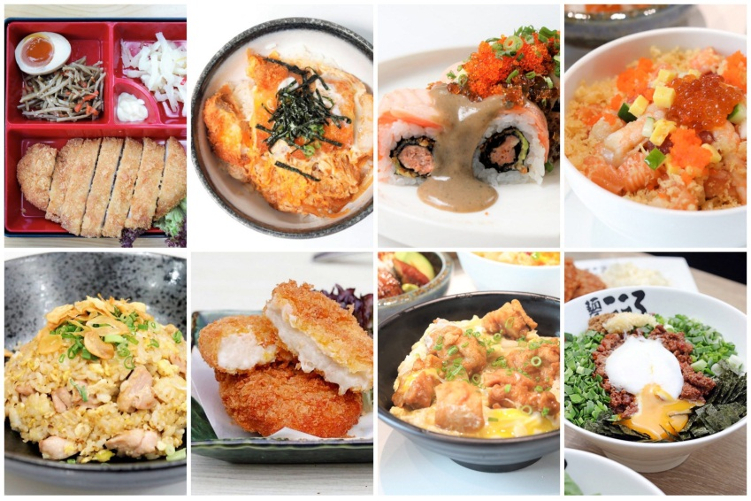
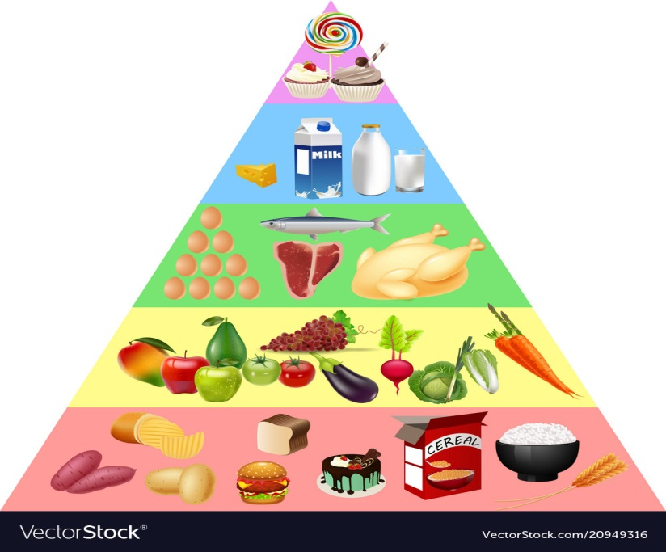
Key Word
Essential
Meaning
Necessary
Food is essential to life.

Slide 9
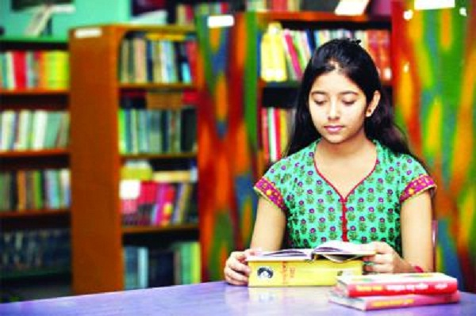
Key Word
Concentrate
Meaning
Focus / Centralize
You should concentrate on your study.

Slide 10
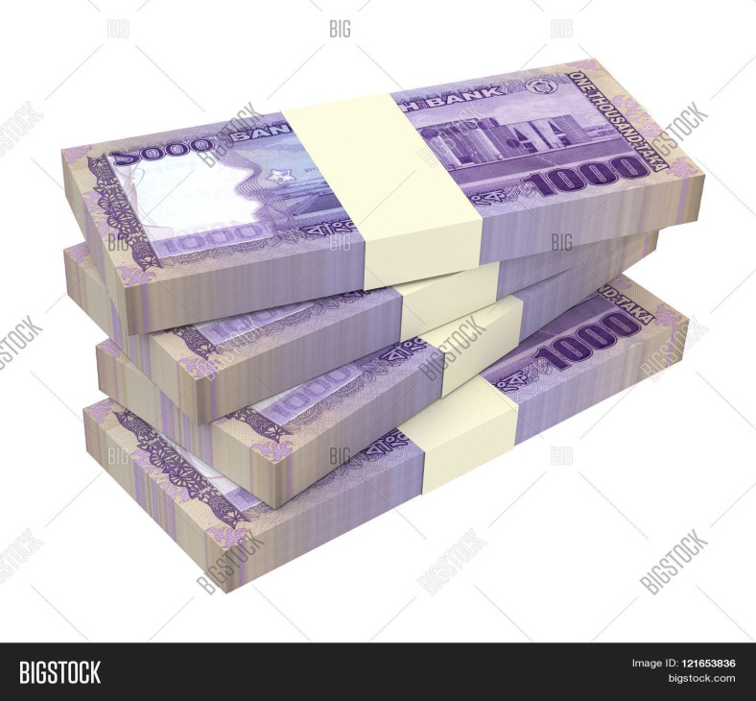
Key Word
Possession
Meaning
Ownership/Authority
Happiness does not lie in the mere possession of money.

Slide 11
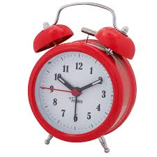
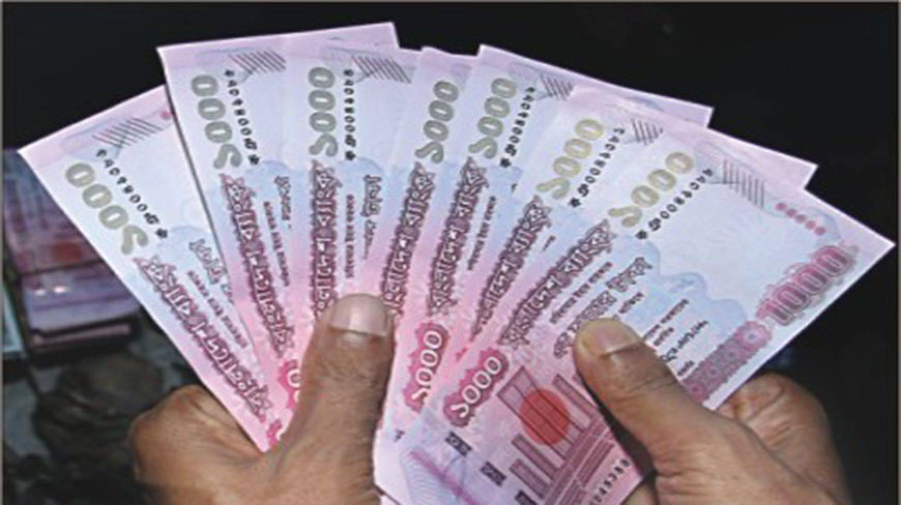
Key Word
Proverb
Meaning
Saying
As the proverb goes, time is money.

Slide 12
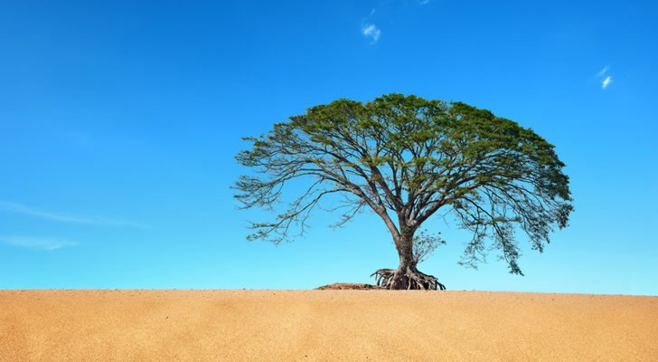
Key Word
Vast
Meaning
Huge
Vast areas of land have become desert.

Slide 13
Choose the correct answer from the alternative.
1.The physically weak person can hardly ___ on any work.
a. concentrates
b. not concentrate
c. concentrate
d. concentrated
2. The word ‘balanced’ in the text means-
a. fair
b. unequal
c. evenhanded
d. stabilized

Slide 14
3. The word ‘lead’ in the text means-
a. guide
b. direct
c. advance
d. live
4. The phrase ‘to keep late hours’ mean-
a. To go to bed late
b. To wake up late
c. To do things late
d. To be late in class

Slide 15
5. Gold is not __ valuable than health.
a. as
b. more
c. most
d. least
6. What is another condition for good health?
a. Vast property
b. Peace of mind
c. Money and power
d. Rich food

Slide 16
7. The word ‘activity’ in the text means-
a. pastimes
b. doings
c. movement
d. indolence
8. ‘Condition’ refers to-
a. fiction
b. tradition
c. excitement
d. situation

Slide 17
9. The word ‘certain’ in the text means-
a. positive
b. particular
c. several
d. sure

Slide 18
Read the passage and answer the following questions
1. Why is good health essential for us?
2. Why is physical exercise necessary? 3. What does good health mean?
4. What is a balanced diet?
5. What are equivalent to good health?
6. What is the advice in the old saying mentioned in the passage?

Slide 19
Questions
1. Why is good health essential for us?
Ans: Good health is essential for us to lead a happy life.
2. Why is physical exercise necessary?
Ans: Physical exercise is necessary to keep our body fit for work.

Slide 20
3. What does good health mean?
Ans: Good health means healthy body free from diseases.
4. What is a balanced diet?
Ans: A balanced diet means the diet consisting of right amount of food from all six groups of foods.

Slide 21
5. What are equivalent to good health?
Ans: Gold or any other possessions are equivalent to good health.
6. What is the advice in the old saying mentioned in the passage?
Ans: The advice in the old saying is that we should go to bed early and rise early.

Slide 22
Read the following text and fill in the gaps with appropriate words.
(a) remains
(b) that
(c) read
(d) play
(e) children
We can keep good health if we play regularly. If the body is sound, the mind also (a) ………….. .sound, We should bear in mind (b)………….. it is a very good rule to (c)………… while it is time for reading and (d)…………. while it is time for playing. Good (e) …………….do not play all day long.

Slide 23
Home Work
Write a paragraph about Good health

Slide 24
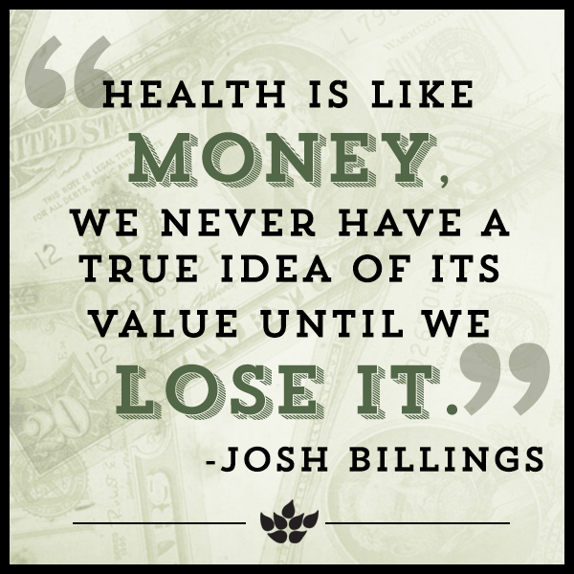
Thank you all

