Slide 1
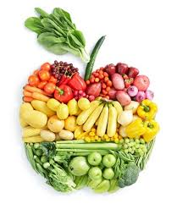
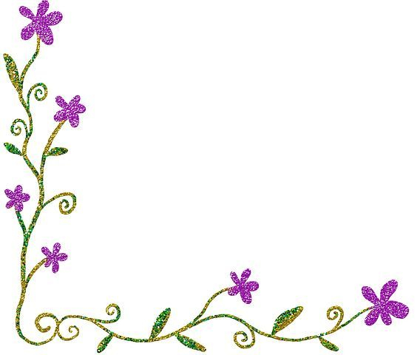
Welcome

Slide 2
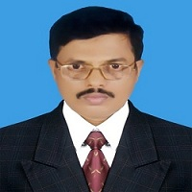
IDENTITY
Md. Saiful Islam Chowdhury
Senior Teacher
C. J. M High School,
Mohara,Chandgaon,Chittagong.
ENGLISH FOR TODAY
Class: - Eight
Unit – Two , Lesson - One ;
Time: 40 Minutes.

Slide 3
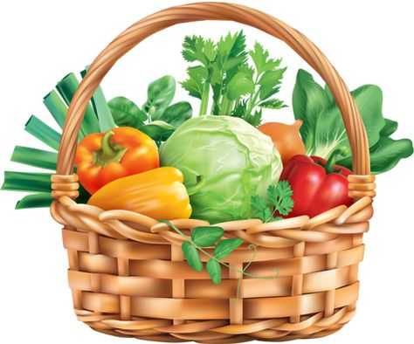
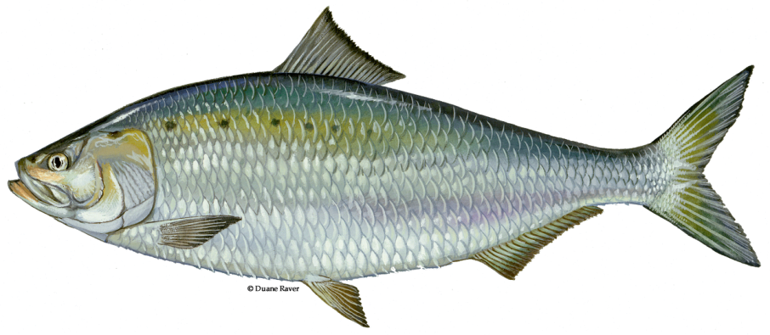
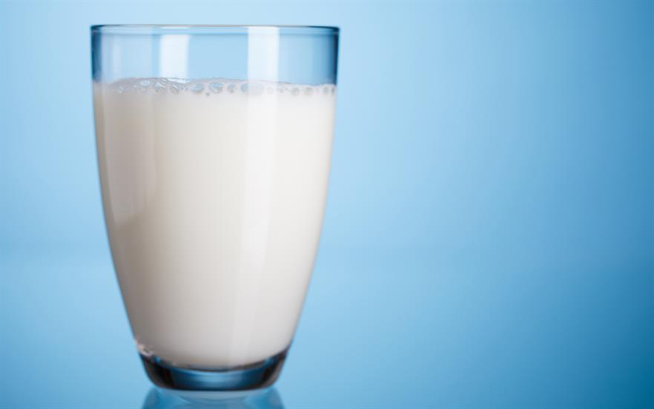
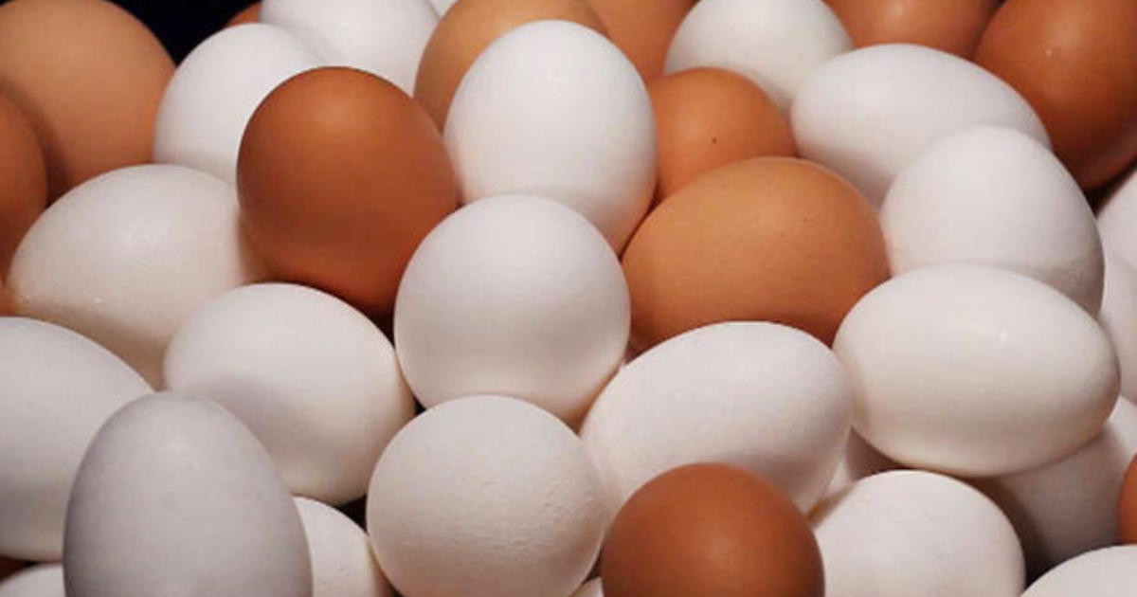
Look at the pictures
Try to guess what our today’s lesson may be --

Slide 4
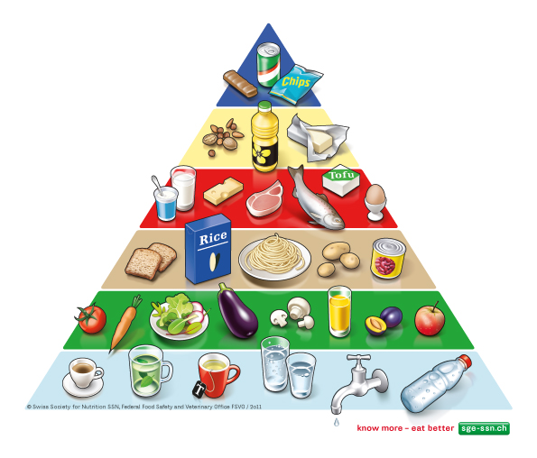
Today our Lesson is about
Good Food
Unit: 2 ; lesson: 1

Slide 5
Learning outcomes
After completing the Lesson students will be able to------
Read and understand texts through silent reading;
Infer meaning from the context;
Ask and answer questions;
Fill in the blanks;
Write a short paragraph.

Slide 6
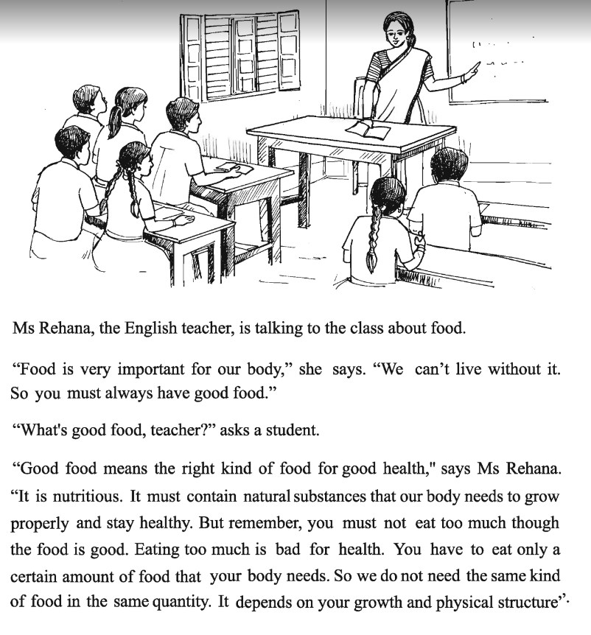
Read the following passage about
Good Food

Slide 7
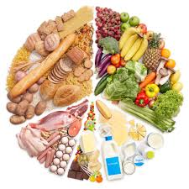
Key Word
Nutritious
Meaning
Healthful
Nutritious food is very important for our body.

Slide 8
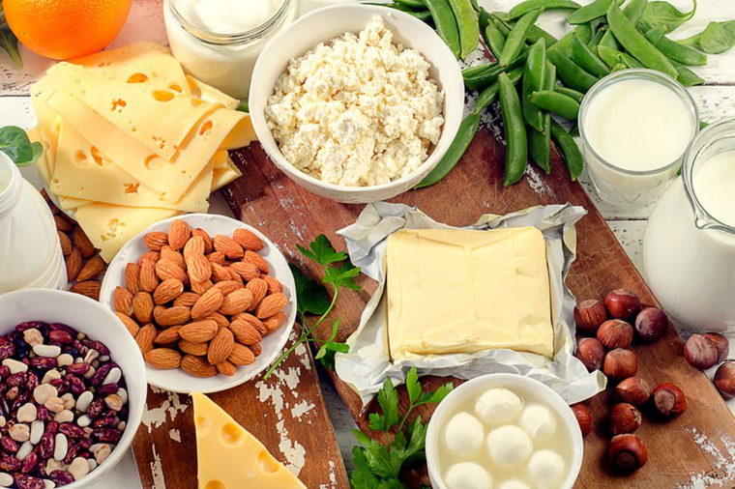
Key Word
Substances
Meaning
Elements
Good food contain natural substances.

Slide 9
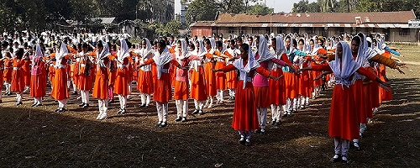
Key Word
Physical
Meaning
Bodily
We must do physical exercise regularly to keep our body fit for work.

Slide 10
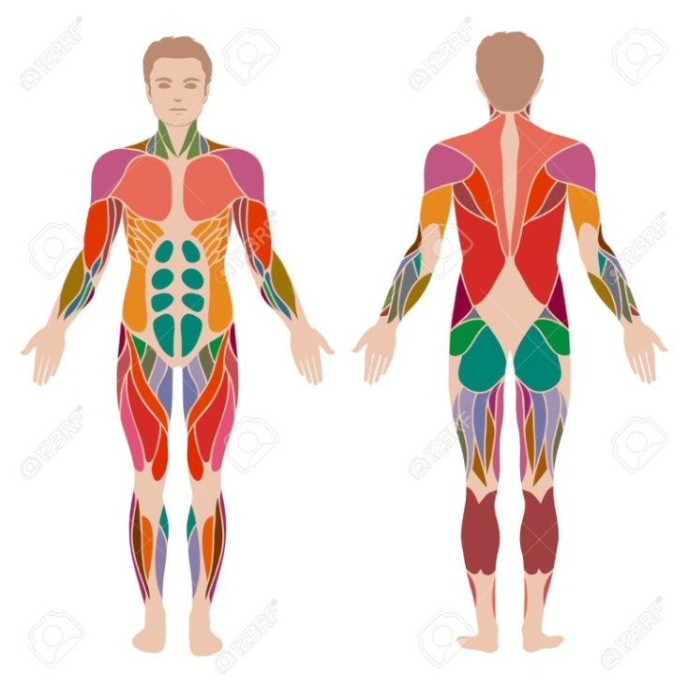
Key Word
Structure
Meaning
Frame / Construction
Your growth and physical structure depend on your food intake.

Slide 11
Key Word
Depend
Meaning
Rely
You can depend on your parents.

Slide 12
Key Word
Certain
Meaning
Sure
I agree with you to a certain degree.

Slide 13
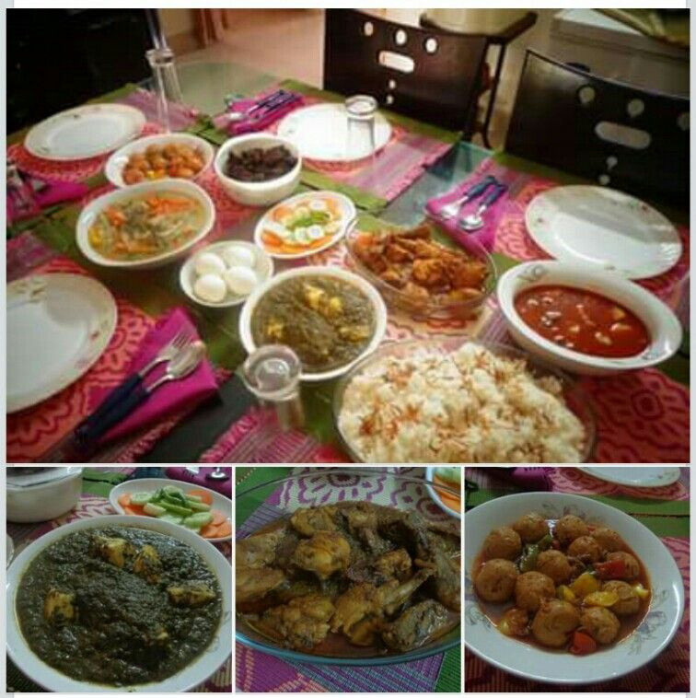
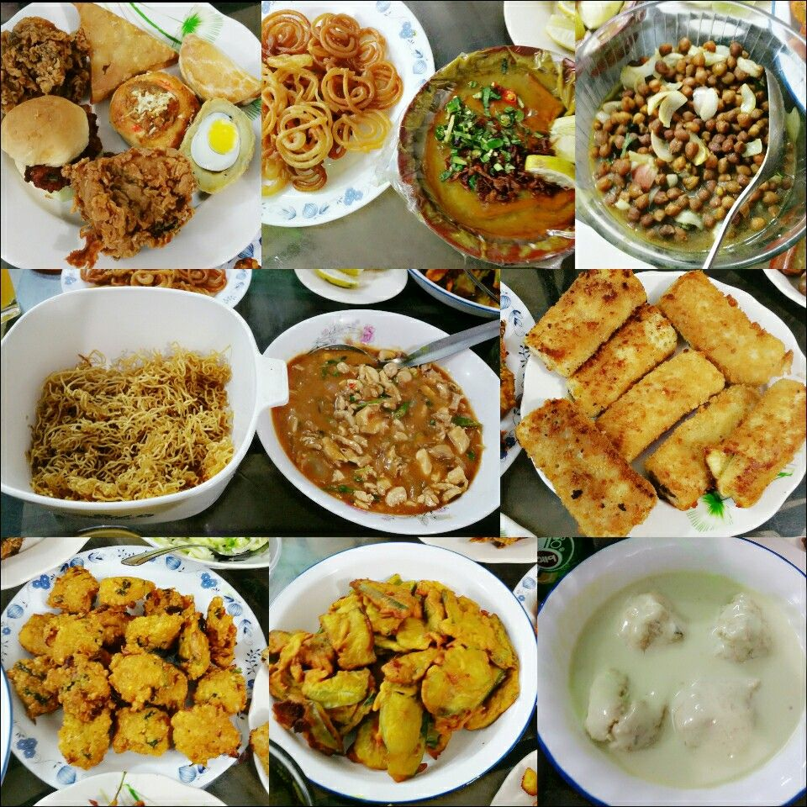
Key Word
Properly
Meaning
Correctly/Appropriately
We should take food properly.

Slide 14
Complete the sentences.
Individual
Work
We should eat good food to ______.
2. We should not eat more than ______.
3. Eating too much food is not ______.
4. Good food means ______.
grow properly and stay healthy.
what our body needs.
good for health.
right kind of food for good health.

Slide 15
Choose the best answer to each question from the alternatives given below
Pair Work
The word ‘mean’ means ___
a. medium
b. says
c. indicates
d. suggests
2. We ___ always eat good food.
a. should
b. shall
c. can
d. do

Slide 16
Choose the best answer to each question from the alternatives given below
Pair Work
3. The teacher tells them what ___ .
a. daily diet is
b. is food
c. good food is
d. kinds of food
4. The word ‘contain’ means __
a. bear
b. carry
c. hold
d. comprise

Slide 17
Choose the best answer to each question from the alternatives given below
Pair Work
5. Over-eating is ___ health.
a. take care of
b. bad for
c. benefit
d. call for
6. We cannot live without ___.
a. food
b. home
c. clothes
d. medicine

Slide 18
Choose the best answer to each question from the alternatives given below
Pair Work
7. Good food means __ food .
a. costly
b. right kind of
c. common
d. cheap
8. In the passage ‘Eating’ is used as a/an ___.
a. verb
b. adjective
c. adverb
d. noun

Slide 19
Choose the best answer to each question from the alternatives given below
Pair Work
9. What is the similar meaning of ‘kind’ ?
a. kindness
b. shortage
c. sort
d. sympathetic

Slide 20
Group work
Read the passage and answer the following questions.
1. What is healthy food?
2. How is the necessary quantity of food determined? 3. Why must food contain natural substances?
4. What is food important for and why?
5. What amount of food do we have to eat?
6. Do you agree eating too much is bad? If yes, why?

Slide 21
Compare with your answers.
Group - A
1. What is healthy food?
Healthy food is the right kind of food for good heath.
2. How is the necessary quantity of food determined?
Ans: The necessary quantity of food is determined by our growth and physical structure.

Slide 22
Compare with your answers.
Group - B
3. Why must food contain natural substances?
Ans: Food must contain natural substances, because our body needs these to grow properly and stay healthy.
4. What is food important for and why?
Ans: Food is important for our body, because we cannot live without food.

Slide 23
Compare with your answers.
Group - C
5. What amount of food do we have to eat?
Ans: The amount of food to be eaten depends on the growth and physical structure of our body.
6. Do you agree eating too much is bad? If yes, why?
Ans: Yes, I think that eating too much is bad for health. Because if we eat too much, we may become fat and suffer various diseases .

Slide 24
Evaluation
Read the following text and fill in the gaps with appropriate words.
Ms Rehana, the English teacher, tells the class about the (a)…. of good food. According to her, we must always have good food (b)…….. we can’t live without it. In (c)………. . to the question of a student, she says that good food means the (d)…….. food for good health. And eating (e)……….. is bad for health.
importance
as
reply
right
too much

Slide 25
Home Work
Write a short paragraph on Good Food.

Slide 26
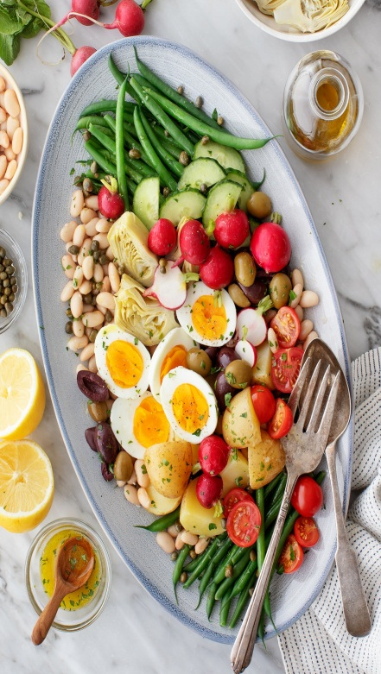
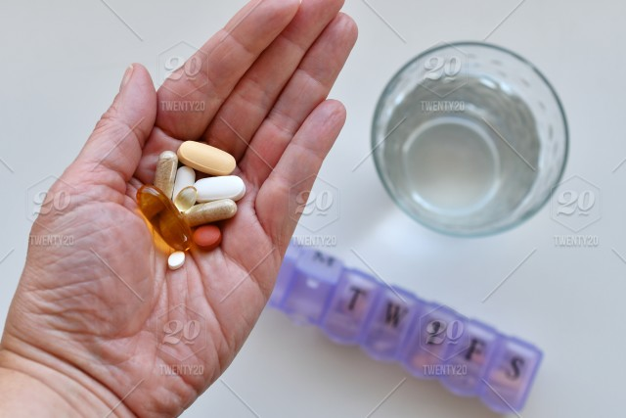
Eat your food as your medicines.
Otherwise you have to eat medicines as your food.

Slide 27
Thank you all

