Slide 1
welcome

Slide 3
A
Class : Two
Subject : English
Lesson :1-3
Unit:4
Activity : A
Time : 45 min
e
r
G

Slide 4
Learning Outcomes
Student’s will be able to-
Listening:1.1.1-become familiar with English sounds by listening to common English word.
Speaking:1.1.2-say simple words and phrases with proper sounds and stress.
Reading:2.1.1 Recognize and read cardinal numbers up to 30.

Slide 5
Let’s see the video
Discuss about the video
Can you understand our todays topic?

Slide 6
Topic of the lesson
Numbers

Slide 7
Presentation of the class

Slide 8
5-five

Slide 9
6-six

Slide 10
7-seven

Slide 11
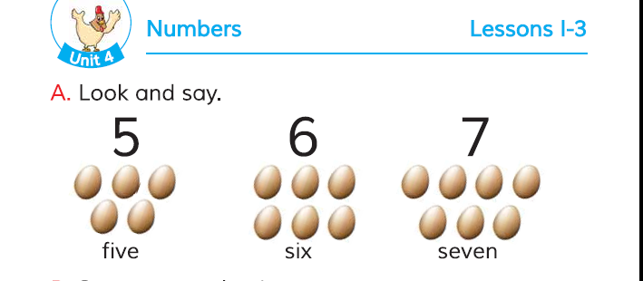
Open your book at page 8.

Slide 12
Say the number .
5-five
5-five
6-six
7-seven

Slide 13
Read the number in words.
5-five
6-six
7-seven

Slide 14
Match the pictures with correct number. pw
5
1
6

Slide 15
What can you see in the picture ? Count and circle.
6

Slide 16
Count and circle.
5

Slide 17
Say the missing letter
gw
x
6-si--
7-se--en
v
5-f--ve
i

Slide 18
One day one word
Count-গণনা

