Slide 1
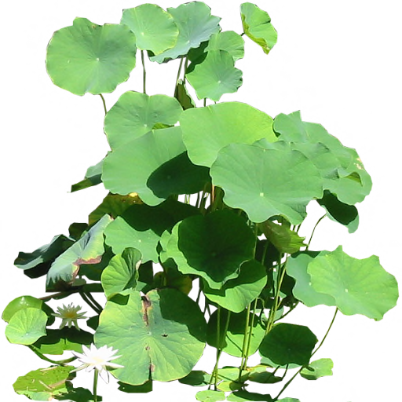
Welcome To My Class

Slide 2
Good
morning

Slide 3
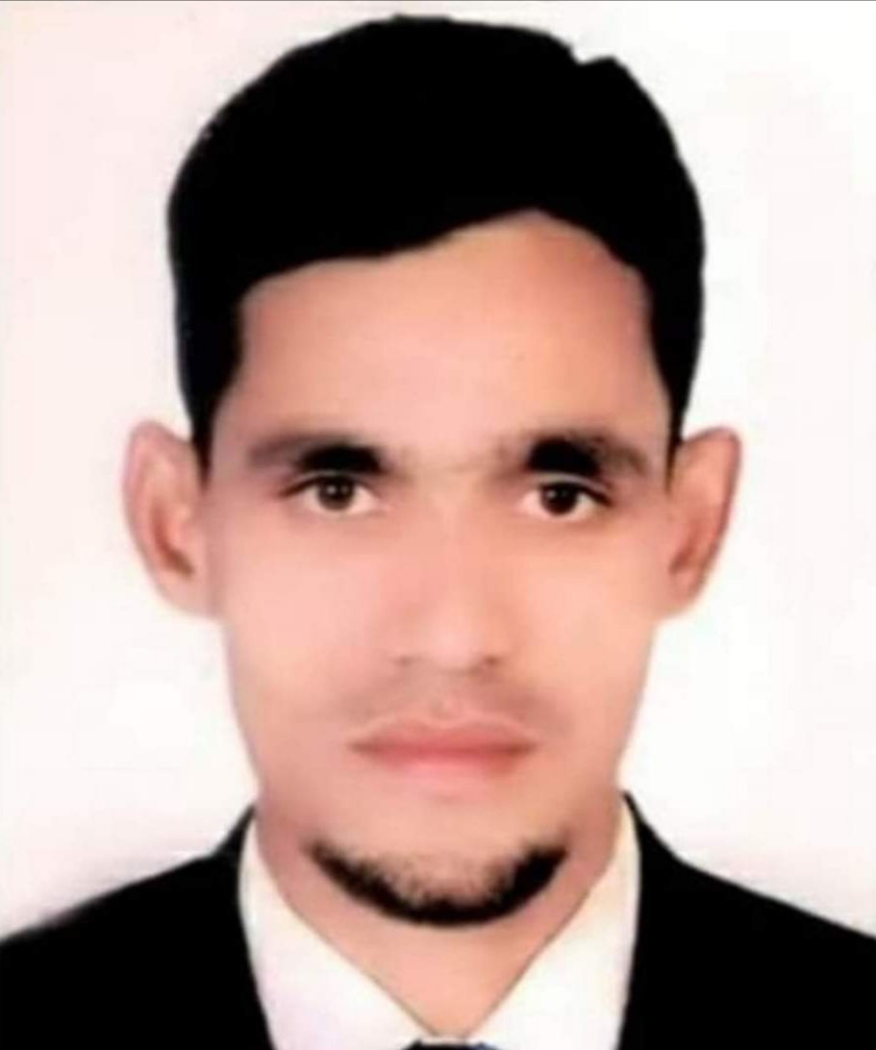
Teacher Identity
Muhammad Abdul Wahid
Assistant Teacher
Moyshashi Govt. Primary School
Balaganj, Sylhet.

Slide 4
Lesson Introduction
English for today
Class- Two
Numbers Unit- 2
Lesson- 1-3
Page- 4

Slide 5
Learning outcomes
Students will be able-
2.1.1 recognize and read cardinal numbers up to 4.
4.1.1 copy numbers up to 4 in figures and in words
4.1.2 write numbers up to 4 in figures and in words

Slide 6
Let’s watch a video

Slide 7
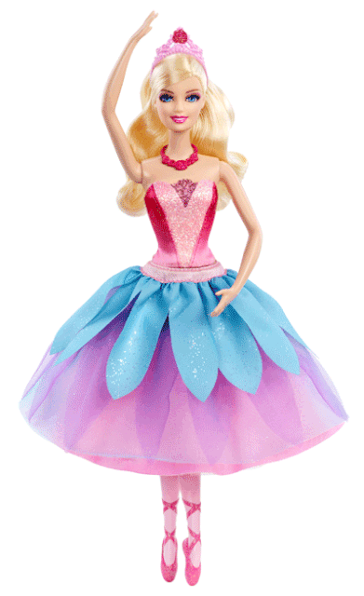
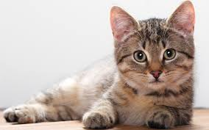
Lets see some pictures
What can you see?
Can you guess what we are going to learn today?

Slide 8
Today’s lesson
Numbers
Unite : 2
1,2,3,4

Slide 9
Look and say.
1
2
3
4

Slide 10
Look and say.
1
one

Slide 11
4
Look and say.
four

Slide 12
2
Look and say.
two

Slide 13
3
Look and say.
three

Slide 14
Let’s watch a video
1
2
3
4

Slide 15
WCW
Say , trace and write.
3
3
1
1
2
2
4
4

Slide 16
WCW
Say , trace and write.
one
two
three
four
one
two
three
four

Slide 17
Match correctly:
P.W
1
three
2
four
3
one
4
two

Slide 18
Group work
Count and write the number of the balls.
three
Group-A
four
Group-B
two
Group-C

Slide 19
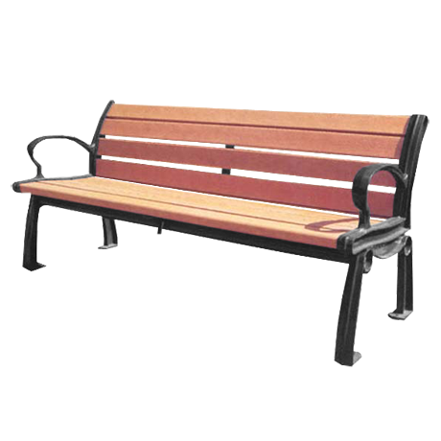
Evaluation
Count and write the numbers.
FOUR
ONE
THREE
TWO
4
1
3
2

Slide 20
Thank you all

