Slide 1

Welcome
Subject: English First Paper

Slide 2

Teacher’s Introduction
Rajon Mahmood
B.A. (Hons) & M.A. in English (Major in ELT)
Assistant Teacher
Dariapur Secondary School
Mujibnagar, Meherpur
E-mail: raz_bd@live.com
Mobile: 01719-271306

Slide 3
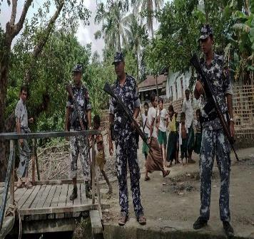
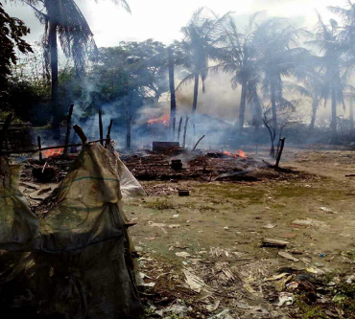
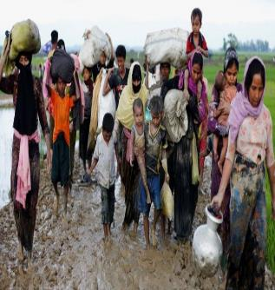
Look at the pictures…
Can you explain what is happening in the pictures?

Slide 4
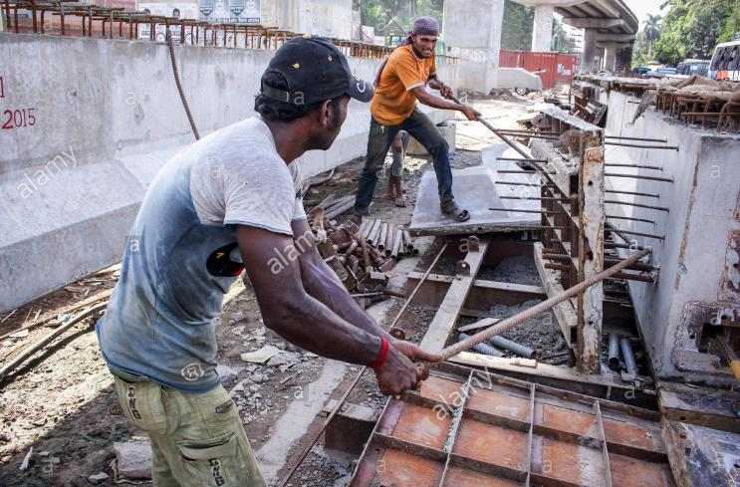
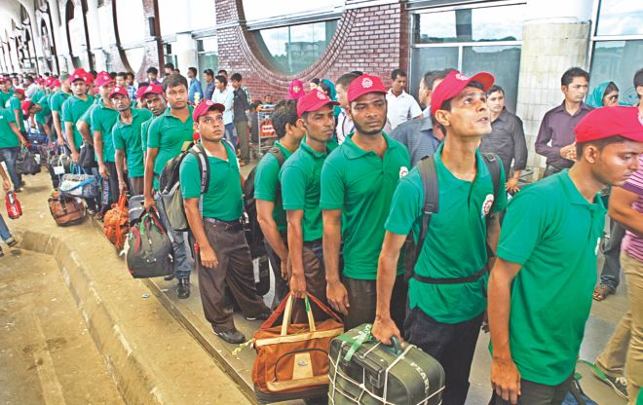

Look at the pictures…
Why do some workers of our country leave their motherland?

Slide 5


Today’s Lesson
What is Diaspora?
Unit: 11: Diaspora
Lesson: 01
Reference Book: English For Today
Page No: 132-33

Slide 6
Learning Outcomes
At the end of this lesson, students will be able to –
define the term diaspora
apply some key words from the text
explain the factors behind diaspora
write a reflective paragraph

Slide 7
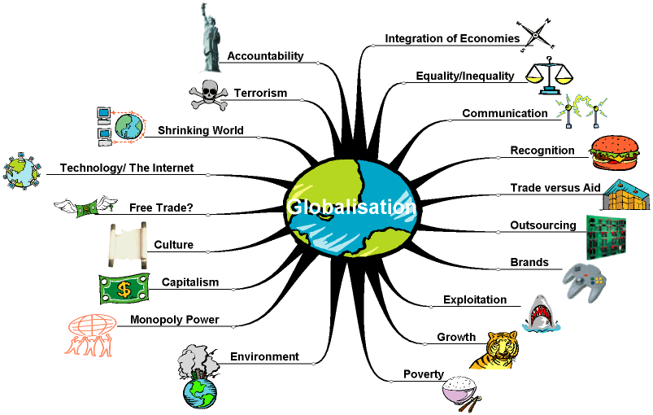
Defining globalization
the process by which businesses or other organizations develop international influence or start operating on an international scale.

Slide 8
Defining Diaspora
What have you noticed in the previous pictures?
What were the people doing?
Why do people move from one place to another place?
Refers to the people who have left their homelands and settle down in other country
Reasons:
To lead a comfortable life
To save life

Slide 9


What do you think?
Does globalization have a link or connection with diaspora?
How?

Slide 10
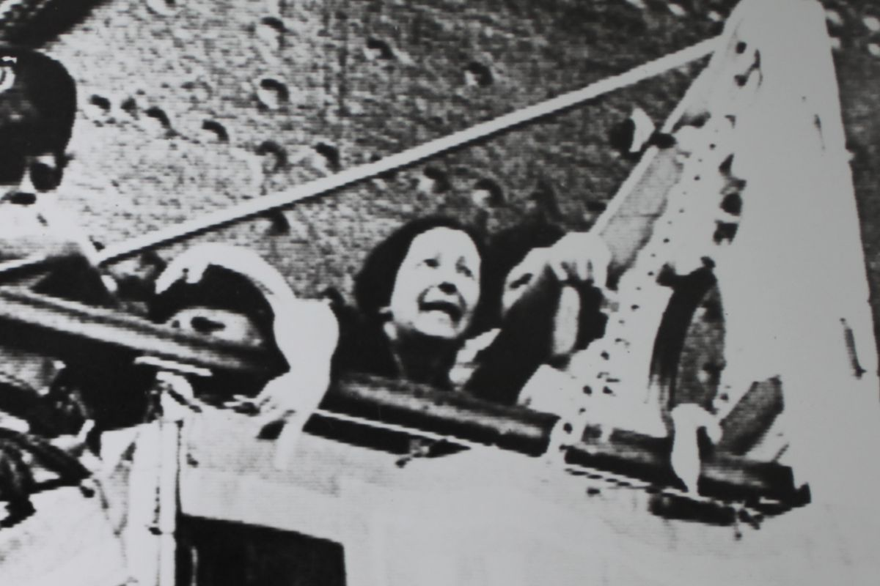
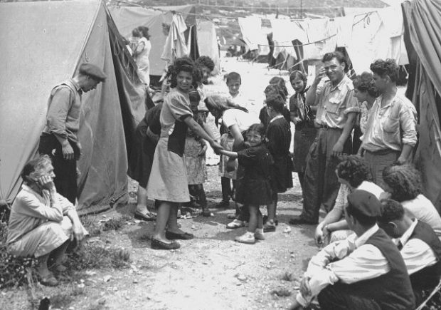
History of diaspora
Jewish were forced to leave their land in ancient times.
Jewish refugees in Palestine

Slide 11
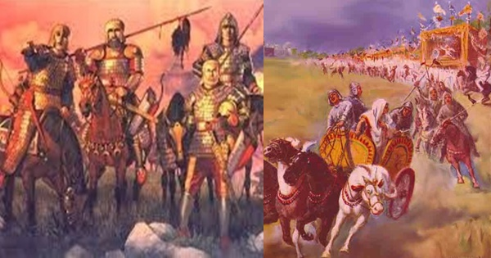
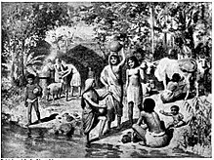
History of diaspora
Aryan Dynasty in Indian History
Indo-Aryan Migration

Slide 12
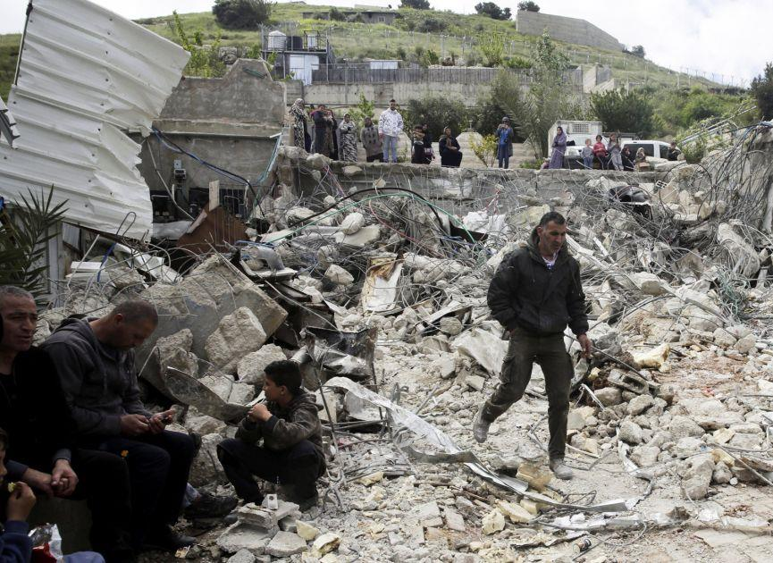
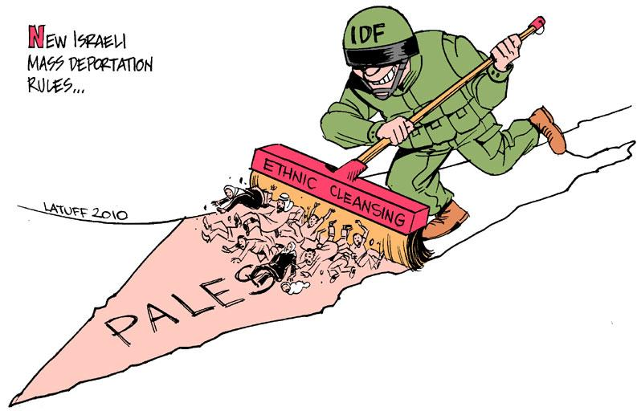
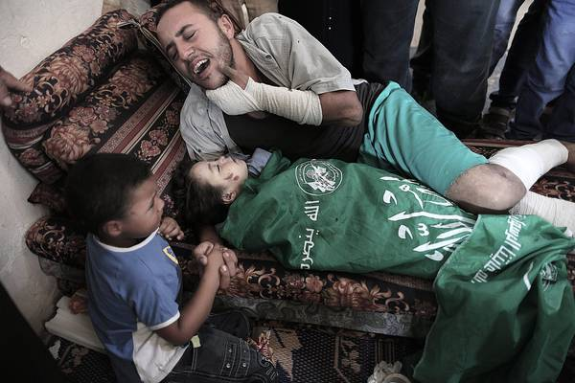
History of diaspora
Demolishing buildings
Killing mercilessly

Slide 13
Key Vocabularies
Settle in = locate/live
Many people from Bangladesh settle in England.
Collective = combined
Often, they live in a collective group.
Phenomenon = occurrence
Diaspora is a global phenomenon.
Movement = activity
The movement of Rohingya to our country is a threat.
Noteworthy= worth mentioning / outstanding
We have already seen a noteworthy change in our eating habit.

Slide 14
Key Vocabularies
Concern = worry
His behaviour has become a major concern for his parents.
Plight = trouble
The plight of slum dwellers is beyond imagination.
Massive = large
Recently, there has been a massive change in our environment.
Ravage= devastation
We saw the ravages of nature in 2004.

Slide 15

Silent Reading
Students will be instructed to read the text silently.

Slide 16
Individual Assessment
Guess the meaning of the words in Column A from the context and match with the meaning given in Column B:
Column A | Column B
Settled | i. occurrence
b. Community | ii. significant
c. Noteworthy | iii. moved to
d. Ravages | iv. negative effects
e. Phenomenon | v. group of people

Slide 17
Pair Work
Discuss and write down the answers of the following questions-
Are all diaspora voluntary?
If all diasporas are not voluntary, why would a group of people want to leave their country?
When has the study of diasporas started to attract scholars?
What has globalization to do with diaspora?
Note: Students will be divided into pair. They will discuss and write down their answers, and share in front of all students.

Slide 18

Homework
Paragraph Writing
Write a paragraph of about 180 words on Diaspora explaining the history and the reasons of rapid growth of it.

Slide 19


