Slide 1


Welcome
Subject: English First Paper
Class: Ten/Nine

Slide 2

Teacher’s Introduction
Rajon Mahmood
B.A. (Hons) & M.A. in English (Major in ELT)
Assistant Teacher
Dariapur Secondary School
Mujibnagar, Meherpur
E-mail: raz_bd@live.com
Mobile: 01719-271306

Slide 3




Look at the logos!
Have you ever seen these logos before?
What does each logo represent?
What is the common name of theses logos?

Slide 4
Social Networking Services
Social Networking
Services
Facebook
Twitter
Google+
LinkedIn
Tumblr
Pinterest

Slide 5

Today’s Lesson
Social Networking Services
Unit: 13: Media and Modes of E-communication
Lesson: 02
Reference Book: English For Today
Page No: 168-67

Slide 6
Learning Outcomes
At the end of this lesson, students will be able to –
tell about social networking services
apply some key words from the text
critically analyse the impacts of social networking sites
use some connectors of making list
write a dialogue using compare and contrast techniques

Slide 7

What is e-communication?
e-communication = electronic communication or communication which takes place through electronic (such as internet & mobile) media

Slide 8
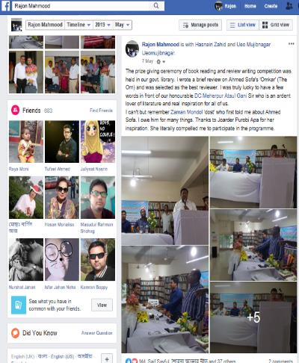
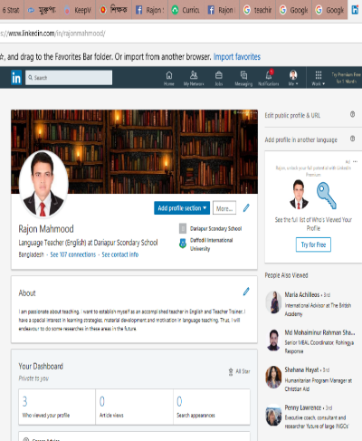
Why do we use social networking sites?
Creating Profile
Making Friends
Uploading photos
Sharing interests
Modify information

Slide 9
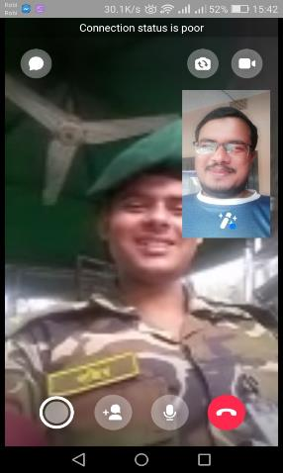
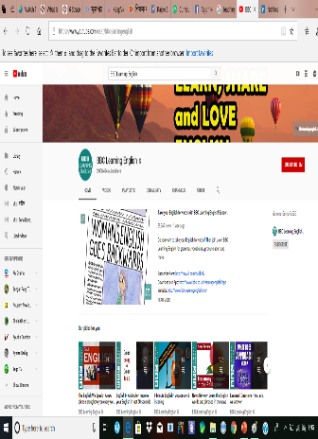
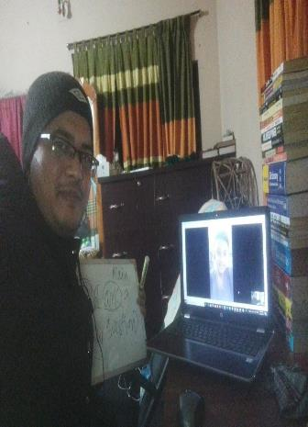
Why do we use social networking sites?
Communicating with friends and family
Learning and Teaching

Slide 10
Key Vocabularies
Interact = communicate
People can interact with anyone in online.
Frequently = often
They frequently communicate with one another.
Expand =Spread
Social networking sites are expanding rapidly.
Entire = whole
People of the entire world use Facebook.
Global village= the modern world in which all countries depend on each other and seem to be closer together because of modern communications
Internet technology has enabled us to live in a global village.

Slide 11
Key Vocabularies
Facilitate = promote
Many websites facilitate social relation among the people.
Modify = make partial or minor changes to something
The users can modify their profile in Facebook.
Dedicated = allocated
The room was dedicated for the blind.
Community= group
There is a large number of communities in Facebook.

Slide 12

Silent Reading
Students will be instructed to read the text silently.

Slide 13
Individual Assessment
Choose the best answers.
1. The _________ technology has helped social networking sites to emerge.
LinkedIn b. Google+ C. Internet d. Twitter
2. Users have to pay______.
a social network b. their online connections c. multimedia contents d. uploading pictures
3. User accounts have _______ protecting measures.
virus b. identity c. personal secrecy d. network
4. User profiles have a section for _____________.
a. others’ remarks b. outsiders’ editing c. outsiders’ moderation d. outsiders’ uploading

Slide 14
Pair Work
Discuss and write down the answers of the following questions-
What do you understand by social networks?
What are some uses of social networks?
What are the reasons of rapid expansion of social networking?
Note: Students will be divided into pair. They will discuss and write down their answers, and share in front of all students.

Slide 15
Usages of Connectors
Most of the social networking sites are cost-free. You can make use of them free, paying a very little to your internet service provider. Secondly, you can make your personal profile public before the entire online community. …. . Thirdly, social networks allow users to upload pictures, multimedia contents and modify the profile. Some services like Facebook allow users to update their profile. Fourthly, networks allow users to post blog entries. …Finally, there are privacy protection measures too.
Connectors for making a list of positive/negative sides or uses/abuses of something

Slide 16

Homework
Dialogue Writing
Social network services have many positive sides. However, many people think that social networking sites harm the young generation since many of them are addicted to these sites. Now, write a dialogue between you and your friend highlighting the merits and demerits of using Facebook.
Note: Your dialogue must contain six or more than six questions on the topic.

Slide 17



