Slide 1

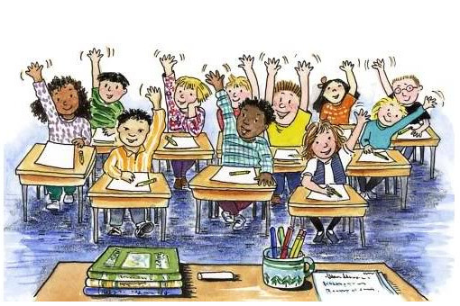
Welcome
Subject: English First Paper
Class: Nine

Slide 2

Teacher’s Introduction
Rajon Mahmood
B.A. (Hons) & M.A. in English (Major in ELT)
Assistant Teacher
Dariapur Secondary School
Mujibnagar, Meherpur
E-mail: raz_bd@live.com
Mobile: 01719-271306

Slide 3
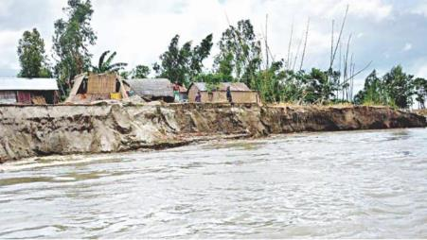
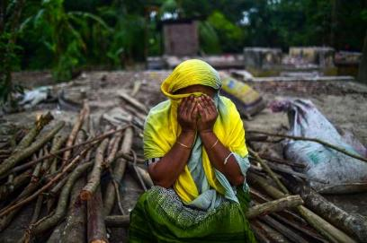
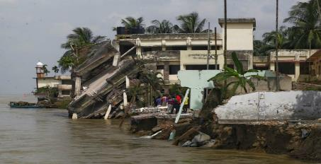

Look at the pictures…
What can you see?
Why is she crying?

Slide 4
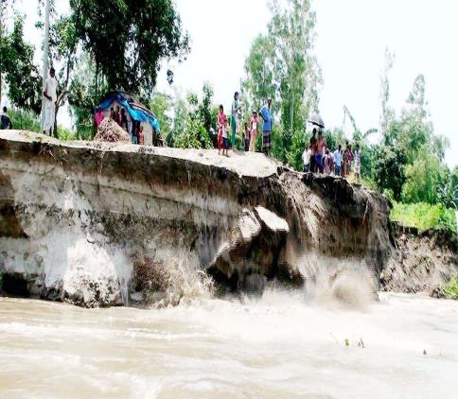
Today’s Lesson
The Greed of The Mighty Rivers
Unit: 5: Nature and Environment
Lesson: 01
Reference Book: English For Today
Page No: 56-58

Slide 5
Learning Outcomes
At the end of this lesson, students will be able to –
tell about natural calamities
apply some key words from the text
explain the effects of river erosion
analyse the causes of river erosion
make arguments on climate change through debating

Slide 6
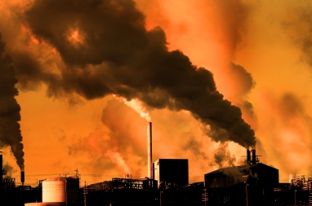
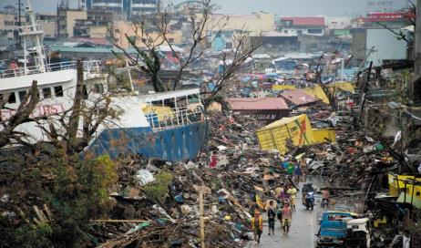
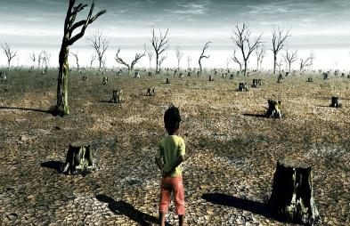
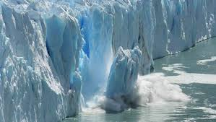
Climate Change
Causes & Effects

Slide 7
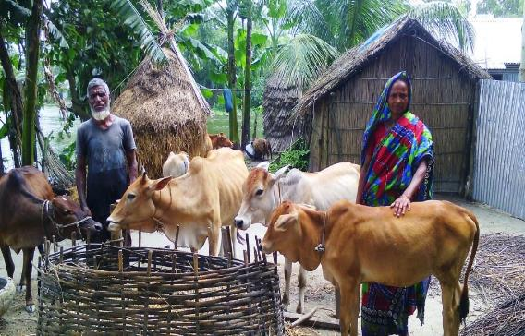

Meherjan: A Victim of River Erosion
Meherjan (45age) had a happy Greedy Jamuna took away her family. family, cultivable land and cattle.

Slide 8
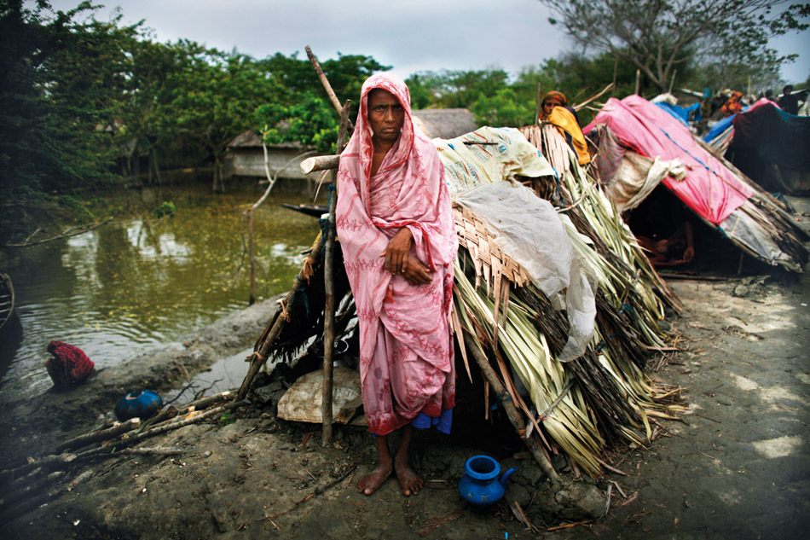
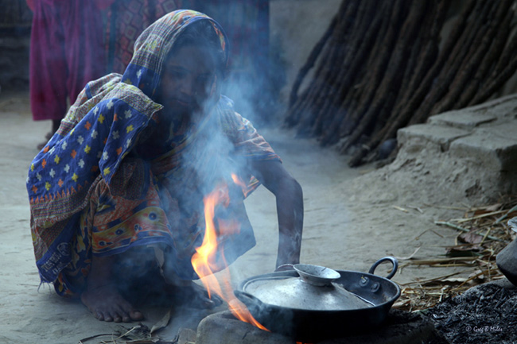
Meherjan: A Victim of River Erosion
She lives in a slum on the The dancing flame reminds Sirajgonj Town Protection. Meherjan of the turmoil in her life.

Slide 9
Key Vocabularies
shelter = a house
Meherjan’s polythene-roofed shelter looks like a cage.
Tremble = Shake
They were trembling with fear when they saw the ghost.
Whisper = Murmur
You don’t have to whisper, no one can hear us.
Unsteady= Unstable
The wind makes the fire unsteady.
Remind= Cause to remember
Ahnaf reminds me of my young brother.

Slide 10
Key Vocabularies
Turmoil = Trouble
She was thinking of her past turmoil.
Consume = Destroy
The river consumed the whole area last year.
Devour = Destroy
The child’s health was devoured by the disease.
Cruel = Brutal
Sometimes, mother nature shows its cruel face.
Greedy = Ravenous
The greedy river consume her landed property, family and cattle.

Slide 11
Key Vocabularies
Shatter = Break into pieces
Her dream was shatter after hearing the news.
Erode = Diminish
The river bank was gradually eroded away.
Estimated = Calculated
The estimated loss was almost one million.
Prompt = Instant
They should take prompt actions to protect the area.
Adapt to = Cope with
We should learn to adapt to a new environment.

Slide 12
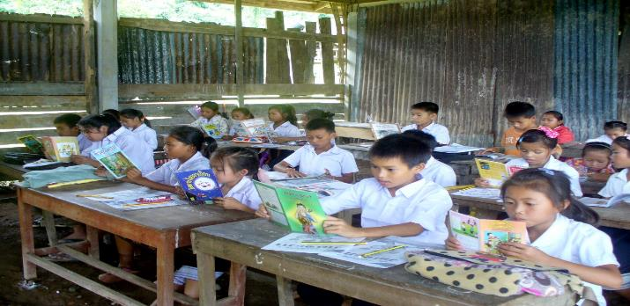
Silent Reading
Students will be instructed to read the text silently.

Slide 13
Pair Work
Discuss and write down the answers of the following questions-
What does Meherjan use to make fire for cooking her meals?
What property did Meherjan lose due to river erosion?
What do you know about Meherjan’s family?
Why is the phrase ‘greedy Jamuna’ used to describe the river?
What greed do you notice in the description?
Note: Students will be divided into pair. They will discuss and write down their answers, and share in front of all students.

Slide 14

Homework
Debate
Motion: Humans can’t do anything to control the course of nature.
Note: The teacher will select 8 students who will be divided into two groups. He will also explain the rules of debate. Students will take their preparation at home. The teacher will show a video on debate and explain the language and how to present the topic. Next class, he will arrange the debate and observe as the moderator. Some students will be selected as judges.

Slide 15

