Slide 1
Welcome
Slide

Slide 2
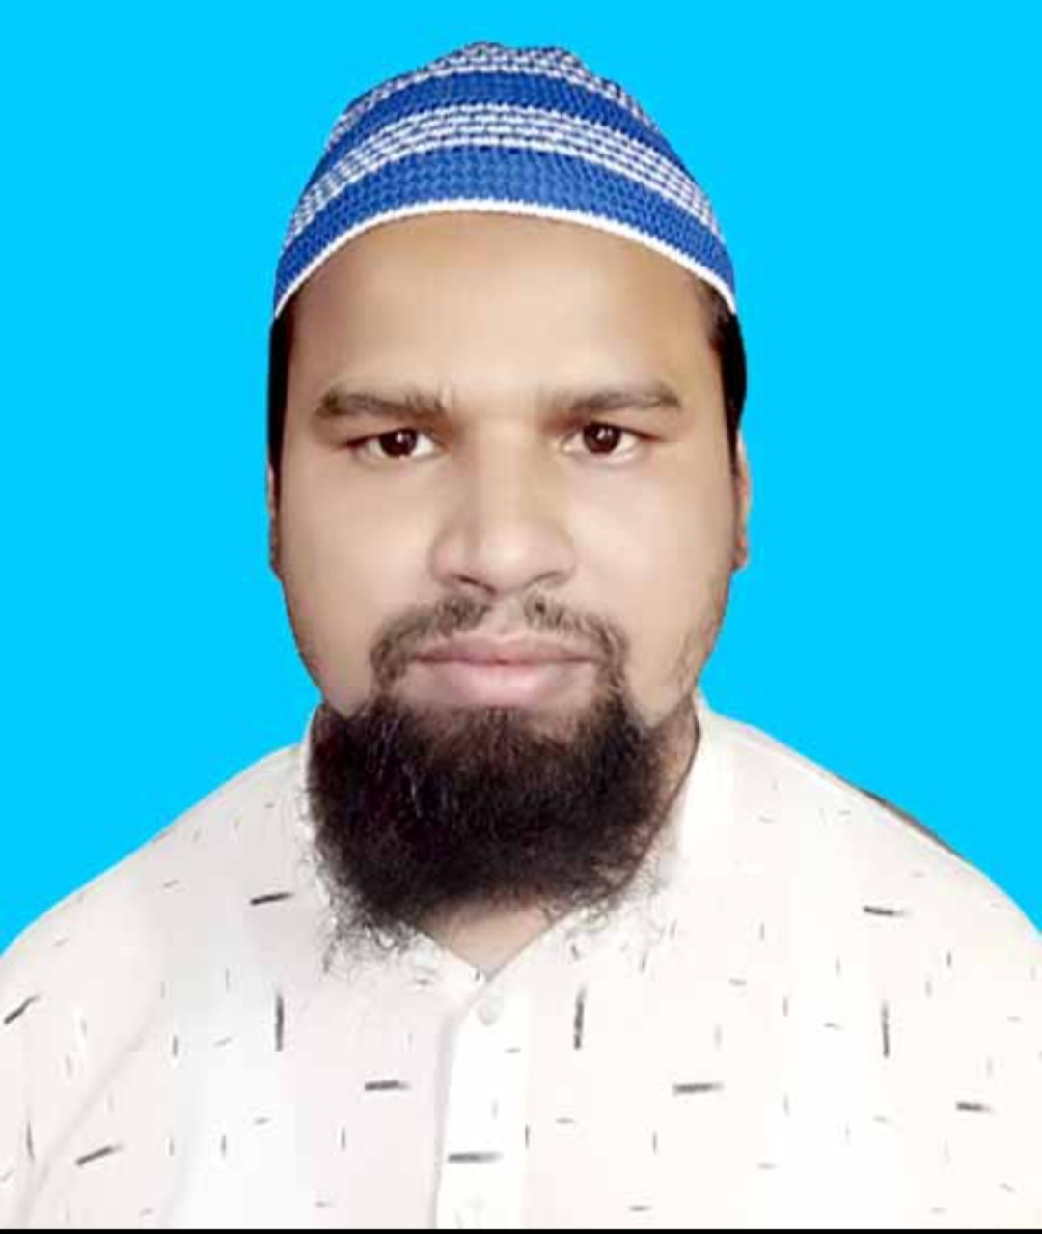
Teacher’s Identity
Md. Farid Uddin
Lecturer in English
Chipatali Jamia Gausia Muinia Kamil (M.A) Madrasah,
Hathazari, Chattogram.
Mob. 01737719924
E-mail: fariduddin111989@gmail.com

Slide 3
Lesson Declaration & Learning Outcome
We has been working for 4 hours.
They are going to market with a view to (buy) some chocho.
No sooner had the criminal (see) the police,than he (run) away.
👉 There are some mistake in above sentences. What kind of mistake do you notice here? Yes, there are some mistake of verbs.
So, our today’s lesson is Right Form of Verbs

Slide 9
Individual work
When my father came, I (read) a book.
I heard him (speak) English.
I would rather (die) than beg.
The U.S.A (be) a powerful country.
Would that I could (be) a child again.

Slide 10
Match your Answer
1. Was reading.
2. Speaking
3. Die
4. Is
5. Be

Slide 11
Pair Work
1. The rich (be) not always happy.
2. You need to ( do) the work.
3. By ( read) books you can gain knowledge.
4. If he read attentively, he (pass) in the exam.
5. (Saw) me, he became highly glad.

Slide 12
Match Your Answer
1. Are
2. Do
3. Reading
4. Could pass
5. Seeing

Slide 13
Group Work
Having ( forget) him, I went out.
Every boy and every girl (be) given a prize.
Only the brave ( deserve) the fair.
Something (be) better than nothing.
Who (know) the answer.
Rice (be) our staple food.
Ill news (run) fast.

Slide 14
Match your Answer
1. Forgotten
2. Is/ Was
3. Deserves
4. Is
5. Knows
6. Is
7. Runs

Slide 15
Home Work
1. Bread & butter (be) my favourite food.
2. Time & tide ( waits) for none.
3. A number of books (have) been lost from our home.
4. The number of stars in the sky ( seem) countless.
5. Many a student (ruin) his future through using drugs.
6. The committee (have) issued its blame.
7. The committee ( be) devided in their opinion.
8. Both of the two men (be) foolish.
9. Neither you nor he(be) leaving this madrasah.
10. Oxygen (be) necessary for all living beings.

