Slide 1
Welcome to Everybody

Slide 2
Introduction
Md. Khalidur Rahman
Asst. teacher
Joginimura High School
Sherpur Sadar Sherpur
01995291979
khalidurr82@gmail.coms

Slide 3
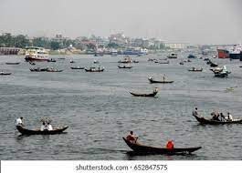
What will happen if we have to live on trees or on boat?s

Slide 4
Open Your EFT book page at 51 and read silently of the passage on Our food and Shelter.

Slide 5
Learning Outcomes.
After Comleting the lesson the students will be able to :
1.Explain about the food and Shelter problem of Bangladesh.
2.Will be able to exlain the reasons of those problem.
3. Will be able to show the way of coping with the problems.

Slide 6
Find out the meaning of the word given below.
Comes up, scarcity, serious, agriculturist, develop, varity, production, definitely, increase, Keep pace, Rapidly, Break into, Separate, Arable , Set up, Occupy, Considerable, Portion, Shrinking, Day by day, Argues, Water bodies, Quite right, Brought up, Mustered Field, Seemed to be unending, Used to wave, Breeze, Wood, Tamarind tree, Banyan tree, Huge green umbrella, Aerial, hanging down, Often, Climb, Pick, Swing, hanging roots, Crop , Spoiled, Unplanned.

Slide 7
Make a list of the reasons of our food and shelter problem

Slide 8
Evaluation
Show the way of coping with the food and housing problems of Bangladesh.

Slide 9
Homework
Write down in brief about the reason of the food and housing problems of Bangladesh and show the way of copying with these problems.

Slide 10
Thank You all

