Slide 1
WELCOME TO MY MULTIMEDIA CLASS

Slide 2
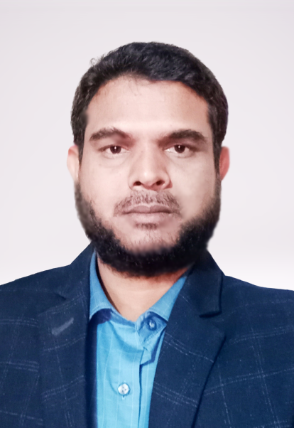
Presented By
Md . Hafizur Rahman
Md . Hafizur Rahman
Assistant Teacher
Haripur Government Primary School
Haripur , Thakurgaon .
Phone: 01716437086
Email:hafizict5@gmail.com

Slide 3
Lesson Identity
Subject : English
Class: Five
Time: 40 minutes
Date: 20-12-2022

Slide 4
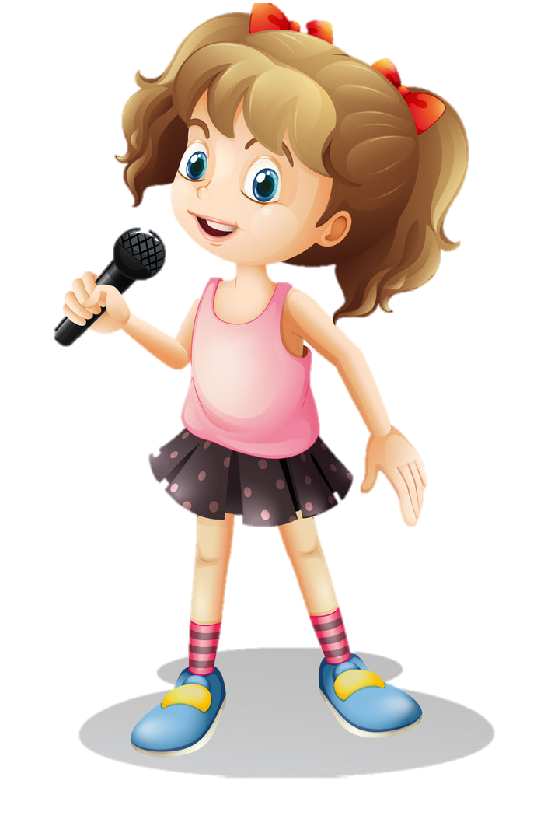
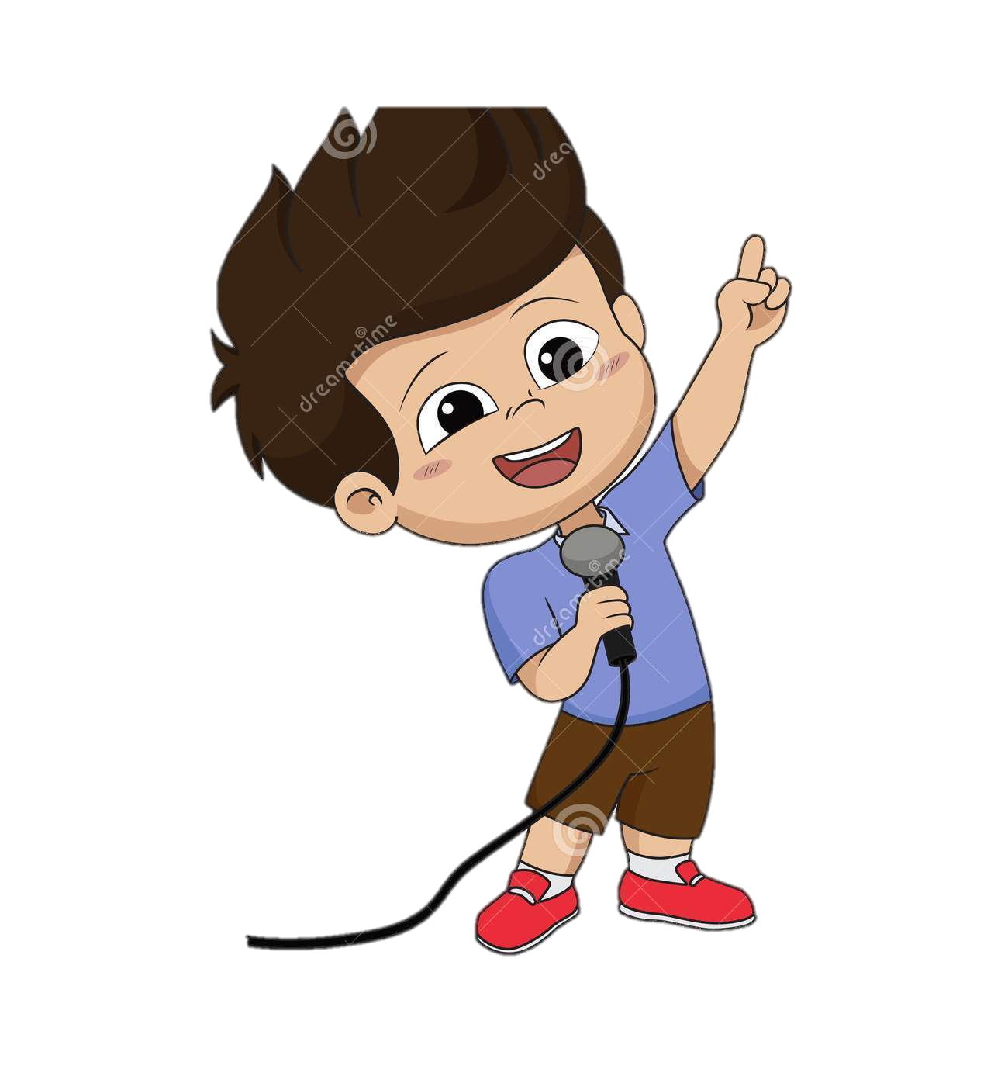
Let’s sing
We shell over come Song together

Slide 5
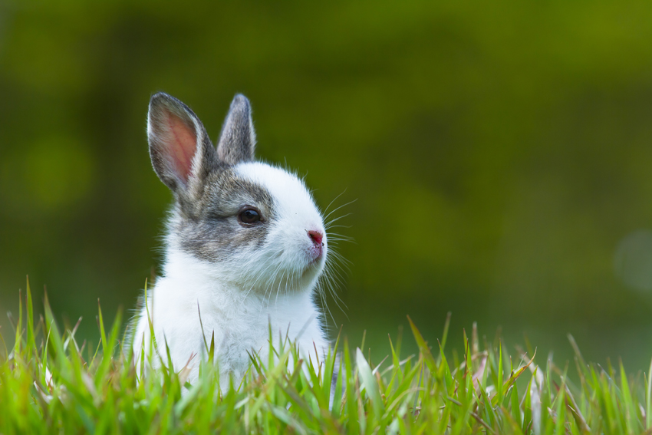
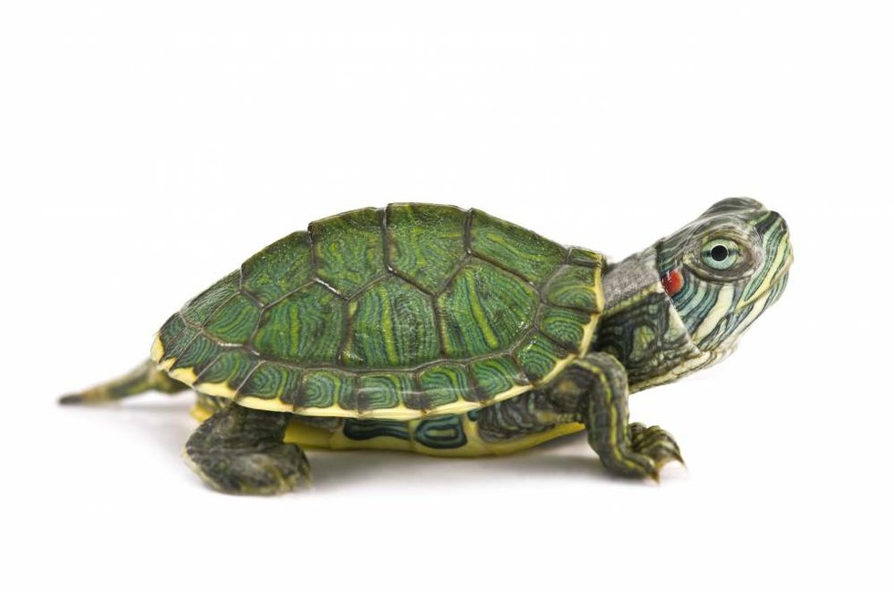
Dear Student ,what do you see in the picture?
Hare
Tortoise
Do you know, which of the two species fastest and slowest animal?

Slide 6
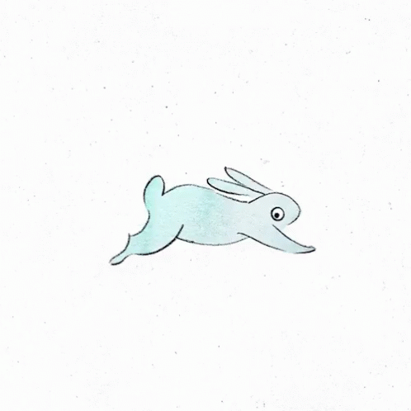
Thank you
Hare is the fastest animal.
Tortoise is the slowest animal.
Can you guess what’s the lesson today?

Slide 7
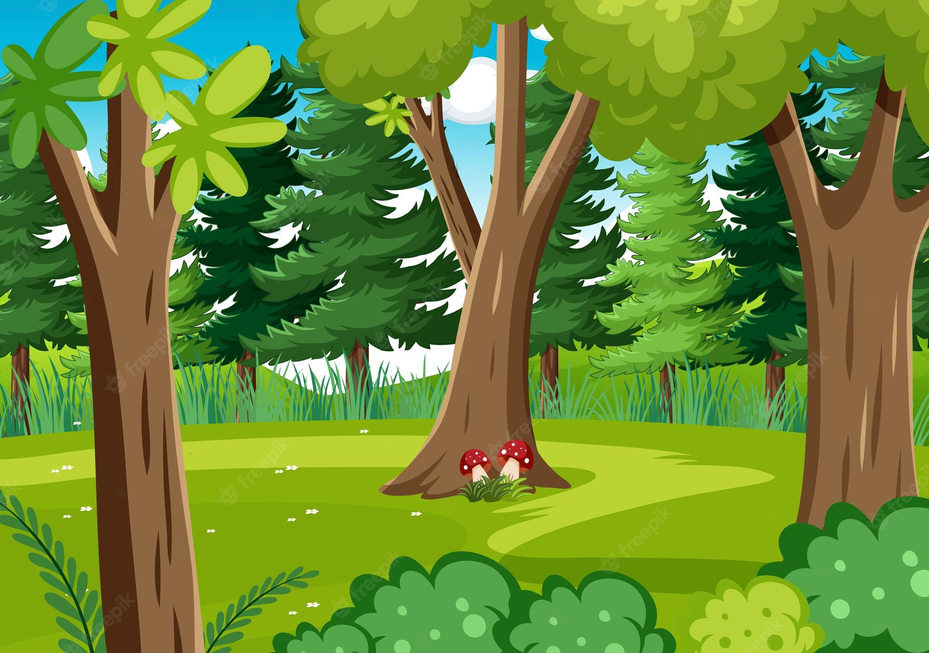
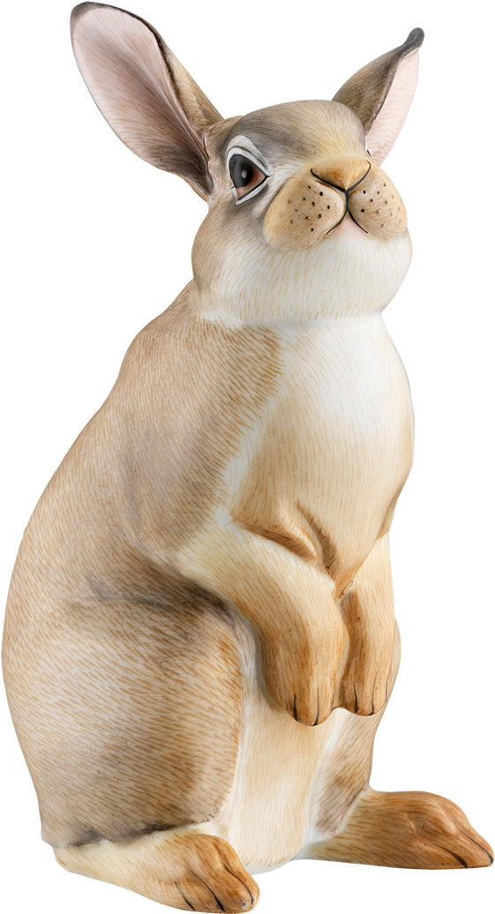
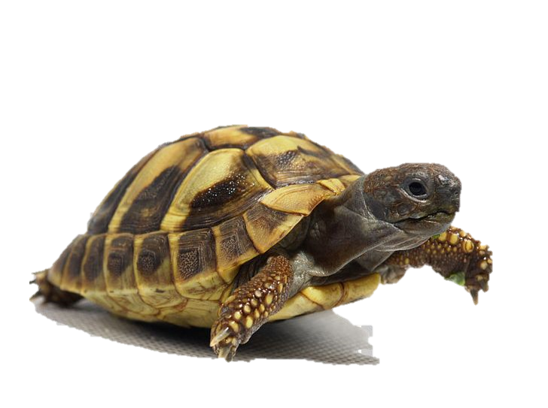
Today lesson
The hare and the tortoise

Slide 8
Learning Outcomes
By end of the lesson student will be able to-
Listening:
4.2.1-understand and enjoy simple stories.
3.4.1-understand statements made by the teacher and student.
Reading
1.7.1 - read paragraphs, dialogues, stories, letters and other text.

Slide 9
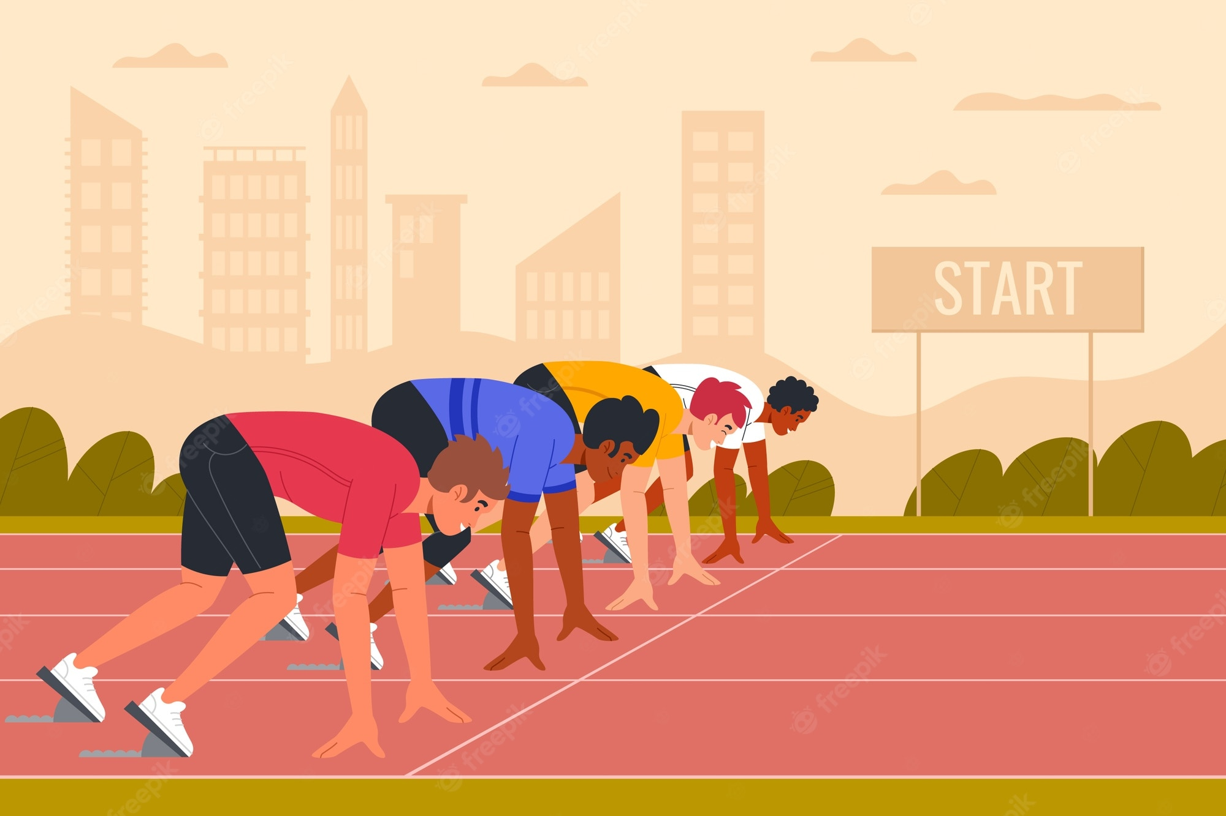
Introducing new words
Start
Begin.
শুরু করা
Lets starts the game.

Slide 10
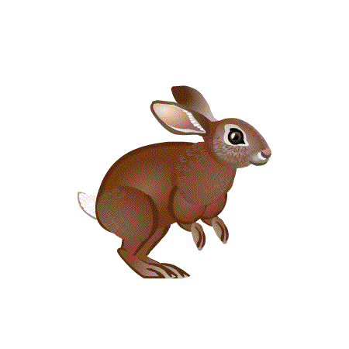
Introducing new words
Fast
Quick
দ্রুত
The hare is the fastest animal in the forest

Slide 11
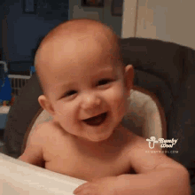
Introducing new words
Laugh
Smile.
হাসি
The girl is laughing.

Slide 12
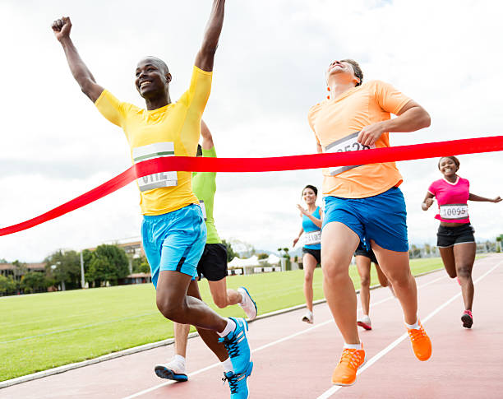
Introducing new words
Finish
End.
শেষ করা
They cross the finish line .

Slide 13
Introducing new words
Slow
Late.
ধীরে
The tortoise is the slowest animal.

Slide 14
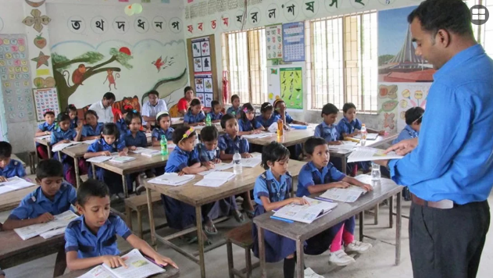
Teacher speaking loudly

Slide 15
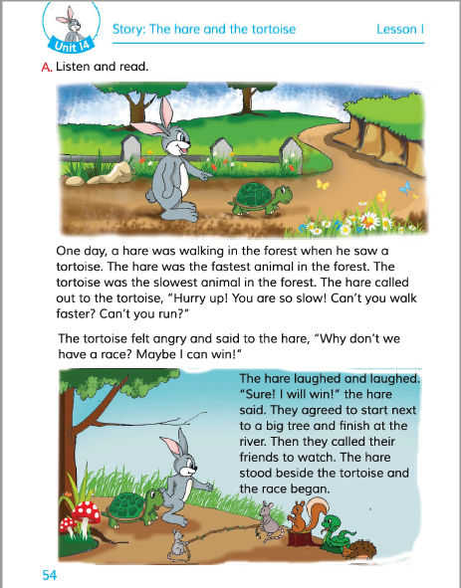
Open your book and turn to page 54

Slide 16
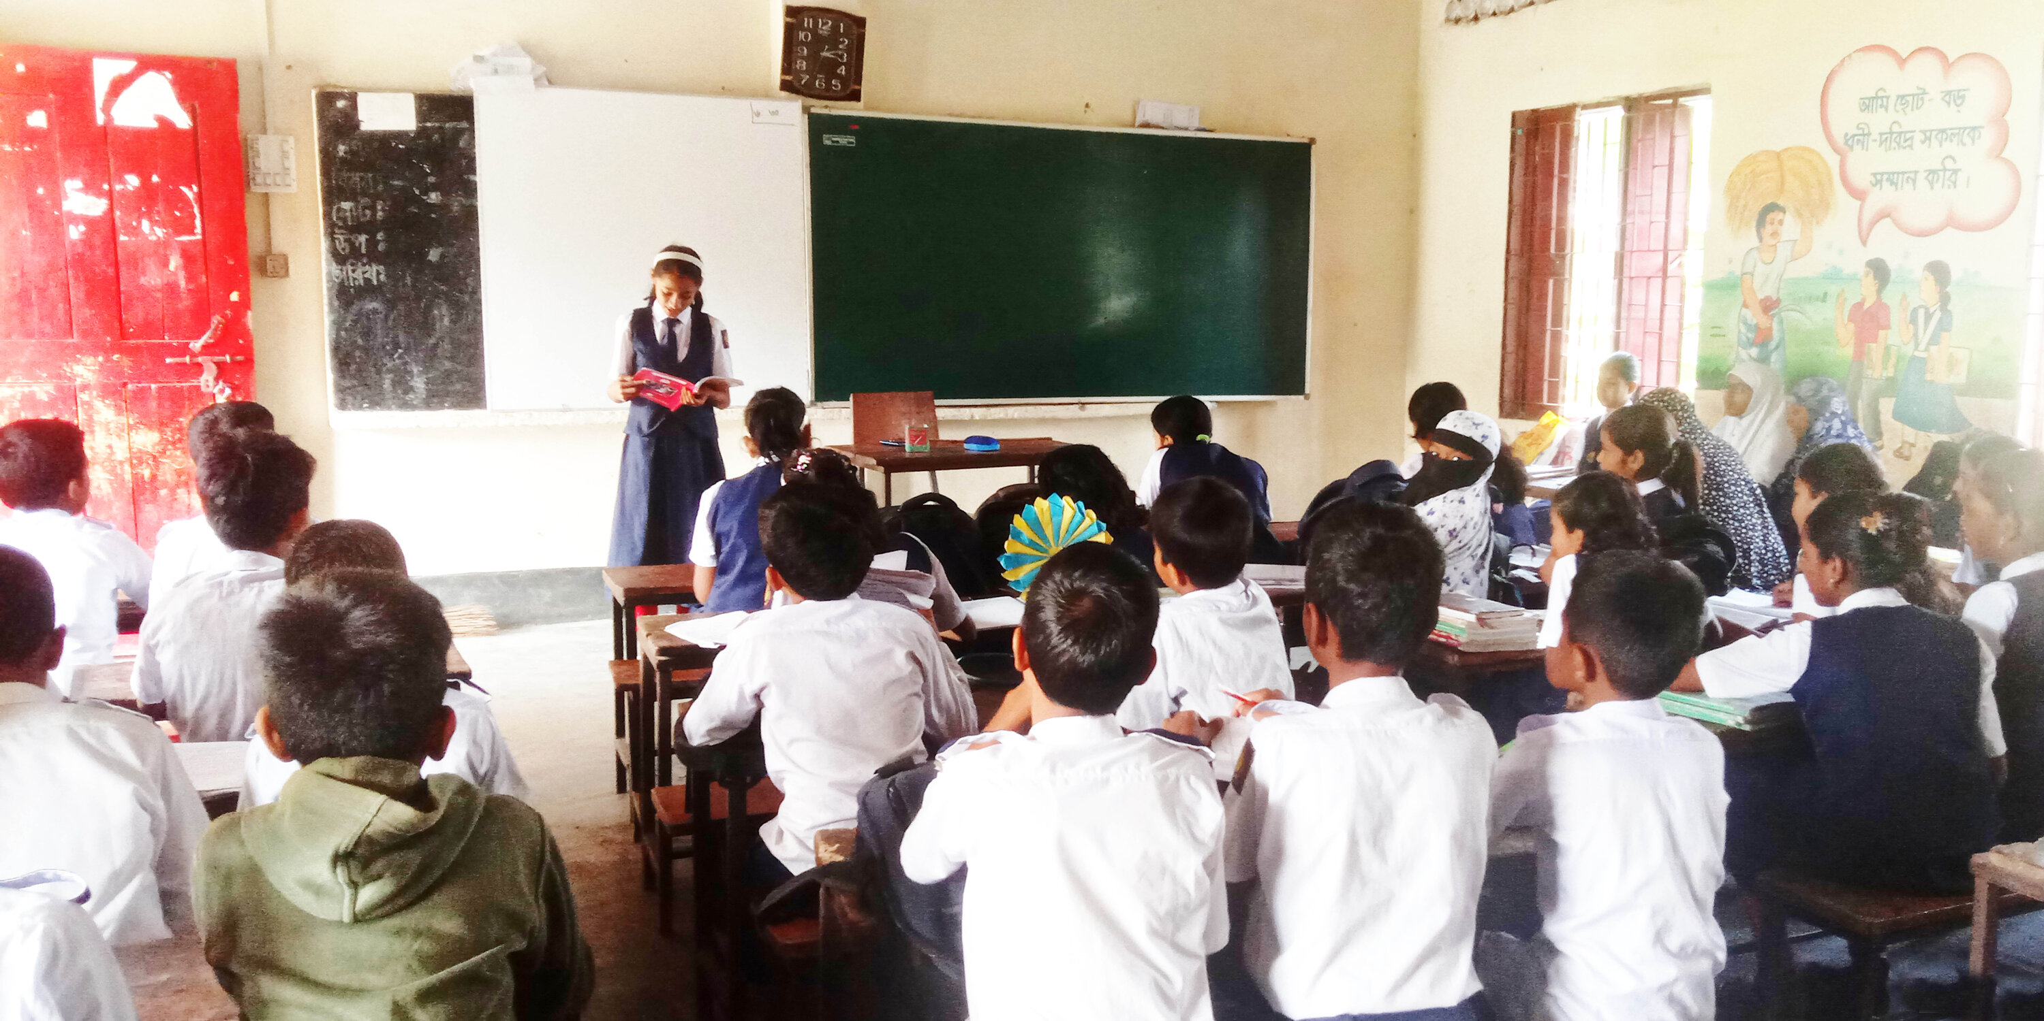
Students reading loudly

Slide 17
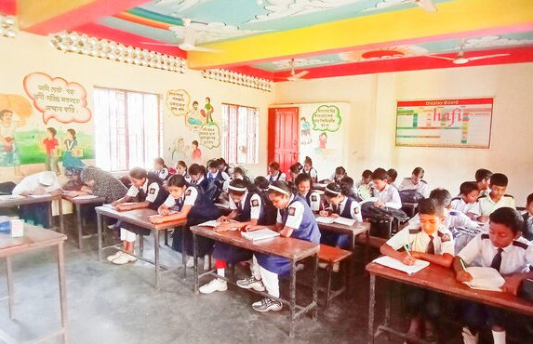
Students silent reading

Slide 18
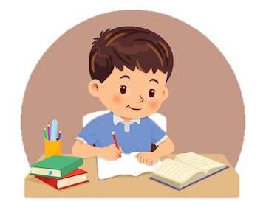
Individual work
Write True for correct statement and False for incorrect statement
True
False
a)
a)The hare laughed and laughed
b) The hare was walking in the forest
True
False
b)
c) The tortoise felt happy
True
c)
False
True
False
d)
d) The hare is the slowest animal
e) They agreed to start next to a small tree
True
False
e)
Let’s check the answer

Slide 19
Pair work
Match the words of the column A with present form in column B
Column-A | Column-B
1.Called | a. Begin
2.Laughed | b. Stand
3.Began | c. Call
4.Felt | d. See
5.Saw | e. Feel
6.Stood | f. Laugh

Slide 20
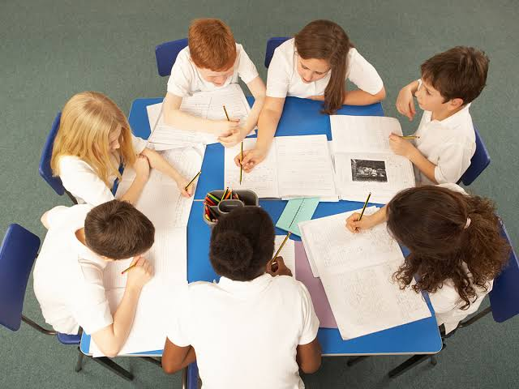
Group work
Group
Tiger
Group
Hare
Group
Tortoise
Group
Lion
- Have you experienced any race ?
- Have you participate in a race ?
When was it?
Who won the race

Slide 21
Evaluation
1.Where did they finish?
2.Where did they start the race from?
3.Who came to watch the race?
4.Who was the fastest and who was the slowest animal in the forest?
5.Why do you think the tortoise want to have a race with the hare?

Slide 22
One day one word
Hurry up
তারাতারি/জলদি
sentence making
Hurry up , you are so slow.

Slide 23
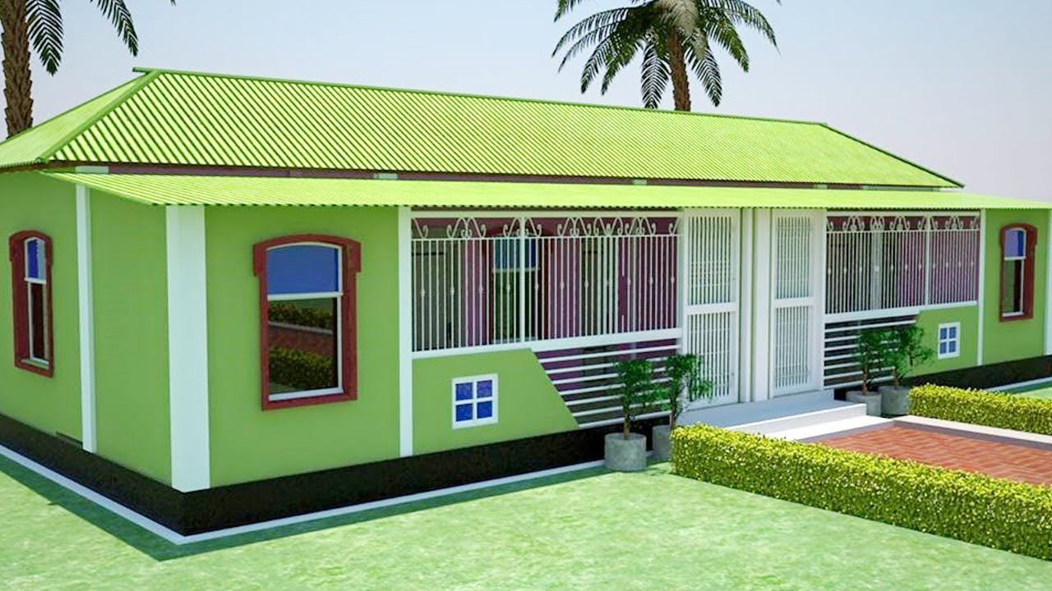
Home Task
Write 5 sentences About “Your Daily routine”.

Slide 24
Good Bye

