Slide 1
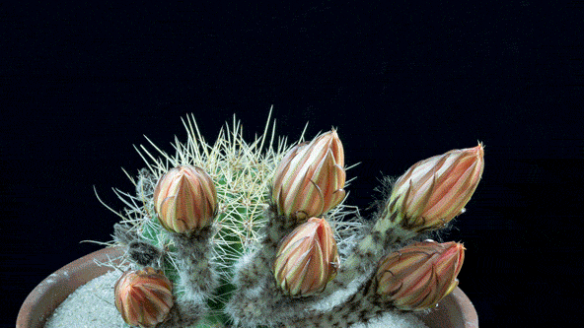
WELCOME TO MY DEAR STUDENTS

Slide 2
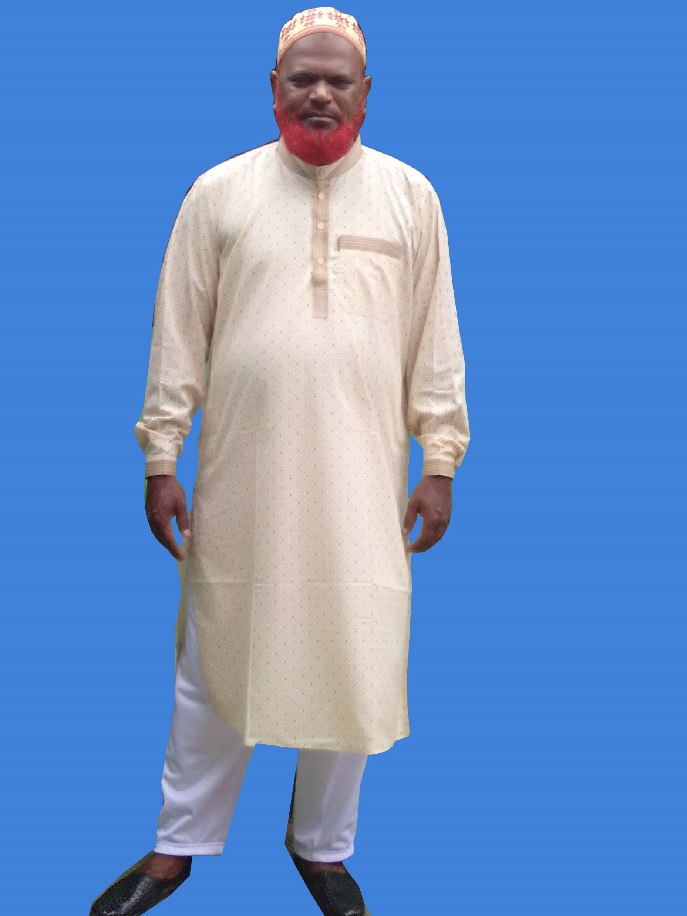
Identity
Md Khalilur Rahman
(B A B Ed)
Asst Teacher (English)
Atgharia High School
Haripur, Thakurgoan.
Sub: English Second Paper
Topic: Prefix
Class: 8, 9 & 10

Slide 3
Read the Text Attentively.
Tanar is an honest man. He does not like a dishonest person. He believes that industry is the key to success. Though rest is the part of a work, to be successful he always remains restless. So nobody dislikes him as he is industrious.
Can you guess what do the colored parts indicate of the text?
Here the colored words of the text indicate affix.

Slide 4
Announcement
Today’s Lesson
Affix
(Prefix)

Slide 5
Learning Outcomes
After the end of the lesson students will be able to-
-tell the definition of prefix
-explain prefix
-give example
-use prefix properly

Slide 6
Primary Concept
ইংরেজিতে ৮ প্রকার Part of Speech রয়েছে। এর মধ্যে ৪টি যেমনঃ Noun, Verb, Adjective, Adverb এদেরকে Root/Base word বলে। এবং বাকি ৪টি যেমনঃ Pronoun, Preposition Conjunction, Interjection এদেরকে Subsidiary word বলে। Root/Base word পরিবর্তনশীল কিন্তু Subsidiary word পরিবর্তন করা যায়না।

Slide 7
Affix
Root word বা Base word এর শুরুতে বা শেষে বর্ণ বা বর্ণসমষ্টি যুক্ত হয়ে নতুন শব্দ গঠন করা যায়। এ পদ্ধতিকে Affix বলে। আর এ পদ্ধতিতে উৎপন্ন নতুন শব্দকে Derivatives বলে।
Affix = উপযোজনা, উপাংগ, বাড়তি, বর্ধন……

Slide 8
Affix (উপযোজনা) দুই প্রকারঃ
1. Prefix (উপসর্গ)
2. Suffix (প্রত্যয়)

Slide 9
Pre (পূর্বে) + Fix (অবস্থান) = Prefix (উপসর্গ)
Suf (পরে) + Fix (অবস্থান) = Suffix (প্রত্যয়)
Example
I dislike his manner.
Charu is my faithful friend.

Slide 10
ইংরেজি শব্দভাণ্ডারে মোট চারটি ভাষার Affix এর ব্যবহার রয়েছে।
যেমনঃ
1. English
2. Latin
3. Greek
4. French

Slide 11
English Prefix:
A-(Sense- on, in); abed, abroad, ashore, ajar, asleep,…
A-(Sense- out, from); arise, awake, alight,…
For-(Sense- thoroughly); forbear(পূর্ব পুরুষ), forgive,…..
In-(Sense- in); income, inland, inlay,…
Mis-(Sense- wrong, wrongly); misdeed, misjudge,…
Over-(Sense- above, beyond); overflow, overcharge, over-date…
To-(Sense- this) to-day, to-morrow, to-night,..
Un-(Sense- not); untrue, unkind, unholy, ..
Un-(Sense- to reverse an action); untie, undo, unfold(উন্মুক্ত করা) , …
With-(Sense- against, back); withdraw, withhold(প্রতিরোধ করা), …..

Slide 12
Latin Prefix:
Ad (Ac/ Of/ Ag/ Al/ Ap/ Ar/As/At/A)- (Sense- to); adjoin, accord(সংগতি), affect, aggrieve (অত্যাচার করা), allege (অভিযোগ করা), announce, appoint, arrest, assign, attach….
Ante (anti/an)- (Sense- before); antedate, anticipate (প্রত্যাশা করা), ancestor (পূর্ব পুরুষ),
Bene -(Sense- well); benediction (আশির্বাণী), benefit, benevolent (হিতৈষী),…
Bis (Bi/Bin) –(Sense- twice/two); biscuit, beset, binoculars,..
Con (Com/Col/Cor)- (Sense- with/together); contend, collect, combine,…
De-(Sense- down); descend, dethrone, depose,….
Dis (Dif/Die)- (Sense- apart); disjoin, differ, divide, ..
Demi -(Sense- half); demigod,

Slide 13
French Prefix:
Extra- (Sense- beyond, outside, of); extraordinary, extravagant (অমিতব্যয়ী),….
In (Sense- il/im/ir/en/em)- (in/to); invade, illustrate, immerse, irrigate, enact,
embrace,…
In (il/im/ir/e)- (Sense- not); insecure, illegal, imprudent (বিচক্ষণ/প্রাজ্ঞ),
Male (mal)- (Sense- ill, badly); malevolent, malcontent, malnutrition,..
Non-(Sense- not); nonsense, nonstop, ..
Post- (Sense- half); postscript, postdate, postpone (মুলতবি করা),…
Semi-(Sense- half); semicircle, semicolon, semi double,..
Sub-(Suc/ Suf/ Sug/ Sum/ Sup, Sur, Sus)-(Sense- under); subdue, succeed,
suffer, suggest,….
Super- (Sense- above); superfine, supersonic, superman, ….
Vice- (Sense- in the place of); viceroy, vice-president, vice chairman,

Slide 14
Greek Prefix:
A(An)- (Sense- without/ not); atheist, apathy, .......
Anti(ant)- (Sense- against); antipathy, antagonist, agony,
Auto- (Sense- self); autocrat, autography, autograph,..
Di-(Sense- twice); dilemma, ...
Dia- (Sense- through); diagonal, diameter, diagram,..
Hom (Sense- Homo)- (like); homogenous, homonym (ভিন্নার্থবোধক শব্দ).
Hypo-(Sense- under); hypothesis, hypocrite,…
Mono- (Sense- alone/ single); monoplane, monopoly (একাধিকার),…….
Para- (Sense- beside/ by the side of); parallel, paradox (কূট),
Peri- (Sense- round); period, Perimeter
Philo(Phil) – (Sense- love); philosophy, , philanthropy (জনকল্যাণ), …
Pro-(Sense- before); prophesy (ভবিষ্যদ্বাণী করা), programme,….
Syn(sym/sy/) – (Sense- with, together); synonym, sympathy, syllable, system,.

Slide 15
Analysis of some words:
Shore - a + shore = ashore
Rise - a + rise = arise
Give – for + give = forgive
Deed – mis +deed = misdeed
Diction – bene + diction = benediction
Prudent – im + prudent = imprudent
Content – mal + content = malcontent
Meter – peri + meter = perimeter
Thesis – hypo + thesis = hypothesis

Slide 16
Pair Work
Complete the text adding prefixes with the root words given in the parenthesis
Literacy is a benison. But (a)………(literacy) is a curse. Most of the people in our society are (b)……… (literate). They are (c)……… (able) to read and write. The main cause of it many people of our country are (d)………(conscious). It is our duty to (e)………(light) the light of education. To (f)……... (move) illiteracy is not an easy task. There are some restrictions in our society. Firstly, we are (g)………..(aware) of it. Secondly, religious superstitions among some people lie firmly in their mind. They are (h)………. (willing) to take modern education. As a result, we lag (i) ……….(hind) from the first countries in the world. If we want to (j)……… (prove) this condition, educated people should come forward.

Slide 17
Desired Answer:
Literacy is a benison. But (a) illiteracy is a curse. Most of the people in our society are (b) illiterate. They are (c) unable to read and write. The main cause of it many people of our country are (d) unconscious. It is our duty to (e) enlighten the light of education. To (f) remove illiteracy is not an easy task. There are some restrictions in our society. Firstly, we are (g) unaware of it. Secondly, religious superstitions among some people lie firmly in their mind. They are (h) unwilling to take modern education. As a result, we lag (i) behind from the first countries in the world. If we want to (j) improve this condition, educated people should come forward.

Slide 18
Home Work
Make Word with the Prefix
Hom (Sense- Homo)- (like);
Hypo-(Sense- under);
Mono- (Sense- alone/ single); Para- (Sense- beside/ by the side of);,
Peri- (Sense- round
Extra- (Sense- beyond, outside, of);
In (Sense- il/im/ir/en/em)- (in/toIn (il/im/ir/e)- (Sense- not
Male (mal)- (Sense- ill, badly
A-(Sense- out, from);
For-(Sense- thoroughly);
In-(Sense- in); Mis-(Sense- wrong, wrongly);
Over-(Sense- above, beyond); To-(Sense- this)

Slide 19
Good Bye

