Slide 1
WELCOME

Slide 2

Introduction
Mohammad Babul Hossen
Assistant teacher
Best content maker a2i
Noagoan west GPS
Sarail, Brahmonbaria
Cell no-01719287270.
Class: One
Subject: English
Unit : 2(Alphabet- Bb)
Lesson:4-6,
Page : 7

Slide 3
Learning Outcomes:
Listening:
1.1.1 become familiar with English sounds by listening to common English works.
Speaking:
1.1.1 repeat after the teacher simple words and phrases
Reading:
1.2.1 recognize and read the alphabet both small and capital.
( non- cursive)

Slide 4


What is the boy playing?
What is this ?
B
Ball

Slide 5
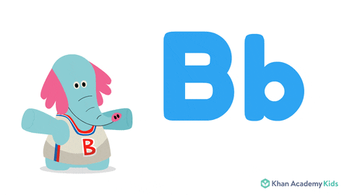
Our Todays lesson
Alphabet(Bb)

Slide 6

Look at the picture
Ball
What is this?
B for Ball

Slide 7

Letter practice….
Ball
B
a
l
l
B

Slide 8
B

Slide 9

Look at the picture
What is this?
book
B for book

Slide 10
Letter practice
Book
B-O-O-K

Slide 11
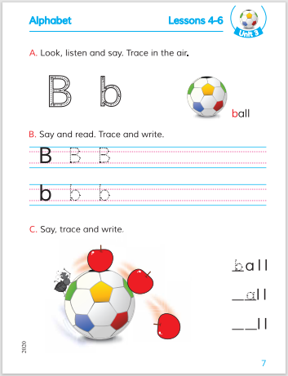
Open your English book at page 7

Slide 12
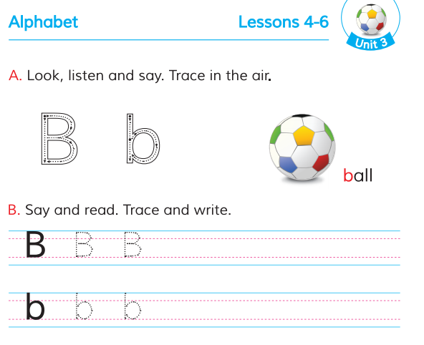
Trace in the air

Slide 13


Checking learning
Ball

Slide 14

Pair Work
Matching the words with pictures
Book
Ball

Slide 15
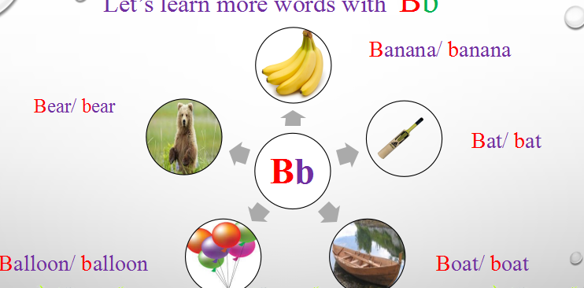
Let’s learn more words with B b
Bb

Slide 16
Home work
Write capital letter and small letter “Bb”.

