Slide 2
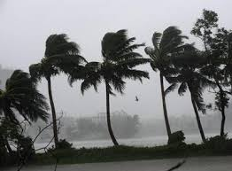
GOOD AFTERNOON TO ALL

Slide 3
Teacher’s Identity
Nahida Akhter
Assistant Teacher
Kalikaccha North Government Primary School
Sarail, Brahmanbaria
E-mail: nahidaakhter99@gmail.com
Twitter:@NahidaA92015591

Slide 4
LEASSON
CLASS:Five
UNIT :24
LESSON :2&3
LESSON’S TITLE:Cyclone Aila
TODAYS LESSON:D

Slide 5
Let’s see a video

Slide 6
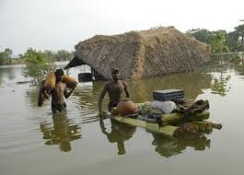
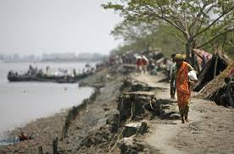
Look at the pictures and think about these
What about are these pictures ?
These pictures are natural disaster
( flood and river erosion ).
These are the pictures of natural calamities

Slide 7
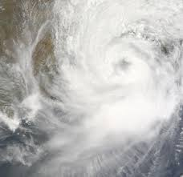
Today’s lesson is -
Aila
Cyclone

Slide 8
Learning outcomes--
Listening:
1.3.1:Recognize which words in a sentence are stressed.
3.4.1:Understand statements made by teachers &students
Speaking:
1.1.2:Say sentence with proper intonation.
6.2.1:Talk about people, objects, events etc.
Reading:
1.5.1:Read words, phrases and sentence in the text with
Proper pronunciation, stress and intonation
writing:
3.1.1:Write words, phrases and sentences using non-
-cursive Capital and small letters.
8.1.1:Make sentences using words & Phrases given in
the textbook.

Slide 9
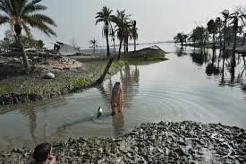
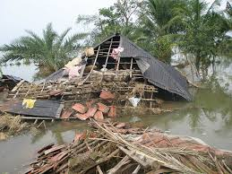
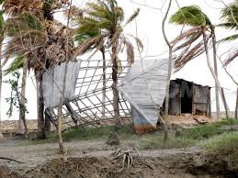
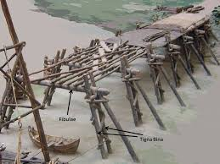
Everybody see the pictures and
say , what is about the pictures ?
These pictures are about natural
Calamity ‘Cyclone’.

Slide 10
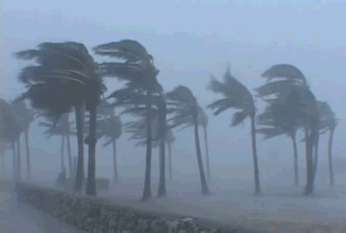
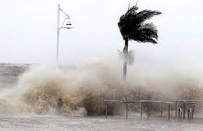
What are you looking at the pictures ?
The picture is about ‘Cyclone Aila’

Slide 11
What can you see in the pictures ?
Cyclone is in the Sea.
The river is rising.

Slide 12
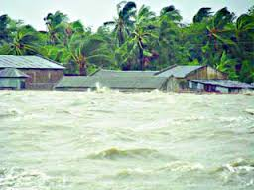
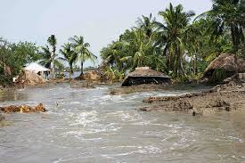
What can you see in the pictures ?
The river flooded the field.

Slide 13
Let’s see another video-

Slide 14
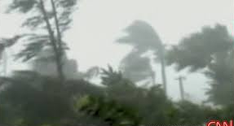
Look at the pictures and think about these.
The wind is blowing and the roof away

Slide 15
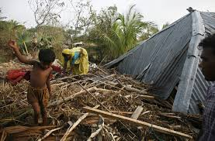
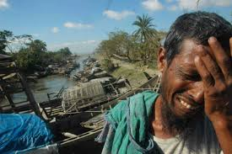
See another pictures and think about these
The wind has blown the roof away
and the man is so sorrow.

Slide 16
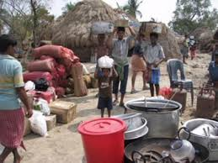
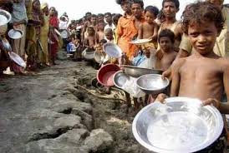
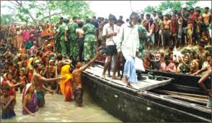
What can you see in pictures? Think about these.
The people are house & foodless for Cyclone Aila
The Army are distributing food to the people .

Slide 17
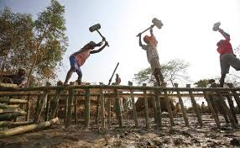
What can you see in the pictures ?
The bridge is damaged by Cyclone.
After Cyclone (Aila)
The workers are repairing the bridge.

Slide 18
Everybody look at the blackboard and
write the meaning of these words,
Rising
Flooded
Blowing
Roof
Away
Repairing
বৃদ্ধি পাওয়া
বন্যাকবলিত / পানিতে ডুবে যাওয়া
বহা ( বাতাস বহা )
ছাদ / ঘরের চালা
উড়িয়ে নেয়া
মেরামত করা / পুনরায় তৈরি করা

Slide 19
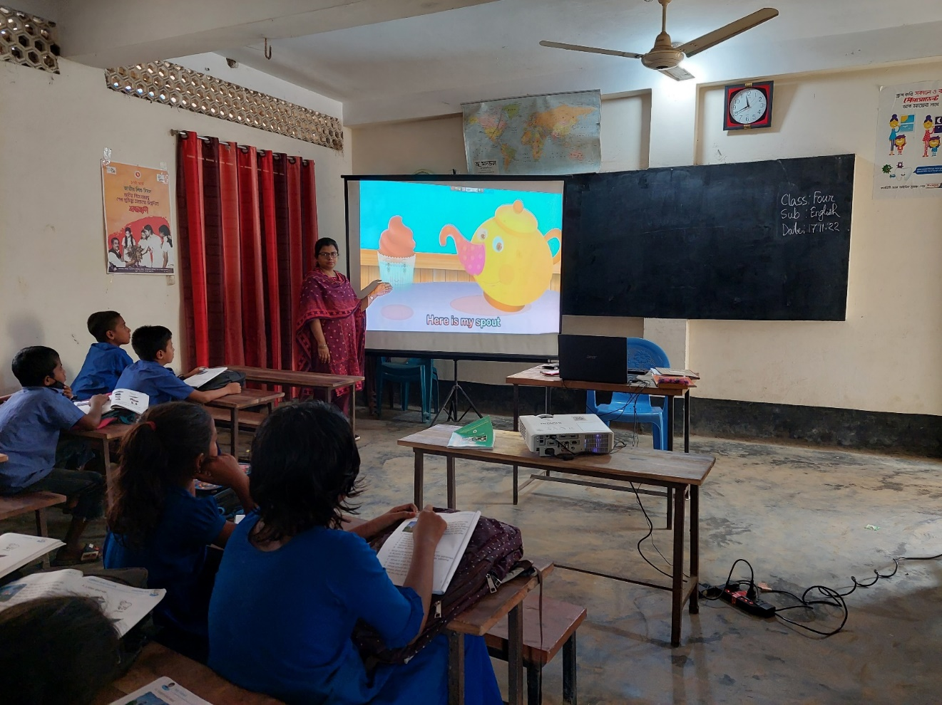
Teacher’s Reading

Slide 20
Everybody take your book and open page at 94.

Slide 21
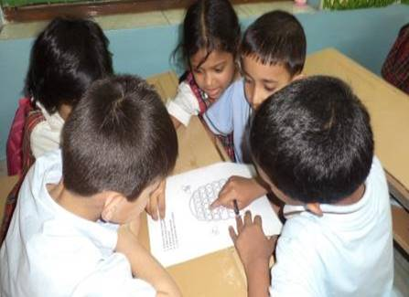
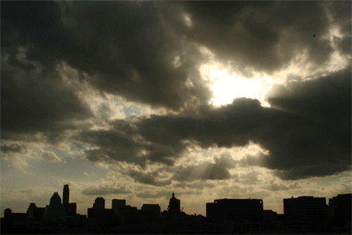
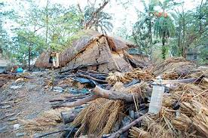
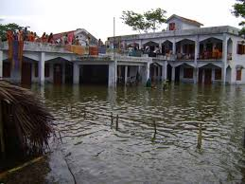
Look at the pictures and
discuss in groups
The sky is cloudy
The wind is starting
The wind has broken
house & trees
People has gone in
shelter center

Slide 22
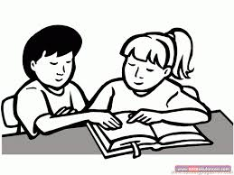
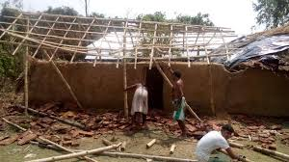
Look at the pictures and
discuss in pairs
The wind is blowing and the roof away
The house is repairing

Slide 23
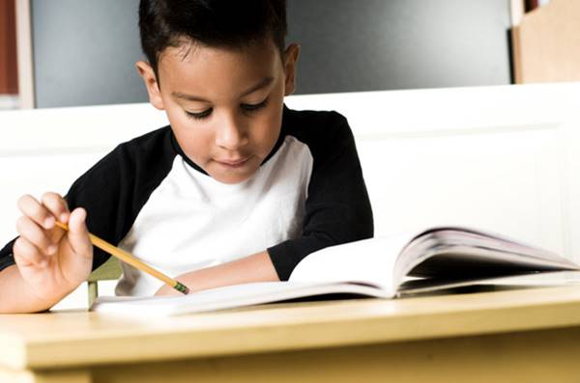
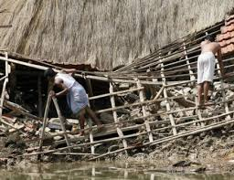
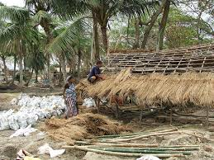
Look at the pictures and
think about these lonely
The houses are repairing after Aila

Slide 24
Evalution
*Everybody come in front of and
say about the pictures by turns .
*Write five sentences about
‘Cyclone Aila ’ .

Slide 25
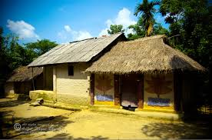
Home work
Everybody read about ‘Cyclone Aila’.

Slide 26
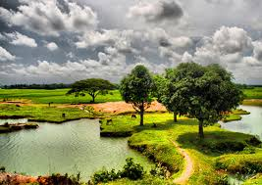
GOOD-BYE TO ALL.

