Slide 1
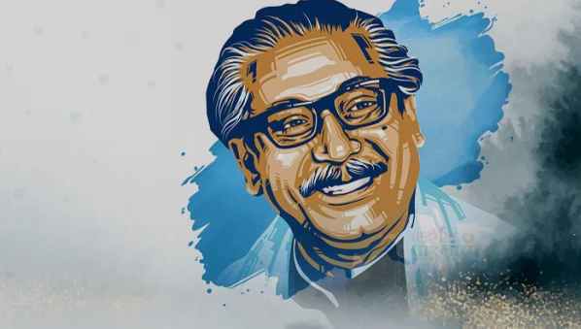
Welcome

Slide 2
Teacher’s Identity
Faridul Islam
Assistant Teacher (English)
Pakhimara Prafulla Bhowmik Secondary School
Contact: 01721913032
faridul13579@gmail.com

Slide 3
Lesson Identity
Class: Six
Subject: English Second Paper
Unit: 09- Lesson: 02
Time: 50 Minutes.
Date: November 04, 2022

Slide 4
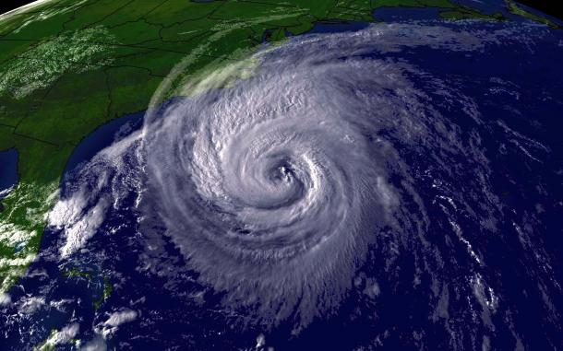
A. Look at the picture and answer the questions.
What do you see in the picture?
Why does it happen?
What measures can we take to get rid of this kind of a situation?
What are some of the natural calamities that affect Bangladesh?

Slide 5
Answers
It is the picture of a cyclone.
When warm, moist air over the ocean rises upward from near the surface, a cyclone is formed.
We can lock doors, turn off power, gas, and water. Take our emergency kits to get rid of this kind of a situation?
Floods, cyclones, storm, river erosion, earthquake, drought these calamities are affecting Bangladesh.

Slide 6
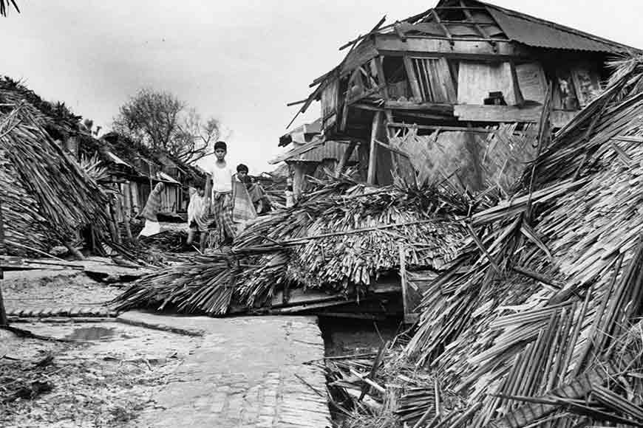
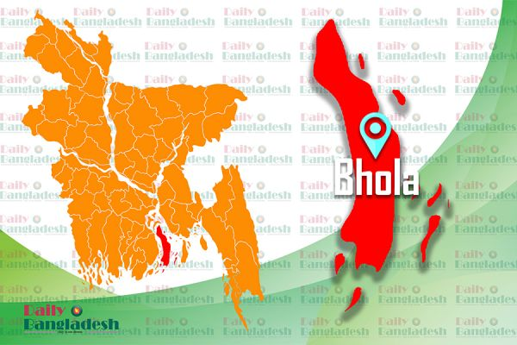
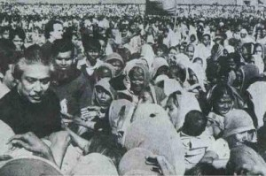
A terrible cyclone occurred in the then East-Pakistan on November 11, 1970 which took total 500,000 (5 lacks mentioned in Wikipedia) lives. In history it is known as The Great Bhola Cyclone.
Bangabandhu came forward to rehabilitate the cyclone affected people.

Slide 7
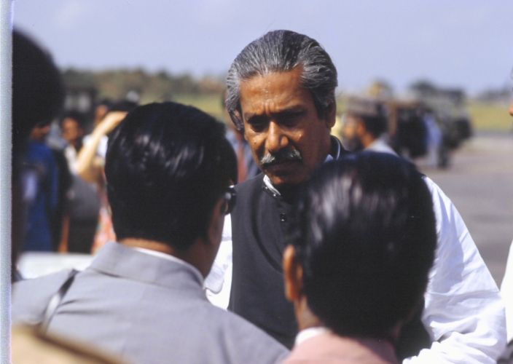
Bangabandhu’s Responses To Natural Calamities
Our today’s lesson is …
Unit-9, Lesson-2

Slide 8
Learning outcomes
After completing this lesson the students will be able to …
ask and answer questions.
say the meaning of some keywords.
match the words with their meaning given in a table.

Slide 10
Climate
জলবায়ু
Weather
আবহাওয়া

Slide 11
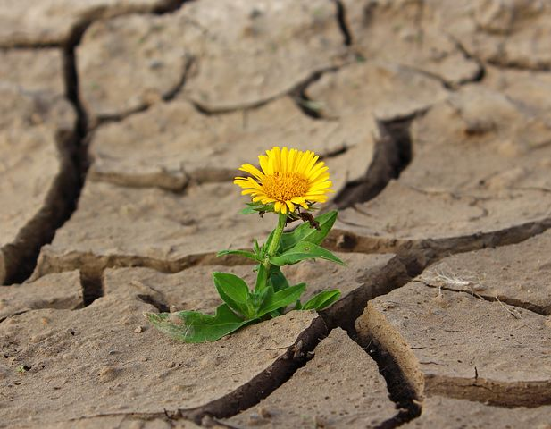
Extreme
চরম
Survival
টিকে থাকা

Slide 12
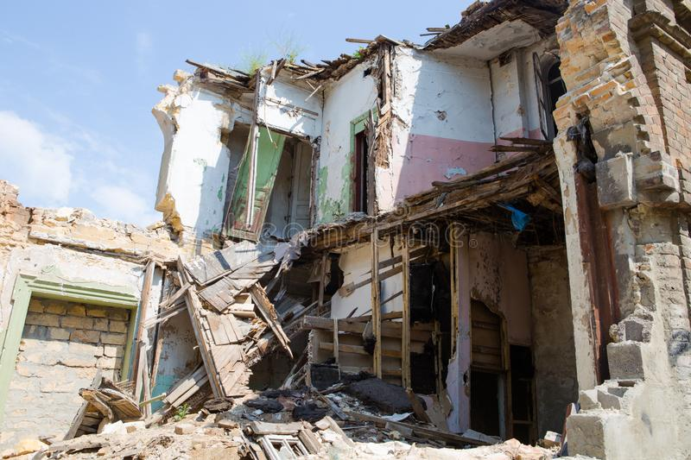
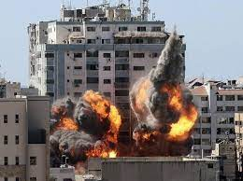
Ruin
নষ্ট
Destroy
ধ্বংস

Slide 13
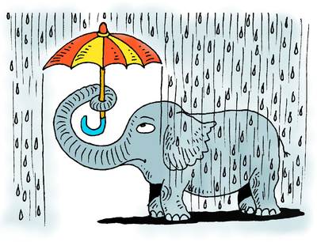
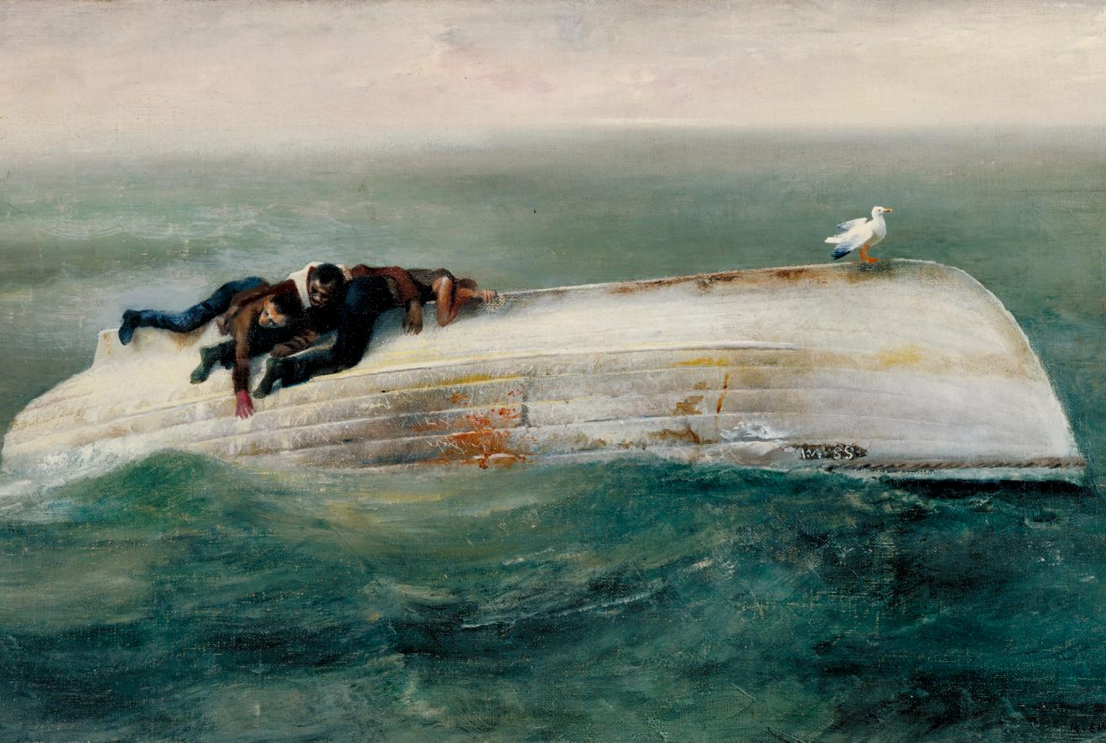
Inadequate
অপর্যাপ্ত
Survivors
বেঁচে থাকা

Slide 14
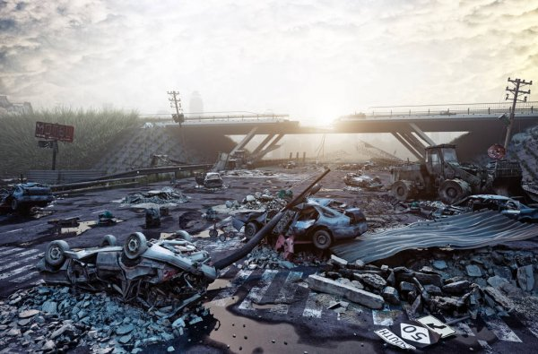
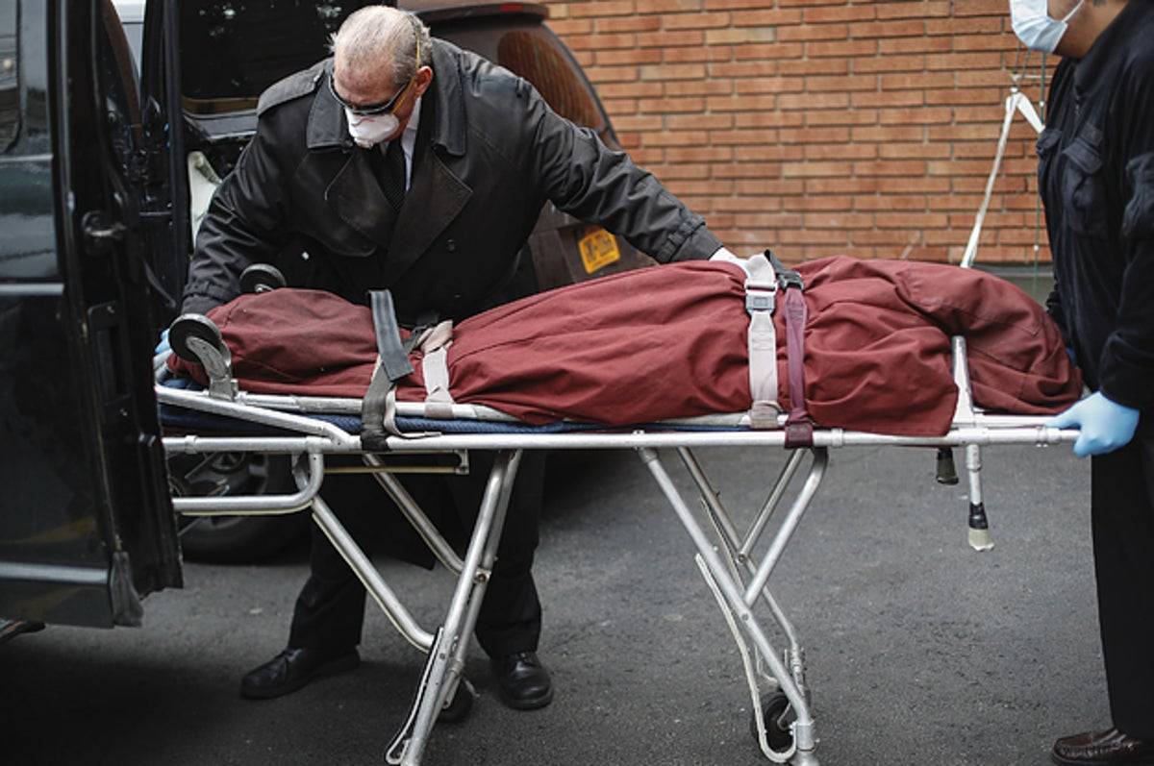
Ravage
বিধ্বস্ত করণ
Corpse
মৃতদেহ

Slide 15
Let’s go through the text.

Slide 16
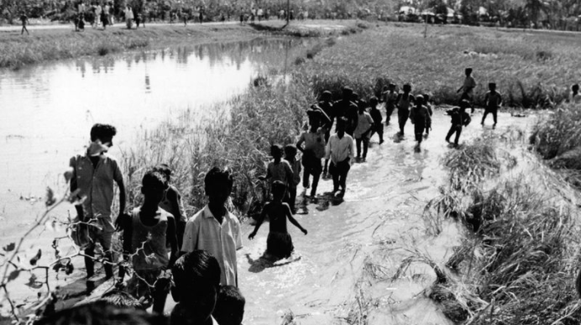
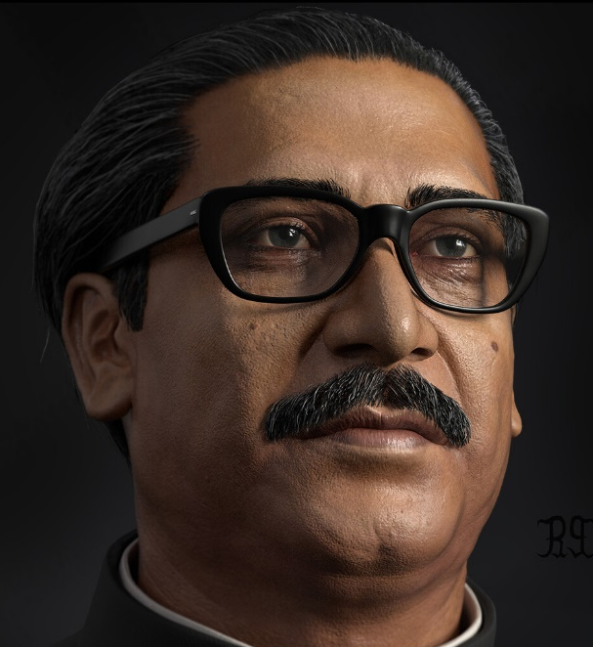
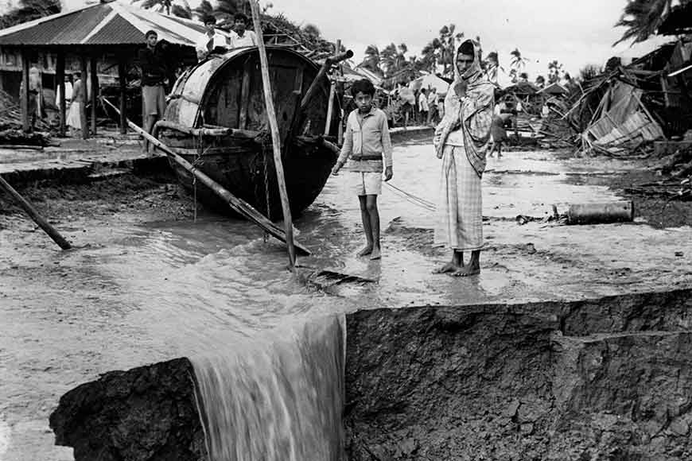
B. Read the text silently. Then go to section C and match the words in column A with their meanings in column B.
One of the major effects of climate change is extreme degradation of weather. Sometimes devastating tornadoes and cyclones destroy the areas they visit. Trees get fallen down, houses are damaged, people and other animals are killed, and crops are damaged. A terrible natural calamity occurred during the lifetime of Bangabandhu Sheikh Mujibur Rahman. It was the tornado of 1970. As the tornado occurred in and around Bhola, the incident is popularly known as Bhola Tornado. Sheikh Mujib’s responses towards it were prompt and positive.

Slide 17
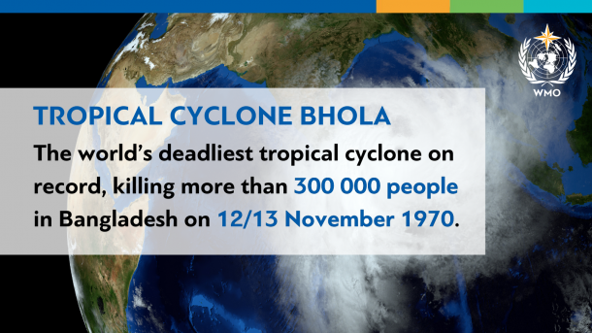
In November 1970, the tornado hit Bhola killing around 50,000 people damaging their houses and other belongings. The response by the Pakistan government was slow and inadequate. Sheikh Mujib visited the affected areas and was shocked to see the destruction and the sufferings of the survivors. Many places in Patuakhali, Bhola and Noakhali became devastated. Corpses were floating in the river and there was not much initiative from the government that could lessen the sufferings.

Slide 18
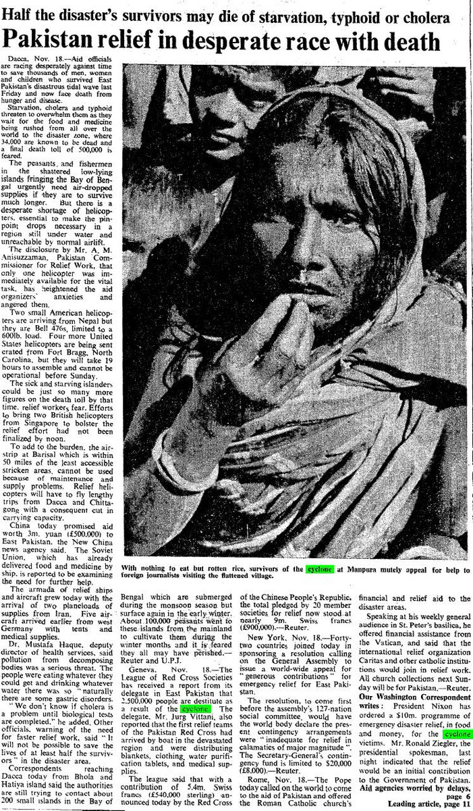
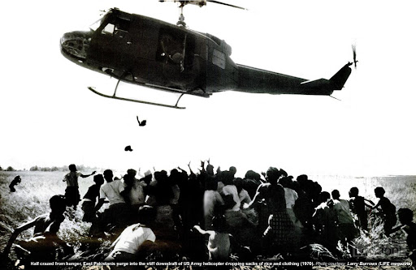
The people who survived did not have food, clothes, shelter, medicines and drinking water. At that time, Mujib provided relief and other types of support to the suffering people. He asked the Pakistan government to provide adequate relief to the affected people and to take proper measures for burying the dead.

Slide 19
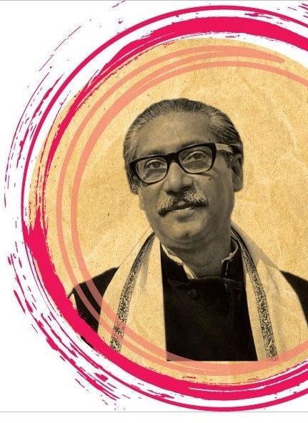
The small and big cyclones and other disasters in the sixties made Mujib much aware of steps that need to be taken to face the natural calamities. When the government of Bangabandhu came to power in 1971, his government drew up a plan regarding how to stand by the people before, during and after the calamities. To save and provide support to the people, the newly formed Mujib government set up a Ministry of Disaster Management and Relief in 1972. Through various efforts, the government was able to combat all the natural calamities successfully.

Slide 20
C. Match the words in column A with their meaning in column B.
Column A | Column B
1. extreme (adj.) | a. conscious
2. aware (n) | b. destructive
3. famine (n) | c. spoil
4. survive (v) | d. utmost
5. initiative | e. fight
6. destroy (v) | f. step
7. combat (v) | g. scarcity of food
8. devastating (adj.) | h. live
1 + d
2 + a
3 + g
4 + h
5 + f
6 + c
7 + e
8 + b

Slide 21
D. Match the beginning of sentences in column A with the ending in column B.
Column A | Column B
1. The tornado in 1970 | a. about the tornado victims of Bhola in 1970.
2. Sheikh Mujib faced much | b. by the then government.
3. Natural calamities were effectively managed | c. established Ministry of Disaster Management and Relief in 1972.
4. Bangabandhu could anticipate the future natural calamities in Bangladesh and he | d. big cyclones in the 60s.
5. The Pakistan government was apathetic | e. killed about half a lac of people.
1 + e
2 + d
3 + b
4 + c
5 + a

Slide 22
E. There are some statements/facts below. Read the text in section B again and put tick (√) marks against the statements which go with Sheikh Mujibur Rahman.
1. visited the tornado-hit areas
2. was apathetic about the famine victims
3. provided relief goods to the tornado victims
4. went to West Pakistan government to stand by the side of distressed people
6. had empathy with the poor people
7. managed natural calamity very well during his time in the government
8. did not have empathy for the poor.
9. established Ministry of Disaster Management and Relief
10. opened free food centres across the country.

Slide 23
F. Ask and answer the following questions in pairs.
1. What are the main effects of climate change?
Answer: Extreme degradation of weather such as untimed rainfall, drought, excessive rain, shifting seasons, flood, cyclone are the main effects of climate change.
2. How many large natural calamities took place in Bangabandhu’s life?
Answer: A large natural calamity took place in during the lifetime of Bangabandhu.
3. Why was Bangabandhu unhappy with the Pakistan government?
Answer: After the great Bhola Tornado many people lost their properties and were living in untold sufferings. But the then Pakistan government did not take any proper step to rehabilitate them. So, Bangabandhu was unhappy with the Pakistan government.

Slide 24
F. Ask and answer the following questions in pairs.
4. How did Bangabandhu provide support to the people in the affected area?
Answer: Banganbandhu provided relief and other types of support to the people in the affected area.
5. Why did Sheikh Mujib ask Pakistan government for relief?
Answer: After the devastating cyclone people were in great distress but the then Pakistan government seemed to be remain inactive. So, Sheikh Mujib asked the government to come forward for helping the people. The lose was huge and it was quite impossible to rehabilitate the survivors without government help.

Slide 25
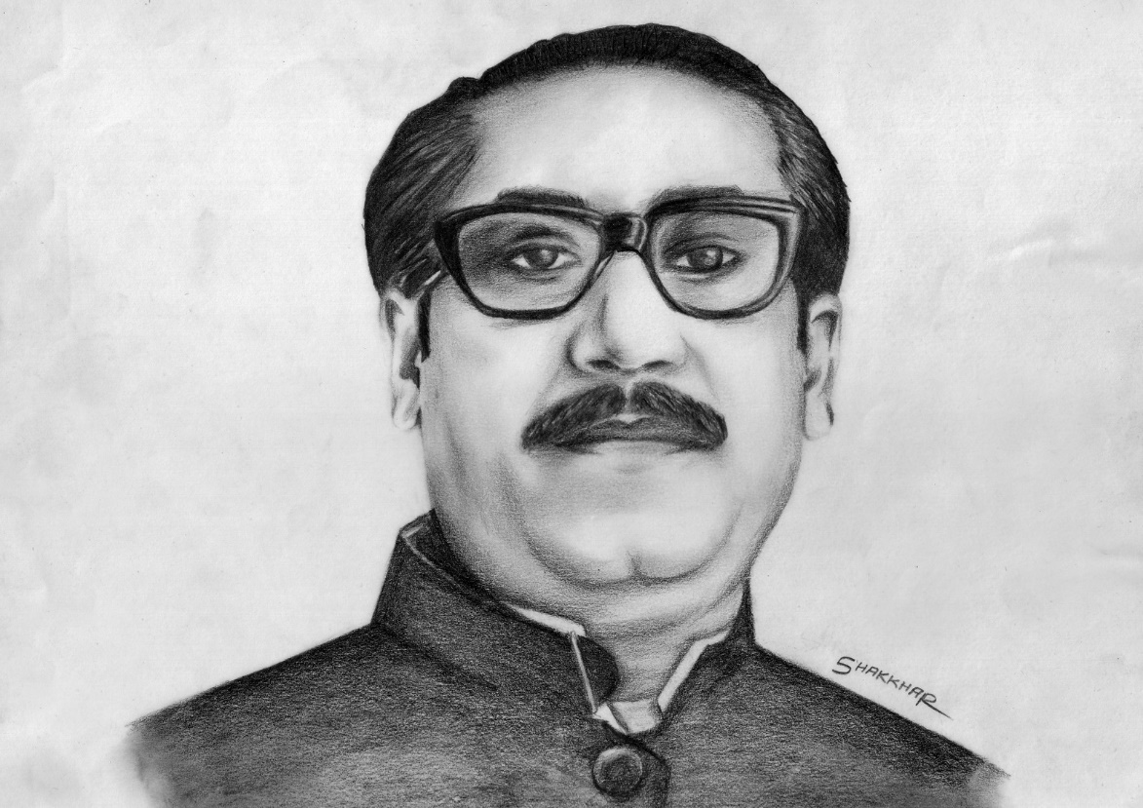
That’s all for today.

