Slide 2
Teacher’s Identity
Faridul Islam
Assistant Teacher (English)
Pakhimara Prafulla Bhowmik Secondary School
Contact: 01721913032
faridul13579@gmail.com

Slide 3
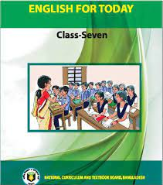
Lesson Identity
Class: Seven
Subject: English Second Paper
Topic: Great Women to Remember.
Time: 50 Minutes.
Date: July 22, 2022

Slide 4
Learning
Outcomes
At the end of the lesson students will able to-----------
read and explain the text.
talk about people.
ask and answer questions.
write answers to questions.

Slide 5
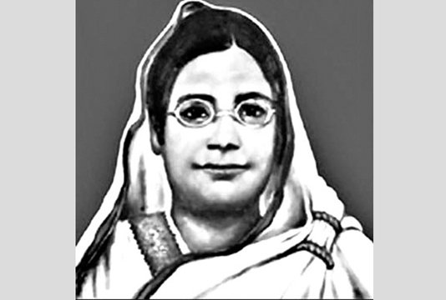
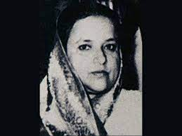
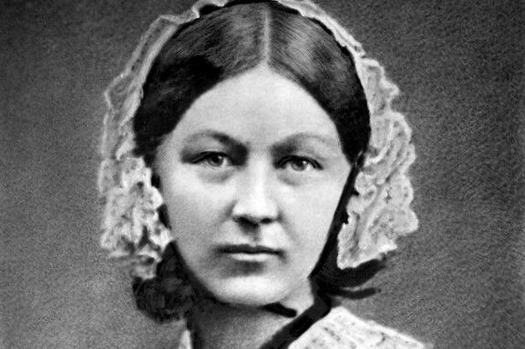
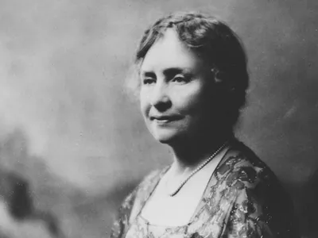
Look at the pictures
Brain
Storming

Slide 6
So, our today’s topic is ………………?
Great Women
to
Remember

Slide 7
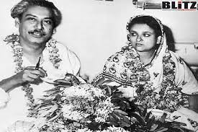
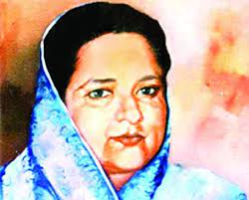
Unit -5, Lesson-1
Bangamata: our source of inspiration

Slide 8
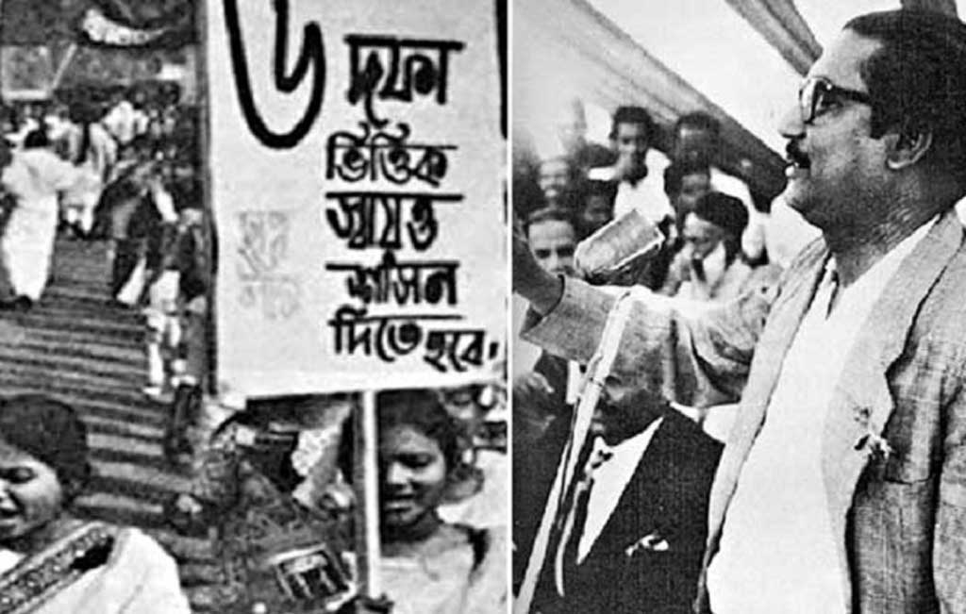
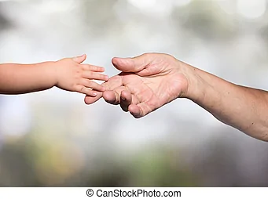
Key Words
historical movement
the movement which is important or likely to be important in history
affection
a feeling of fondness or liking
nation maker
a person who actively takes part in building his / her nation

Slide 9
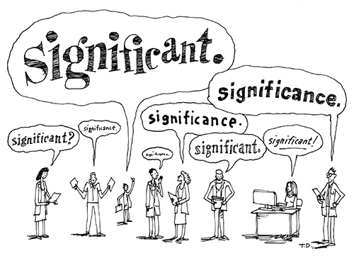
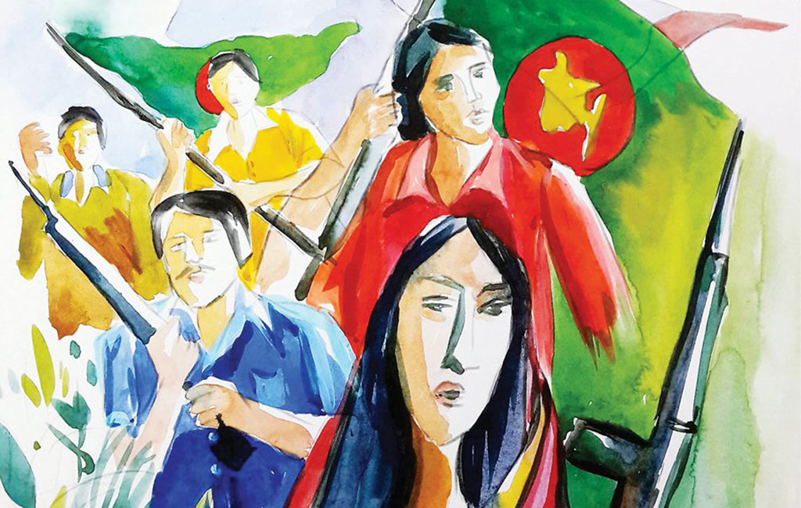
significant
of great importance
Pull back
to move back from a position or place
martyr
the suffering or death of a martyr
prosperous
flourishing financially

Slide 10
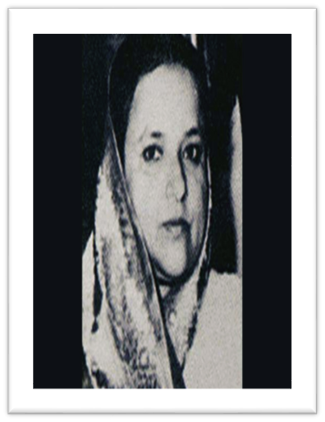
A Look at the picture and answer the following questions.
1.What does ‘Bangamata’ mean?
2. Why is this great woman in
the picture called ‘Bangamata’?
3. What do you know about her?
Let’s find out the answers from the text.

Slide 11
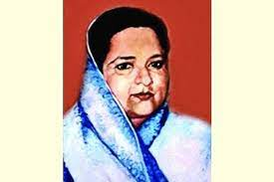
the movement which is important or likely to be important in history
B Read the text about Bangamata.
Sheikh Fazilatunnesa Mujib is a great woman ìn the history of Bangladesh. She was the wife of Father of the Nation, Bangabandhu Sheikh Mujibur Rahman. She is called ‘Bangamata’ because of her motherly love and affection for the people and her sacrifice in all historical movements, specially the Liberation War of Bangladesh.
a war fought to gain independence for a country or to free it from oppression
an honorific title given to a person considered the driving force behind the establishment of a country

Slide 12
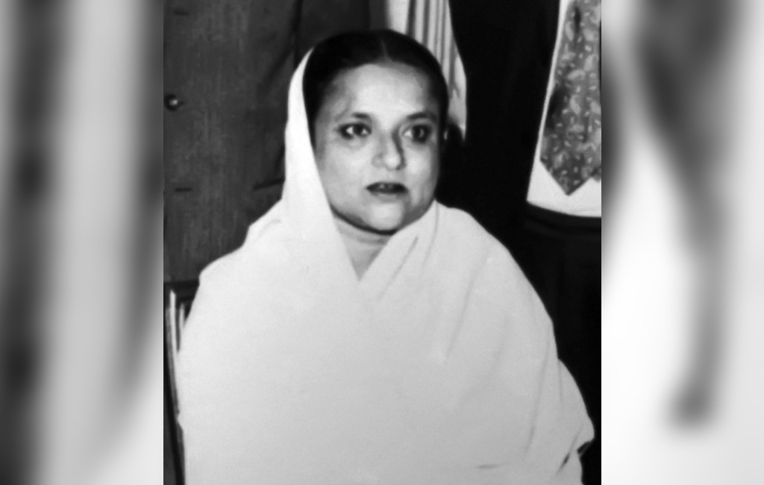
the wife of the president
nation builder
This noble woman was born in Tungipara, Gopalganj on 8 August 1930. She had no demands for her own. She lived a very simple life and taught her five children how to lead an ordinary life. Gradually, she became a nation maker along with Bangabandhu. Even though she was the First Iady of Bangladesh, she had no pride and did not want luxury.
Bangamata always inspired Bangabandhu in all difficult situations of the country. She always encouraged him to involve himself in politics freely for the people of this country. She never pulled him back and never thought of her own interests. She played a prominent role in the Six-Point Movement in 1966.
a charter of demands enunciated by the Awami League for removing disparity between the two wings of Pakistan

Slide 13
a sedition case in Pakistan during the rule of Ayub Khan in 1968 against Sheikh Mujibur Rahman, the then leader of the Awami League and East Pakistan, and 34 other people
in the speech Bangabandhu informally declared independence of Bangladesh by announcing disobedience movement in the province
She gave the right suggestion to Bangabandhu to face the Agartala Conspiracy Case in 1969. She strongly supported him to participate in the General Elections in 1970 and inspired him to deliver the historic 7 March Speech in 1971. Her role in rebuilding the newly-born nation was also significant.
On 15 August 1975, the most tragic event in the history of Bangladesh took place. On this very sad day Bangamata met martyrdom along with Bangabandhu, their three beloved sons and some close relatives. She will remain in our hearts because she and Bangabandhu worked together to build a happy and prosperous ‘Sonar Bangla’ for us all.

Slide 14
Answer to the questions for Activity A
1. What does Bangamata mean?
Answer: The term ‘Bangamata’ consists of ‘Banga’ and ‘mata’. ‘Banga’ refers to ‘Bangla’ or ‘Bangladesh’ and ‘mata’ means ‘mother’. Hence , ‘Bangamata’ means the ‘Mother of Bangladesh’.
2. Why is the great woman in the picture called ‘Bangamata’?
Answer: The great woman in the picture denotes Bangamata Sheikh Fazilatunnesa the wife of the Father of the Nation, Bangabandhu Sheikh Mujibur Rahman. She is called ‘Bangamata’ because of her role in inspiring Bangabandhu in his fight for the liberation of Bangladesh. Her sacrifice for the nation is also noteworthy.
3. What do you know about her?
Answer: Bangamata was the wife of Bangabandhu Sheikh Mujibur Rahman. She was a very simple woman and did not have any demand of her own. She was a woman with no pride and lived an ordinary life. She sacrificed her personal happiness for the sake of the nation.

Slide 15
Evaluation
46 Unit Five: Great Women to Remember
C Answer the following questions.
1. What lesson did Bangamata teach her children?
Answer: Bangamata Sheikh Fazilatunnesa herself led a very simple life and taught her five children to lead an ordinary life, too.
2. How did she lend her life?
Answer: Bangamata had no demands of her own. She used to lead a very ordinary life despite being the First Lady of Bangladesh.

Slide 16
3. How did she help the Father of the Nation?
Answer: Bangamata had no demands of her own. She used to lead a very ordinary life despite being the First Lady of Bangladesh.
4. What lesson do you learn from Bangamata’s life?
Answer: We learn from the life of Bangamata that the love for the nation is the most important thing in our life. Throughout her life, she led a simple life and taught her children to do the same. She sacrificed her personal joy for the sake of the nation. Her motherly love for the country has made her Bangamata.

Slide 17
46 Unit Five: Great Women to Remember
D. Read the text again and find Bangamata’s ideals and contribution.
Fill in each gap with the information. One is done for you.
Her right suggestion to Bangabandhu to face Agartala Conspiracy Case
Her support for Bangabandhu in the general election and inspiration to deliver the historic 7 March Speech
Her great
affection for the country
Her very
simple
life
Her prominent role in Six –
point Movement

Slide 18
E Project Work
Plan and design a wall magazine for your school on Bangamata and Bangabandhu on the observance of 15th August, National Mourning Day. Call for poems, short – stories and essays on these two great persons from your class.
Firstly, from a committee for this work.
Secondly, divide the roles and responsibilities among the members of the committee and select a place for the wall magazine.
Thirdly, call for papers and poems, short-stories, and essays on these two great persons and give a deadline.
Fourthly, sort out the best literary pieces.
Fifthly, publish them on the wall magazine.
Finally, invite your school and community people to see your work.

Slide 19
Reading: The text about Bangamata
( Unit-5, Lesson-1)
Writing: Activity C (Answer the following
questions)

