Slide 1
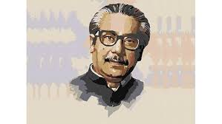
Welcome

Slide 2
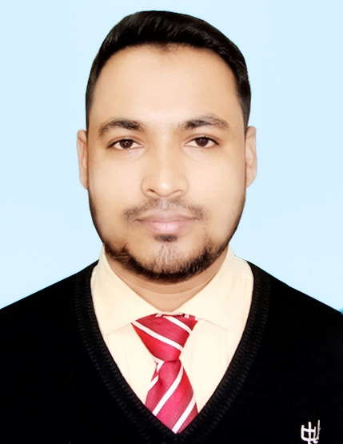
Teacher’s Identity
Faridul Islam
Assistant Teacher (English)
Pakhimara Prafulla Bhowmik Secondary School
Contact: 01721913032
faridul13579@gmail.com

Slide 3
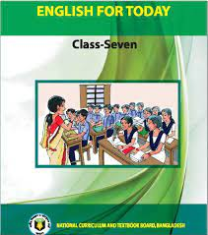
Lesson Identity
Class: Seven
Subject: English Second Paper
Unit: 07 - Lesson: 03
Time: 50 Minutes.
Date: October 07, 2022

Slide 4
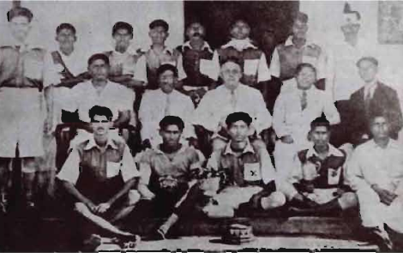
A. Ask and answer the questions in pairs.
What are the popular games and sports in Bangladesh?
What games and sports do you play?
Why do you like them?
Who among Bangladeshi statesmen was a passionate lover of games and sports?

Slide 5
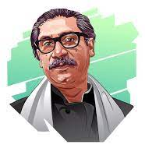
Bangabandhu’s Love For Sports
Our today’s lesson …
Unit-7, Lesson-3

Slide 6
Learning outcomes
After completing this lesson the students will be able to …
ask and answer questions.
say the meaning of some keywords.
match the words with their meaning given in a table.
find out the true and false sentences.
fill in the gaps with appropriate words given in the box.

Slide 8
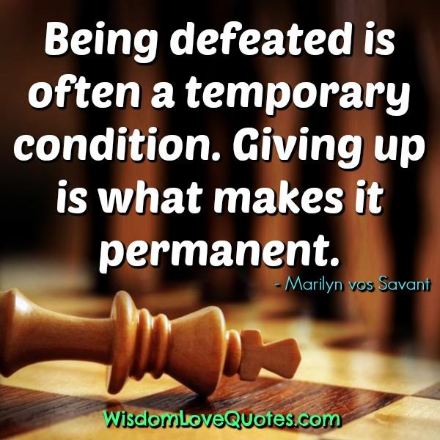
Passionate
Profound (প্রগাঢ়)
Defeat
Loss (পরাজয়)

Slide 9
Take a lease
(ভাড়া করা)
Hire
Expense
Charge (ব্যয়)

Slide 10
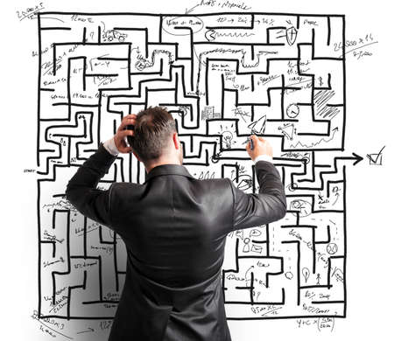
Difficult
Hard (কঠিন)
Propose
Propound (প্রস্তাব করা)

Slide 11
Competition (প্রতিযোগিতা)
Tournament
Acknowledgement (স্বীকৃতি দান)
Recognition

Slide 12
Let’s go through the text.

Slide 13
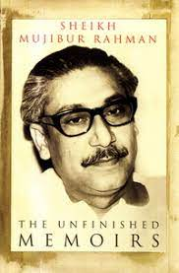
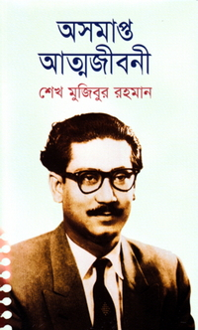
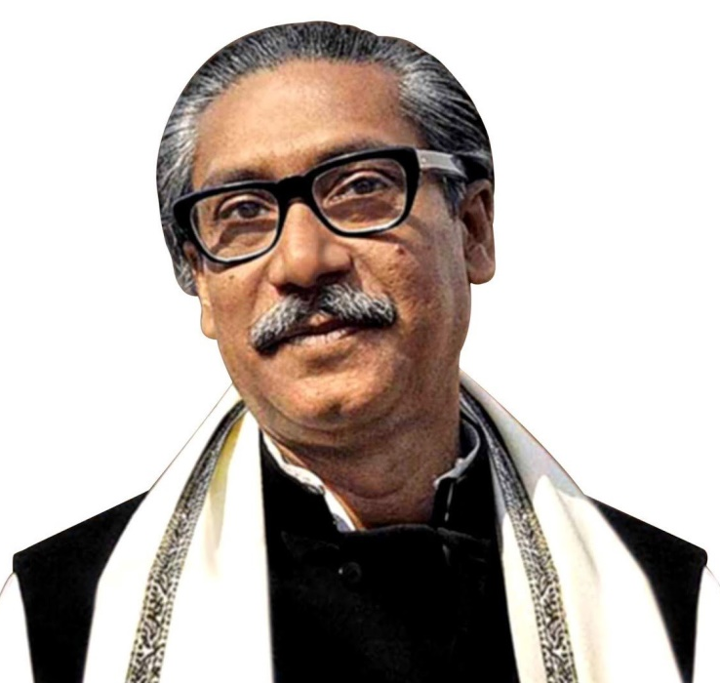
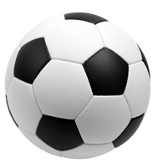
B. Read the text silently and match the parts of sentences in section C.
Father of the Nation, Bangabandhu Sheikh Mujibur Rahman, was a passionate lover of sports through his life. During his early age, he took part in many football competitions and defeated many teams. In his autobiography Unfinished Memoirs, he mentions that he was a student of class seven in 1934. He used to play games and sports such as football, hockey, and volleyball and also sing songs. But his father, Sheikh Lutfor Rahman, who was also a good player, did not allow him to play much as Sheikh Mujib had a heart problem.

Slide 14
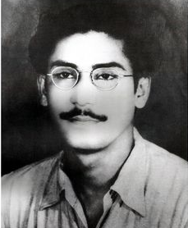
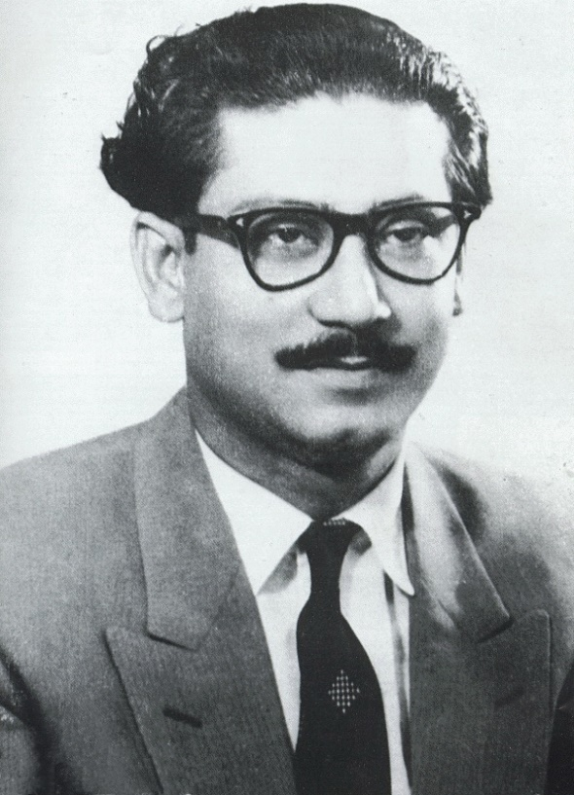
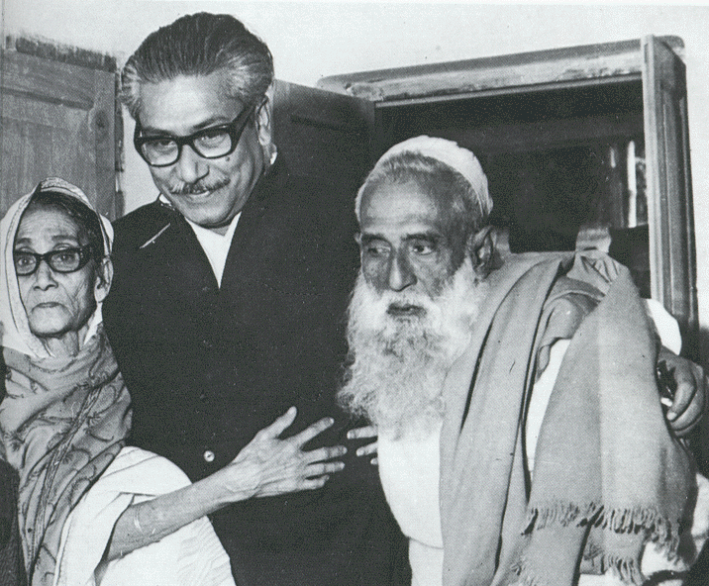
Young Mujib was the captain of Gopalgonj Mission School football team and his father was the secretary of the Officers’ Club. At that time, there was a culture of competition between the students and the teachers, students and the officials, and married and unmarried people. People used to enjoy when Sheikh Mujib’s team and his father Sheikh Lutfor Rahman’s team played against each other. Mujib would collect the best players for his team from the Sub-division and get them admitted into Mission School with full-free studentships. His father used to hire the best players from the locality to make his team stronger.

Slide 15
Once five consecutive matches between Sheikh Mujib and his father’s teams were played and none could win. His father proposed to them to play the final match the next morning as the expenses of the hired players were increasing. The Head Master of Mission School, Babu Rasranjan Sengupta tried to make Mujib agree to play the next morning. Sheikh Mujib Said, “Sir, you know, we, the same players are playing round the year; now we are tired; our legs are hurt and we need rest for two or four days at least. Otherwise we’ll lose the game.” However Mujib agreed to play the match the next morning in honour of his teacher, and his team with the same players was defeated by his father’s team with hired players by one-nil score.

Slide 16
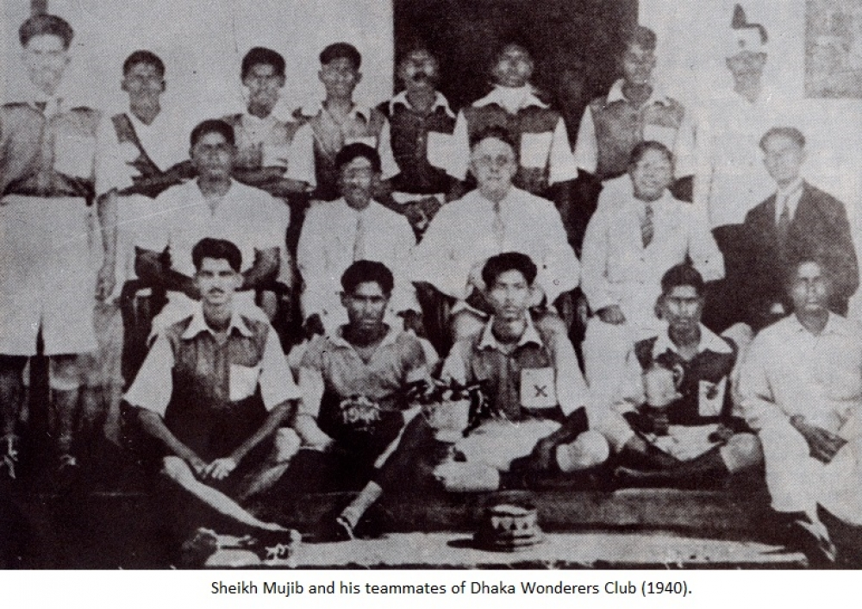
In the 40s, Mujib played in the Second Division Football League for the Wanderers Club. He was a striker in the team and used to wear a jersey numbered 9 or 10. Under his captaincy, the Wanderers Club won Bogura Tournament by 5-0 goals.

Slide 17
Due to his strong involvement in politics, Sheikh Mujib could not engage himself in sports fully but he continued to remain a great fan of sports. He established Bangladesh Football Federation (BFF) and Bangladesh Cricket Control Board (BCCB), in 1972, for the development of cricketers. Bangladesh Sports Council Act was passed in 1974. Bangabandhu Krirasebi Kolyan Foundation was also founded in 1975 to provide support to the players and their families as recognition of his contribution to the field of games and sports.

Slide 18
C. Match the parts of the sentences in Column A with the right ending of the sentences in Column B.
Column A | Column B
1. Mujib did not disagree to the Head Master’s proposal | a. with a view to acknowledging the contributions of Bangabandhu in sports.
2. BCCB was established in 1972 | b. under the captaincy of Sheikh Mujib.
3. In the 1940’s, Mujib played at | c. about his son’s physical fitness.
4. Sheikh Mujib was trying to convince his head teacher, Babu Rasranjan Sengupta | d. whom he respected much.
5. Mujib had a great | e. to provide support to the cricketers.

Slide 19
Column A | Column B
6. Sheikh Lutfor Rahman was worried | f. a national level club in Dhaka.
7. Bangabandhu Krirasebi Kolyan Foundation was founded | g. because he wanted to energize his team players.
8. Wanderers Club performed very well | h. love for games and sports.
Answers
1 | 2 | 3 | 4 | 5 | 6 | 7 | 8
d | e | f | g | h | c | a | b

Slide 20
D. Ask and answer the following questions in pairs.
How did Mujib make a strong football team in Mission School?
Why didn’t Sheikh Lutfor Rahman like to allow his son to play much?
What are the contributions of the Father of the Nation to sports?
Answer: Mujib collected the best players from the Sub-Division and got them admitted into Mission School with full free studentship to make the school’s football team strong.
Answer: Sheikh Lutfor Rahman didn’t like to allow his son to play because Mujib’s physical condition was not good.
Answer: The Father of the Nation established BFF and BCCB in 1972 for the development of football and cricket. He also established Bangabandhu Krirasebi Kolyan Foundation to provide support to the players and their families.

Slide 21
E. Read the statements in Column A and write if they are True or False in Column B.
Column A | Column B (True/False)
1. Mujib did not agree to the head teacher’s proposal.
2. There were consecutive draws in the tournaments between the Mission School and the Officers’ Club.
3. The Officers’ Club was not defeated in the final match.
4. Sheikh Lutfor Rahman was happy to see his son playing.
5. Sheikh Mujib increased engagement in sports after his college life.
True
True
True
False
True

Slide 22
F. Fill in the gaps with the words from the box. Use the appropriate words and their right forms. You may have to use a word more than once.
passionate | defeat | hire | expense | difficult | propose | tournament | convince
Sheikh Mujibur Rahman used to take part in (a) _________ with his team-mates of Mission School but his father would (b) ______ the best players of the area. Mujib’s (c) ______ for games and continuous practices helped him to win in most competitions. Mujib’s team-mates were younger, energetic, slim, and faster in movement. It was not (d) ______ for Mujib to (e) ______ other teams including his father’s Officers’ Club. Although tired and hurt, Mujib was (f) ________ with the head teacher’s (g) _______ to play in the following morning. However, in the final match, Mujib’s team got (h) _______ by one-nil. Sheikh Lutfor Rahman felt stress-free as he won’t have to bear (i) _______ on the (j) ______ players.
tournaments
hire
passion
difficult
defeat
convinced
proposal
defeated
expenses
hired

Slide 23
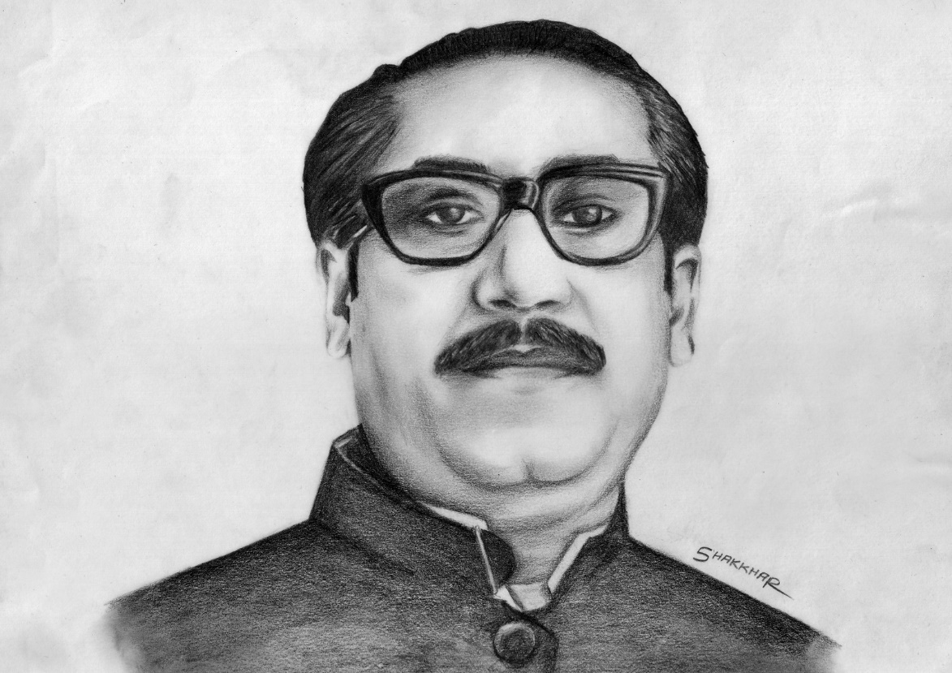
That’s all for today.

Slide 24
