Slide 1
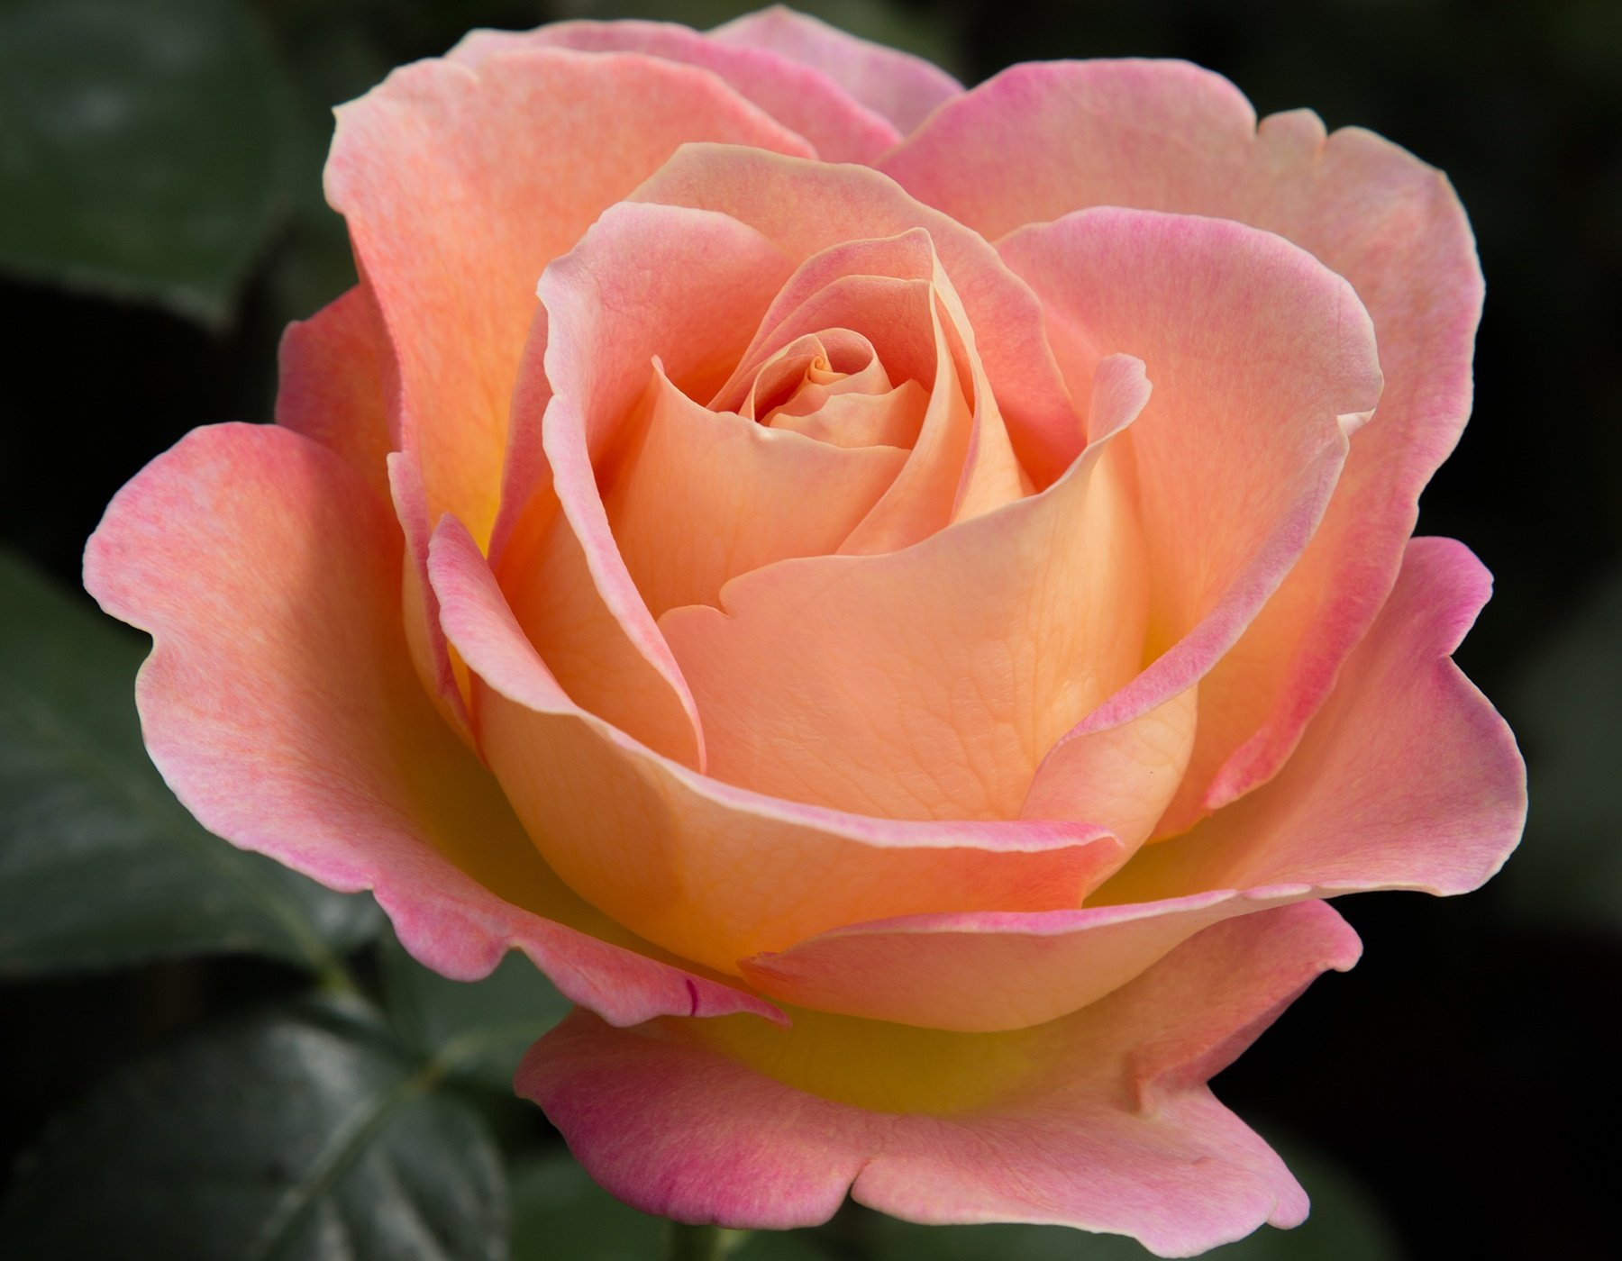
WELCOME TO MY MULTIMEDIA CLASS

Slide 2
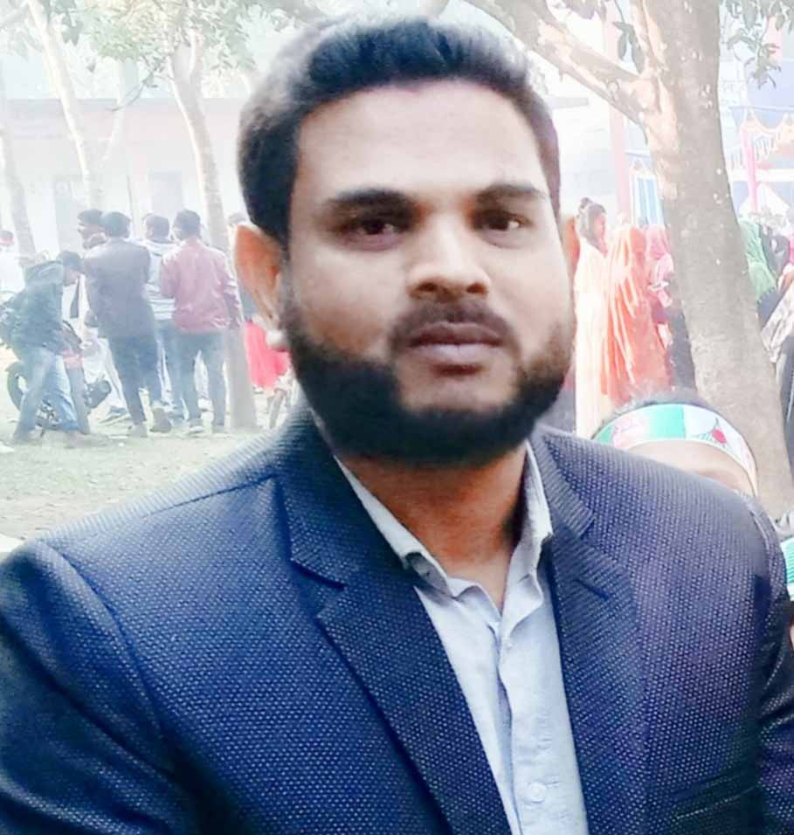
Presented By
Md . Hafizur Rahman
Md . Hafizur Rahman
Assistant Teacher
Haripur Government Primary School
Haripur , Thakurgaon .
Phone: 01716437086
Email:hafizict5@gmail.com

Slide 3
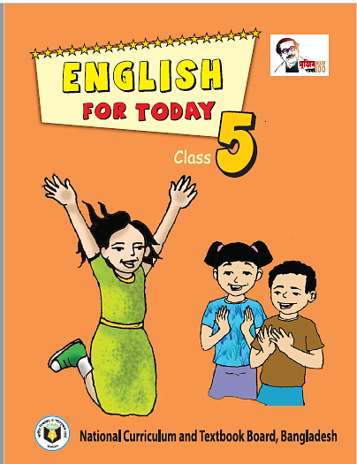
Lesson Identity
Subject : English
Class: Five
Time: 40 minutes
Date: 07-12-2022

Slide 4
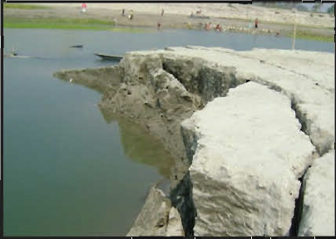
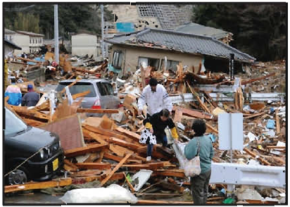
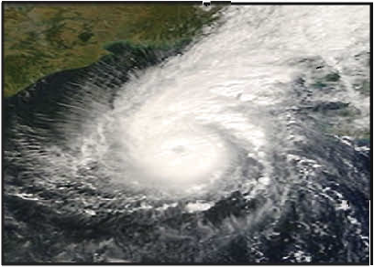
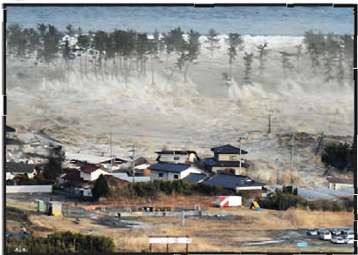
Dear Student ,what do you see in the picture?
All this are natural Disaster?
River erosion
Earthquake
Cyclone
Tsunami

Slide 5
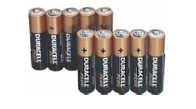
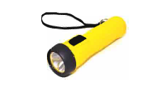
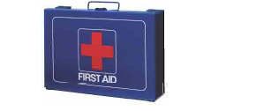
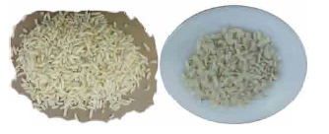
Dear Student ,what do you see in the picture?
Do you have this item in your home?
Batteries
Torch
First-aid Kit
Dried Food

Slide 6
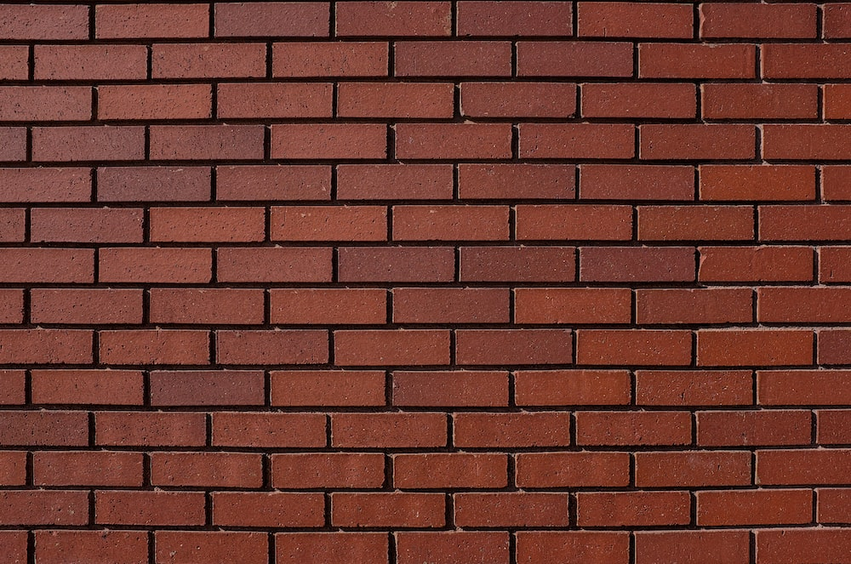
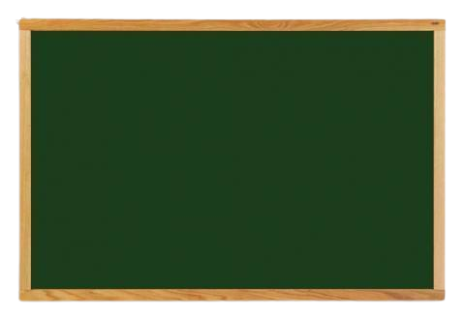
Today lesson
Cyclone Aila
Unit: 24
Lesson: 1
Page No. 91

Slide 7
Learning Outcomes
By end of the lesson student will be able to-
Listening:
4.2.1 understand and enjoy simple stories.
3.4.1- understand statements made by the teacher and student.
Speaking
6.1.2 Say what others are doing.
Reading
1.7.1 read paragraphs, dialogues, stories, letters and other text.

Slide 8
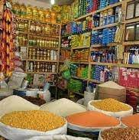
Introducing new words
Grocery
items of food sold in a shop
মুদি
My father have a grocery shop.

Slide 9
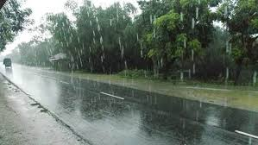
Introducing new words
Drizzling
especially in a thin line or in small drops.
গুড়ি গুড়ি বৃষ্টি পরা
It was drizzling from evening.

Slide 10
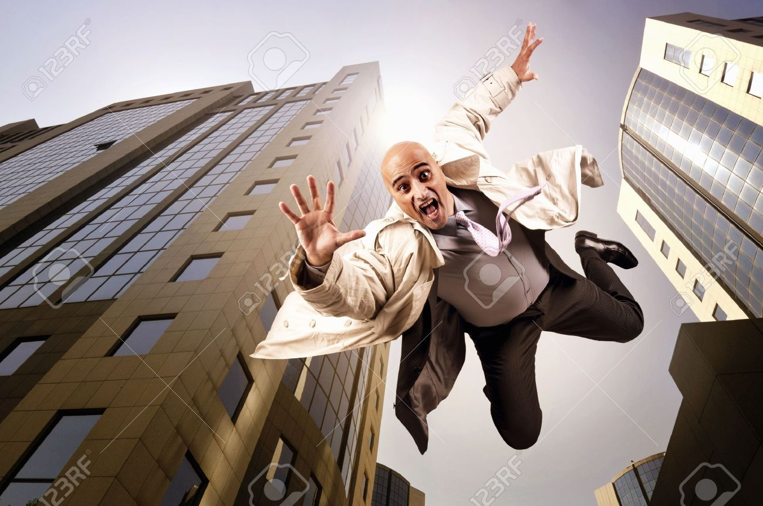
Fallen
Introducing new words
lost
পতিত হওয়া
The trees have fallen down on the road

Slide 11
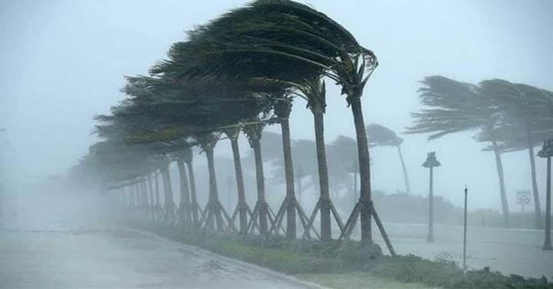
Introducing new words
Blow
move creating an air current
প্রবাহিত হওয়া
The wind stared to blow.

Slide 12
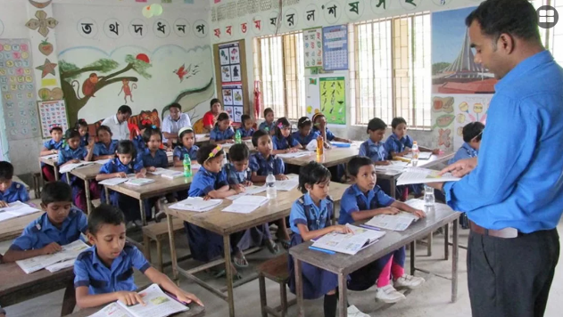
Teacher speaking loudly

Slide 13
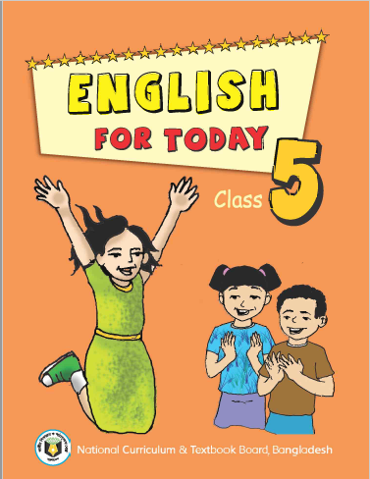
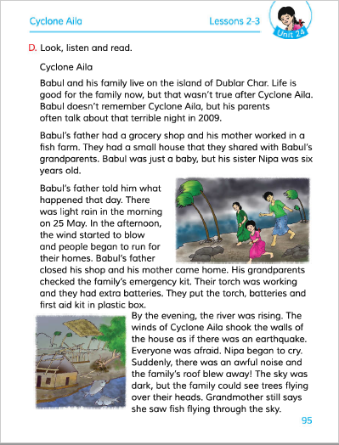
Open your book and turn to page 95

Slide 14
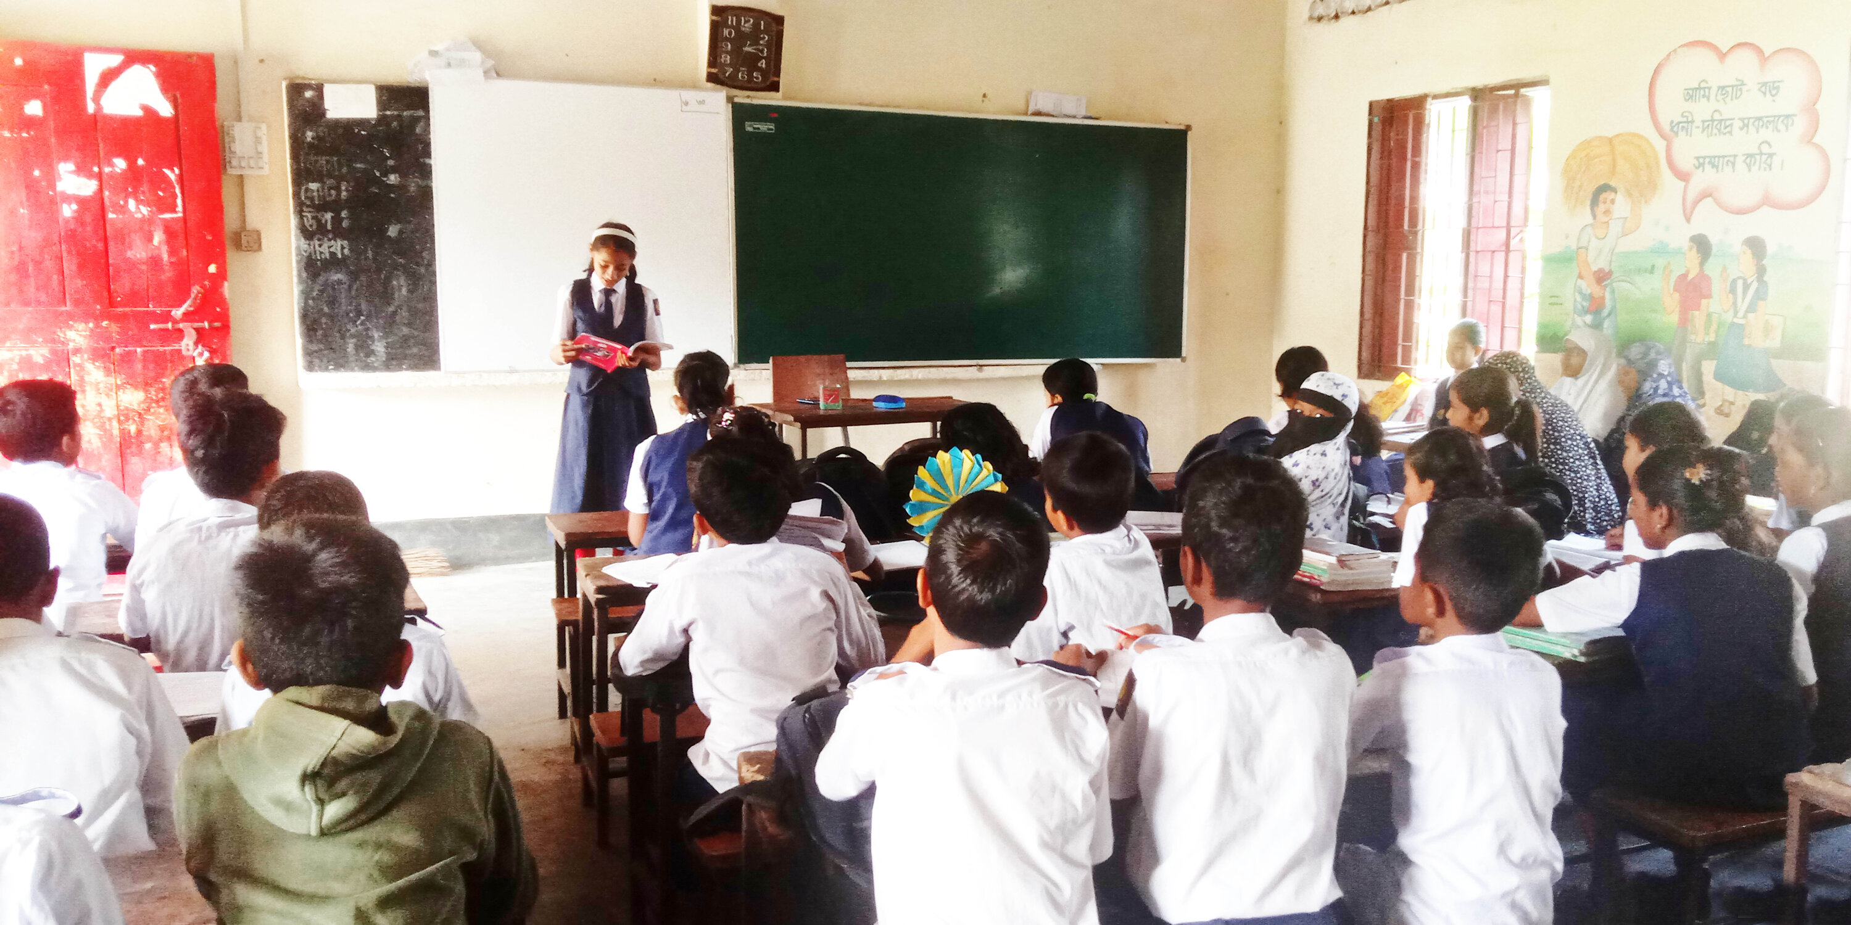
Students reading loudly

Slide 15
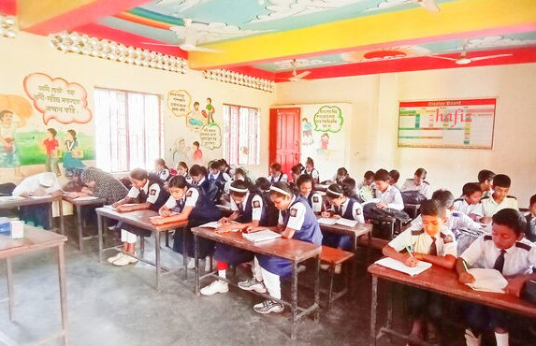
Students silent reading

Slide 16
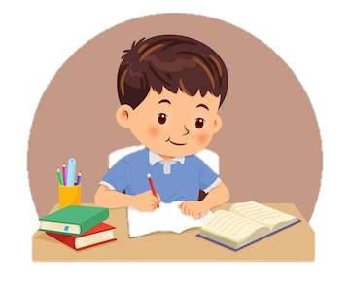
Individual work
Write True for correct statement and False for incorrect statement
True
False
a)
a)Babul’s family lives on an island
b) Babul’s sister is Nipa
True
False
b)
c) Babul’s parents check the emergency kit.
True
c)
False
True
False
d)
d) Nipa is older than Babul.
e) Babul’s mother closed her shop
True
False
e)
Let’s check the answer

Slide 17
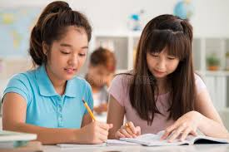
Pair work
Fill in the blanks.
father
six
father
six
dark
small
dark
small
island
island
a. Dublar Char is an …………..
b. Babul’s family had a small ………….. house.
c. Babul’s family had ……………. members.
d. The sky was ………………on the evening.
e. Babuls …………....had a shop.

Slide 18
Pair work
Match the words of the column A with their meanings in column B
Column-A | Column-B
a. Island | i ) very unpleasant.
b. Remember | ii) A store that’s sells food and others things
c. Terrible | Iii) A kind of violent storm.
d. Grocery | iv) To keep an important fact in your mind
e. Aila | v) A land that surround by water.
 | vi) Natural calamity.
c
d
e
b
a

Slide 19
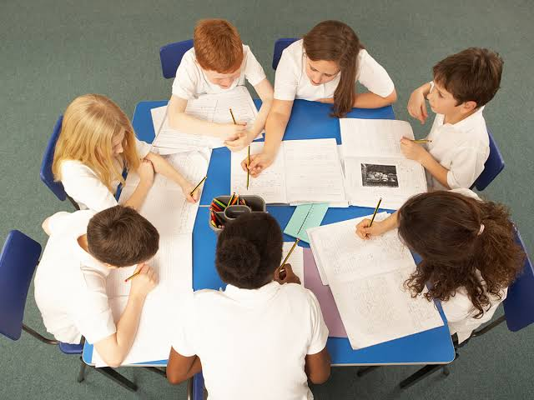
Group work
Group
A
Group
B
Group
C
Group
D
Have you experienced a natural disaster in your life?
What kind of natural disaster was it?
When was it? Or imagine a disaster.

Slide 20
Evaluation
Q:1. 1.What did Babul’s mother do?
Q: 2.What emergency kit did grandparents take with them?
Q: 3. What happened in the afternoon?
Q: 4. Why was everyone afraid?
Q :5. Write two sentence about Babul’s family?

Slide 21
One day one word
Roof
ছাদ
sentence making
The family’s roof blew away.

Slide 22
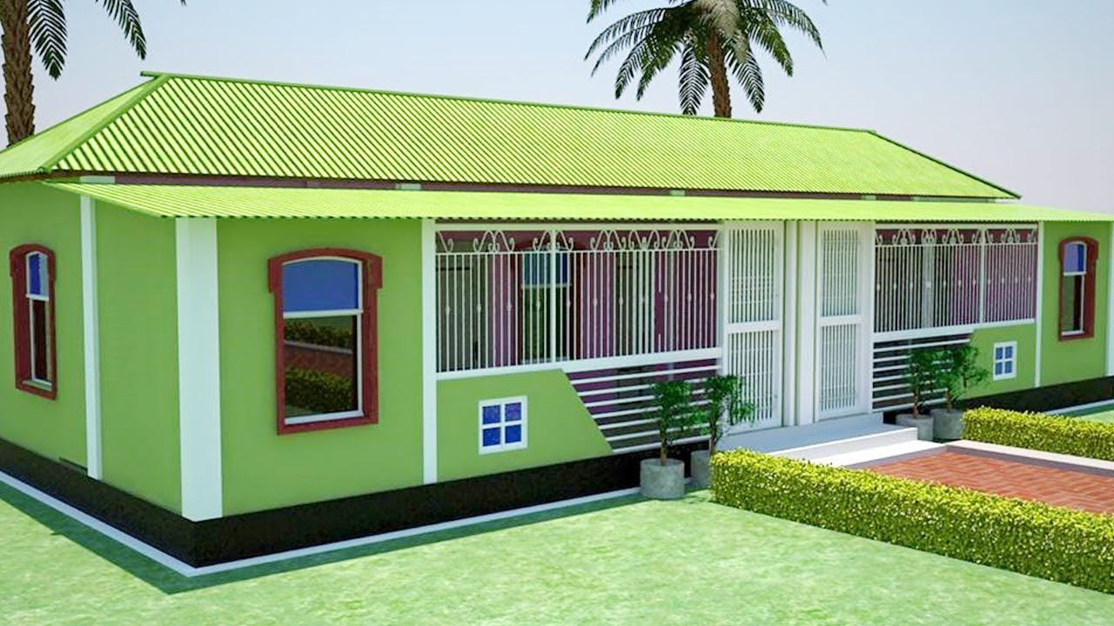
Home Task
Write 5 sentences About “cyclone Aila”.

Slide 23
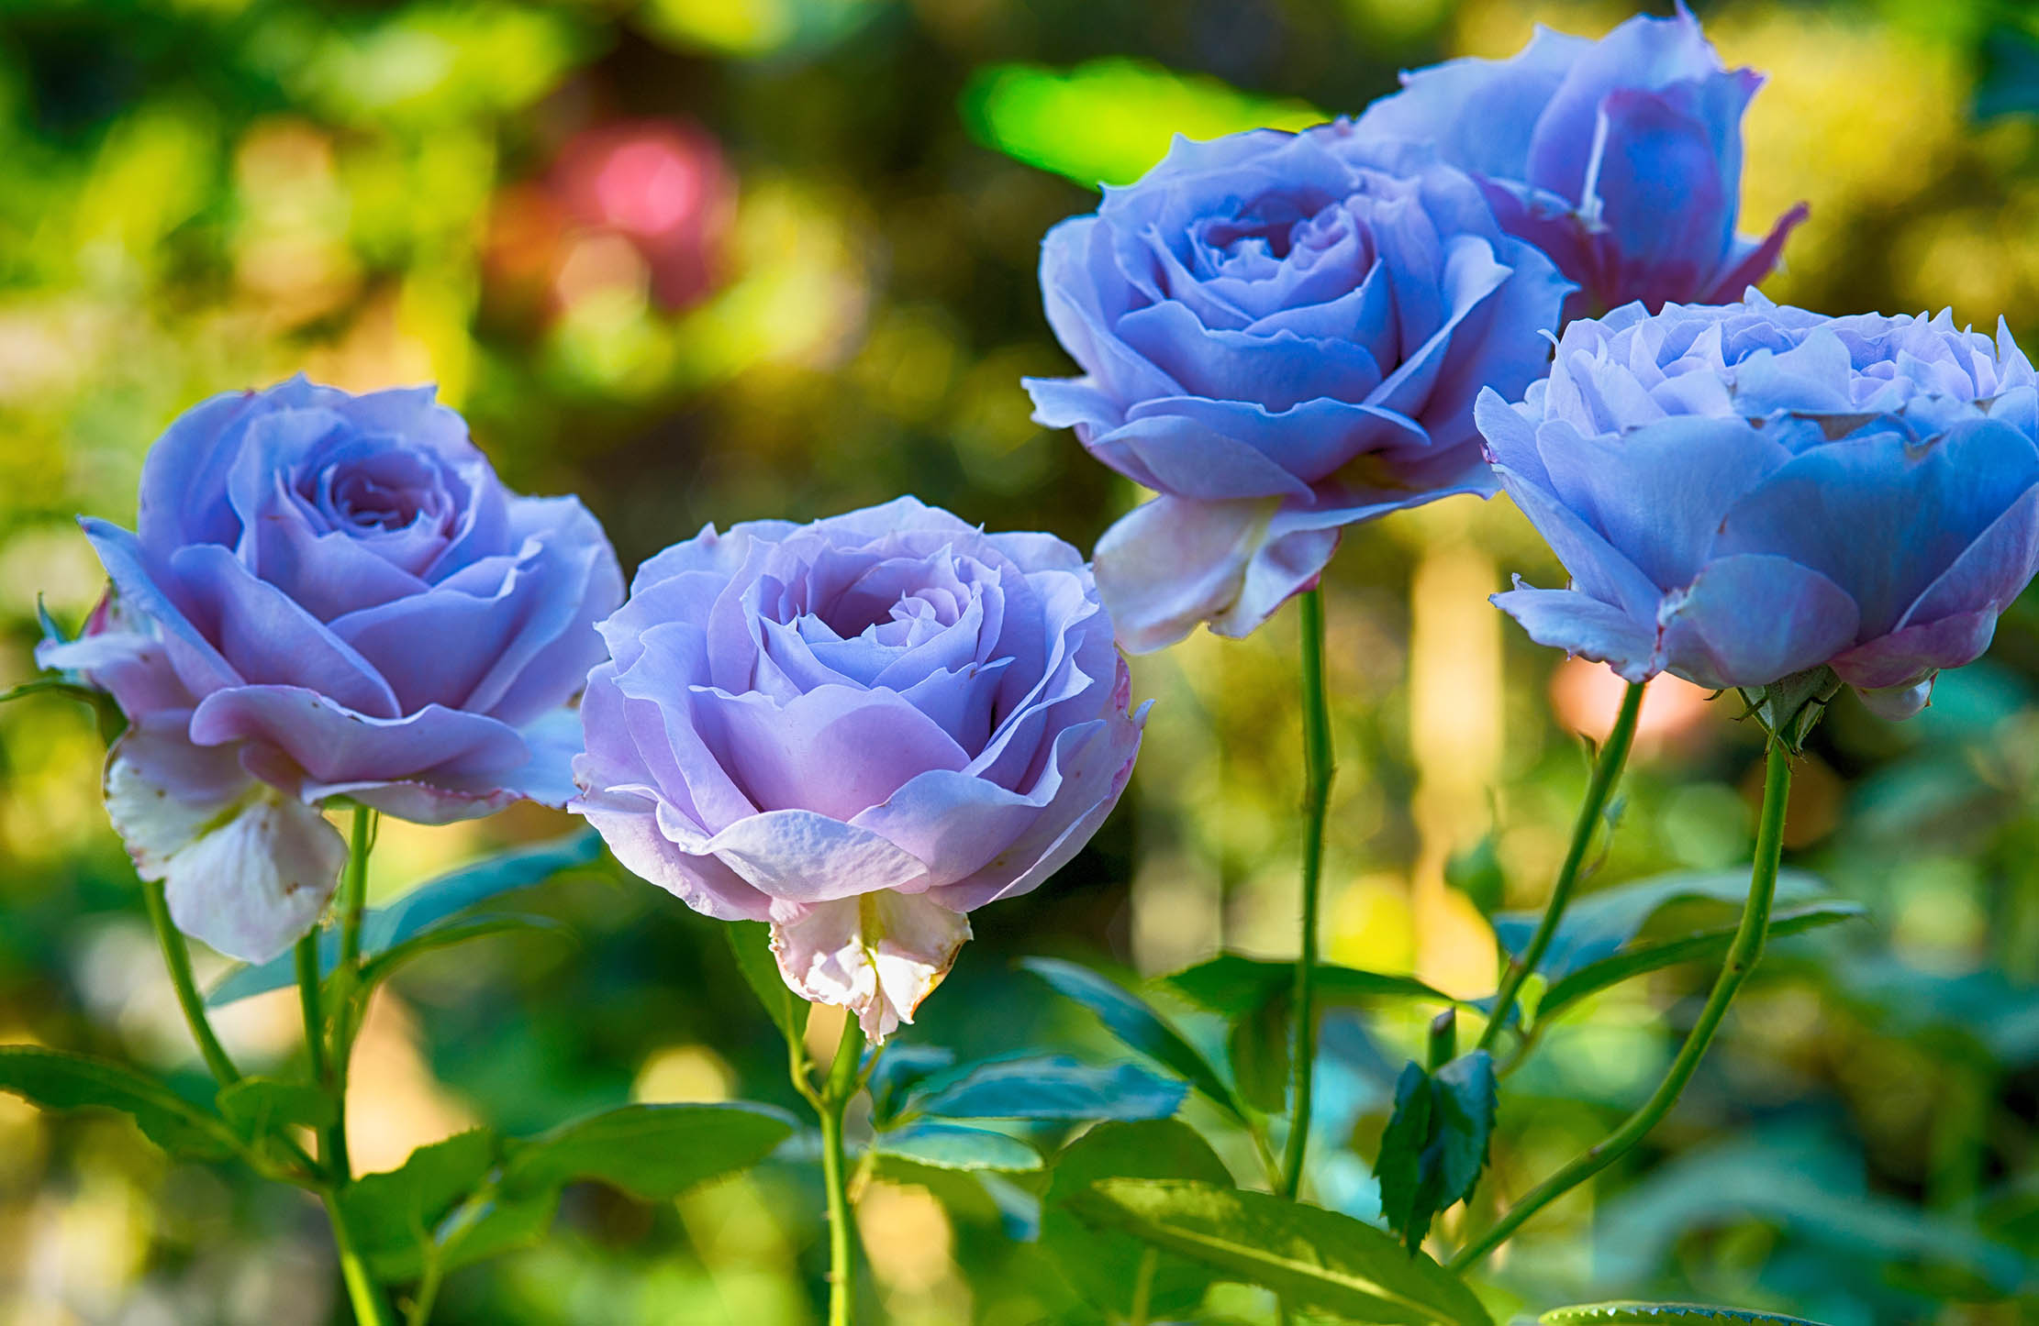
Good Bye

