Slide 1
WELCOME EVERYONE

Slide 2
Presented by:
Md.Shakhawat Hossain
Assistant Teacher
Borogangni Govt.Primary School
Alamdanga,Chuadanga.
shakhawat041086@gmail.com

Slide 3
Lesson Identity
Subject :English
Class:Two
Unit:3
COMMANDS
Lesson:1-3
Page:06

Slide 4
Learning outcomes -
Listening
2.1.1 follow simple commands and instructions
Speaking
1.1.1repeat after the teacher words and phrases with proper sound and stress.
1.1.2 say words and phrases with proper sound and stress.
7.1.1 give simple commands and instructions.

Slide 5
Good morning students!
How are you?
I’m fine thank you.

Slide 6
Let’s follow my commands
Sit down
Stand up
Close your book
Open your book

Slide 7
Today’s Lesson
Commands

Slide 8
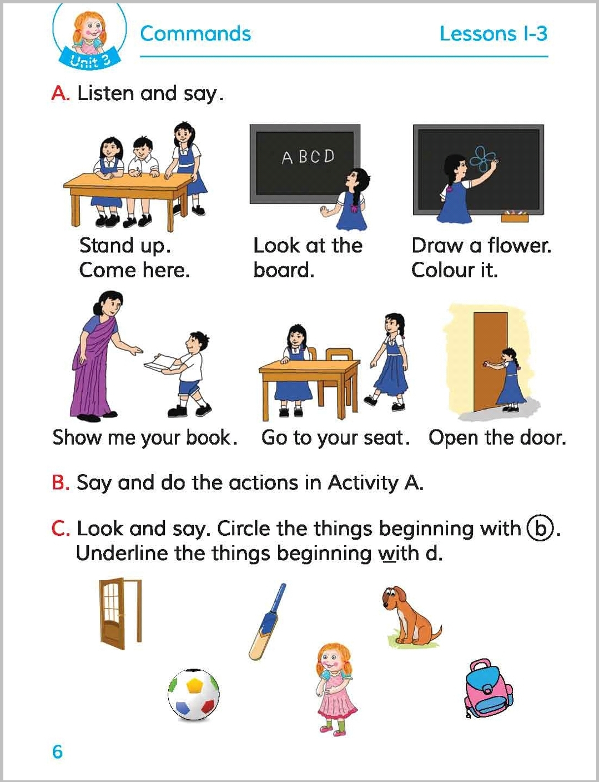
Let’s open at page 03,
A.Look,listen and say.
Now describe with your pair about these picture....

Slide 9
What are they doing in the pictures?
They are following their teacher’s commands

Slide 10
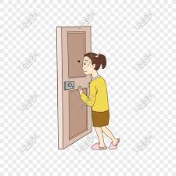
Now read with me loudly
Draw a flower. Colour it.
Open the door.
Stand up.
Come here.
Show me your book.
Go to your seat.
আমাকে তোমার বই দেখাও।
Look at the board.
দরজাটা খোল।
তোমার আসনে যাও।
একটি ফুল আঁকো। ফুলটি রঙ কর।
বোর্ডের দিকে তাকাও।
উঠে দাঁড়াও।এখানে এসো।

Slide 11
Pair work
Now work in pair.At first you command your pair then your pair command you.

Slide 12
Now read and say
1.Stand up
What does it mean?
2.Look at the board.
What does it mean?
3.Open the door.
What does it mean?
4.Show me your book.
What does it mean?

Slide 13
Home work
Write at least three commands we hear at home.

Slide 14
Thank you all
That’s all for today.
Goodbye!

